Slide 1

Interfacing A/D converter with 8086 Microprocessor

Slide 2
Why Analog to Digital?
Signals in the real world are analog: light, sound, temperature, pressure, acceleration or other phenomenon. So, real-world signals must be converted into digital, using a circuit called ADC (Analog-to-Digital Converter), before they can be manipulated by digital equipment.
When you scan a picture with a scanner what the scanner is doing is an analog-to-digital conversion: it is taking the analog information provided by the picture (light) and converting into digital.
When you record your voice on your computer, you are using an analog-to-digital converter to convert your voice, which is analog, into digital information.
When an audio CD is recorded at a studio, once again analog-to-digital is taking place,
converting sounds into digital numbers that will be stored on the disc.
Whenever we need the analog signal back, the opposite conversion – digital-to-analog, which is done by a circuit called DAC, Digital-to-Analog Converter – is needed. When you play an audio CD, what the CD player is doing is reading digital information stored on the disc and converting it back to analog so you can hear the audio.
As microprocessor only understand digital signal, so real world analog signal
should be converted into digital to process it by microprocessor.
2

Slide 3
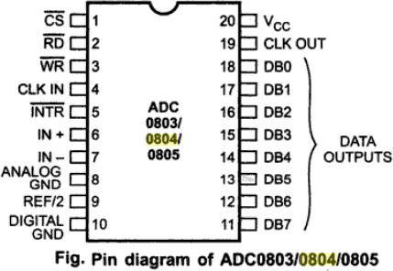
A/D Converter 0804 Family
The ADC0803, ADC0804 and ADC0805 are CMOS 8-bit successive-approximation analog to digital converters. These devices are design to operate from common microprocessor control buses ,with tri-state output latches driving the data bus and are identical except for accuracy.
Figure shows the pin diagram of
and
ADC0803, ADC0804
ADC0805 . IN+ and IN- inputs allow application of different input voltage which has high common mode rejection and eliminates offset due to the zero input analog voltage value. The device can operate with an external clock signal or, the on chip clock generator can be used independently by adding an external resistor and capacitor to set time period.
3

Slide 4
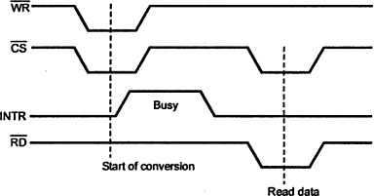
A/D Converter 0804 Family (Cont.)
Features
8-bit successive approximation ADC
Conversion time 100 us.
Access time 135 us.
It has on-chip clock generator.
It does not require any zero adjustment.
It operates on single 5V power supply.
Output meet TTL voltage level specification.
Operation
When the 𝑊𝑅 input goes low, the internal successive approximation register (SAR) is reset. As long as both 𝐶𝑆 and 𝑊𝑅 remain low, the A/D converter will remain in its reset state. One to eight clock
period after 𝐶𝑆 and 𝑊𝑅 makes a low-to-high transition, conversion starts. The 𝐼𝑁𝑇𝑅 signal is held high during conversion process. After conversion, 𝐼𝑁𝑇𝑅 goes low which is used as end of conversion signal. By making 𝐶𝑆 and
𝑅𝐷 signal low, an output can be read through
𝐷𝐵₀ to 𝐷𝐵₇ data signal.
4

Slide 5
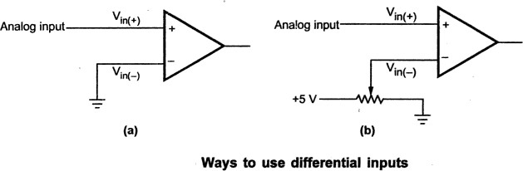
A/D Converter 0804 Family (Cont.)
The analog input signal
There are two analog inputs to the ADC0804: VIN+ and VIN-. These inputs are connected to an internal operational amplifier and are differential inputs. These are connected to an internal operational amplifier and are differential inputs. The differential inputs are summed by the operational amplifier to produce a signal for the internal A/D converter. Figure shows a few ways to use these differential inputs. The first way uses a single input that can vary between 0V and +5V. The second way shows a variable voltage applied to the VIN- pin, so the zero reference for VIN+ can be adjusted.

Slide 6

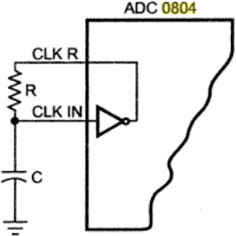
A/D Converter 0804 Family (Cont.)
Generating the clock signal
The ADC0803/0804/0805 requires a clock source ranging 100 KHz to 1460 KHz for operation. The clock signal can be applied external or it can be generated with an RC circuit as shown in fig. When RC circuit is used to generate the clock, the clock frequency is given as

Slide 7
Interfacing A/D Converter to 8086

Slide 8
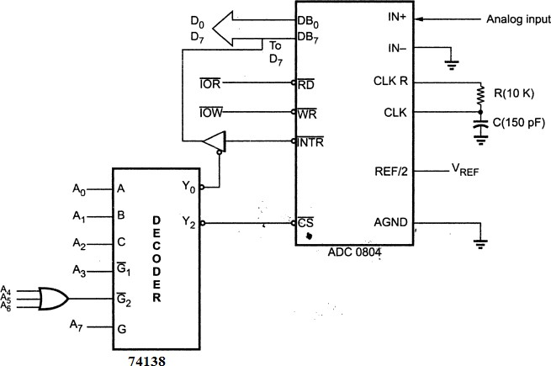
Interfacing A/D Converter to 8086 (Cont.)
Problem 1:
Figure shows the interfacing of ADC 0804 to the 8086 microprocessor. Write an assembly language
procedure to read the converted digital data through data bus.

Slide 9
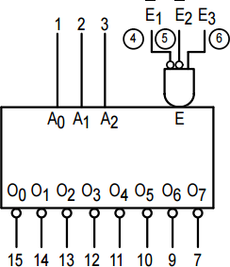
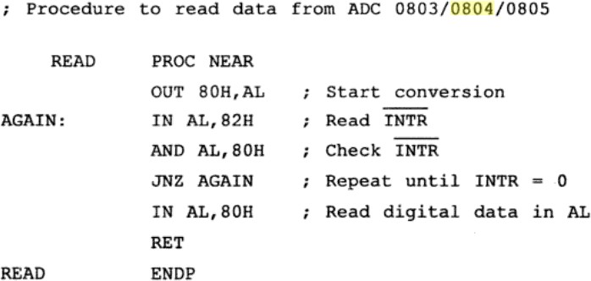
Interfacing A/D Converter to 8086 (Cont.)
A7 | A6 | A5 | A4 | A3 | A2 | A1 | A0 | Address
1 | 0 | 0 | 0 | 0 | 0 | 0 | 0 | 80H | Address to read INTR
1 | 0 | 0 | 0 | 0 | 0 | 1 | 0 | 82H | Address to read converter

Slide 10
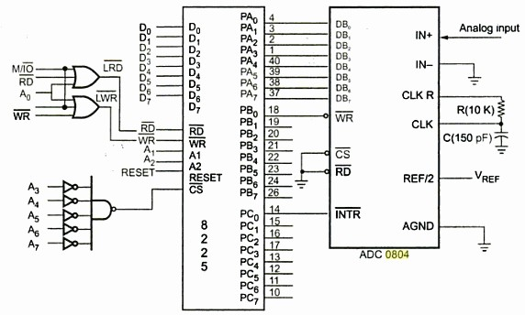
Interfacing of ADC 0804 to 8086 using 8255
Problem 2:
Figure shows the interfacing of ADC 0804 to the 8086 microprocessor using 8255. Write an
assembly language procedure to read the analog value that is connected with IN+ pin of ADC0804 .

Slide 11
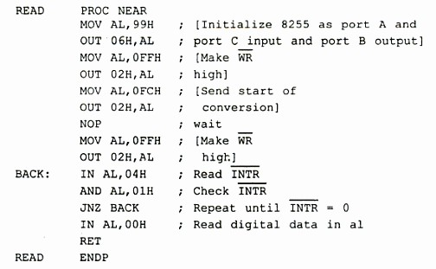


Interfacing of ADC 0804 to 8086 using 8255 (Cont.)
A7 | A6 | A5 | A4 | A3 | A2 | A1 | A0 | Address
0 | 0 | 0 | 0 | 0 | 0 | 0 | 0 | 00H | PORTA
0 | 0 | 0 | 0 | 0 | 0 | 1 | 0 | 02H | PORTB
0 | 0 | 0 | 0 | 0 | 1 | 0 | 0 | 04H | PORTC
0 | 0 | 0 | 0 | 0 | 1 | 1 | 0 | 06H | Control Register
Finding address
Assembly language Procedure
Control Word to initialize 8255 as portA and portC input and portB output
D7 | D6 | D5 | D4 | D3 | D2 | D1 | D0
1 | 0 | 0 | 1 | 1 | 0 | 0 | 1
So, Control Word= 99H

