Slide 1
M.Sc. IV Semester
PHY – 402 (Nuclear and Particle Physics II)
Unit - IV
Elementary Particles & their Interactions
Dr. Kamal Jain
Guest Lecturer
School of Studies in Physics
Vikram University Ujjain

Slide 2
Elementary Particles
The nucleus of an atom is made of positively charge proton and electrically neutral neutrons.
Protons and neutrons are made of more fundamental particles called quarks.
There are two different types quarks, up and down type, which make the proton and the neutron.
Electron on the other hand are structure less to the extent we know.
All matter around us is made of the quark, the down quark and the electron.

Slide 3
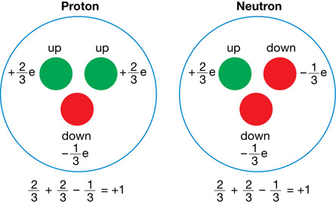
Charge and Spin

Slide 4
Elementary Particles
A neutral particle called neutrino was observed in β-decay.
Many more particles found in cosmic rays (1930-1950).
These were then rediscovered in various laboratory experiments
Particels collider experiments also discovered newer particles, otherwise not found in cosmic rays elsewhere in nature.
Muon similar to the electron, pion, kaon, lambda etc. (identified as a composite made of quark).

Slide 5
Elementary Particles
Leptons |  | Quarks
Electron Charge: -1 Mass: 0.5 MeV/C² | e Neutrino Charge:0 | Up quark Charge: +2/3 Mass: 2.3 MeV/C² | Down quark Charge: -1/3 Mass: 4.8 MeV/C²
Muon Charge: -1 Mass: 106 MeV/C² | Mu Neutrino Charge: 0 | Charm quark Charge: +2/3 Mass: 1275 MeV/C² | Strange quark Charge: -1 /3 Mass: 95 MeV/C²
Tau lepton Charge: -1 Mass: 1777 MeV/C² | Tau Neutrino Charge: 0 | Top quark Charge: +2/3 Mass: 173.5 GeV/C² | Bottom quark Charge: -1 /3 Mass: 4.18 GeV/C²

Slide 9
The Higgs Boson
The Standard model of particle physics (based on Gauge Quantum Field Theory) requires a scalar (Spin = 0) particle (the Higgs Boson) to generate masses for the matter particles as well as the force carriers.

Slide 10
Thanks to all

