Slide 1
M.Sc. Botany (CBCS) II Semester Paper BOT PG 202 : Cell and Molecular Biology Unit 4: Transcription Prof. R.C. Verma

Slide 2
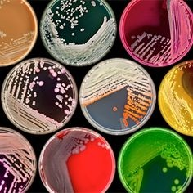
Transcription in Prokaryotes
Prof. R. C. Verma
School of Studies in Botany
Vikram University, Ujjain

Slide 3
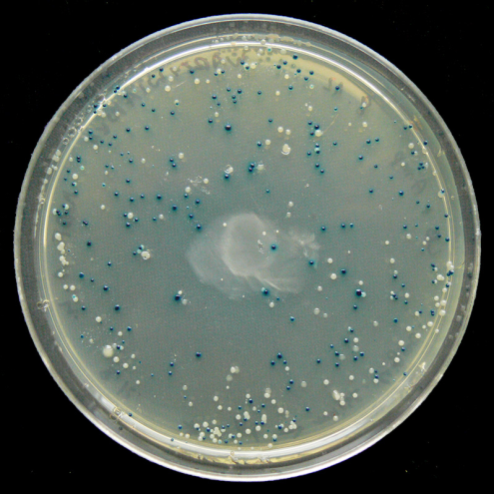
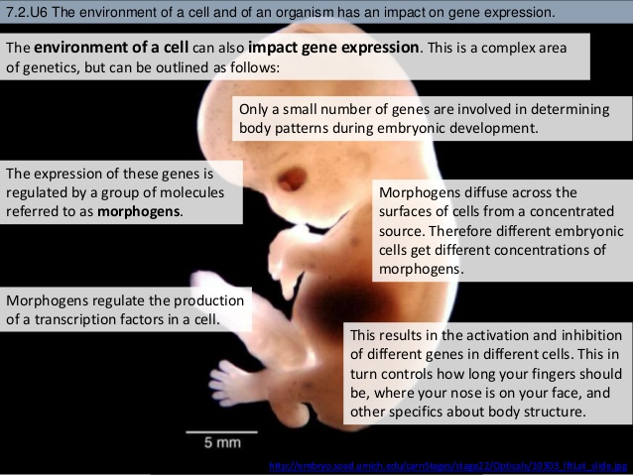
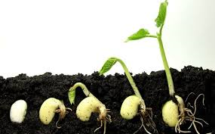
DNA has two essential functions:
Replication and Expression. Replication means that the DNA, with all its genes, must be copied every time a cell divides.
Expression means that the genes on DNA must control characteristics.

Slide 4
Transcription
Transcription is the first step of gene expression, in which a particular segment of DNA is copied into RNA (especially mRNA) by the enzyme RNA polymerase. Both DNA and RNA are nucleic acids, which use base pairs of nucleotides as a complementary language.

Slide 6
Transcriptional Control
DNA
Environmental change
Turn gene(s) on/off
RNA
Protein
Proteins to deal with
new environment
Very important to:
express genes when needed
repress genes when not needed
Conserve energy resources; avoid expressing unnecessary/detrimental genes

Slide 7
Transcriptional Control
Many places for control
Transcription
Initiation
Elongation
Termination
Processing
Capping
Splicing
Polyadenylation
Turnover
Translation
Protein processing
DNA
RNA
Protein

Slide 8
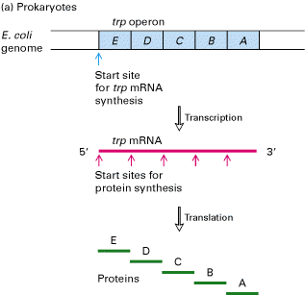
Prokaryotic Transcription
Operons
Groups of related genes transcribed
by the same promoter
Polycistronic RNA
Multiple genes transcribed
as ONE TRANSCRIPT
No nucleus, so transcription and
translation can occur simultaneously

Slide 9
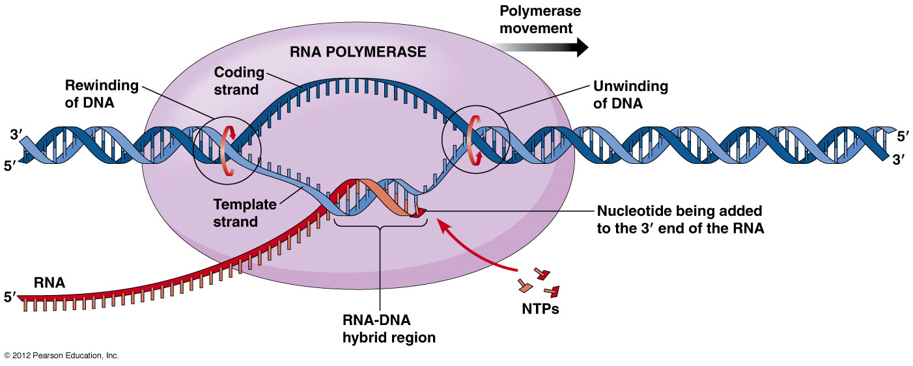

Slide 10
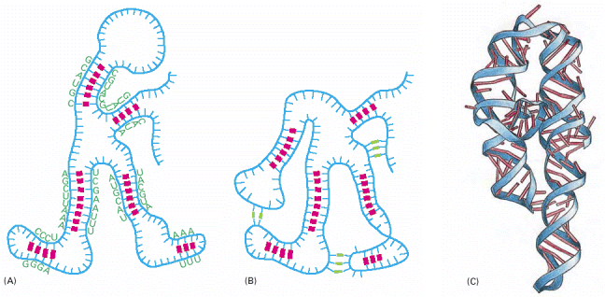
RNA Structure
Contain ribose instead of deoxyribose
Bases are A,G,C,U,
Uracil pairs with adenine
Small chemical difference from DNA, but large structural differences
Single stranded helix
Ability to fold into 3D shapes - can be functional

Slide 11
RNA Structures Vary
RNA more like proteins than DNA:
structured domains connected by more flexible domains, leading to different functions
e.g. ribozymes – catalytic RNA

Slide 12
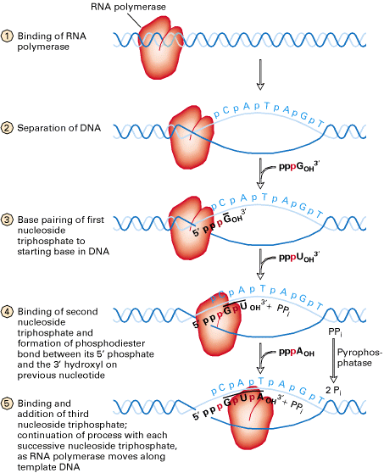
RNA synthesis
RNAP binds, melts DNA
Nucleosides added 5’ → 3’

Slide 13
Types of RNA
Messenger RNA (mRNA) – genes that encode proteins
Ribosomal RNA (rRNA) – form the core of ribosomes
Transfer RNA (tRNA) – adaptors that link amino acids to mRNA during translation
Small regulatory RNA – also called non-coding RNA

Slide 15
Transcriptional Control
Transcription
Initiation
Elongation
Termination
Processing
Capping
Splicing
Polyadenylation
Turnover
Translation
Protein processing
Control of initiation
usually most
important.

Slide 16
Initiation
RNA polymerase
Transcription factors
Promoter DNA
RNAP binding sites
Operator – repressor binding
Other TF binding sites
Start site of txn is +1
α α β β’σ

Slide 17
Initiation
RNA polymerase
4 core subunits
Sigma factor (σ)–
determines promoter
specificity
Core + σ = holoenzyme
Binds promoter sequence
Catalyzes “open complex” and transcription of DNA to RNA

Slide 19
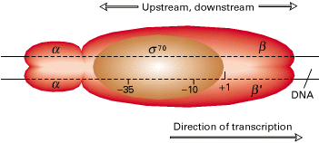
RNAP binds specific promoter sequences
Sigma factors recognize consensus
-10 and -35 sequences

Slide 20
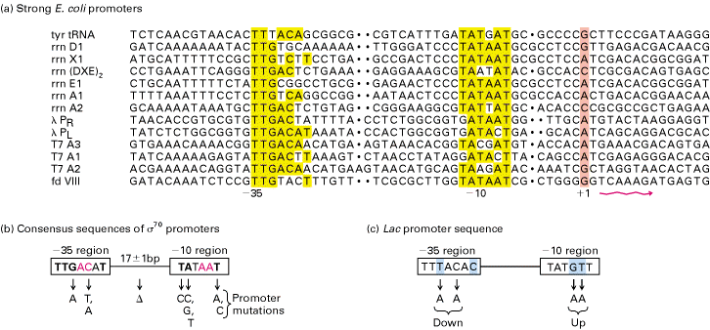
RNA polymerase promoters
TTGACA
TATAAT
Deviation from consensus -10 , -35 sequence leads to
weaker gene expression

Slide 21
Bacterial sigma factors
Sigma factors are “transcription factors”
Different sigma factors bind RNAP and recognize specific -10 ,-35 sequences
Helps melt DNA to expose transcriptional start site
Most bacteria have major and alternate sigma factors
Promote broad changes in gene expression
E. coli 7 sigma factors
B. subtilis 18 sigma factors
Generally, bacteria that live in more varied environments have more sigma factors

Slide 22
Sigma factors
σ⁷⁰
σ⁵⁴
σ^{S}
σ^{S}
σ^{F}
σ³²
Extreme heat shock, unfolded proteins
E. coli can choose between 7 sigma factors and about 350
transcription factors to fine tune its transcriptional output
An Rev Micro Vol. 57: 441-466 T. M. Gruber

Slide 23
What regulates sigma factors
Number of copies per cell (σ⁷⁰ more than alternate)
Anti-sigma factors (bind/sequester sigma factors)
Levels of effector molecules
Transcription factors

Slide 24
Bacterial RNAP numbers
In log-phase E. coli:
~4000 genes
~2000 core RNA polymerase molecules
~2/3 (1300) are active at a time
~1/3 (650) can bind σ subunits.
Competition of σ for core determines much of a cell’s protein content.

Slide 25
Activating transcription factors
Crp dimer w/ DNA
Helix-turn-helix (HTH) bind major groove
of DNA
HTH one of many
TF motifs

Slide 26
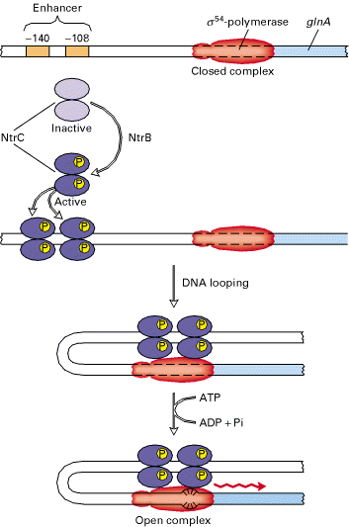
Enhancers
activating regions not
necessarily close to RNAP
binding site
NtrC example:
NtrC required for RNAP to
form open complex
NtrC activated by P
P NtrC binds DNA, forms loop
that folds back onto RNAP,
initiating transcription
signature of sigma 54

Slide 27
Transcriptional Control
Transcription
Initiation
Elongation
Termination
Processing
Capping
Splicing
Polyadenylation
Turnover
Translation
Protein processing

Slide 28
Transcriptional Termination
Bacteria need to end transcription at the end of the gene
2 principle mechanisms of termination in bacteria:
Rho-independent (more common)
Rho-dependent

Slide 29
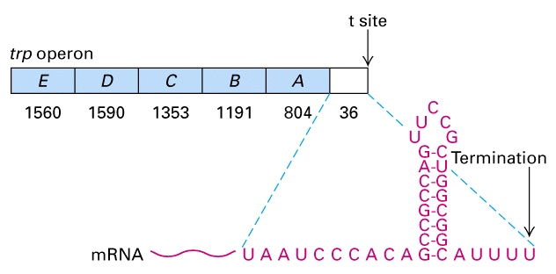
Rho-independent termination
Termination sequence has 2 features:
Series of U residues
GC-rich self-complimenting region
GC-rich sequences bind forming stem-loop
Stem-loop causes RNAP to pause
U residues unstable, permit release of RNA chain

Slide 30
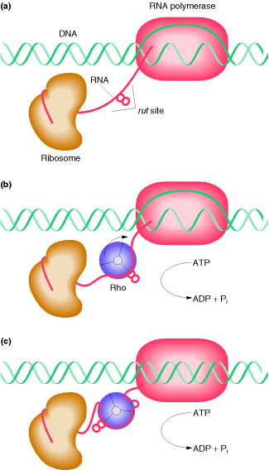
Rho-dependent termination
Rho is hexameric protein
70-80 base segment of RNA wraps around
Rho has ATPase activity, moves along RNA until site of RNAP, unwinds DNA/RNA hybrid
Termination seems to depend on Rho’s ability to “catch up” to RNAP
No obvious sequence similarities, relatively rare

Slide 31
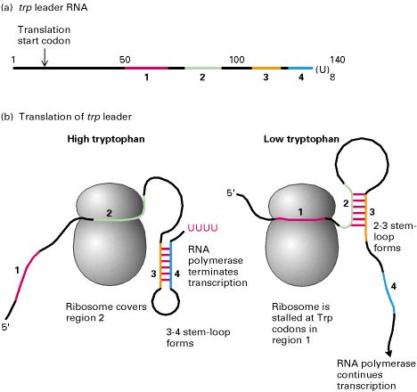
Transcriptional attenuation
Attenuator site = DNA sequence where RNAP chooses between continuing transcription and termination
trp operon
4 RNA regions
for basepairing
2 pairs w/ 1 or 3
3 pairs w/ 2 or 4
Concentration of
Trp-tRNA^{Trp} determines
fate of attenuation
At high Trp conc,
transcription stops via
Rho-independent

Slide 32
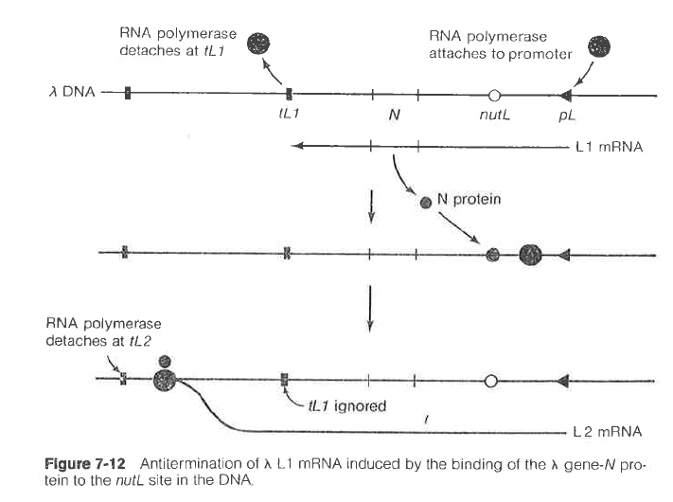
Anti-termination
λ phage encode protein that prevents termination

Slide 33
An overview of gene expression

Slide 34
Thank you For queries contact rakeshcverma@yahoo.com

