Slide 1
Introduction to Secondary Metabolites
Definition , classification, properties and tests for identification
Alkaloid,
Glycoside,
Flavonoid,
Volatile oil,
Tennins,
Resins
Dr. Darshan Dubey
Institute of Pharmacy, Vikram University, Ujjain

Slide 2
Secondary plant metabolites
Secondary plant metabolites are numerous chemical compounds produced by the plant cell through metabolic pathways derived from the primary metabolic pathways. The concept of secondary metabolite was first defined by Albrecht Kossel, Nobel Prize winner for physiology or medicine in 1910.
Secondary metabolites have shown to possess various biological effects, which provide the scientific base for the use of herbs in the traditional medicine in many ancient communities. They have been described as antibiotic, antifungal and antiviral and therefore are able to protect plants from pathogens

Slide 3
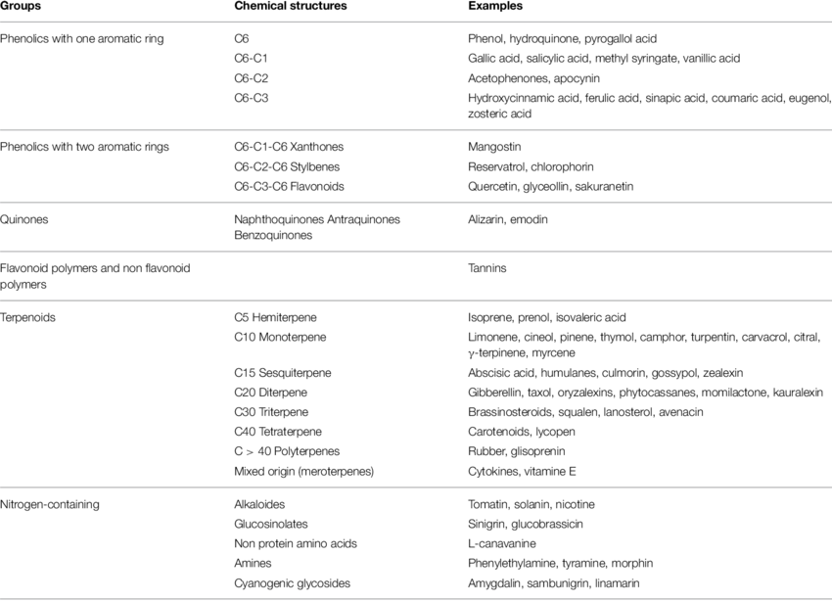

Slide 4
Alkaloid
Definition:
Alkaloid is defined as organic products of natural or synthetic origin which are basic in nature, and contain one or more nitrogen atoms, normally of heterocyclic nature, and possess specific physiological actions on human or animal body, when used in small quantities.

Slide 5
Physical properties
Colorless, crystalline solid with sharp melting point.
Some alkaloids are amorphous gum while other like coniine, nicotine are liquid in nature.
Some alkaloid are color in nature,
eg.Betanidine shows red color
Berberine shows yellow color
Salt of most alkaloid are soluble in water.
free bases are insoluble in water and their salts are very sparingly soluble in organic solvent.

Slide 6
PHYSICAL PROPERTIES continue…
Quaternary bases are only water soluble
Pseudo and proto alkaloid give higher solubility in water.
Solubility and salts of alkaloid is useful in pharmaceutical industry for extraction
They give color precipitation with halogenated compound

Slide 7
CHEMICAL PROPERTIES
Basic in reaction
Turns to be neutral or acidic when adjacent functional groups are electron withdrawing like amide group.
Contain 1 or more N
In natural form – exist either in free state as amine or as salt with acid or alk. N-oxide
Salt formation with inorganic acid: their decomposition during their storage

Slide 8
Identification of Alkaloids
The different reagents are
1. DRAGENDORFF’S REAGENTS:
(potassium bismuth iodide solution) giving reddish brown ppts.
2. MAYER REAGENT: (polassium mercuric iodine solution) giving cream colored ppts.
3. WAGNER REAGENT: (iodine potassium iodide solution) yielding reddish brown ppts.
4. HAGER REAGENT: give yellow ppts with picric acid.

Slide 9
Types of alkaloid
Biosynthetic classification
Chemical classification
True alkaloid
Proto alkaloid
Pseudo alkaloid
Taxonomical classification
Pharmacological classification

Slide 10
A) Biosynthetic classification
Indole alkaloids : Tryptophan
Piperidine alkaloids : Lysine
Imidazole alkaloid : Histidine
Phenylethyl amine alkaloids : Tyrosine
-

Slide 11
B) Chemical classification
True alkaloid : On the basis of Heterocyclic ring they are also known as Heterocyclic alkaloids.
They are toxic in nature.
They contain heterocyclic nitrogen which is derived from amino acids.
They are basic in nature.
Pseudo alkaloids: They include mainly steroidal & terpenoid alkaloid & purines. They are not derived from amino acids
eg. Conessine, caffeine
Protoalkaloids: They are also known as biological amines or
amino alkaloids. They are simple amines in which the “Nitrogen” Is not in a heterocyclic ring.
eg. Colchicine, ephedrine

Slide 12
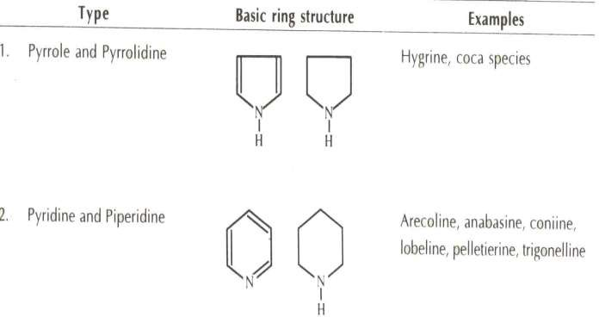
Chemical classification

Slide 13
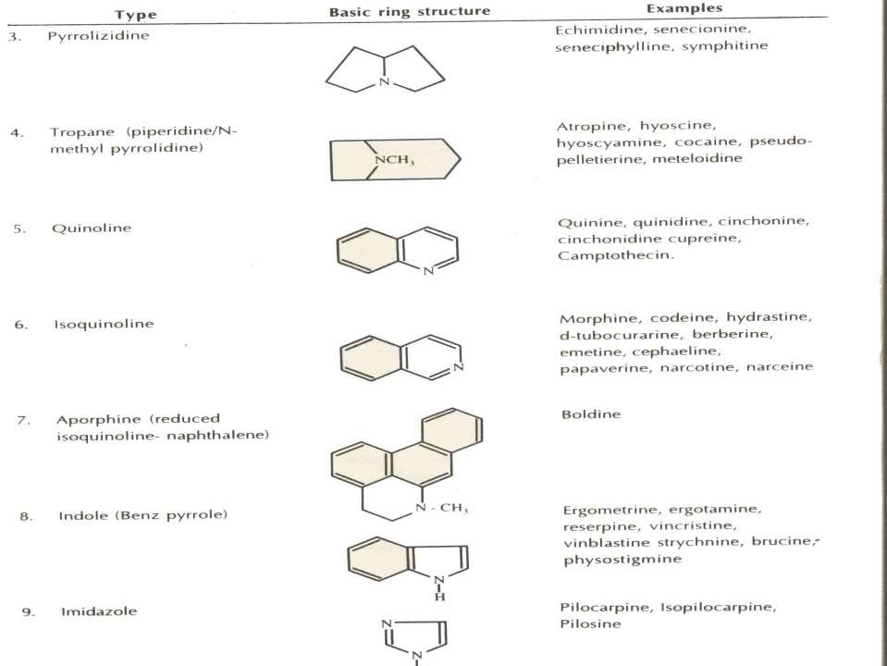

Slide 14
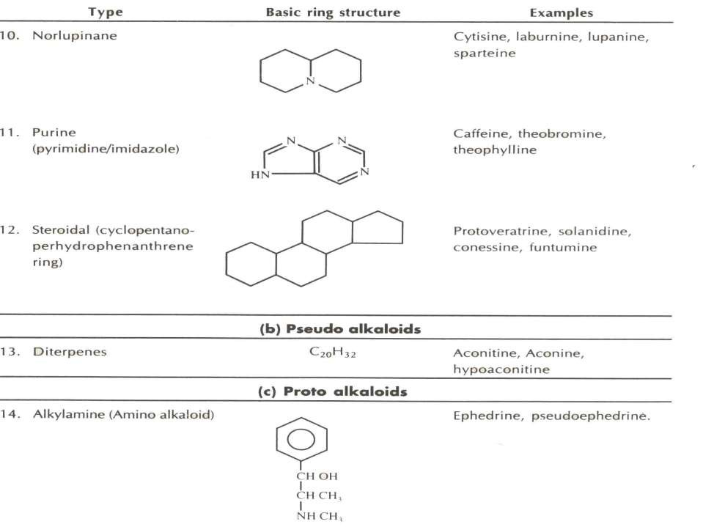

Slide 15
GLYCOSIDES
Definition:
They are the organic compounds occurring most abundantly in plants that yields sugar & non sugar substances on enzymatic or acid hydrolysis.
sugar part called Glycon
Non-sugar part called Aglycon
Glycoside Glycon + Aglycon
Glycosides are named on basis of source of glycoside ending with “in” e.g. Digoxin, Prunasin, Salicin etc…

Slide 16
Glycosides are acetyls or sugar ethers formed by interaction of –OH group each of aglycon & glycon part with loss of water molecules. Biologically glycosides involved in regulatory, protective & sanitary function in plant.
Chemistry
Stereochemically, Two types of glycosides
α-glycoside 2) β-glycoside
This both glycosides are obtained by passing dry hydrogen chloride to methyl alcohol.

Slide 17
hydrolysis hydrolysis
α –methyl glycoside α –glucose+methyl alcohol
β – methyl glycoside β –glucose+methyl alcohol
If, sugar is glucose called Glucosides
Other sugars called Glycosides
Properties
Colorless
Crystalline or amorphous solid
Soluble in water & alcohol
Insoluble in ether & chloroform
Optically active usually levorotatory

Slide 18
Classification of Glycosides
Glycosides can be classified as per different way on the basis following
Nature of sugar
Therapeutic action
Glycosidic linkage
Chemical nature of aglycon

Slide 19
Based on nature of sugar
According to nature of glycon part present called as
Glucosides if glucose present
Pentoside if pentose(arabinose)
Rhemnoside if rhemose present
Rhemnoglucoside if rhemnose+glucose
Cardiac glycoside if digitoxose, digitalose,
cymarose present

Slide 20
Based on therapeutic action
Cardiotonic glycoside : Digitalis, Strophanthus
Laxative : Seena, Cascara, Aloe
Anti ulcer : Liquorice
Anti-inflammatory : Dioscorea, Liquorice
Expectorant : Quillaia , Liquorice
Brain tonic : Ginseng

Slide 21
Based on glycosidic linkage
Classified as per the linkage formed between aglycon & glycon part.
C-glycoside In this glycoside sugar is directly attach to carbon atom.
Glycon –OH+HC-Aglycon glycon-C- aglycon+H2O This glycoside not hydrolyse by heating with acids /alkalies but hydrolyse with FeCl3
e.g. Anthraquinone glycoside such as cascaroside from cascara Aloin from aloe

Slide 22
2) O-glycoside
In this type glycoside, sugar is combined with phenol
Or –OH group of aglycon.
Glycon-OH + OH-Aglycon Glycon-O- Aglycon+H₂O
They hydrolyzed by treatment with acid or alkali into aglycon & sugar.
e.g. Seena, Rhubarb

Slide 23
3) S-glycoside
In this ‘S’ from –SH group of aglycon is combined with sugar containing –OH group.
Glycon-OH+HS-aglycon Glycon-S- Aglycon+H2O
e.g. Isothiocynate glycosides such as sinigrin from Black mustard
4) N-glycoside
In this glycoside ‘N’ from –NH group of aglycon is attached to sugar containing –OH group.
Glycon-OH +HN-Aglycon Glycon-N- Aglycon+H2O
e.g. Nucleosides & Some enzyme

Slide 24
Based on chemical nature of aglycon
Anthracene glycosides
e.g. Seena, Aloe, Rhubarb, Cascara
Specific test:
Brontrager’s test:
Power drug
+
Extracted with water
+
Filtered extract
+
Made alkaline with caustic soda or ammonia
Aqueous layer show pink, red or violet color

Slide 25
2) Sterol or cardiac glycoside
Aglycon part of this glycosides are steroidal moiety.
They are either C23 or C24 due to either five or six membered lactone ring respectively.
Two type of cardiac glycoside :
Cardinolides
e.g. Strophanthus, Thevatia, Digitalis
b) Bufadinolides
e.g. Squill

Slide 26
Specific tests:
a) Cardinolides:
Baljet test:
Powered drug + Na-picrate Yellow to orange color
2) Legal test:
Powder + pyridine
+
Na-nitroprusside
+
Shake & filter
+
Filtrate make alkaline
Pink to red color

Slide 27
b) Bufadinolides:
Liebermann buchard’s test:
Rug + D CHCl3
+
Equal volume of acetic anhydride
+
1to2 drops of conc. H2SO4
Green color
c) Desoxy sugar:
Killer killiani test:
Drug + glacial acetic acid + drop of Fecl3
+
Add H2So4 which forms
lower layer Reddish brown color at junction of two liquid
& upper layer become bluish green

Slide 28
Saponin glycosides
In this glycoside the aglycon part shows the soap like or froth like effect.
Two types of this glycosides
Steroidal saponins (Tetracyclic saponin):
e.g. Dioscorea, Shatavari
b) Pentacyclic saponins:
e.g. Sarsaparila, Liquorice, Quillia, Senega , Brahmi
Specific test:
Foam test:
Drug powder + water + Boil + Shake properly Foam production
b) Hemolytic test:
Powder solution + Blood sample Hemolysis of RBCs

Slide 29
4) Cynogenetic glycosides
They are also called as CYNOPHORE GLYCOSIDES due to presence of hydrocyanic acid in aglycon moiety. e.g. Bitter almond, Wild cherry bark, Linseed
Specific test :
Grignard reaction or Na-picrate test:
Filter paper strip soak in 10%picric acid
+
10%Na2co3
+
This Na-picrate paper contact with moist drug
Filter paper change to brick red
b) Drug + aqueous mercuric nitrate Metallic mercury formed

Slide 30
c) Dip filter paper strip in guaiacum resin & CuSO₄
₊
Expose it to freshly cut surface of drug
Blue stain is produced
5) Isothiocynate glycosides
They also called as GLUCOSINOLATE COMPOUND.
e.g. Mustard
6) Flavanol glycosides: They are phenyl benzo-γ-pyrone derivative occurs as flavone, flavonol, flavonone, isoflavonones, isoflavones etc.
e.g. Kampherol Ginkgo Quercetin
+

Slide 31
Specific test:
a) Shinoda test:
Drug
Few drops of conc.
HCl
0.5gm magnesium tanning
Pink color
Powder + 5ml
95% ethanol
+
+
b) Residue + lead acetate
Yellow color
Excess amount of NaOH
Yellow color
Addition of acid decolorize
c) Residue
+

Slide 32
7) Coumarins & Furanocoumarins glycosides
Coumarins are derivative of benzo-α-pyrone. Furanocoumarins is found by fusion of furan ring to coumarins at either 6 & 7 position or 7 & 8 position which is responsible for the action of drug.
e.g. Visnaga, Psoralea Ammi manjus
Coumarin
Specific test:
Aromatic smell
Alcoholic solution on alkalization
Fluorescence
Blue or green

Slide 33
8) Aldehyde glycosides e.g. Vanilla pods 9) Phenol glycosides e.g. Bearberry 10) Steroidal glyco-alkaloids e.g. Solanum 11) Glycosidal bitter & miscellaneous glycosides e.g. Picrorhiza Quassia Chirata Kalmegh

Slide 34
Identification Tests of Glycosides. . .
Aglycone / sugar Chemical test Examples
1. Anthraquinones
i.
Microsublimation test Brontrager’s test
Modified borntrager’s test
Senna, Aloe, Rhubarb, Cascara
ii.
iii.
Cardiac glycoside:
Cardenlolides
Baljet test Legal test
Digitalis, Nerium, Thevetia
Scilla
Digitalis, Nerium, Thevetia, scilla
i.
ii.
Bufedienolides
Desoxy sugar
Liebermann Burchard’s test keller-killiani’s test
3. Cyanogenetic
Grignard reaction (sodium picrate test)
Bitter almond, Wild
cherry bark, linseed

Slide 35
Aglycone / sugar
Chemical test
Examples
4. Flavonoids
Shinoda’s test
Rue
5. Saponins
Foam production
Gokhru, Liquorices
Sataveri,
Quillaia bark
i.
ii.
Haemolytic Zone Libermann’test (for Triterpenoid)
iii
Coumarins
Reducing sugar
Florescence in alkali media
Psoralea
Fehling’s test
Honey, Agar, Acacia, Tragacanth, Alginates

Slide 36
VOLATILE OIL
Definition:
“The Volatile oils ” a collective term, implying the preparation of vegetable and animal extracts according to the rules of the art, or rectification and separation.
Chemistry of volatile oils;
They evaporated when exposed to air at temperature of 15.5 to 16.5⁰c, so they are called as “Ethereal oils.”
They represent essence Or Active constituents of plant, Hence they are also known as “Essential oils.”Chemically, they are derived from terpenes and their Oxygenated compounds.

Slide 37
Properties
Diffusing readily into air at room temp
Sol. in alcohol, ether, other org. solvents
Slightly miscible with water & lighter than water
Most of them are optically active
Detected by smell rec.
Liable to deterioration especially resinification & peroxide formation
Solid essential oil – stearoptene
Liquid essential oil - eleoptene

Slide 38
Identification Tests
Thin section + alcoholic sol. of sudan III – red colour
Thin section + drop of tincture alkane – red colour
Separate volatile oil from distillate and perform following tests.
Filter paper is not permanently stained with volatile oil.
Solubility test : Volatile oil are soluble in alcohol, ether… and insoluble in water.
Also identified by
Physical Characteristics.
Chemical Characteristics

Slide 39
1) Physical Characteristics
Following physical properties of the volatile oils are generally important for the quality control.
Boiling point.
Refractive index.
Optical rotation.
Specific gravity.
Freezing point.
Solubility characteristics.
39

Slide 40
2) Chemical Characteristics
Manily,following physicochemical method of analysis, such as:
UV-Visible spectroscopy,
IR-spectroscopy,
NMR-spectroscopy,
GC-spectroscopy,
HPLC-analysis,
MASS-spectroscopy,
HPTLC
40

Slide 41
Classification
Alcohol volatile oil
Peppermint, cardamom, coriander
Aldehyde volatile oil
Lemon grass oil, lemon peel, orange peel
Ester volatile oil
Gaultheria, lavender, mustard
Hydrocarbon volatile oil Turpentine, black papper

Slide 42
Ketone volatile oil : Caraway, spearmint, camphor
Oxide volatile oil :
Chenopodium - Anthelmintic
Eucalyptus - counter irritant
Phenolic ester volatile oil
Fennel - stimulant, carminative
Nutmeg - stimulant, carminative
Phenol volatile oil : Clove

Slide 43
Flavonoids
Group of polyphenolic compounds which are found in fruits, flowers, seeds & vegetable. They are more common in higher plants being abundant in families, Polygonaceae, Rutaceae, Leguminosae, Umbelliferae & Compositae. Flavonoids (named from the Latin word flavus meaning yellow, their colour in nature) are a class of plant secondary metabolites.

Slide 44
Classification:
They are classified according to chemical structure into:
1- Flavones: 2-phenylchromen-4-one
examples: 1- Apigenin.
2- Luteolin.
3- Tangeritin.
4- Diosmetin
2-Flavonol: 3-hydroxy-2-phenylchromen-4-one.
examples: 1- Kaempferol.
2- Rutin.
3- Myricetin.
4- Quercetin.
5- Quercetrin.
6- Fisetin

Slide 45
3-Flavanone: 2,3-dihydro-2-phenylchromen-4- one
examples: 1- Hesperetin.
2- Hespereidin.
3-Naringenin.
4-Flavanonol: 3-hydroxy-2,3-dihydro-2-phenylchromen-4-one examples: 1-Taxifolin.
2- Silymarin
5- Flavan: 1- Flavan-3-ol 2- Flavan-4-ol 3- Flavan-3,4-diols Flavan-3-ol known as flavanol
Examples: 1- Catechin (β-OH)
2- Epicatechin (α-OH)

Slide 46
Isoflavones: 3-Phenylchromen-4-one skeleton 4
Example: 1- Genistein
2- Daidzin
7-Neoflavonoides ring B in position 4 (4-phenyl-coumarins) The Isoflavonoids and the Neoflavonoids can be regarded as abnormal flavonoids.
8- Anthocyanidins: Flavylium (2-Phenylchromenylium) ion skeleton of anthocyanidins.
e.g 1-Cyanidin.
2- Delphenidin.

Slide 47
Identification test
Lead subacetate test:-
all flavonoids give yellowish precipitate with Pb subacetate.
2.-Shinoda´s test for flavanones and flavonols:-
alcoholic solution + Mg metal ⁄ Hcl , an orange , red or violet color is produed.
3. Antimony pentachloride test for chalcones:
alcoholic solution + SbCl5⁄ CCl4 , red or violet color is produced.
4- Reaction with aluminum chloride:
The different classes of flavonoids give yellow color with AlCl3

Slide 48
Tannins
Tannins are naturally occurring complex organic compounds possessing nitrogen free polyphenols of high molecular weight. They form colloidal solution with water giving acid reactions. They also precipitate proteins and alkaloids. The astringent in nature of tannins is due to the fact that they can precipitate proteins and render them resistant to enzymatic attack. When applied on a wound or injury, tannins form a protective coating so as to prevent external irritation and thus promote healing.

Slide 49
1. Hydrolysable tannins
2. Condensed tannins
3. Pseudo tannins.
Classification of tannins:

Slide 50
1. Hydrolysable tannins:
These tannins are hydrolyzed by acids, or enzyme and produce gallic acid and ellagic acid. Chemically, these are esters of phenolic acid like gallic acid and ellagic acid. The tannins derived from gallic acid are known as gallitannins and from that of ellagic acid are known as gallitannins. The gallic acid is found in rhubarb, clove and ellagic acid is found in eucalyptus leave and myrobalans and pomegranate bark. These tannins treated with ferric chloride to produced blue or black colour.

Slide 51
2. Condensed tannins:
These tannins are resistant to hydrolysis and they derived from the flavonols, catechins and flavan-3, 4-diols. On treatment with acids or enzymes they are decomposed into phlobaphenes. On dry distillation condensed tannin produce catechol. These tannins are called as catechol tannins. These tannins are found in cinchona bark, male fern, areca seeds, tea leaves and wild cherry bark, bahera fruits, Amla, etc. they produce green colour with ferric chlorides.

Slide 52
3. Pseudotannins
This is not as such a separate group of tannins, but may be treated as sub group because they do not obey to goldbeaters skin test and are low molecular weight compounds. Chlorogenic acid in coffee and nuxvomica, ipecacuanhic acid in ipecacuanha and catechins in cocoa are examples of pseudotannins. The detection test for chlorogenic acid is carried out by extracting the drug with water

Slide 53
Chemical tests:
1. Gelatin test:
To a solution of tannin, aqueous solution of gelatin and sodium chloride are added. A white buff coloured precipitate is formed.
2. Match stick test (Catechin test):
A match stick is dipped in aqueous plant extract, dried near burner and moistened with concentrated hydrochloric acid. On warming near flame, the matchstick wood turns pink or red due to formation of phloroglucinol.

Slide 54
3. Chlorogenic acid test:
An extract of chlorogenic acid containing drug is treated with aqueous ammonia. A green colour is formed on exposure to air.
4. Goldbeater’s skin test:
A small piece of goldbeater skin (membrane prepared from the intestine of an ox) is soaked in 20% hydrochloric acid, ringed with distilled water and placed in a solution of tannin for 5 minutes. The skin piece is washed with distilled water and kept in a solution of ferrous sulphate. A brown or black colour is produced on the skin due presence of tannins.

Slide 55
5. Phenazone test:
A mixture of aqueous extract of a drug and sodium acid phosphate is heated and cooled and filtered. A solution of phenazone is added to the filtrate. A bulky coloured precipitate is formed.
6. Vanillin-hydrochloric acid test:
Sample solution and added vanillin- hydrochloric acid reagent (Vanillin 1 gm, alcohol 10 ml, concentrated hydrochloric acid 10 ml). A pink or red colour is formed due to formation of phloroglucinol.

Slide 56
RESIN
The term ‘resin’ is applied to more or less solid, amorphous products of complex chemical nature. These are amorphous mixtures of essential oils, oxygenated products of terpene and carboxylic acids found as exudation from the trunk of various trees.
Resins and related resinous products are produced in plants during normal growth or secreted as a result of injury to the plants They are usually occur in schizogenous or schizolysigenous cavities or duct.
They are transparent or translucent solid, semi solid or liquid substances containing large number of carbon atom.

Slide 57
Physical characters of Resins :–
Heavier than water
Amorphous ,hard, and brittle solids
Insoluble in water.
Soluble in more or less completely in alcohol, volatile oils, fixed
oils, chloral hydrate and non polar organic solvents like benzene,
chloroform and ether.
Electrically non conductive
Combustible mass
When heated, they soften and ultimately melt.

Slide 58
Classification
Acid resin : carboxylic acid group containing resinous substances
e.g. Abietic acid (Colophony), Sandracolic acid (Sandrac), Copaivic and Oxycopaivic acid (Copaiba) & Commiphoric acid (Myrrh)
Ester resin : contains esters as the chief constituts of resin,
eg. Benzoin and Storax, storax contains Cinnamyl cinnamate,
Benzoin contains Coniferyl benzoate
Alcohol resin (resinol): alcoholic compound with high mol. wt.
e.g. benzoresinol in benzoin, storesinol in storax,
Resin phenol (resino tannols): contains phenol group
e.g. peru- resinotannol in peru balsam & tolu-resinotannol in tolu balsam & siaresinotannol in benzoin

Slide 59
Gluco resins:resins when get combined with sugars by glycosylation, e.g. Convolvulaceae family drugs
Resene: stable, neutral, unaffected by most chemical reagents or by exposure to moisture produced a hard film.
e.g. asafetida
Oleo resin: resin + volatile oil
e.g. turpentine, ginger, copaiba, Canada
Gum resin: resin + gum e.g. ammoniacum
Oleogum resin: resin + volatile oil + gum
e.g. myrrh, asafetida, gamboges
Balsam: contains aromatic acids like benzoin & cinnamic
e.g. Tolu balsam, peru balsam, storax

Slide 60
COLOPHONY
Chemical tests –
1.Dissolve the 1 gm of powdered drug in 10 ml of acetic anhydride by gentle heat and add a drop of con. Sulphuric acid – violet colour is produced
2. An alcoholic solution of colophony is acidic to litmus
3. Colophony is dissolved in light petroleum and filtered. To the filtrate 2-3 times its volume , dilute copper acetate solution is added – emerald green colour is seen in the petroleum layer ( upper layer )

Slide 61
PODOPHYLLUM
Identification:
0.5 gm powdered resin
5 ml of 60% alcohol and 5 ml 1 N KOH sol
(Yes) Indian podophyllum resin
Stiff Jelly
(NO) American podophyllum resin

Slide 62
MYRRH
Identification test
Powder + Water after triturating yellow emulsion
Ethereal extract evaporate to dryness exposed to bromine vapor violet color

Slide 63
References:
“C. K. Kokate”, “A.P. Purohit”, “S. B. Gokhale” Pharmacognosy, 41st edition May 2008, Nirali prakashan ,
page no 9.1 to 9.17,
page no 11.100 to 11.140,
Appendics A. 1 to A.5
2. Jones ME, Kossel A. A biographical sketch. Yale Journal of Biology and Medicine. 1953;26(1):80-97
3. Bennets HW, Underwood EJ, Shier FL. A specific breeding problem of sheep in subterranean clover pastures in Western Australia. Australian Veterinary Journal. 1946;22(1):2-12

