Slide 1
Subject – Operations Management Unit-2 : Products Module-1
Mrs. Anjali Upadhyay
Mechanical Engineering Dept.
SoET, VU, Ujjain (M.P)

Slide 2
Contents
Product life cycle
Product life cycle management (PLM)
Design process
Morphology of design
Evolution and innovation in design
Concurrent Engineering
Form and functional design
Simplification and Standardization Product Differentiation
Mass Customization
Modular design

Slide 3
Product Life Cycle
The product life cycle is the process a product goes through from when it is first introduced into the market until it declines or is removed from the market.
The life cycle has four stages –
Introduction
Growth
Maturity
Decline

Slide 4
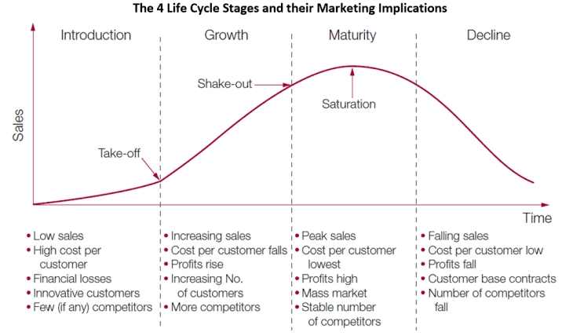
Product Life Cycle
Sales
Cost per customer
Profit /loss
Customers
Competitors

Slide 5
Product Life Cycle Management
Product life cycle management (PLM) is the integration of all aspects of a product, taking it from conception through the product life cycle (PLC) to the disposal of the product and components.
PLM consists of mainly three phases-
Beginning of life phase – Conceptualization ,design to manufacturing
Middle of life phase- Post manufacturing, distribution, sales and service
End of life phase- Retirement, disposal, recycling, reuse etc.

Slide 6
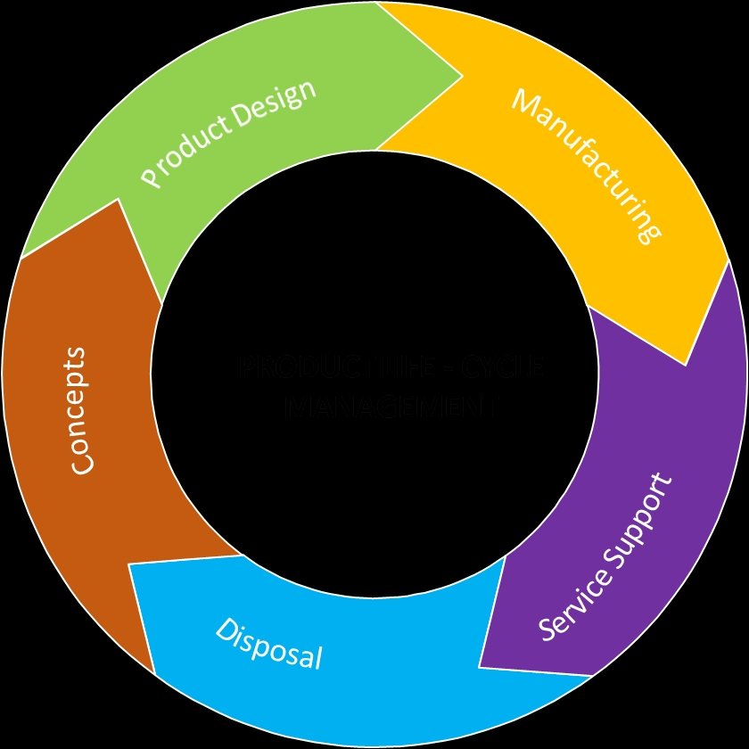
Product Life Cycle Management

Slide 7
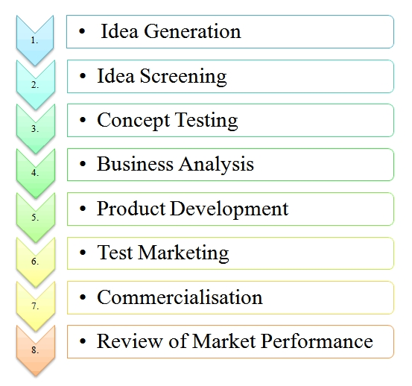
Product Design Steps
1
2
3
4
5
6
7
8

Slide 8
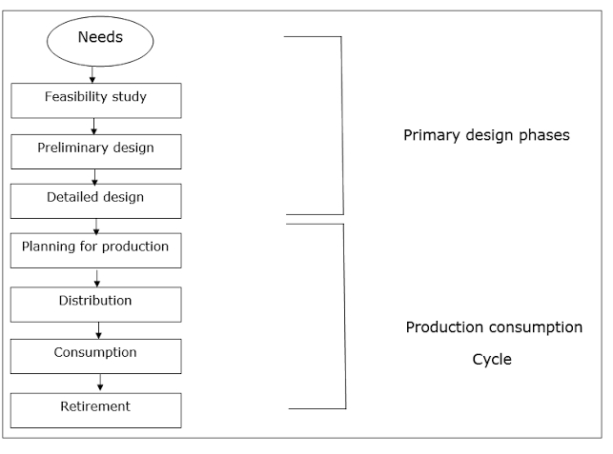
Morphology of Design

Slide 9
Evolution in Design
Innovation in Design
Design approach based on the observation that products typically go through a series of phases after their initial market introduction.
Ex-motor vehicle, which started out as a horseless carriage fitted with a motor.
Design approaches focussing on improving existing or developing completely new products.
Ex-Robots, smartphones, smart bands

Slide 10
Concurrent Engineering
Concurrent engineering, also known as simultaneous engineering.
Concurrent engineering is a method of designing and developing products, in which the different stages run simultaneously, rather than consecutively.
It decreases product development time and also the time to market, leading to improved productivity and reduced costs.

Slide 11
Traditional Engineering
Traditional engineering, also known as sequential engineering.
In traditional engineering the process of design, manufacturing, testing, production and marketing and each stage of the development process is carried out separately.
Next stage cannot start until the previous stage is finished.
The information flow is only in one direction.

Slide 12
Concurrent Engineering and Traditional Engineering
TIME

Slide 13
Form and Functional Design
Form Design- Associated with how product will look.
Design
Size and Shape
Colour
Texture
Functional Design- It is associated with the working or performance of the product
Reliabitity
Maintainability
Usability
“FORM FOLLOWS FUNCTION”

Slide 14
Simplification and Standardisation
Simplification- Simplification is the process of reducing the variety of products manufactured. Simplification is concerned with the reduction of product range, assemblies, parts, materials and design.
Standerization-Standardization means producing maximum variety of products from the minimum variety of materials, parts, tools and processes. It is the process of establishing standards or units of measure by which extent, quality, quantity, value, performance etc., may be compared and measured.

Slide 15
Product Differentiation
Process of distinguishing a good or service from others.
Making a product or service to stand out.
Companies do this to show their product’s uniqueness and attributes to customers.
This may include products within the company or of the same line.
Rita Gunther McGrath and Ian MacMillan wrote: “Offering customers something they value that competitors don’t have.”
Differentiation provides better value to customers at reasonable price,
Creats win-win scenario
Boost profitabitity and buisness viability.

Slide 16
Types of product differentiation
Horizontal differentiation- Not associated with product price or quality. It depends on customer’s personal choice because this offers almost same thing at same price.Ex- Mineral water bottles, dishwash bars.
Vertical differentiation- Products with vertical differentiation highly dependent on price. High price denotes mark of luxury or quality. Ex.- Branded vs generics; Sonata vs Fossils etc.
Mixed differentiation (Simple differentiation)- Combination of vertical and horizontal differentiation. Ex-Vehicles of the same class and similar price points from two different manufacturers.

Slide 17
Factors of differentiation
Form
Feature
Customization
Durability
Quality
Price
Style
Reliability

Slide 18
Mass Customization
Organization’s ability to efficiently mass produce products that meet individual consumer wants and needs.
Mass customization is a marketing and manufacturing technique which combines the flexibility and personalization of custom-made products with the low costs associated with mass production.
People strives to be unique so a common way to carry out mass customization is to offer a basic package for a product and then offer customers a range of features they can add or subtract.
That way, businesses can provide a certain set of options for modifying a product without the costs associated with making a unique product.

Slide 20
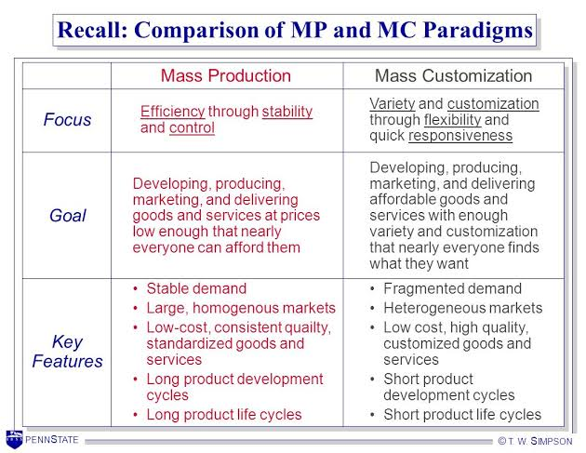
Mass Production v/s Mass customization

Slide 21
Modular Design
Modular design is a design theory and practice that subdivides a system into smaller parts called modules, which can be independently created, modified, replaced or exchanged between different systems.
Combine customization with advantages of standardization.
Advantages
Faster time to market Reduced cost Reduced resource requirement
Reduced risk and high safety
Quality fabrication or assembly
Simple changes
More organized

