Slide 1
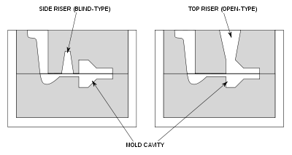
RISERS

Slide 2
Mainly used for
Reducing the shrinkage problem in the casting.
Promotes direction solidification

Slide 3
Comparison b/w open & blind riser
Open Riser
Having open top
Feeding force is gravity force and atm. Pressure
Connected at the top/on the side at the parting line
Cylindrical in shape
Comparatively larger
Blind Riser
Closed at the top
Only gravity force responsible for feeding
Can be placed at any position in the mold
A rounded cavity
Smaller in size

Slide 4
Continue…..
Due to rapid cooling rate insulating & exothermic compounds is recommended
Height depends on height of molding box
Easy to mold
Slow cooling rate due to surrounding molding sand
Height depend on feeding requirement
Difficult to mold

Slide 5
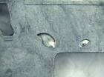
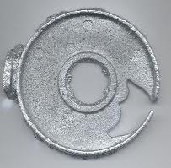
Casting Defects
Deviation of casting from its requirements
Flaws- due to improper appearance

Slide 6
Classification of Defects
Visually expectable
Exists under surface
Discovered by testing

Slide 7
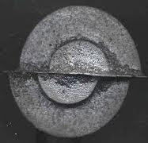
DEFECTS CAUSED BY PATTERN & MOLDING BOX
MISMATCH/MOLD SHIFT
Mismatch of top & bottom part of the casting

Slide 8
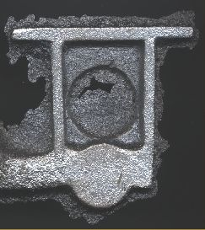
2) Variation in wall thickness of casting-
due to oversize dimensions
3) Fins, Fash and strain-
occurs at parting line.
mold movement makes casting thicker
4)crush-
displacement of sand during mold closing

Slide 9
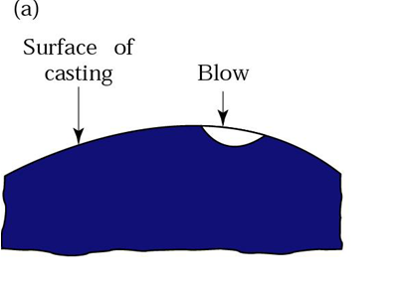
2. DUE TO IMPROPER SAND CASTING
BLOWHOLES-
smooth round holes
visible at surface – open holes
May occur in cluster /one large smooth depression

Slide 10
Causes of blow holes
Excess moisture in sand
Improper baked and inadequately vented core.
Presence of gas producing ingredients
Extra hard ramming of sand

Slide 11
2) DROP
mixing of sand into the molten metal
Causes-
Low green strength
Low mold hardness
Insufficient reinforcement

Slide 12
3) SCAB-
penetration of molten metal in sand
Causes-
Too fine sand
High moisture content sand
Local heating
Uneven ramming

Slide 13
4) PIN HOLES/POROSITY-
No of small holes present on casting surface
Causes-
High moisture in sand
Metal-mold reaction

Slide 14
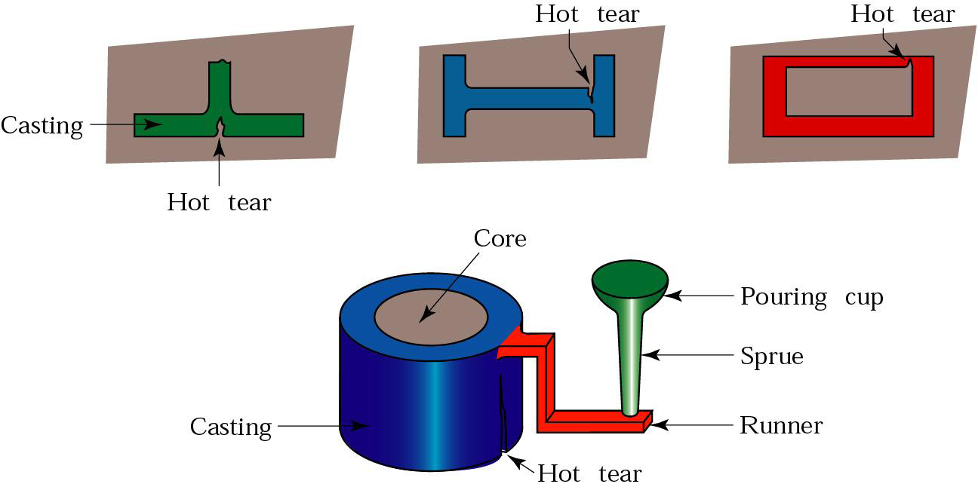
5) HOT TEARS-
internal/ external cracks with ragged edges

Slide 15
Causes-
High sulphur content
Low pouring temperature
very hard ramming
high dry & hot strength
Too much shrinkage

Slide 16
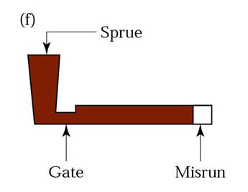
6) MISRUN-
Incomplete filling of casting before solidification
Causes-
Too cold metal
Too thin casting
Too small gates

Slide 17
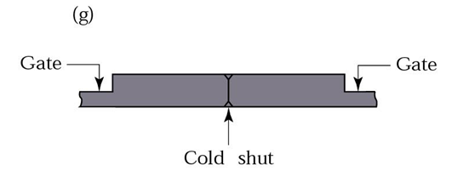
7) COLD SHUTS-
Inability of fusing metal coming from 2 gates

Slide 18
8) SLAG HOLES
9) SHRINKAGE DEFECTS

Slide 19
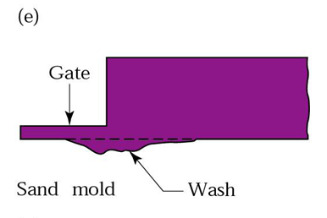
DEFECTS DUE TO MOLTEN METAL
SAND CUTS & WASHES-
Flow of molten metal over mold /core
Causes-
Soft ramming
Insufficient draft
Improper gating system

Slide 20
WARPAGE
HARD SPOTS
SWELLS
INCLUSIONS
FUSION

Slide 23
MELTING FURNACES
used to melt the metal
Remelting created by combustion of fuel, electric arc, electric resistance
Blast furnace for melting
Electric arc furnace for remelting

Slide 24
SELECTION CRITERION
cost
Type of metal to be melted
Quality required
Flexibility
Melting efficiency
Degree of control

Slide 25
Furnace for melting
Grey cast iron
Cupola
Air (reveberatory)
Rotary
Electric arc
Steel
Open hearth
Electric
converter

Slide 26
Non-ferrous metals
Crucible
Pot
Air
Rotary
Induction
Electric arc

Slide 27
CUPOLA FURNACE
Melt scrap metal
Economical for gray, nodular, malleable cast Fe
Fuel used
high grade low sulphur coke
Anthracite coal
Or C- briquettes

Slide 28
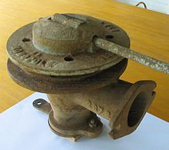
CONSTRUCTION
Cylindrical shell of 6-10 mm thick plate
Tuyeres dimensions- 50mm* 150mm
Upto 75cm dia cupola 3-4 tuyeres used

Slide 29
CONSTRUCTION
Normal air pressure
12”-16” water gauge for small cupola
16”-35” for large
Capacity- 1-15 tons/heat
Height – 2.5 m - 4 m & 6 m
Inside dia- 75 cm – 2.5m

Slide 30
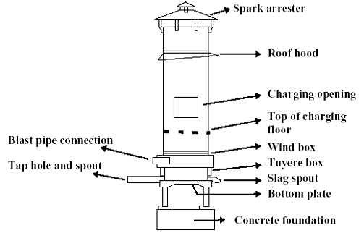

Slide 32
CUPOLA OPERATION
PREPARATION OF CUPOLA
Cleaning repairing operation
Patching-(2 parts ganister/silica & 1 part fireclay)
Cupola block-
Si - 52% -62%
Al- 31%-43%
Titania- 1.5%-2.5%
Fluxing oxides- 3%- 6%

Slide 33
LIGHTNING THE FIRE
Started 3 hrs before working
Can be lighten by-
Electric spark ignitor
Gas torch

Slide 34
CHARGING OF CUPOLA-
Adding layers of flux ,iron & coke
Commonly used flux-
CaCO3
Na2CO3
CaF2
CaC2
Avoid large amount of flux
Amount – 2% - 4% by weight of metal
Fuel used
Low S coke, anthracite coal & carbon briquettes

Slide 35
Metal fuel ratio- 4:1-12:1
Metal charge consists
Pig Fe -30%
Scrap iron -30%
Returns -40%

Slide 36
MELTING
soaking period- 30 min
SLAGGING AND METAL TAPPING
collect slag
Collect metal into the ladle
DROPPING DOWN THE BOTTOM
Shut down the cupola

Slide 37
ZONES OF CUPOLA

Slide 39
WELL
Collect molten metal
SUPERHEATING COMBUSTION/ OXIDIZING ZONE
15-30cm above tuyere level
C, Mn, Si react with O2
Amount of heat generated- 14452 BTU/ pound
Temperature 1550 -1850 degree C

Slide 40
REDUCING ZONE/ PROTECTIVE ZONE
Temperature- 1200 degree C
C + CO2 → 2CO - heat(2910BTU)
MELTING ZONE
90cm above coke bed
Temperature- 1600 degree C
3Fe +2CO → Fe3C + CO2

Slide 41
PREHEATING ZONE
Melting zone – bottom of charging door
Temperature about 1100 degree C
STACK ZONE
Exhaust
Stack gases contains
Nitrogen-76%, 12% CO2, CO

