Slide 1
Subject-Operations Management
Mrs. Anjali Upadhyay (Pandya)
Mechanical Engineering Department
SoET, VU, Ujjain (M.P)

Slide 2
Contents-
Operations management
Goal of operations management
Transformation process
History of operations management
Employment shift
Goods v/s Services
Goods service continuum
Manufacturing System
Volume variety graph
Buisness strategy
Environment scan
SWOT analysis
Porter’s five forces model
Competitive Priorities

Slide 3
Operations Management
Operations management is the management of processes that transform inputs into goods and services that add value for the customer.
Operations management is dealing with the value added activities with proper planning , organising, leading and controlling the organisations resources.
Operations management transforms inputs (labor, capital) into outputs (goods and services) that provide added value to customers.

Slide 4
The Goal of Operations Management
To maximize efficiency while producing output.
Effectively fulfill customer needs.
Decesion Making
Added value to customers
Quality Improvement
Improvement in scheduling
Training of workers
Reduced cost
Improves productivity

Slide 5
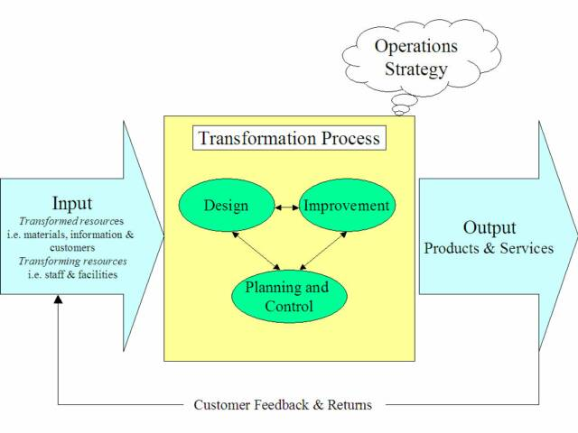
Typical Transformation Process

Slide 6
History of Operations Management (Time Line)
1776-1900- Industrial Revolution, Division of Labour ( Adam Smith)
1900-1920-Scientific Management, Time & Motion Study (F.W. Taylor)
1920-1940- Howthron Study (Western Electric)
1940-1960- Operations Research (World War 2)
1960-1980- MRP, JIT
1980-2000-Total Quality Management
2000- Information technology
2005- Flattening of World, Globalization

Slide 7
Employment shift towards services
Agriculture➡️Manufacturing➡️Services
With industrialization of the world in which the traditional agricultural economy was gradually replaced by the new industrial economy.
USA became the first country to shift to a ‘service economy’ in the middle of the twentieth century
Other countries and developed countries now shifted towards service economies.

Slide 8
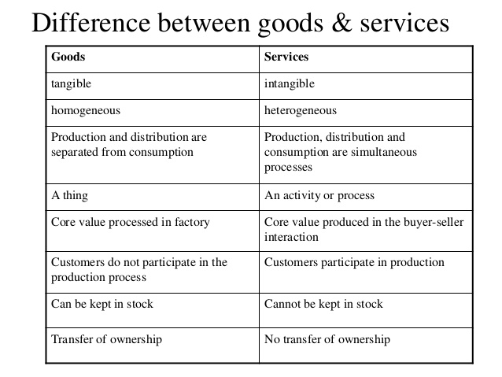
Goods (Products) Vs Services

Slide 9
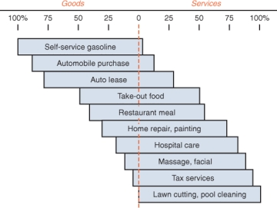
Goods-services continuum

Slide 11
Volume -Variety Graph

Slide 12
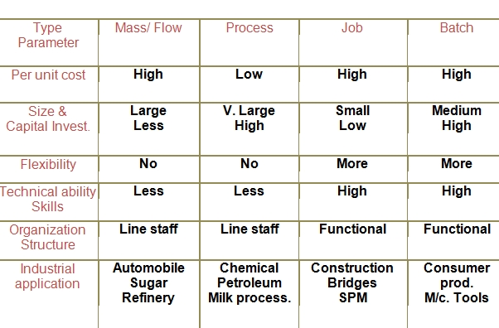
Production systems

Slide 13
Buisness Strategy
The combination of the actions to be performed and decision taken by the organisation to accomplish goals and to secure a competitive position in the market.
Levels of buisness strategy-
Corporate level- Sets goals, vision and mission
Organisation unit level
Functional level

Slide 14
Environment Scan
Environmental scanning is to monitor external and internal environments by the organization.
Techniques for environment scan
SWOT Analysis
PEST Analysis
PESTLE
Industry Analysis-Porter’s 5 Forces Model
Gap Analysis
QUEST
Life Cycle Analysis etc.

Slide 15
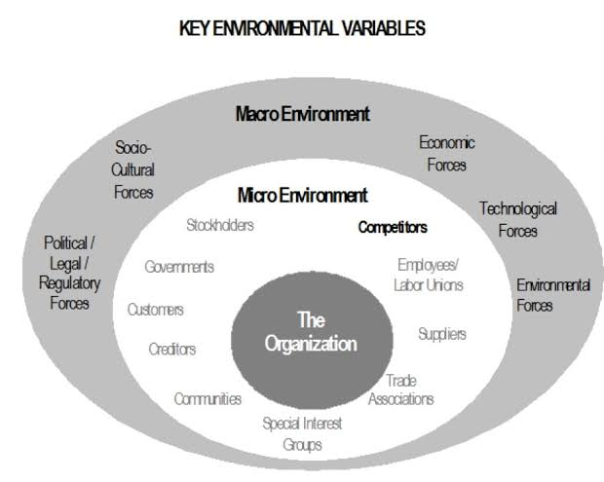

Slide 16
SWOT Analysis
 | FAVOURABLE | UNFAVOURABLE
INTERNAL Environment | S – STRENGTH Positive Factors | W-WEAKNESS Negative factors
EXTERNAL Environment | O- OPPORTUNITY Possibilities for Organization | T-THREATS Outside obstacles

Slide 17
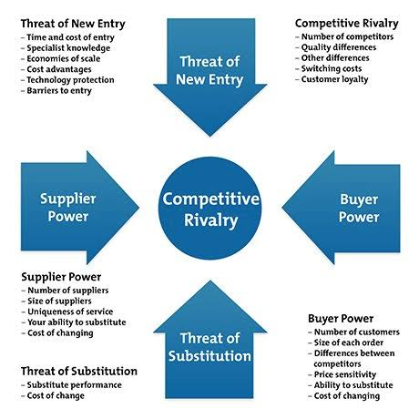
Porter’s Five Forces Model

Slide 18
Competitive Priorities (Cost, Time, Quality, Flexibility)
Competitive Priorities | Emphasis | Example
Cost | Low Cost | D- Mart Parle-G
Quality | High Performance or consistent quality | Samsung , Sony Honda, toyota
Flexibility | Variety / Quantity Flexibility | Dell
Time/Pace | Rapid Delivery On time delivery | Swiggy Dominoz

