Slide 1
SPREAD SPECTRUM COMMUNICATION

Slide 2
CONTENTS
INTRODUCTION
SPREAD SPECTRUM COMMUNICATION?
HOW IT WORKS
SPREAD SPECTRUM TECHNIQUES
APPLICATIONS

Slide 3
ITRODUCTION TO SPREAD SPECTRUM COMMUNICATION
Spread-spectrum radio communications is a favorite technology of the military because it resists jamming and is hard for an enemy to intercept, Just as they are unlikely to be intercepted by a military opponent

Slide 4
Block diagram of spread spectrum system

Slide 5
Overview of Spread Spectrum Communications
Spread Spectrum is a means of transmission in which the data sequence occupies a bandwidth in excess of the minimum bandwidth necessary to send it. ▫ Effectively the signal is mapped to a higher dimension signal space
Signal spreading is done before transmission by using a spreading sequence. The same sequence is used at the receiver to retrieve the signal
Spread Spectrum is most effective against interference (intentional or non-intentional) with fixed energy.
Main commercial applications in wireless and GPS.

Slide 6
Why Spread Spectrum?
Spread spectrum signals are distributed over a wide range of frequencies and then collected back at the receiver
• Initially adopted in military applications, for its resistance to jamming and difficulty of interception
• More recently, adopted in commercial wireless communications

Slide 7
NEED FOR SPREAD SPECTRUM
Safeguards for physical security must be even greater in wireless communications
Encryption: intercepted communications must not be easily interpreted
Authentication: is the node who it claims to be?

Slide 8
How Spread Spectrum Works
Spread Spectrum uses wide band, noise-like signals. Because Spread Spectrum signals are noise-like, they are hard to detect.
Spread Spectrum signals are also hard to Intercept or demodulate.
Further, Spread Spectrum signals are harder to jam (interfere with) than narrowband signals.
These Low Probability of Intercept (LPI) and anti-jam (AJ) features are why the military has used Spread Spectrum for so many years.

Slide 9
Spreading Codes
• A noise-like and random signal has to be generated at the transmitter. • The same signal must be generated at the receiver in synchronization. • We limit the complexity by specifying only one bit per sample, i.e., a binary sequence.
Spread Spectrum signals use fast codes that run many times the information bandwidth or data rate. These special "Spreading" codes are called "Pseudo Random" or "Pseudo Noise" codes. They are called "Pseudo" because they are not real Gaussian noise.

Slide 10
PN Sequences
• PN generator produces periodic sequence that appears to be random
• PN Sequences
▫ Generated by an algorithm using initial seed
▫ Sequence isn’t statistically random but will pass many test of randomness
▫ Sequences referred to as pseudorandom numbers or pseudonoise sequences
▫ Unless algorithm and seed are known, the sequence is impractical to predict

Slide 11
SPREAD SPECTRUM TECHNIQU
THE MAJOR SPREAD SPECTRUM TECHNIQUES ARE
DSSS
FHSS

Slide 12
Direct Sequence Spread Spectrum (DSSS)
Data signal is multiplied by a spreading code, and resulting signal occupies a much higher frequency band
• Spreading code is a pseudo-random sequence

Slide 13
Frequency Hopping Spread Spectrum (FHSS)
Data signal is modulated with a narrowband signal that hops from frequency band to frequency band, over time
• The transmission frequencies are determined by a spreading, or hopping code (a pseudo-random sequence)

Slide 14
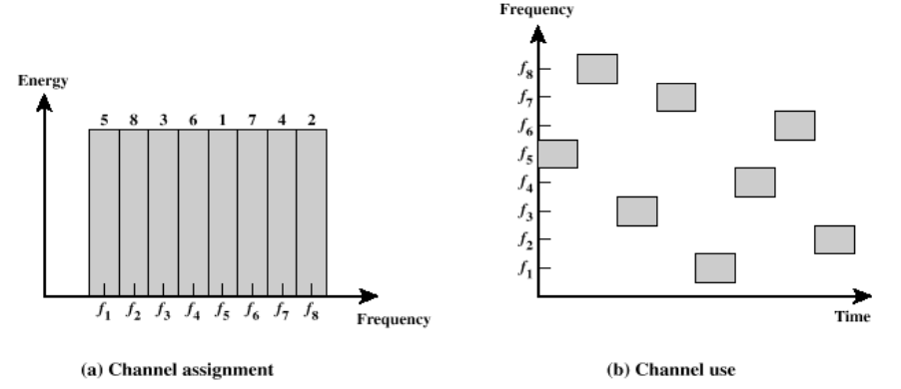
Frequency Hoping Spread Spectrum

Slide 15
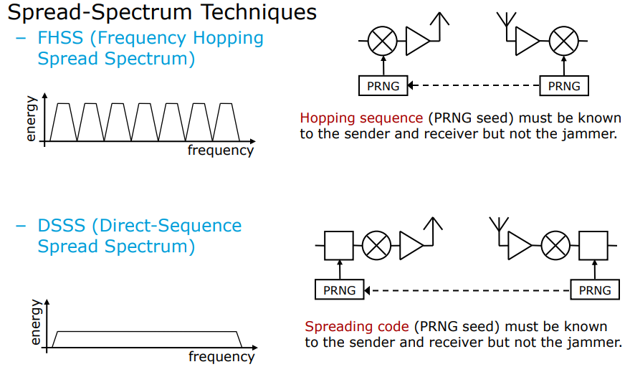
Spread spectrum techniques

Slide 16
Advantages of Spread Spectrum
Reduced crosstalk interference:
Better voice quality/data integrity and less static noise
Lowered susceptibility to multipath fading
Inherent security:
Co-existence:
Longer operating distances
Hard to detect:
Hard to intercept or demodulate:
Harder to jam

Slide 17
Thank you

