Slide 1
Superheterodyne receiver

Slide 2
Superheterodyne receiver that uses frequency mixing to convert a received signal to a fixed intermediate frequency (IF) which can be more conveniently processed than the original carrier frequency.
The superheterodyne receiver operates by taking the signal on the incoming frequency, mixing it with a variable frequency locally generated signal to convert it down to a frequency where it can pass through a high performance fixed frequency filter before being demodulated to extract the required modulation or signal.

Slide 3
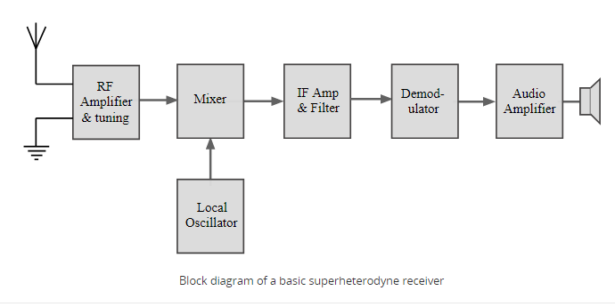
Superheterodyne receiver block diagram

Slide 4
Superheterodyne receiver circuit blocks
RF tuning & amplification:
Local oscillator:
Mixer:
IF amplifier & filter:
Demodulator:
Automatic Gain Control, AGC:
Audio amplifier

Slide 5
RF tuning & amplification:
This RF stage within the overall block diagram for the receiver provides initial tuning to remove the image signal. It also provides some amplification.
Low cost broadcast radios may have an amplifying mixer circuit that gives some RF amplification. HF radios may not want too much RF gain because some of the very strong signals received could overload later stages. The RF design may incorporate some amplification as well as RF attenuation to overcome this issue. Radios for VHF and above will tend to use more gain to have a sufficiently low noise figure to receive the signal.

Slide 6
Local oscillator:
Like other areas of the RF circuit design, the local oscillator circuit block within the superhet radio can take a variety of forms.
There was a considerable degree of RF circuit design expertise used with these oscillators in high performance superhet radios to ensure the lowest possible drift. High Q coils, low drift circuit configurations, heat management (because heat causes drift), etc . .

Slide 7
Mixer:
The mixer can be one of the key elements within the overall RF design of the receiver. Ensuring that the mixer performance matches that of the rest of the radio is particularly important.
Both the local oscillator and incoming signal enter this block within the superheterodyne receiver. The wanted signal is converted to the intermediate frequency.

Slide 8
IF amplifier & filter:
This superheterodyne receiver block provides the majority of gain and selectivity. Often comparatively little gain will be provided int he previous blocks of the RF circuit design of the radio. The IF stages are where the main gain is provided. Being fixed in frequency, it is much easier to achieve high levels of gain and overall performance.
Originally the IF stage might have included a number of different transistors, FETs or thermionic valves / vacuum tubes, but nowadays it is possible to obtain integrated circuits that contain a complete IF strip.

Slide 9
Demodulator:
The superheterodyne receiver block diagram only shows one demodulator, but in reality many radio RF designs may have one or more demodulators dependent upon the type of signals being receiver.
Even many broadcast radios will have AM and FM, but professional radios used for monitoring and two way radio communications may require a larger variety in some instances. Having a variety of demodulators will enable many different signal modes to be received and increase the capability of the radio.

Slide 10
Automatic Gain Control, AGC:
An automatic gain control is incorporated into most superhet radio block diagrams. The function of this circuit block is to reduce the gain for strong signals so that the audio level is maintained for amplitude sensitive forms of modulation, and also to prevent overloading.
Although the basic concept is the same through all radio RF circuit designs, there are some variations in the implementation. Some of the key variations are the time constant of the AGC system. For AM and the like a relatively slow time constant is acceptable. For SSB, a shorter time constant is needed so that the envelope of the SSB signal is followed.

Slide 11
Audio amplifier:
Once demodulated, the recovered audio is applied to an audio amplifier block to be amplified to the required level for loudspeakers or headphones. Alternatively the recovered modulation may be used for other applications whereupon it is processed in the required way by a specific circuit block.
In many ways, this circuit block within the superheterodyne radio is the most straightforward. For many applications, the audio amplifier will involved some straightforward electronic circuit design, especially if the audio is applied to simple headphones or a loudspeaker. For two way radio communication applications, the audio bandwidth may need to be limited to the "telecommunications" bandwidth of about 300 Hz to 3.3 kHz. Audio filters could be employed as well.

Slide 12
Thank you

