Slide 1
SNR Calculations in AM System

Slide 2
Signal to Noise Ratio
Signal-to-Noise Ratio (SNR) is the ratio of the signal power to noise power. The higher the value of SNR, the greater will be the quality of the received output.

Slide 3
Figure of Merit
The ratio of output SNR and input SNR can be termed as Figure of Merit. It is denoted by F. It describes the performance of a device.
F=(SNR)o/p/(SNR)i/p

Slide 4
SNR Calculations in AM System
Consider the following receiver model of AM system to analyze noise.

Slide 5
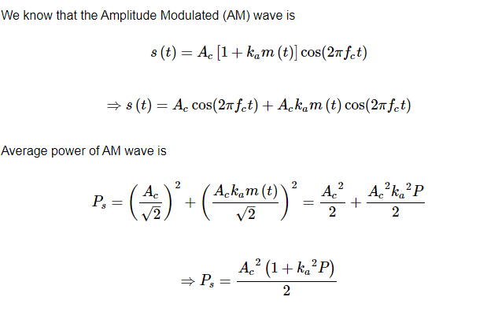

Slide 6
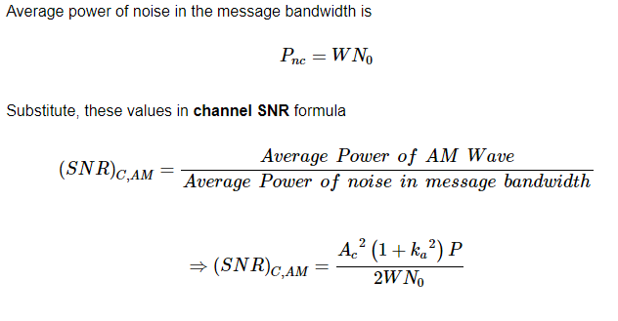

Slide 7
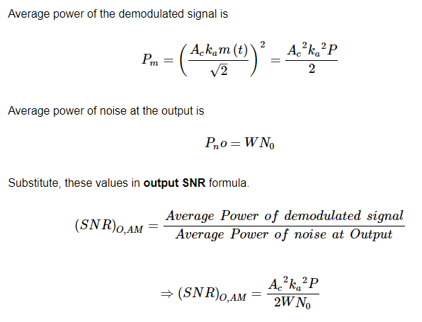

Slide 8
