Slide 1
SCHOOL OF STUDIES IN COMMERCE VIKRAM UNIVERSITY, UJJAIN (M.P.)

Slide 2
PRACTICES IN BUSINESS COMMUNICATION
LECTURE BY:
DR. KAYNAT TAWAR

Slide 3
RELEVANT TOPICS ON PRACTICES IN BUSINESS COMMUNICATION FOR
B.COM (HONS.)
B.B.A. (HONS.)
M.COM.

Slide 4
PRESENTATION ROADMAP
Best Practices in….
Effective and Ethical Business Communication
Professionalism in the Workshop
Intercultural Business Communication
Writing Tips for the Business Professional
Electronic Message and Digital Media for Business Communication
Positive and Negative Message
Business Presentations
Business Reports, Plans and Proposals

Slide 5
BEST PRACTICES IN EFFECTIVE BUSINESS COMMUNICATION
What is communication ?
*Guffey and loewy (2011) define communication as “the transmission of introduction and meaning from one individual or group to another.”
Why is communication in business important?
*Communication skills are often just as important to employers as teamwork skill or critical thinking (Guffey and Loewy 2011) .
*Candidate with strong communication skills can set themselves apart from the rest (Guffey and Loewy 2011) .

Slide 6
COMMUNICATION CHANNELS
Formal communication channels usually follow the hierarchy of an organization (Berger & Lyengar, 2013).
*Download flow from decision makers to subordinates.
Keep the communication chains short.
*Upward flow from non-mangement to management.
Building trust to encourage employees to
share information upward.
*Horizontal flow among workers at the same level.
Increase training on teamwork.

Slide 7
Informal communication channels are often referred to as the grapevine.
*Employees have a desire to know information.
*Office gossip can be an effective communication tool if managed appropriately by (Guffey Lowery , 2011):
1. Providing more information through formal channels.
2. Monitoring information flow.
3. Correcting any misinformation

Slide 8
BEST PRACTICES IN ETHICAL BUSINESS COMMUNICATION
What are ethics?
According to Guffey and Loewy (2011), ethics are system of moral “standards of right and wrong that prescribe what people should do”.
Why are ethics in business communication important?
*Organization with shoddy ethics risk losing business through bad reputations and litigation (Brenkert, 2010).
*To avoid this, organization are encouraged to develop a company code of ethics enforced by policies and procedures (Guffey & Loewy, 2011).

Slide 9
TOOLS FOR DOING THE RIGHT THING
Guffey and Loewy (2011) have put together five tools for doing the right thing when solving ethical dilemmas.
*Is the action legal?
*How would the problem look on the opposite side?
*Are there alternate solutions?
*Can the problem be discussed with someone trustworthy?
*How would family, friend, coworkers, or the employer feel about the action?

Slide 10
BEST PRACTICES FOR PROFESSIONALISM IN THE WORKPLACE
Professionalism in the workplace is critical for an employee’s credibility and success within an organization (Guffey & Loewy, 2011)
This involved competency in the following soft skills:
Working in terms.
Listening skills.
Business etiquette.

Slide 11
PROFESSIONALISM: WORKING IN TERMS
The ability to effectively work in terms is a professional skill employers are looking for due to the following benefits (Guffey & Loewy, 2011):
*Improved decisions
*Faster responses
*More productive
*Diffused responsibility
*Better employee morale
*Lower resistance to change

Slide 12
Strong listening skills have been found to be a predictor of career success and organization effectiveness (Guffey & Loewy, 20911)
These skills can be improved by:
Asking clarifying questions
Avoiding interruptions
Controlling distractions
Being actively involved
Having the ability to separate facts from opinions.
PROFESSIONALISM LISTENING SKILLS

Slide 13
PROFESSIONALISM: BUSINESS ETIQUETTE
The goal of communication is to convey a message or meaning; the message can get lost if the speaker is unprofessional and impolite (Guffey & Loewy, 2011)
Proper Etiquette | Poor Etiquette
Be respectful towards others. | Bad manners and discourteous behavior
Rise above rudeness | Telling off color jokes and using profanity
Always express gratitude | Taking credit for the work of others
Keep claim in conflict | Engage in conflict and shouting
Keep person information personal | Over sharing detailed information about health concern

Slide 14
BEST PRACTICES: INTERCULTURAL BUSINESS COMMUNICATION
Why is intercultural communication in business important?
*Today’s business are expanding into the global marketplace and incorporating more diversity into their workforces (Guffey & Loewy, 2011).
How can organization benefit?
*Diverse workforces have an advantages from individual differences and unique perspectives (Canas & Sondak, 2014)
*Increase in creative thinking (Farry, 2012).

Slide 15
Cultural competency can be achieved through education on cultures outside one’s own, avoiding sterotypes, and always remaining respectful (Canas & Sondak, 2014)
Improve intercultural communication through:
INTERCULTURAL BUSINESS COMMUNICATION
Respect
Empathy
Patience
Listening
Speaking slowly
Learning foreign phrases (Guffey & Loewy, 2011)

Slide 16
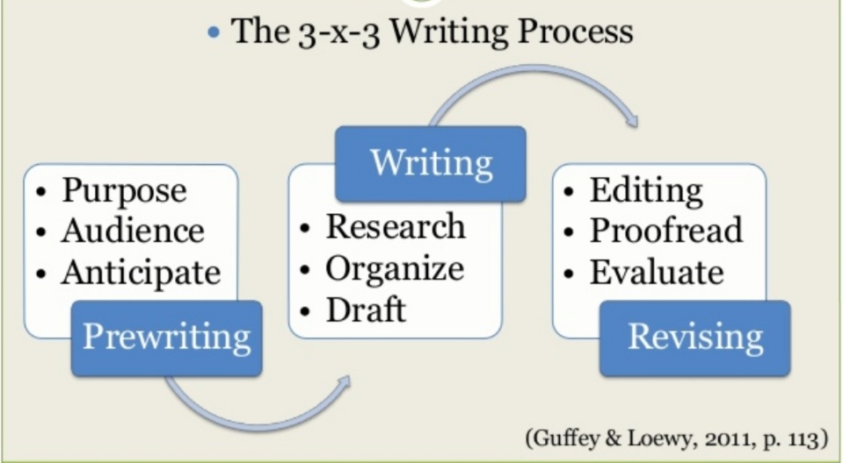
WRITING TIPS FOR THE BUSINESS PROFESSIONAL (GUFFEY & LOEWY,2011)

Slide 17
REVISING FOR CONCISENESS
Direct and efficient message are highly desired in business communication (Guffey & Loewy, 2011)
Trim sentences and eliminate unnecessary words and phrases.
Get rid of cliches.
Avoid long lead-ins.

Slide 18
SELECTING A COMMUNICATION CHANNEL
When selecting the best channel, it is important to consider:
*The importance of the message
*The desired amount of feedback and speed required
*If a permanent record is required
*The cost
*Level of formality needed
*Message is confidentiality (Guffey & Loewy, 2011)

Slide 19
ELECTRONIC MESSAGE & DIGITAL MEDIA FOR BUSINESS COMMUNICATION
Best practices in:
E-Mil
Instant messaging and texting
Social networking

Slide 20
E- mail has become “the communication channel of choice” for many organizations (Guffey & Loewy, 2011)
*Use the same 3-multiply-3 process as paper based messages
*Use a structured format with consideration for:
- Subject line: provides a summary of the central idea.
- Opening: state the purpose.
- Body: organize information appropriately.
- Closing: request action and use a good will statement (Guffey & Loewy,2011)

Slide 21
BEST PRACTICES IN INSTANT MESSAGING AND TEXTING
Instant messaging and texting are popular in business because they are interactive and immediate (Guffey & Loewy, 2011)
*Consider your audience
*Keep business and personal contact separate
*Do not use for sending confidential information
*Use proper grammar and spelling
*Be patient
*Remain professional

Slide 22
BEST PRACTICES IN SOCIAL NETWORKING
If used appropriately, business can use social networking as a powerful customer service platform and to gain important feed back (Kaufman, 2013)
*Keep professional and personal data separate
*Use strong passwords
*Do not post or send inappropriate photographs, jokes or messages.

Slide 23
BEST PRACTICES FOR POSITIVE MESSAGES
The majority of business communication involves routine, positive messages (Guffey & Loewy, 2011)
Can be transmitted through verbal, electronic or paper-based channels.
Best to use a direct organizational plan, stating the main point towards the beginning of the message followed by explanations (Jansen & Janssen,2013)

Slide 24
BEST PRACTICES FOR NEGATIVE MESSAGES
Negative messages are best conveyed with an indirect organization plan the first provides reasoning and explanation followed by the major idea(Jansen & Janssen,2013).
*Consider your audience
*Be clear and concise
*Practice empathy
*Choose an appropriate communication channel, bad news is best delivered face to face. (Jansen & Janssen,2013)

Slide 25
BEST PRACTICES FOR BUSINESS PRESENTATIONS
Use the 3-multiply-3 writing process:
Effective business presentations are well organized, visually stimulating, and used to accompany the verbal messages. (Guffey & Loewy,2011)
- Identify the purpose:
To inform
To explain
To motivate
To persuade
- Know your audience
(Guffey & Loewy,2011)

Slide 26
Best practices for business presentations
Steps for an effective PowerPoint presentation:
Start with the message, identify purpose and audience then add all text.
Select appropriate background and font.
Add relevant images.
Create graphics to improve understanding.
Include special effects for interest and emphasis.
Provide hyperlinks for an interactive experience.
Encourage audience participation with interactive options.
Makes slides accessible online.

Slide 27
BEST PRACTICES FOR BUSINESS REPORTS
Formal | Informal
Used less frequently | Used frequently and routinely
Adheres to specific formatting | Multiple format options
For external use | For internal use
Very lengthy | Much shorter than formal reports
Presents all data | Summarizes data

Slide 28
BEST PRACTICES FOR BUSINESS PLANS
Purpose:
Business plans are presented to secure funding for new business (Guffey & Loewy, 2011).
Components:
Letter of transmittal
Table of contents
Company description
Product / service description
Market analysis
Operations and management
Financial analysis
Appendixes

Slide 29
BEST PRACTICES FOR BUSINESS PROPOSALS
Proposals are written with the purpose:
To solve problems, provide services, or sell equipment / services (Guffey & Loewy, 2011)
Components of informal proposals:
Introduction
Background, problem and purpose
Proposal, plan and schedule
Staffing
Budget
Authorization request

Slide 30
FORMAL BUSINESS PROPOSALS
Additional components of formal proposals:
Copy of the request for proposal (RFR)
Letter of transmittal
Abstract
Title page
Table of contents
List of illustrations
Appendix (Guffey & Loewy, 2011)

Slide 31
REFERENCE
www.google.com.
www. wikipedia.com.
www.studymafia.org

Slide 32
CONTACT DETAILS
EMAIL : dr.kaynattawar@gmail.com

