Slide 1
SCHOOL OF STUDIES IN COMMERCE VIKRAM UNIVERSITY, UJJAIN (M.P.)

Slide 2
PRESS RELEASE
LECTURE BY :
DR. KAYNAT TAWAR

Slide 3
RELEVANT TOPICS ON PRESS RELEASE FOR
B.COM (HONS.)
B.B.A. (HONS.)
M.COM.

Slide 4
TOPICS
LEARNING GOALS
THE PRESS RELEASE
WHAT PRESS RELEASE DO?
ELEMENTS OF PRESS RELEASE
PRESS RELEASE TEMPLATE
CONTACT INFORMATION
HEADLINE
THE LEAD
THE BODY
CLOSING PARAGRAPH

Slide 5
ENDING
WRITING GUIDELINES
HOW TO FORMAT A PRESS RELEASE
HOW TO WRITE A GOOD PRESS RELEASE
WRITING TIPS FOR PRESS RELEASE
CONTACT
NEWS RELEASE NEWS VALUE
THINK LIKE A REPORTER
DEVELOP AN ANGLE
EXAMPLE: LOCAL ANGLE

Slide 6
LEARNING GOALS
Even in the age of technology, writing remains the key to effective public relations.
Public relations practitioners are professional communicators, and communications means writing.
Most of us know how to write and speak, but public relations professionals should know it better than their colleagues.

Slide 7
There is no substitute for clear and precise language in informing, motivating and persuading.
The ability to write and speak with clarity is a valuable and coveted skill in any organization.
The ability to write easily, coherently, and quickly distinguishes the public relations professional from others in an organization.

Slide 8
A press release or news release is a public relations tool that is used to make suggestions to journalists, editors, bloggers or other thought leaders. It is a writing and distribution service for iOS / Android apps marketing is extremely most important thing to BUZZ all over the world. These press release distribution websites are regularly searched by other news agencies & reporters which can again be reproduced on their respective channels.

Slide 9
THE PRESS RELEASE
A press release is pseudo-news story, written in third person, that seeks to demonstrate to an editor or reporter the newsworthiness of a particular person, event, service or product.
The press release is the “granddaddy” of public relations writing vehicles. Everyone uses it to publicize their organizations, products and services.
The overriding purpose is to influence a publication to write favorably about the organization.

Slide 10
They are distributed via. Email, websites and social media. They can also be part of a full press kit, or may be a accompanied by a pitch letter.
The best way is e-mail. Remember, a survey of journalists found 77% prefer to be contacted via. E-mail. So, for our assignment, you will e-mail your press release.
News release are rarely used verbatim. Rather, they may stimulate editors to consider covering a story.

Slide 11
WHAT PRESS RELEASE DO?
Press release are the most cost-effective way of building awareness about your business and what you do. Press release have more credibility than paid advertising because they are regarded as news and are often delivered, creating the impression of an endorsement.

Slide 12
ELEMENTS OF PRESS RELEASE
Your release must include:
Contact information
For immediate release
Headline
Dateline
Lead paragraph
Body
Closing paragraph

Slide 13
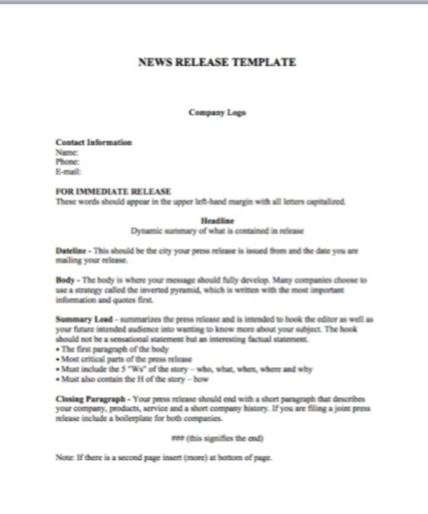
PRESS RELEASE TEMPLATE

Slide 14
CONTACT INFORMATION
Put in your information. Use your cell phone and E-mail.
Make sure your greeting and E-mail are professional.
So, nothing like :
“YankeesFan1988@yahoo.com

Slide 15
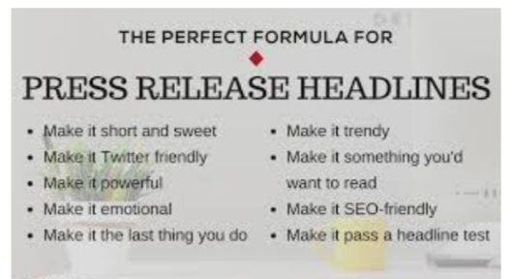
HEADLINE
Before you write a word, remember this: the reporter isn’t interested in helping you make money or driving visitors to your site. He’s looking for a story that will be interesting to his readers and pleasing to his editor. He could care less about your great selection, super customer service and commitment to quality. He wants to know only the info that will help him craft a good story.

Slide 16
Take your ego out of it. Take your natural inclination to sell, sell, sell out of it. Look at your story with a cold, objective eye.
State your most exciting news, finding or announcement in as few words as possible. Emulate the headlines you see in the newspaper every day.
Use a subheading, if appropriate.

Slide 17
THE LEAD
It’s journalism 101 – the lead paragraph includes the who, what, when, where and how of the story. If the reporter were only to read the lead of a good press release, he’d have everything he needed to get started.
There’s no room for BS, hype or sell. Just the facts.

Slide 18
The lead should also contain the hook that will appeal to the reporter’s audience. The hook should not be a sensational statement but an interesting factual statement.
The lead should be preceded by the city your press release is issued from (wherever your client is located) and the date you are e-mailing your release (which may not be the present date).

Slide 19
THE BODY
The Body is where your message should fully develop. Many companies choose to use a strategy called the inverted pyramid, which is written with the most important information and quotes first. Use this approach for your press release.
Your body should also contain quotes from your clients and , perhaps, others (testimonials from happy customers or expert quotes).

Slide 20
CLOSING PARAGRAPH
Your press release should end with a short paragraph that describes your organization and what they do. If you are filing a joint press release include a boilerplate for both companies.

Slide 21
ENDING
* Type and center # # # below your text (this signifies the end of the press release).
Note : if there is a second page insert (more) at bottom of page.

Slide 22
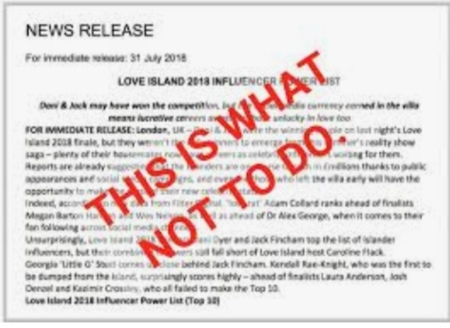
WRITING GUIDELINES
What to put in press release
Textbook advice
Flesch readability formula
Active voice
Associated press style
5 W’s and H
The inverted pyramid
Paragraph breaks
Quotes
Editing

Slide 23
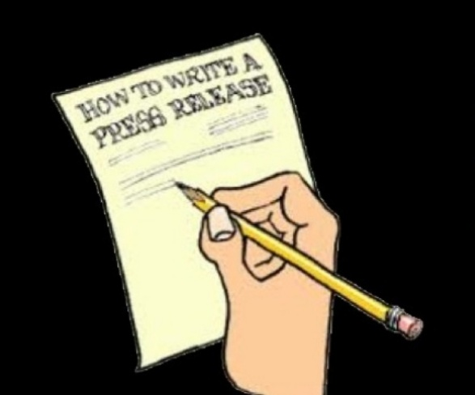
HOW TO FORMAT A PRESS RELEASE
Keep the total length under 2 pages, ideally 400-500 words.
Avoid using “I”, “We” or “You”.
Use a standard font, such as times new roman or calibri.
Bolded, larger headline.
Body text should be single spaced, with one line of space between paragraphs.
Use standard 1 inch margins and white paper

Slide 24
HOW TO WRITE A GOOD PRESS RELEASE
What is this about?
What is the actual news?
When does this event happen?
Where does this even take place?
Why this is news?
How is this happening?

Slide 25
WRITING TIPS FOR PRESS RELEASE
EYE CATCHY HEADLINES
Make an unusual headlines that make a powerful influence on the journalist or reader and force then to read the press release anyway.
DRAFT
Make a gist of your work. It would help the journalist to make an estimate of your work quickly.

Slide 26
CONTACT
End up press release reasonably. Must finish press release with the sentences “further information, please contact at the following”.
Give your mobile number.
E-mail address.
And any other number of address on which you can communicate.

Slide 27
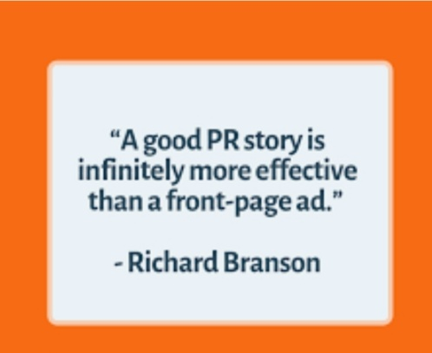
NEWS RELEASE NEWS VALUE
The best way to learn what constitutes news is to scrutinize the media on a daily basis. When sending your news release:
Have a well- defined reason for sending it.
Focus on one subject.
Make certain the subject is newsworthy.
Include facts about the product, service or issue.
Eliminate “puff” and unnecessary jargon.

Slide 28
Use quotes, but avoid inflated superlatives.
Include product specifications, shipping dates, price etc.
Include a brief description of the company.
Write clearly, concisely and forcefully.

Slide 29
THINK LIKE A REPORTER
What’s the secret to getting free publicity?
It’s not a fancy press kit. Its not having a superstar spokesperson. It’s not hiring the world’s biggest PR firm.
Actually, the ultimate insider secret is quite simple.
You need to think like a reporter. That’s it.

Slide 30
THIS MEANS :
Being able to separate real news about your company from promotional puffery.
Being able to deliver a sharp story angle that will be of real interest to the news reading or viewing public.
Being able to deliver this angle in a professional, courteous way.

Slide 31
Here are some truths that you ignore only at your own risk :
Reporters don’t care about helping you.
Reporters are hassled all day by PR people and they are pretty much sick of it.
Reporters don’t care about your website, your book, your products or your life story, unless…
….. You are providing something that helps make their job easier– that is, a really good story.

Slide 32
When you design your public relations campaign, develop your angles, develop your media materials and begin contacting the press, always think:
“ what can I do at this step that will make this more useful to a journalist? ”

Slide 33
THAT MEANS :
Developing story angles from a reporter’s perspective, not a business owner’s.
Conducting yourself in a manner free of hype, clichés and puffery.
Using proper etiquette when contacting a reporter or editor (we’ll get to that in just a bit).

Slide 34
DEVELOP AN ANGLE
What does it mean to “develop a story angle from a reporter’s perspective”?
Have you ever met someone who has gotten way too absorbed by his hobby? He can go on for hours about his model trains or his coin collection. He can’t possibly image why you, or anyone else, wouldn’t be riveted by his in- depth discussion peruvian 19th century coinage.

Slide 35
He’s far too close to his hobby to be objective. As it turns out, most business owners are the same way about their company. If you spend all day absorbed in the world of vitamins– or golf clubs, or health insurance, or any other field – you can lose sight of the realization that most of the rest of the world doesn’t really care.

Slide 36
If you work in PR, you can expect many calls from clients that go something like this :
“Mark, we’ve just released the new X251 and I think we should really push this hard to the media with a PR campaign. How about a press conference? ”

Slide 37
“Well, how is the X251 different from the X250?”
“It’s got a new right- angle flange and it’s blue. I’m telling you, this will be big !”
Instead of telling your client to forget about it, take a different angle- think like a reporter.

Slide 38
You might ask the client : “ Does this new right- angle flange give the X251 a use that the X250 didn’t have – one that would really make a difference in people’s lives? ”
“Does the new blue color have any purpose, or is just for looks? ”

Slide 39
Who knows, maybe it turns out that the right angle flange allowed the X251 to be used in third world hospitals at a fraction of the cost of what they were using now. May be the blue color was to prevent endangered birds from bumping into it when it’s used in the rainforest.(As you can tell, the X251 is a figment of my imagination, not some new amazing outdoor topical hospital gizmo).

Slide 40
Of course it might also turn out that the right angle flange only has some obscure use and it’s blue because that’s the CEO’s favorite color.
But at least try to extract a real story from what was only a promotional PR pitch. You must do the same when it comes time to develop your main publicity angle.

Slide 41
Step away from your business or organization. View it as a reporter looking for an interesting story. Remember, he’s looking for a story that satisfy his editor and his readers. He’s not interested in promoting you, only in crafting a story that will make reader stop and say “Hmmmm, I never knew that. Now there’s something I can use !”

Slide 42
EXAMPLE :
With that in mind, let’s talk about one of my clients, Down Tube Bicycles.
There are lots of companies that make bicycles, so simply announcing that their new models are out would get us nothing in terms of press coverage.

Slide 43
But , there were some interesting and unique things about the company.
It was founded by a young math professor who designed the bikes and, within a few years, established it into a multi-million dollar business.
It was a folding bicycle, which made it easy to store and carry around.
It was headquartered near philadelphia. There are a lot of bike companies but not many in the philly area.

Slide 44
So, we played up those newsworthy angles and customized each press release depending on the target publication and audience.

Slide 45
EXAMPLE: LOCAL ANGLE
Business at bucks country – based down tube bikes is booming. The 10 year-old company, whose warehouse is located in Hatboro, enjoyed over $2 million in revenues last year and expects even more growth this year. Down tube has benefited from higher gas prices and a recent surge in the sale of foldable bicycles, according to its founder Yan Lyansky, a former temple professor.
Published in philadelphia inquirer, philadelphia bulletin, philadelphia magazine, philadelphia business journal and bucks county courier times. NBC’s philly affiliate also did a story. Changed bucks county to philly area for philadelphia media.

Slide 46
REFERENCE
www.google.com.
www. wikipedia.com.

Slide 47
CONTACT DETAILS
EMAIL : dr.kaynattawar@gmail.com

