Slide 1
SCHOOL OF STUDIES IN COMMERCE
VIKRAM UNIVERSITY, UJJAIN (M.P.)

Slide 2

PRESENTATION SKILLS
LECTURE BY :
DR. KAYNAT TAWAR

Slide 3
RELEVANT TOPICS ON PRESENTATION SKILLS FOR
B.COM (HONS.)
B.B.A. (HONS.)
M.COM.

Slide 4
TOPICS
MEANING
WHY PRESENTATION SKILLS TRAINING?
BORING PRESENTATION
COMMON CAUSE OF INEFFECTIVE PRESENTATION
STEPS NEEDED TO MAKE AN EFFECTIVE PRESENTATION
SPEAKING TIPS FOR PROFESSIONALS
PLANNING
STEP -1 : LIST YOUR OBJECTIVES

Slide 5
STEP -2 : FOCUS N THE AUDIENCE
STEP – 3 : DETERMINE THE MESSAGE
PREPARE
STRUCTURE
PROMPT
VISUAL AIDS
VOICE
APPEARANCE
STYLE
QUESTIONS

Slide 6
RULES FOR PREPARATION
CONQUER NERVOUSNESS
9 Ps OF HOW TO OVERCOME FEAR OF PUBLIC SPEAKING
DON’T BE AFRAID
ORGANIZING YOUR DELIVERY GENERAL TIPS
THE DELIVERY
ORGANIZING YOUR DELIVERY- THE OPENER
THE OPENER
ORGANIZING THE DELIVERY (MIDDLE)

Slide 7
BODY OF PRESENTATION
BODY LANGUAGE DURING PRESENTATION
ORGANIZING – THE CLOSE
TIME YOURSELF FOR MAXIMUM IMPACT
THE THREE PRESENTATION ESSENTIALS
DESIGNING EFFECTIVE POWER POINT PRESENTATION
DESIGN THE “LOOK” OF YOUR PRESENTATION
WHY VISUALS ?

Slide 8
MAKE IT CLEAR
KEEP IT SIMPLE (PICTURE)
MAKE IT BIG (HOW TO ESTIMATE)
TIPS & TECHNIQUES FOR EFFECTIVE PRESENTATION
TIPS ON VISUAL AIDS
SOME FINAL WORDS
SIGNS TO DETECT THAT AUDIENCE IS NOT LISTENING
STRUCTURE
PROFESSIONAL DRESS CODE
PROFESSIONAL VS. NON PROFESSIONALS

Slide 9
PREPARATION MATERIAL
PRACTICE
PRESENT
SPEAKER’S IMPACT
FLAWS IN PRESENTATION
FACTORS FOR SUCCESSFUL PRESENTATION
CONCLUSION

Slide 10

MEANING
A structured, prepared and speech based means of communicating information, or ideas to a group of interested people, in order to inform or persuade them.
A presentation is a means of communication which can be adapted to various speaking situations, such as talking to a group, addressing a meeting or briefing a team.

Slide 11
WHY PRESENTATION SKILLS TRAINING?
To properly structure your presentation.
To overcome nervousness.
To develop powerful body language.
To deliver effective presentation.
To learn what not to do during presentation.
To design and use visual aids effectively.

Slide 12

BORING PRESENTATION

Slide 13

COMMON CAUSE OF INEFFECTIVE PRESENTATION
Failure to motivate the audience
Confusing structure
Excessive details
Poorly designed slides

Slide 14

STEPS NEEDED TO MAKE AN EFFECTIVE PRESENTATION
For delivering an effective presentation, we need to take the following steps:
*PLANNING
*PREPARATION
*DELIVERY

Slide 15

SPEAKING TIPS FOR PROFESSIONALS

Slide 16

PLANNING

Slide 17

Planning usually include following question:
Who will be your audience ?
Why are they there ?
What is your goal ?
How long will it be ?
Where will it take place?
What is the purpose of your presentation ?

Slide 18

What are you trying to achieve through this presentation ?
Design your message.
Organize your material.
Design the look of your presentation.
Create the slides.

Slide 19
STEP -1 : LIST YOUR OBJECTIVES
Why are you making this presentation ?
What do you expect to accomplish ?

Slide 20
STEP -2 : FOCUS N THE AUDIENCE
Who are they ?
Focus on what your audience needs to know, not – what you know.
Consider audience’s level & interest.
Decide what you want the audience to do, as a result of your presentation.

Slide 21
STEP – 3 : DETERMINE THE MESSAGE
Tailor the point to the audience’s technical level : information needs and interest.
Modify the presentation for each new audience.

Slide 22

PREPARE

Slide 23

Following points must keep in mind while preparing :
STRUCTURE
PROMPT
VISUAL AIDS
VOICE
APPEARANCE
STYLE
QUESTIONS

Slide 24

STRUCTURE
Write your presentation in this order :
Objective
Beginning or introduction
Main content
Summary, conclusion and recommendations
Questions

Slide 25

PROMPT
Short bullet points, key words only.
Put your entire prompt onto your power point slides.
These prompt are for you.

Slide 26
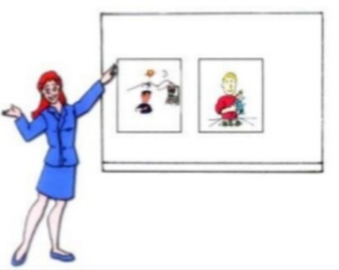
VISUAL AIDS
Use simple fonts, colors and graphs.
Use images and clipart.
3 to 7 bullets per slide.
Don’t over crowd your slides, it will not look professional.
New or different visual aids wake people up.

Slide 27

VOICE
Louder and clear than normal pitch.
Vary pitch and volume.
Over emphasis.

Slide 28

APPEARANCE
Dark colors read as business like.
Wear comfortable shoes to weight your feet evenly.
Allow yourself to move a bit.
Look confident.

Slide 29

STYLE
You already have a style don’t try to copy others.
Use words and sentences you use in normal days.
Be yourself.

Slide 30

QUESTIONS
Sketch an idea that what kind of questions audience may ask.

Slide 31
RULES FOR PREPARATION
Fundamental rules for presentation are :
1. subject for presentation :
(a) decide your message in advance.
(b) have a strong conviction on what you
want to talk.

Slide 32
2. organize your points logically :
(a) what to say at the beginning ?
(b) what you deal in the middle ?
(c) how to close ?
(may be by summarizing entire
presentation.)

Slide 33

3. Rehearse in private :
you need to practice delivery of presentation. Because, “practice makes a person perfect.”

Slide 34
4. keep notes to a minimum :
* if necessary, use index cards.
* jot down the main points.

Slide 35

CONQUER NERVOUSNESS

Slide 36

9 Ps OF HOW TO OVERCOME FEAR OF PUBLIC SPEAKING
Prior & proper
Preparation
Prevent
Poor
Performance of the…
Person
Putting on the…
Presentation

Slide 37

DON’T BE AFRAID
Sometimes an audience may seem intimidating.
But always remember they are also people like you.
Imagine that you are addressing your friends.

Slide 38

Try to conquer nervousness :
Try to minimize your stage-fear.
Take deep breath and try relax.
If required, drink little water.

Slide 39
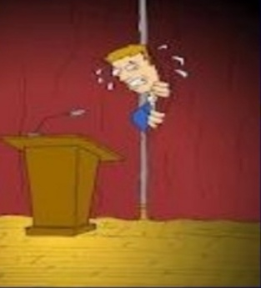
Concentrate on topic & not the audience.
Remember – “ winners continue, losers stop.”

Slide 40
ORGANIZING YOUR DELIVERY GENERAL TIPS
Announce your topic clearly.
Give an outline of your presentation in your introduction.
State your objective upfront.

Slide 41

THE DELIVERY
The eyes
The voice
Expression
The body

Slide 42

ORGANIZING YOUR DELIVERY- THE OPENER
“Tell them what you are going to tell them.”
* Set the tone.
* Capture your
audience’s attention.
* Build rapport.
* Tailor your opener to
your audience.

Slide 43
THE OPENER
1. Introduction :
(a) start with a bang to get attention.
start with an ice-breaker such as a
story , joke or a quotation.

Slide 44

Be warm and friendly
Provide facts & figures
Throw out a question.

Slide 45

ORGANIZING THE DELIVERY (MIDDLE)
“Say it”.
- organize the presentation around main aspects of the subject.

Slide 46
BODY OF PRESENTATION
Cover the subject in logical order.
Repeat important points.
Use visuals wherever possible.
The voice should not be too fast, too high or too slow.

Slide 47

BODY LANGUAGE DURING PRESENTATION
SMILE
Make eye-contact
Do not lock your arms.
Knees unlocked, head up.
Move.
Connect with the audience.
Breathe & relax.

Slide 48

ORGANIZING – THE CLOSE
“Tell them what you have told them”.
*Reiterate the theme.
*Summarize message.
*Repeat key points.
*Ask for action.
*End on a positive
note.

Slide 49
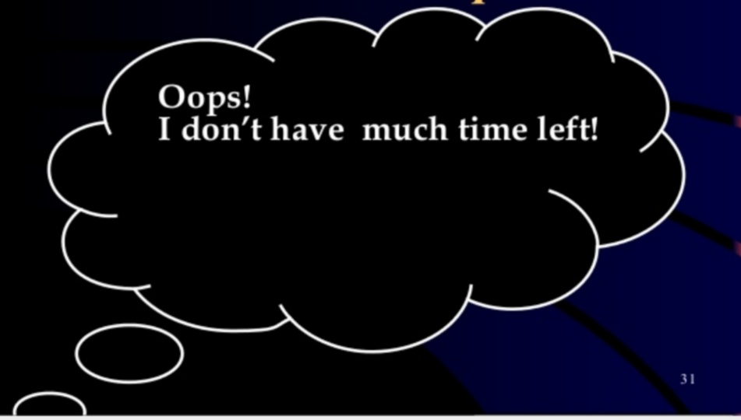
TIME YOURSELF FOR MAXIMUM IMPACT

Slide 50
THE THREE PRESENTATION ESSENTIALS
1.Use visual aids, wherever you can.
2.Rehearse, rehearse, & rehearse
“If you fail to prepare, you are prepared to fail.”
*Rehearse against clock.
3.Memorize your script.

Slide 51
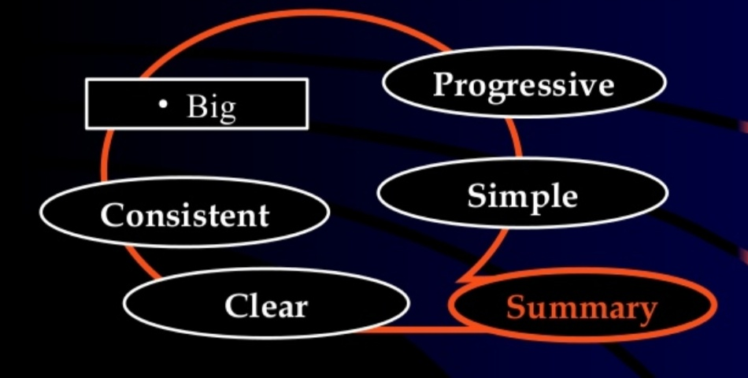
DESIGNING EFFECTIVE POWER POINT PRESENTATION

Slide 52
DESIGN THE “LOOK” OF YOUR PRESENTATION
Follow the “KISS” rule – keep it short and simple.
Use short words and short phrases.
The 6 multiply 7 rules :
- Not more than 7 words per line.
- No more than 6 lines per slide.

Slide 53
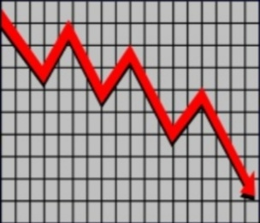
WHY VISUALS ?
Visuals are powerful tools because they :
- increase understanding
- Save time
- Enhance attention
- Help control nervousness

Slide 54

MAKE IT CLEAR
Size implies importance

Slide 55

KEEP IT SIMPLE (PICTURE)
Art work may distract your audience.

Slide 56

MAKE IT BIG (HOW TO ESTIMATE)
Look at it from 2 meters away.

Slide 57
TIPS & TECHNIQUES FOR EFFECTIVE PRESENTATION
Maintain good eye contact.
Vary your speaking volume.
Use pauses
Do not read your presentation
Don’t stand between the audience and the slides
Use stories, questions, clips, example etc.

Slide 58

TIPS ON VISUAL AIDS
Are the visual aids easy to read and easy to understand ?
Can they be easily seen from areas of the room?

Slide 59
SOME FINAL WORDS
Communication is the key
Text to support the communication
Picture to simplify complex concepts
Visuals to support, not to distract

Slide 60

SIGNS TO DETECT THAT AUDIENCE IS NOT LISTENING
Start to look down
Touch or rub the face, hand or hair
Yawn
Fidget
Sigh heavily
Whisper
Tap their feet

Slide 61
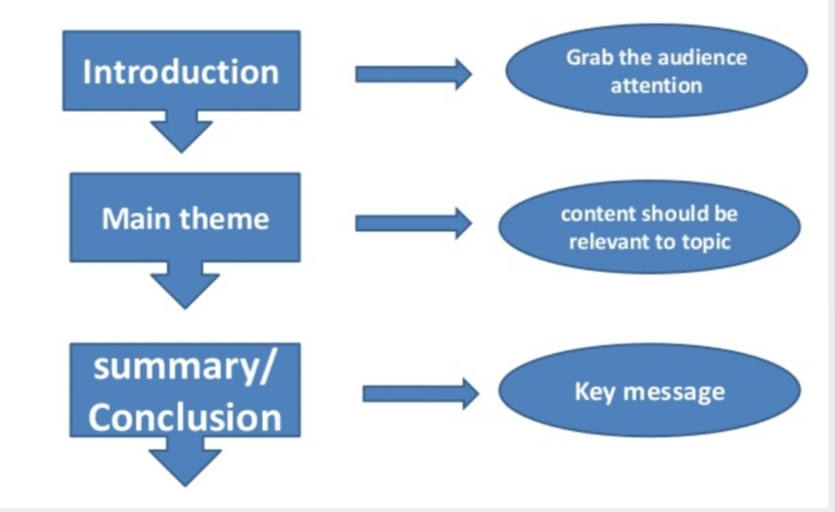
STRUCTURE

Slide 62
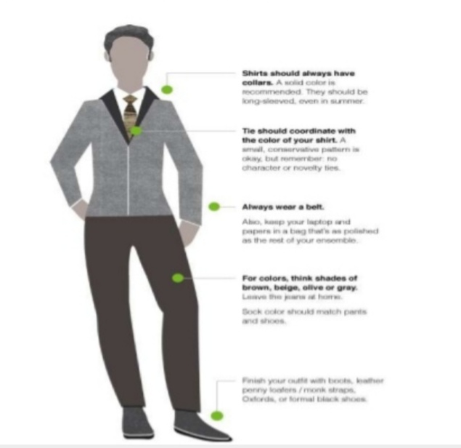
PROFESSIONAL DRESS CODE

Slide 63

PROFESSIONAL VS. NON PROFESSIONALS

Slide 64
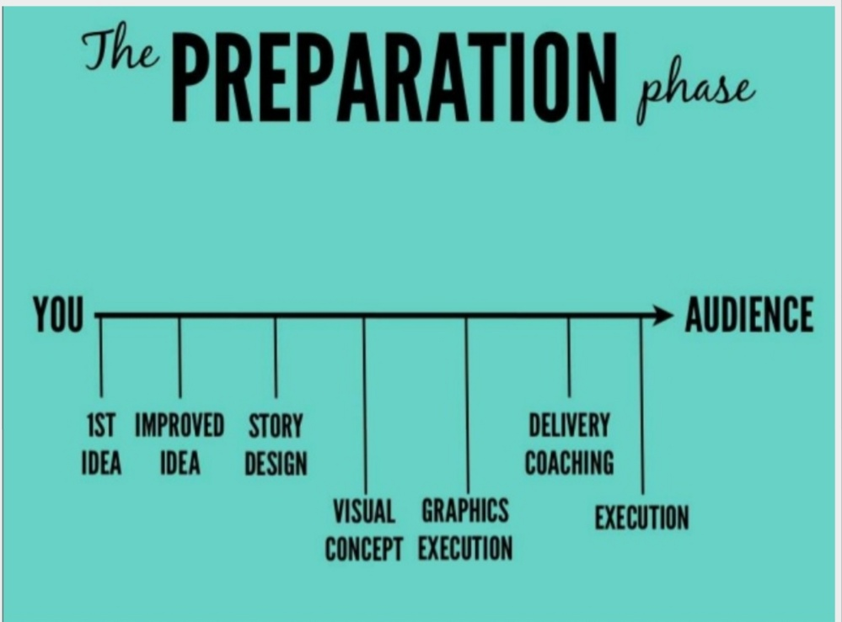

Slide 65

PREPARATION MATERIAL
You can use following items to make the content of your presentation :
*Handouts
*Personal notes
*Internet
*Visual aids

Slide 66

PRACTICE

Slide 67

Rehearse all points what you prepare.
Rehearse with all visual aids and handouts.
Practice again and again to manage time.
Rehearse in front of mirror or a friend.

Slide 68

PRESENT

Slide 69
Make a strong start.
Engage the audience in first 2-3 minutes.
Show your passion through your movements and gestures.
Make an eyes contact.
Don’t forget to smile as well, unless your topic is very grim.

Slide 70
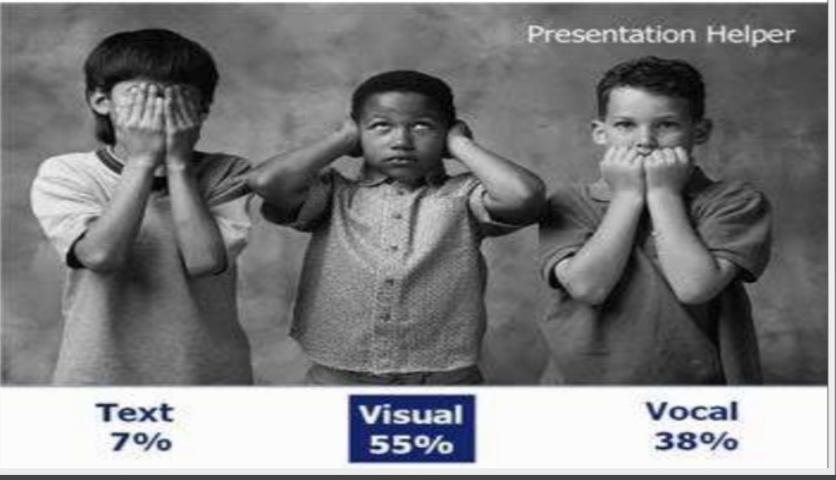
SPEAKER’S IMPACT

Slide 71
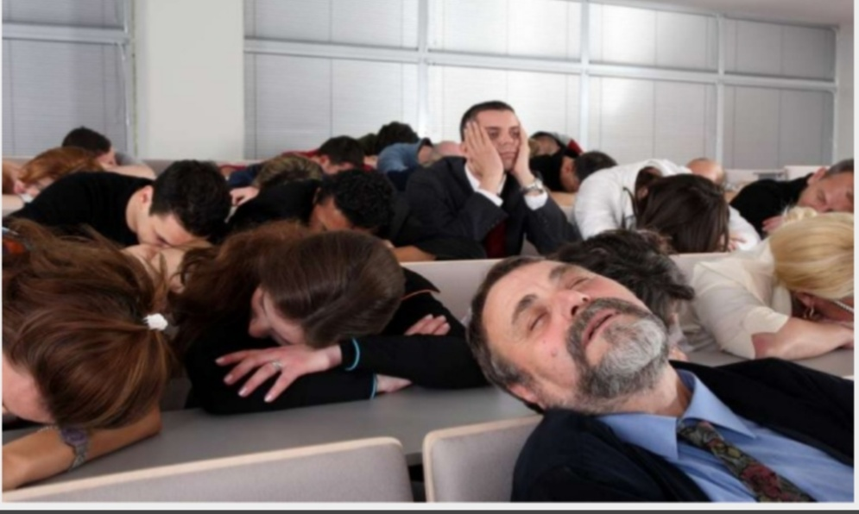
FLAWS IN PRESENTATION

Slide 72
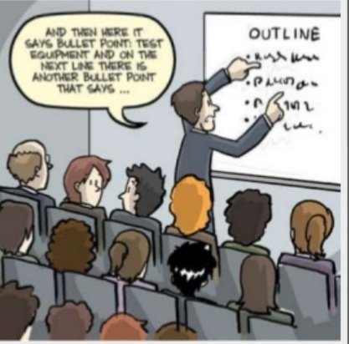
Lack of experience.
Lack of enthusiasm.
Lack of practice.
Lack of confidence.
Hesitation.
Ambiguity in the results that you want to conclude.

Slide 73

FACTORS FOR SUCCESSFUL PRESENTATION

Slide 74

Be over prepared.
Rehearse and practice.
Grip on your subject.
Know your subject.
Be positive.
Avoid stress.

Slide 75

CONCLUSION
Always prepare.
Channelize your fear.
Interact with your audience.

Slide 76
“Make sure you have finished speaking before your audience has finished listening.”
*DOROTHY SARNOFF

Slide 77
REFERENCE
www.google.com.
www. wikipedia.com.

Slide 78
CONTACT DETAILS
EMAIL : dr.kaynattawar@gmail.com

Slide 79
THANK YOU

