Slide 1
SCHOOL OF STUDIES IN COMMERCE VIKRAM UNIVERSITY, UJJAIN (M.P.)

Slide 2
LECTURE BY : DR. KAYNAT TAWAR
THE NEGOTIABLE INSTRUMENT ACT, 1881

Slide 3
RELEVANT TOPICS ON THE NEGOTIABLE INSTRUMENT ACT, 1881 FOR
B.COM (HONS.)
B.B.A. (HONS.)
M.COM.

Slide 4
TOPICS
MEANING
DEFINITION
CHARACTERISTICS OF NEGOTIABLE INSTRUMENT
FORMS OF NEGOTIABLE INSTRUMENT
FEATURES OF A NEGOTIABLE INSTRUMENT
TYPES OF NEGOTIABLE INSTRUMENT
PROMISSORY NOTE
SPECIMEN OF PROMISSORY NOTE
PARTIES TO A PROMISSORY NOTE
ESSENTIALS OF PROMISSORY NOTE
BILL OF EXCHANGE
SPECIAL BENEFITS OF BILL OF EXCHANGE
MECHANICS OF A BILL FINANCING
SPECIMEN OF BILL OF EXCHANGE

Slide 5
PARTIES TO A BILL OF EXCHANGE
ESSENTIALS OF A BILL OF EXCHANGE
TYPES OF BILL OF EXCHANGE
INLAND & FOREIGN BILL
CLASSIFICATION OF BILL OF EXCHANGE
DIFFERENCE BETWEEN BILL OF EXCHANGE AND PROMISSORY NOTE
CHEQUE
DEFINITION
EESENTIAL ELEMENTS OF A CHEQUE
PARTIES TO A CHEQUE
SPECIMEN OF CHEQUE
TYPES OF CROSSING

Slide 6
CROSSING OF CHEQUES
DIFFERENCE BETWEEN BILL OF EXCHANGE AND CHEQUE
NEGOTIATION
MODES OF NEGOTIATION
ENDORSEMENT (SECTION 15)
WHO MAY ENDORSE / NEGOTIATE (SECTION 5)
ESSENTIAL OF A VALID ENDORSEMENT
TYPES / KINDS OF ENDORSEMENT
DISCHARGE OF NEGOTIABLE INSTRUMENT
DISHONOUR OF NEGOTIABLE INSTRUMENT

Slide 7
MEANING
The negotiable instrument act was enacted, in India in 1881. prior to its enactment, the provision of the English negotiable act were applicable in India, and the present act is also based on the English act with certain modifications. It extends to the whole of India except the state of Jammu and Kashmir. The act operates subject to the provisions of section 31 and 32 of the reserve bank of India act,1934.

Slide 8
WHAT IS NEGOTIABLE ?
Negotiable means transferable.
The negotiable that goes on refers to the transfer of the instrument between two people, or from one bank to another, or even from one country to another.
WHAT IS AN INSTRUMENT ?
In the broadest sense, almost any agreed-upon medium of exchange could be considered a negotiable instrument.
In day to day banking, a negotiable instrument usually refers to checks, drafts, bill of exchange, and some types of promissory notes.

Slide 9
DEFINITION
“A negotiable instrument means a promissory note, bill of exchange, or cheque payable either to order or to bearer.”
* ACCORDING TO SECTION 13 (1) OF THE NEGOTIABLE INSTRUMENT
“A negotiable instrument may be made payable to two or more payees jointly, or it may be made payable in the alternative to two or one or some of several payees.”
* ACCORDING TO SECTION 13 (2) OF THE NEGOTIABLE INSTRUMENT

Slide 10
CHARACTERISTICS OF NEGOTIABLE INSTRUMENT
1. FREE TRANSFERABILITY OR EASY NEGOTIABILITY :
Negotiable instrument is freely transferable from one person to another without any formality.
The property (right of ownership) in these instruments passes by either endorsement and delivery (in case it is payable to order) or by delivery merely (in case it is payable to bearer) and no further evidence of transfer is needed.
2.TITLE OF HOLDERS IS FREE FROM ALL DEFECTS :
A person who takes negotiable instrument bona – fide and for value gets the instrument free from all defects in the title. The holder in due course is not affected by defective title of the transferor or of any other party.

Slide 11
3. TRANSFEREE CAN SUE IN HIS OWN NAME WITHOUT GIVING NOTICE TO THE DEBTORS :
A bill ,note or cheque represents a debt, i.e., an “actionable claim” and implies the right of the creditor to recover something from hid debtor.
The creditor can either recover this amount himself or can transfer his right to another person.
In case he transfers his right, the transferee of a negotiable instrument is entitled to sue on the instrument in his own name in case of dishonour, without giving notice to the debtors of the fact that he has become holder.
In case of transfer or assignment of an ordinary “actionable claim” i.e. a book debt evidenced by an entry by the creditor in his account book, under the transfer of property act, notice to the debtor is necessary in order to make the transferee entitled to sue in his own name.

Slide 12
4. PRESUMPTIONS :
Certain presumptions apply to all negotiable instruments.
Section 118 and 119 lay down the following presumption:
(a) For consideration : That every negotiable instrument, was made, drawn, accepted, endorsed or transferred for consideration.
(b) As to date : That every negotiable instrument bearing a date was made or drawn on such date.
(c) As to time of acceptance : That every bill of exchange was accepted within a reasonable time after its date and before its maturity.
(d) As to transfer : That every transfer of a negotiable instrument was made before its maturity.

Slide 13
(e) As to time of endorsements : That the endorsements appearing upon a negotiable instrument were made in the order in which they appear thereon.
(f) As to stamps : That a lost promissory- note, bill of exchange or cheque was duly stamped.
(g) As to a holder in due course : That every holder of a negotiable instrument is holder in due course (this presumption would not arise where it is proved that the holder has obtained the instrument from its lawful owner, or from any person in lawful custody thereof, by means of an offence, fraud or for unlawful consideration and in such a case the holder has to prove that he is a holder in due course.
(h) As to dishonor : That the instrument was dishonored, in case a suit upon a dishonored instrument is filed with the court and the fact of protest is proved.

Slide 14
FORMS OF NEGOTIABLE INSTRUMENT
A negotiable instrument is a written, order promising to pay sum of money.
A document becomes negotiable when it contains an unconditional promise to pay money and is payable to a bearer or payable on demand.

Slide 15
FEATURES OF A NEGOTIABLE INSTRUMENT
It is written document by which certain rights are created and or / transferred to a certain person.
It must be signed by the maker or the drawer as the case may be.
There must exist the unconditional order or promise to pay.
There must be a time mentioned for such payment.
In particular cases, the drawee’s name should be specifically mentioned.

Slide 16
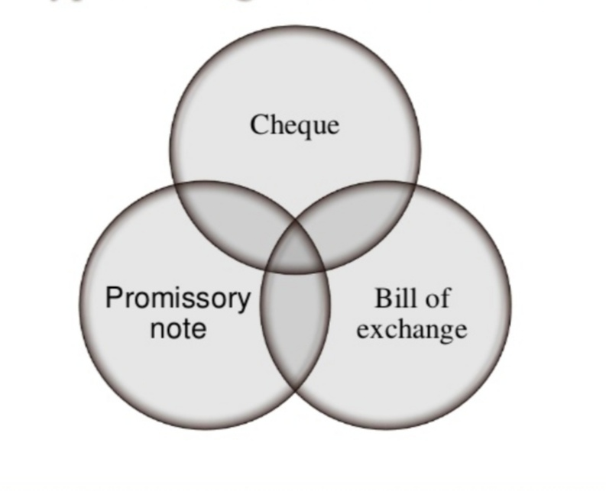
TYPES OF NEGOTIABLE INSTRUMENT

Slide 17
Negotiable instrument are of two types which are as follow :
Negotiable instruments recognized by status : e.g. bills of exchange, cheque and promissory notes.
Negotiable instruments recognized by usage or customs of trade : e.g. bank notes, exchequer bills, share warrants, bearer debentures, dividend warrants, share certificate.

Slide 18
PROMISSORY NOTE
“ A promissory note is an instrument in writing (not being a bank note or a currency note) containing an unconditional undertaking, signed by the maker, to pay a certain sum of money to or to the order of a certain person, or to the bearer of the instruments.”
*ACCORDING TO SECTION 4 OF THE ACT
ILLUSTRATION:
A signs instruments in the following terms:
(a) “I promise to pay B or order Rs. 500.”
(b) “I promise to pay B Rs. 500 which shall be due to him.”
(c) “ I promise to pay B Rs. 500 seven days after my marriage with C.”

Slide 19
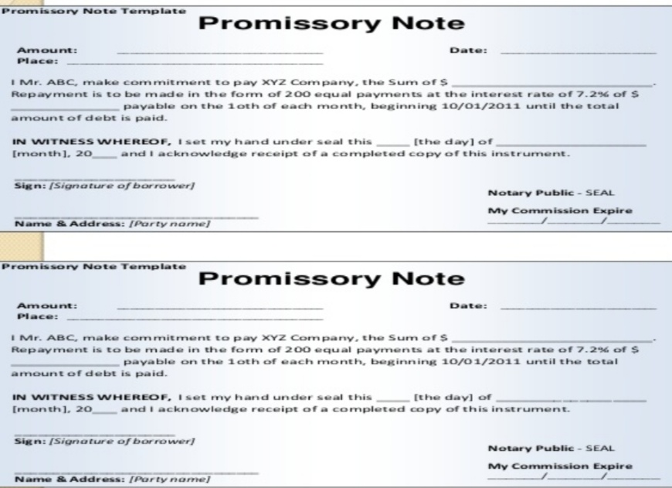
SPECIMEN OF PROMISSORY NOTE

Slide 20
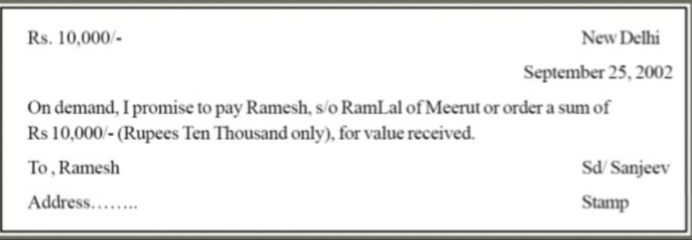
SPECIMEN OF PROMISSORY NOTE

Slide 21
PARTIES TO A PROMISSORY NOTE
There are primarily two parties involved in a promissory note. They are :
(I) THE MAKER OR DRAWER : the person who makes the note and promises to pay the amount stated therein. In the above specimen, Sanjeev is the maker or drawer.
(II) THE PAYEE : the person to whom the amount is payable. In the above specimen it is Ramesh.
* In course of transfer of a promissory note by payee and others, the parties involved may be –
(A) THE ENDORSER – The person who endorses the note in favour of another person. In the above specimen if Ramesh endorses it in favour Ranjan and Ranjan also endorses it in favour of Puneet, then Ramesh and Ranjan both are endorsers.
(B) THE ENDORSEE – The person in whose favour the note is negotiated by endorsement. In the above, it is Ranjan and then Puneet.

Slide 22
ESSENTIALS OF PROMISSORY NOTE
1. IT MUST BE IN WRITING :
A promissory note has to be in writing.
An oral promise to pay dose not become a promissory note.
The writing may be on any paper or book.
ILLUSTRATIONS:
A signs the instruments in the following terms:
“I promise to pay B or order Rs. 500.”
“I acknowledge myself to be indebted to B in Rs. 1000 to be paid on demand, for value received.”
Both the above instruments are valid promissory notes.

Slide 23
2. IT MUST CONTAIN A PROMISE OR UNDERTAKING TO PAY :
There must be a promise or an undertaking to pay.
The undertaking to pay may be gathered either from express words or by necessary implication.
A mere acknowledgement of indebtedness is not a promissory note, although it is valid as an agreement and may be sued upon as such.
ILLUSTRATION :
A signs the instruments in the following terms :
“Mr. B, I owe you Rs. 1000.”
“I am liable to pay to B Rs. 500.”
The above instruments are not promissory notes as there is no undertaking or promise to pay. There is only an acknowledgement of indebtedness.
Where A signs the instrument in the following terms:
“ I acknowledge myself to be indebted to B in Rs. 1000, to be paid on demand, for value received.” there is a valid promissory note.

Slide 24
3. THE PROMISE TO PAY MUST BE UNCONDITIONAL :
A promissory note must contain an unconditional promise to pay.
The promise to pay must not depend upon the happening of some uncertain event, i.e., a contingency or the fulfillment of a condition.
ILLUSTRATION:
A signs the instruments in the following terms :
“I promise to pay B Rs.500 seven days after my marriage with C.”
“I promise to pay B Rs. 500 as soon as I can.”
The above instruments are not valid promissory notes as the payment is made depending upon the happening of an uncertain event which may never happen and as a result the sum may never become payable.

Slide 25
4. IT MUST BE SIGNED BY THE MAKER :
It is important that the promissory note should be duly authenticated by the ‘signature’ of the maker.
‘signature’ means the writing or otherwise affixing a person’s name or a mark to represent his name , by himself or by his authority with the intention of authenticating a document.

Slide 26
5. THE MAKER MUST BE A CERTAIN PERSON :
The instrument must itself indicate with certainty who is the person or are the persons engaging himself or themselves to pay.
Alternative promisors are not permitted in law because of the general rule that “where liability lies no ambiguity must lie.”

Slide 27
6. THE PAYEE MUST BE CERTAIN :
Like the maker the payee of a pronote must also be certain on the face of the instrument.
A note in favour of fictitious person is illegal and void.
A pronote made payable to the maker himself is a nullity, the reason being the same person is both the promisor and the promisee.

Slide 28
7. THE SUM PAYABLE MUST BE CERTAIN :
For a valid pronote it is also essential that the sum of money promised to be payable must be certain and definite.
The amount payable must not be capable of contingent additions or subtractions.
ILLUSTRATION:
A signs the instruments in the following terms:
“I promise to pay B Rs. 500 and all other sums which shall be due to him.”
“I promise to pay B Rs. 500, first deducting there out any money which he may owe me.”
The above instruments are invalid as promissory notes because the exact amount to be paid by A is not certain.

Slide 29
8.THE AMOUNT PAYABLE MUST BE IN LEGAL TENDER MONEY OF INDIA :
A document containing a promise to pay a certain amount of foreign money or to deliver a certain quantity of goods is not a pronote.

Slide 30
BILL OF EXCHANGE
“A bill of exchange is an instrument in writing containing an unconditional order, signed by the maker, directing a certain person to pay a certain sum of money only to, or the order of, a certain person or to the bearer of the instrument.”
* SECTION 5 OF THE NEGOTIABLE INSTRUMENT ACT
ILLUSTRATION:
Mr. X purchases goods from Mr. Y for Rs. 1000 .
Mr. Y buys goods from Mr. S for Rs. 1000.
Then Mr. Y may order Mr. X to pay Rs. 1000 /- Mr. S which will be nothing but a bill of exchange.

Slide 31
SPECIAL BENEFITS OF BILL OF EXCHANGE
A bill of exchange is a double secured instrument.
In case of immediate requirement, a bill may be discounted with a bank.

Slide 32
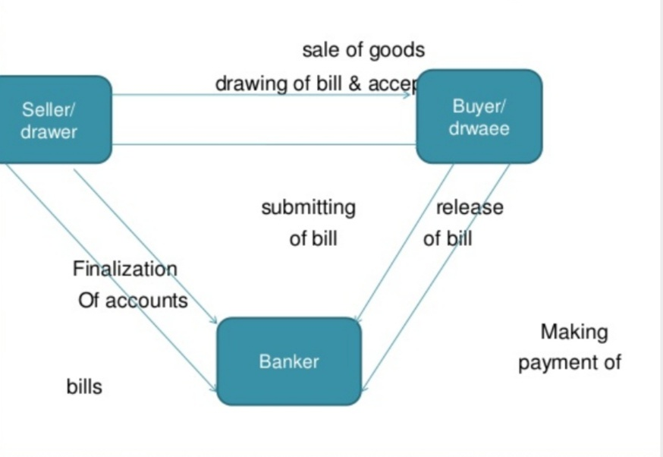
MECHANICS OF A BILL FINANCING

Slide 33
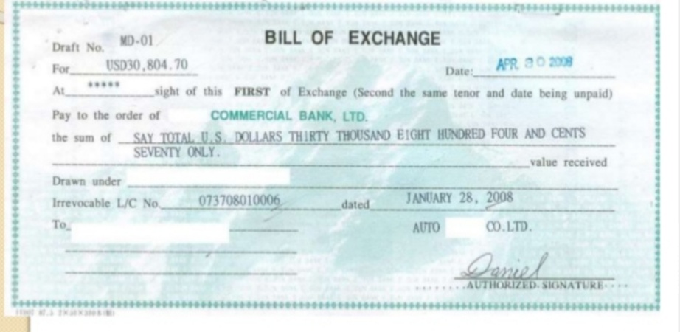
SPECIMEN OF BILL OF EXCHANGE

Slide 34
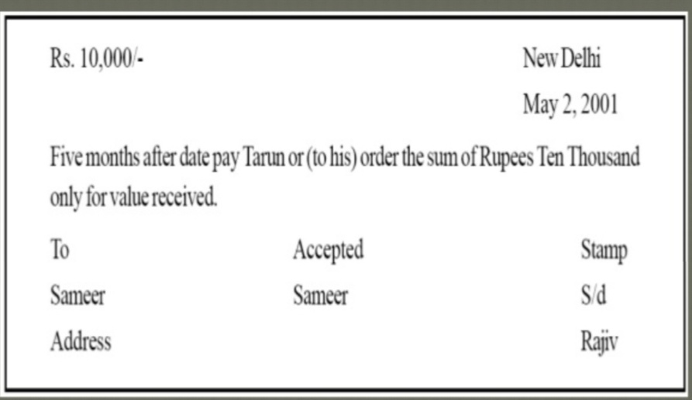
SPECIMEN OF BILL OF EXCHANGE

Slide 35
PARTIES TO A BILL OF EXCHANGE
There are three parties involved in a bill of exchange :
(I) THE DRAWER : The person who makes the order for making payment . In the above specimen, Rajiv is the drawer.
(II) THE DRAWEE : The person to whom the order to pay is made. He is generally a debtor of the drawer. It is Sameer in this case.
(II) THE PAYEE : The person to whom the payment is to be made. In this case it is Tarun.
The drawer can also draw a bill in his own name thereby he himself becomes the payee. Here the words in the bill would be pay to us or order.
In a bill where a time period is mentioned, just like the above specimen, is called a time bill.
But a bill may be made payable on demand also. This is called a demand bill.

Slide 36
ESSENTIALS OF A BILL OF EXCHANGE
It must be in writing.
It must contain an order to pay. A mere request to pay on account, will not amount to an order.
The order to pay must be unconditional.
It must be signed by the drawer.
The drawer, drawee and payee must be certain. A bill cannot be drawn on two or more drawees but may be made payable in the alternative to one of two or more payees.
The sum payable must be certain.
The bill must contain an order to pay money only.
It must comply with the formalities as regards date, consideration, stamps etc.

Slide 37
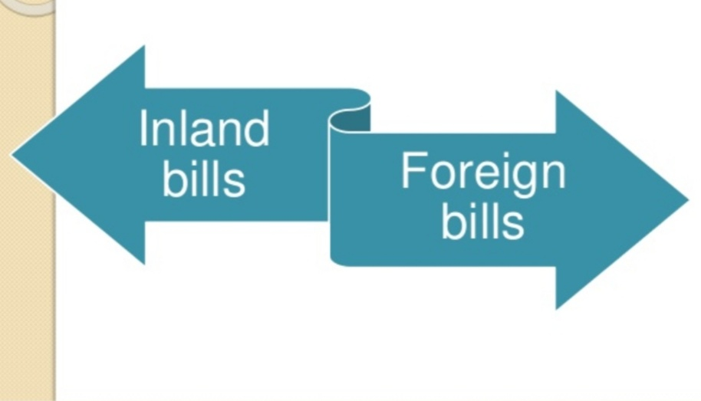
TYPES OF BILL OF EXCHANGE

Slide 38
INLAND & FOREIGN BILL
INLAND BILL :
It is drawn in India on a person residing in India, whether payable in or outside India,
OR
It is drawn in India on person residing outside India but payable in India.
The following are the inland bills:
A bill is drawn by a merchant in Delhi on a merchant in Chennai. It is payable in Mumbai the bill is an inland bill.
A bill is drawn by a Delhi merchant on a person in London but made payable in.

Slide 39
FOREIGN BILL:
A bill drawn outside India & made payable in India.
A bill drawn outside India on any person residing outside India.
A bill drawn in India on a person residing outside India and made payable outside india.

Slide 40
CLASSIFICATION OF BILL OF EXCHANGE
* INLAND AND FOREIGN BILL (SECTION 11 AND 12)
INLAND BILL:
It is drawn in India on a person residing in India whether payable in or outside India ; or
It is drawn in India on a person residing outside India but payable in India.
FOREIGN BILL:
A bill drawn in India on a person residing outside India and made payable outside India.
Draw upon a person who is the resident of a foreign country.

Slide 41
* TIME AND DEMAND BILLS :
TIME BILL :
A payable after a fixed time is termed as a time bill. A bill payable “after date” is a time bill.
DEMAND BILL :
A bill payable at sight or on demand is termed as a demand bill.
* TRADE AND ACCOMMODATION BILLS :
TRADE BILL
A bill drawn and accepted for a genuine trade transaction is termed as “trade bill.”
ACCOMMODATION BILL :
A bill drawn and accepted not for a genuine trade transaction but only to provide financial help to same party to same party is termed as an “accommodation bill.”

Slide 42
DIFFERENCE BETWEEN BILL OF EXCHANGE AND PROMISSORY NOTE
BILL OF EXCHANGE | PROMISSORY NOTE
NUMBER OF PARTIES
There are three parties – drawer, drawee and payee. | There are two parties – maker and payee.
PROMISE / ORDER
It contains an unconditional order. | It contains an unconditional promise given by a debtor to a creditor.
NATURE OF LIABILITY
It requires acceptance to become a valuable instrument. | It does not require any acceptance since it is a valuable instrument right from the beginning.

Slide 43
DIFFERENCE BETWEEN BILL OF EXCHANGE AND PROMISSORY NOTE
BILL OF EXCHANGE | PROMISSORY NOTE
SAME IDENTITY OF PAYER AND PAYEE
The drawer and payee may be the same person. | The maker and payee cannot be the same person
PAYABLE TO BEARER
It can be payable to bearer. It cannot be drawn as payable to bearer on demand. | It cannot be payable to bearer.
PROTEST FOR DISHONOUR
It requires the protesting for dishonour. | It does not require any protesting.

Slide 44
DIFFERENCE BETWEEN BILL OF EXCHANGE AND PROMISSORY NOTE
BILL OF EXCHANGE | PROMISSORY NOTE
NOTICE OF DISHONOUR
Notice of dishonour must be given to all persons (including drawer) liable to pay. | Such notice is not required to be given to the maker.

Slide 45
CHEQUE
A cheque is the means by which a person who has fund in the hand of a bank withdraws the same or same part of it.
A cheque is a kind of bill of exchange but it has additional qualification namely :
It is always drawn on specified banker.
It is always payable on demand without any days of grace.

Slide 46
DEFINITION
A Cheque is a bill of exchange drawn on a specified banker and not expressed to be payable otherwise than on demand.” a Cheque is also, therefore, a bill of exchange with two additional qualification.
It is always drawn on a specified bankers.
It is always payable on demand.
* ACCORDING TO SECTION 6 OF THE ACT

Slide 47
EESENTIAL ELEMENTS OF A CHEQUE
In writing
Express order to pay
Definite and unconditional order
Signed by the drawer
Order to pay certain sum
Order to pay money only
Certain three parties
Drawn upon a specified banker
Payable on demand

Slide 48
PARTIES TO A CHEQUE
DRAWER :
Drawer is the person who draws the cheque.
DRAWEE / BANKER :
Drawee is the drawer’s banker on whom the cheque has been drawn.
PAYEE :
Payee is the person who is entitled to receive the payment of a cheque.

Slide 49
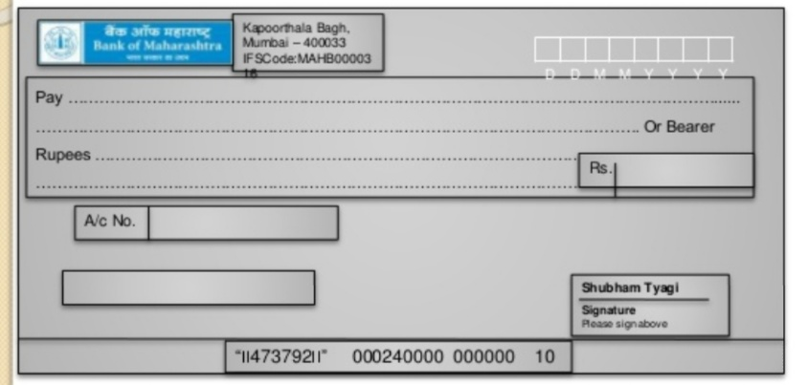
SPECIMEN OF CHEQUE

Slide 50
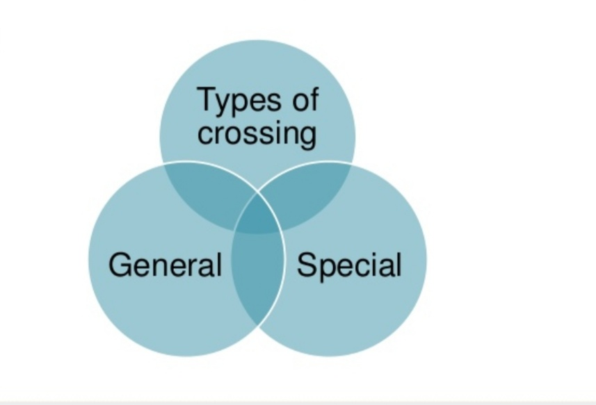
TYPES OF CROSSING

Slide 51
CROSSING OF CHEQUES
It is a direction given by the customer to the banker that payment should not be made across the counter.
Crossing is effected by drawing two parallel transverse lines with or without particular abbreviations.
A cheque that is not crossed is an open cheque.
It serves as a measure of safety against theft or loss of cheques in transit.

Slide 52
TYPES OF CROSSING
General Crossing
Special Crossing
Not negotiable Crossing
Restrictive Crossing

Slide 53
DIFFERENCE BETWEEN BILL OF EXCHANGE AND CHEQUE
BILL OF EXCHANGE | CHEQUES
PERSON / FIRM
A bill of exchange usually drawn on some person or firm. | A cheque is always drawn on bank.
ACCEPTANCE
It is essential that a bill of exchange must be accepted before its payment can be claimed. | A cheque dose not require any such acceptance.
PAYABLE ON DEMAND
The B.O.E may be drawn payable on demand. | A cheque can only be drawn payable on demand.

Slide 54
DIFFERENCE BETWEEN BILL OF EXCHANGE AND CHEQUE
BILL OF EXCHANGE | CHEQUES
CROSSING
No crossing of bills of exchange. | A cheque may be crossed.
GRACE OF DAYS
Three days are allowed in case of B.O.E. | In case cheque no grace of days are allowed.
NOTICE OF DISHONOUR
It is necessary in B.O.E. | No such notice is required.

Slide 55
DIFFERENCE BETWEEN BILL OF EXCHANGE AND CHEQUE
BILL OF EXCHANGE | CHEQUES
STAMP
It must be properly stamped | No stamp is required.

Slide 56
NEGOTIATION
ACCORDING TO SECTION 14 OF THE ACT :
“When a promissory note, bill of exchange or cheque is transferred to any person so as to constitute that person the holder thereof, the instrument is said to be negotiated.” The main purpose and essence of negotiation is to make the transferee of a promissory note, a bill of exchange or cheque the holder there of.
Negotiation thus requires two conditions to be fulfilled, named :
There must be a transfer of the instrument to another person.
The transfer must be made in such a manner as to constitute the transferee the holder of the instrument.

Slide 57
MODES OF NEGOTIATION
NEGOTIATION BY DELIVERY (SEC.47) :
Where a promissory note or a bill of exchange or a cheque is payable to a bearer, it may be negotiated by delivery thereof. Example : A the holder of a negotiable instrument payable to bearer, delivers it to B’s agent to keep it for B. the instrument has been negotiated.
NEGOTIATION BY ENDORSEMENT AND DELIVERY (SEC. 48) :
A promissory note, a cheque or a bill of exchange payable to order can be negotiated only be endorsement and delivery. Unless the holder signs his endorsement on the instrument and delivers it , the transferee dose not become a holder. If there are more payees than one, all must endorse it.

Slide 58
ENDORSEMENT (SECTION 15)
The word ‘endorsement’ in its literal sense means, writing on the back of an instrument. But under the negotiable instruments act it means, the writing of one’s name on the back of the instrument or any paper attached to it with the intention of transferring the rights therein. Thus, endorsement is signing a negotiable instrument for the purpose of negotiation. The person who effects an endorsement is called an ‘endorser’ and the person to whom negotiable instrument is transferred by endorsement is called the ‘endorsee.’

Slide 59
WHO MAY ENDORSE / NEGOTIATE (SECTION 5)
Every sole maker, drawer, payee or endorsee, or all of several joint makers, drawers, payees or endorsee of a negotiable instrument may endorse and negotiate the same if the negotiability of such instrument has been restricted or excluded as mentioned in section 50.

Slide 60
ESSENTIAL OF A VALID ENDORSEMENT
It must be on the back of instrument or on a slip of paper annexed thereto.
It must be signed by the endorser.
It must be completed by the delivery of the instrument.
It must be made by the holder of the instrument.

Slide 61
TYPES / KINDS OF ENDORSEMENT
Blank or general endorsement.
Full or special endorsement.
Partial endorsement.
Restrictive endorsement.
Conditional endorsement.

Slide 62
DISCHARGE OF NEGOTIABLE INSTRUMENT
“Discharge means release from obligation.”
By payment.
By express waiver.
By cancellation.
By material alteration or lapse of time.

Slide 63
DISHONOUR OF NEGOTIABLE INSTRUMENT
It may be by non acceptance or non payment.
A bill of exchange can be dishonoured by non acceptance in the following ways :
Does not accept 48 hours from the time of presentment.
Drawee is fictitious person.
Drawee has become insolvent or dead.
Drawee is incompetent.

Slide 64
REFERENCE
www.google.com.
www. wikipedia.com.
www.studymafia.org

Slide 65
CONTACT DETAILS
EMAIL : dr.kaynattawar@gmail.com

Slide 66
THANK YOU

