Slide 1
GLOBAL WARMING
Presented by
Dr.Anubha Gupta
Faculty , S.S. in Commerce Vikram University
Useful for BBA(H)/B.COM(H)/M.COM and allied subject

Slide 2
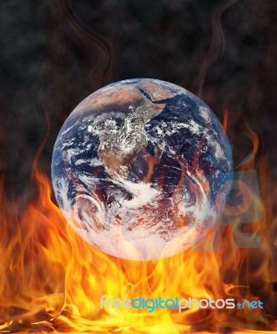

Slide 3
GLOBAL WARMING
Scientists attribute the global warming trend observed since the mid-20th century to the human expansion of the "greenhouse effect" — warming that results when the atmosphere traps heat radiating from Earth toward space.
Certain gases in the atmosphere block heat from escaping. Long-lived gases that remain semi-permanently in the atmosphere and do not respond physically or chemically to changes in temperature are described as "forcing" climate change. Gases, such as water vapor, which respond physically or chemically to changes in temperature are seen as "feedbacks.

Slide 4
GREENHOUSE EFFECT
Life on Earth depends on energy coming from the Sun. About half the light reaching Earth's atmosphere passes through the air and clouds to the surface, where it is absorbed and then radiated upward in the form of infrared heat.About 90 percent of this heat is then absorbed by the greenhouse gases and radiated back toward the surface.
The greenhouse effect is a process that occurs when gases in Earth's atmosphere trap the Sun's heat. This process makes Earth much warmer than it would be without an atmosphere. The greenhouse effect is one of the things that makes Earth a comfortable place to live.

Slide 5
Gases that Contribute to The Greenhouse Effect
Water vapor. The most abundant greenhouse gas, but importantly, it acts as a feedback to the climate. Water vapor increases as the Earth's atmosphere warms, but so does the possibility of clouds and precipitation, making these some of the most important feedback mechanisms to the greenhouse effect.

Slide 6
Gases that Contribute to The Greenhouse Effect
Methane. A hydrocarbon gas produced both through natural sources and human activities, including the decomposition of wastes in landfills, agriculture, and especially rice cultivation, as well as ruminant digestion and manure management associated with domestic livestock. On a molecule-for-molecule basis, methane is a far more active greenhouse gas than carbon dioxide, but also one which is much less abundant in the atmosphere.

Slide 7
Gases that Contribute to The Greenhouse Effect
Nitrous oxide. A powerful greenhouse gas produced by soil cultivation practices, especially the use of commercial and organic fertilizers, fossil fuel combustion, nitric acid production, and biomass burning.

Slide 8
Gases that Contribute to The Greenhouse Effect
Chlorofluorocarbons (CFCs). Synthetic compounds entirely of industrial origin used in a number of applications, but now largely regulated in production and release to the atmosphere by international agreement for their ability to contribute to destruction of the ozone layer.

Slide 9
Gases that Contribute to The Greenhouse Effect
Global warming occurs when carbon dioxide (CO2) and other air pollutants and greenhouse gases collect in the atmosphere and absorb sunlight and solar radiation that have bounced off the earth’s surface. Normally, this radiation would escape into space—but these pollutants, which can last for years to centuries in the atmosphere, trap the heat and cause the planet to get hotter. That's what's known as the greenhouse effect.

Slide 10
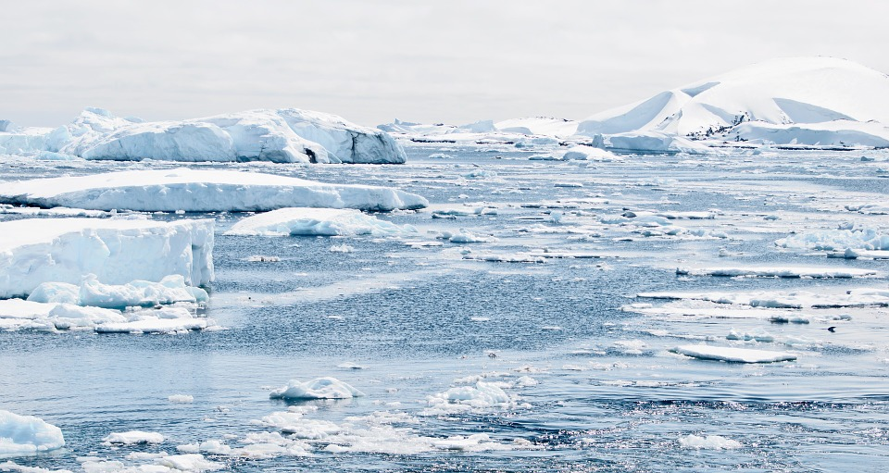
EFFECT OF GLOBAL WARMING
Increase in average temperatures and temperature extremes
More Droughts and Heat Waves & water shortages
Changes in Precipitation Patterns
Hurricanes Will Become Stronger and More Intense
Melting glaciers & early snowmelt
Sea Level Will Rise 1-4 feet by 2100
Arctic Likely to Become Ice-Free
Extreme weather events
Ocean Acidification
damage agriculture and fisheries

Slide 11
The Influences of Human Activity on Climate
Human activities are changing Earth's natural greenhouse effect. Burning fossil fuels like coal and oil puts more carbon dioxide into our atmosphere.
NASA has observed increases in the amount of carbon dioxide and some other greenhouse gases in our atmosphere. Too much of these greenhouse gases can cause Earth's atmosphere to trap more and more heat. This causes Earth to warm up.

Slide 12
References
https://www.nrdc.org/stories/global-warming-101
https://climate.nasa.gov/causes
https://www.nationalgeographic.com/environment
https://www.britannica.com/science/global-warming
https://climatekids.nasa.gov/greenhouse-effect

Slide 13
.
THANK YOU

