Slide 1
M.Sc. 2nd Semester Microbiology (CBCS)
MICROBIAL TECHNOLOGY
Scope of
Bioinformatics
Dr. Alka Vyas
Professor & Head
S. S. in Microbiology
VU, Ujjain

Slide 2
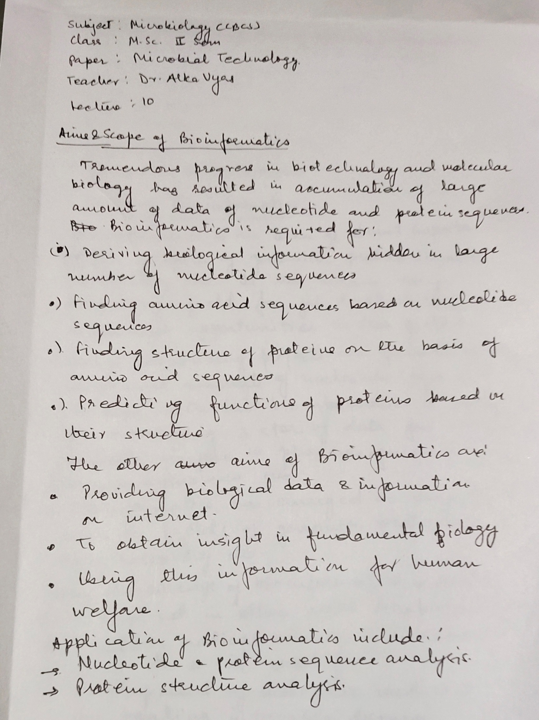

Slide 3
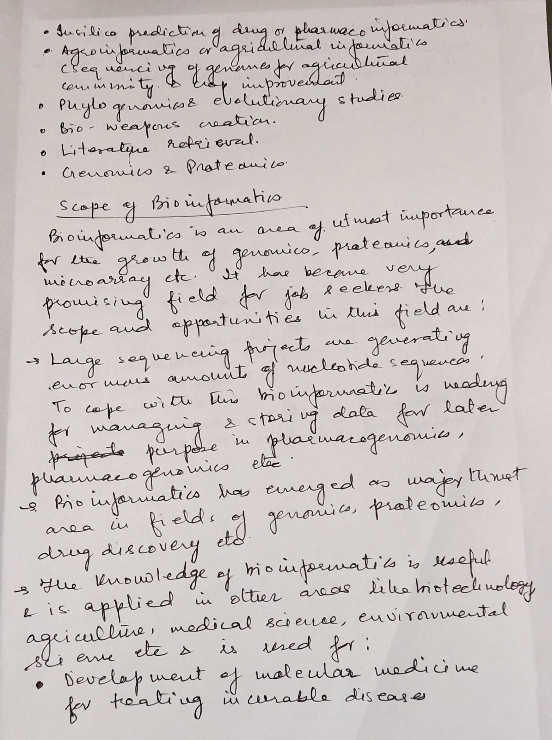

Slide 5
Stay At Home
And
Secure Your Life
Wish You
All
The BEst

