Slide 1
M.Sc. 2nd Semester Microbiology (CBCS)
MOLECULAR BIOLOGY
Adhesion and Nuclear
Receptors
Dr. Alka Vyas
Professor & Head
S. S. in Microbiology
VU, Ujjain

Slide 2
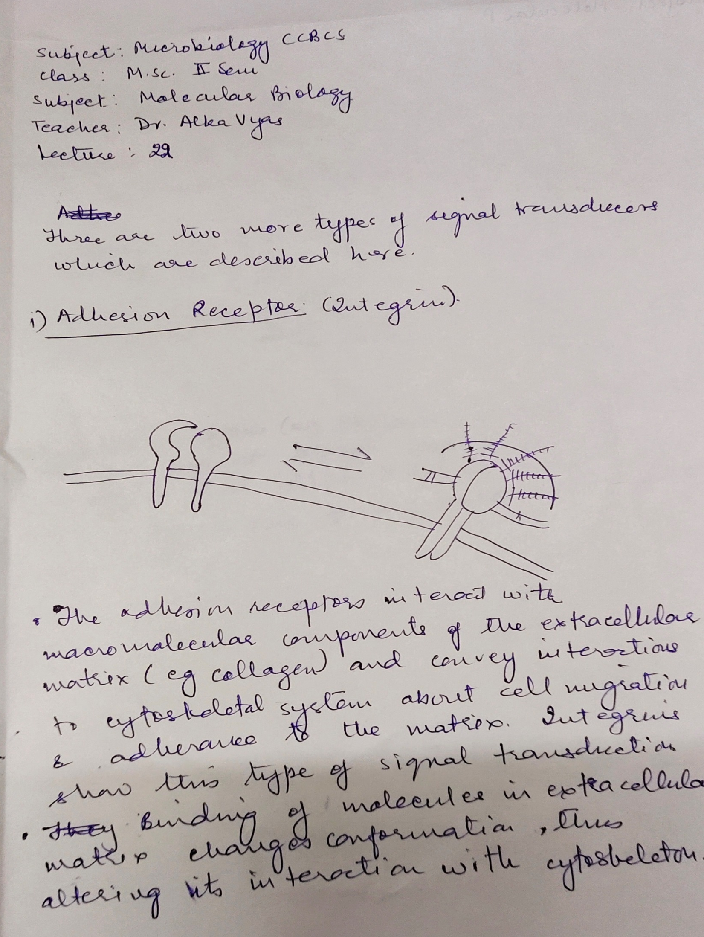

Slide 3
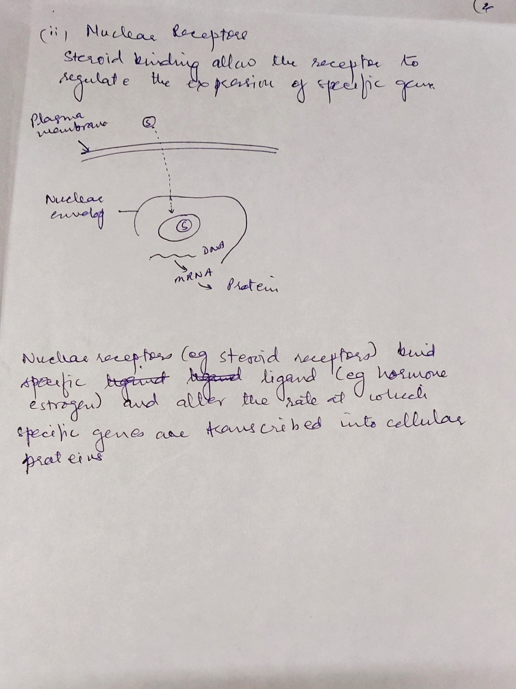

Slide 4
Stay At Home
And
Secure Your Life
Wish You
All
The BEst

