Slide 1
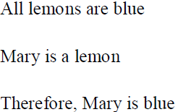
ARTIFICIAL INTELLIGENCE

Slide 2
to be valid if its conclusion is true in cases where its premises are also true. Hence, a valid set of statements such as the ones above can give a false conclusion, provided one or more of the premises are also false.
We can say: a piece of reasoning is valid if it leads to a true conclusion in every situation where the premises are true.
Logic is concerned with truth values. The possible truth values are true and false.These can be considered to be the fundamental units of logic, and almost all logic is ultimately concerned with these truth values.

Slide 4
Logical Operators

Slide 5
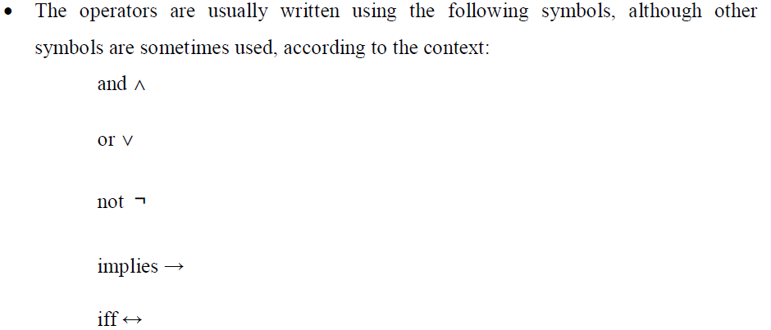
Logical operator contd..

Slide 6
