Slide 1
X-ray Fluorescence Spectroscopy
Dr. (Mrs)Uma Sharma
Professor
School of Studies in Chemistry & Biochemistry,
Vikram University,
UJJAIN (M.P.)
S.S. IN CHEMISTRY & BIOCHEMISTRY

Slide 2
Based on the properties of X-rays, a number of analytical methodologies have been developed over the years. These include:
X-ray emission spectroscopy (XES)
Auger emission spectroscopy (AES)
X-ray fluorescence spectroscopy (XFS)
Electron spectroscopy (ESCA)
X-ray absorption
X-ray diffraction
S.S. IN CHEMISTRY & BIOCHEMISTRY

Slide 3
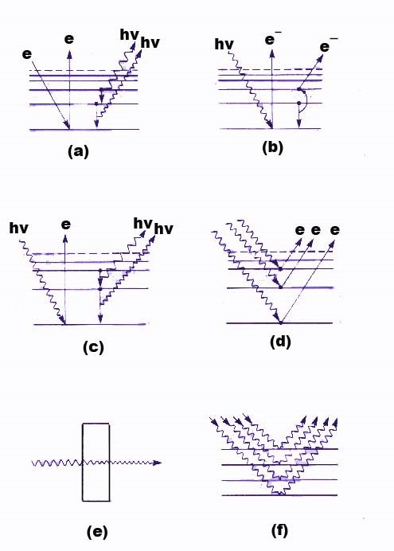
X-RAY ANALYTICAL METHODS
X-ray emission
Auger emission
X-ray fluorescence
Electron Spectroscopy
X-ray absorption
X-ray diffraction
S.S. IN CHEMISTRY & BIOCHEMISTRY

Slide 4
X-Ray line spectra result from electronic transitions in the innermost atomic orbitals. They occur in the longer wavelength range of 4-6 A. The line spectra occur for all the elements having atomic number of 12 and above. Elements having atomic number less than 23 show only tow lines called as K series and designated as K_{α} and K_{β} . These are of short wavelengths, for example K series for tungsten target appear at 0.18 and 0.21 A.
Elements having atomic numbers more than 23 show L series which are also designated as α1, β1. There is a threshold voltage for each element below which line spectra do not appear. For example, below 50kV, no line spectra is obtained for molybdenum. However above 70kV it produces line spectra.
S.S. IN CHEMISTRY & BIOCHEMISTRY

Slide 5
SECONDARY FLUORESCENCE SOURCES
In some applications an X-ray tube with tungsten target is used to excite Kα and Kβ lines. The resulting fluorescence spectrum would contain only line spectra which can be used for the excitation of the specific analyte.
S.S. IN CHEMISTRY & BIOCHEMISTRY

Slide 6
X-RAY EMISSION LINES FOR SOME TYPICAL ELEMENTS
Element | Atomic Number | K-Series |  | L-Series
 |  | α₁ | β₁ | α₁ | β₁
Na | 11 | 11.909 | 11.617 | - | -
K | 19 | 3.742 | 3.454 | - | -
Cr | 24 | 2.290 | 2.085 | 21.714 | 21.323
Rb | 37 | 0.926 | 0.829 | 7.318 | 7.075
Cs | 55 | 0.401 | 0.355 | 2.892 | 2.683
W | 74 | 0.209 | 0.184 | 1.476 | 1.282
U | 92 | 0.126 | 0.111 | 0.911 | 0.720
S.S. IN CHEMISTRY & BIOCHEMISTRY

Slide 7
Important Features of XRF Technique.
1.Thus XRF is a powerful tool for the qualitative (pass fail test) and quantitative estimation of all but the lightest elements having atomic numbers greater than that of oxygen (>8).
2. XRF is a non destructive technique as against most of the other elemental techniques.
3.There are two types of X-ray fluorescence spectrometers : wavelength dispersive X-ray fluorescence (WEXRF) and energy dispersive X-ray fluorescence (EDXRF) spectrometers.
4. Important instrument components of XRF include a source, a transducer, a signal processor and read out.
S.S. IN CHEMISTRY & BIOCHEMISTRY

Slide 8
X-RAY FLUORESCENCE METHODS
As explained earlier there are two types of XRF instruments: Wavelength dispersive (WDXRF) and energy dispersive (EDXRF).
In WDXRF an X-ray beam from a radioactive source is collinated and dispersed into its component wavelengths. Both single channel (sequential) or multichannel (simultaneous) detection systems are employed.
S.S. IN CHEMISTRY & BIOCHEMISTRY

Slide 9
ENERGY DISPERSIVE XRF
(EDXRF)
EDXRF has a polychromatic source such as an X-ray source or a radioactive material, a sample holder, a semiconductor detectors and various electronic components for energy discrimination.
The analytical methodology is very simple. There are no moving parts and no collimators or crystal diffractor. Therefore the energy reaching the detector is 100 times more than WDXRF instruments.
Hence low power X-ray tubes or weaker radioactive materials can be used as radiation sources which are cost effective
S.S. IN CHEMISTRY & BIOCHEMISTRY

Slide 10
EDXRF plots energy vs intensity (cps). The energy is in keV. Quantitative analysis can be obtained by measuring the peak heights. A rough estimate of the concentration can be obtained by,
P_{x} = P_{s} , W_{x}
Where P_{x} is the relative line intensity measured in terms of number of counts per fixed time, W_{x} is the weight fraction of the desired element in the sample and P_{s} is the relative intensity of the line under identical conditions if W_{x} were unity. The value of P_{s} is determined with a standard sample of known composition or pure element.
S.S. IN CHEMISTRY & BIOCHEMISTRY

Slide 11
INSTRUMENTATION FOR XRF
X-ray Source
Detector
Electronics
Computer
X-rays
Sample
X-ray Source
Analyzing
Crystal
X-rays
Focusing
Sample
Detector
Electronics
Computer
S.S. IN CHEMISTRY & BIOCHEMISTRY

Slide 12
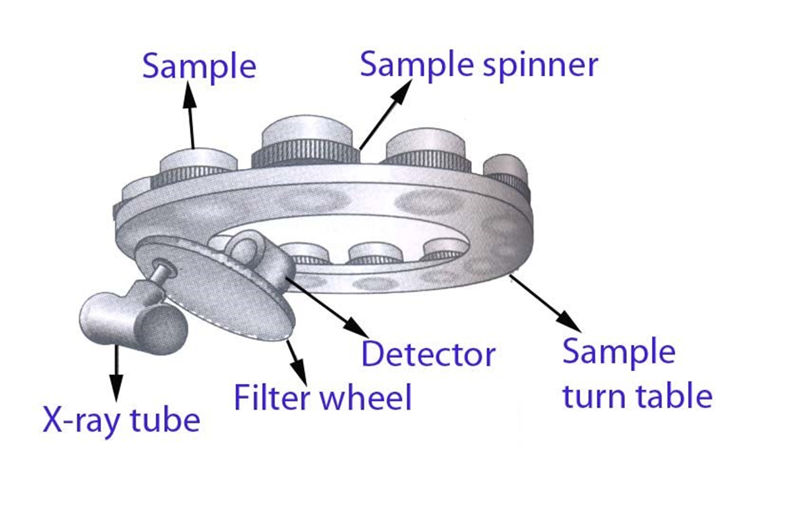
A BENCH TOP XRF MODEL
S.S. IN CHEMISTRY & BIOCHEMISTRY

Slide 13
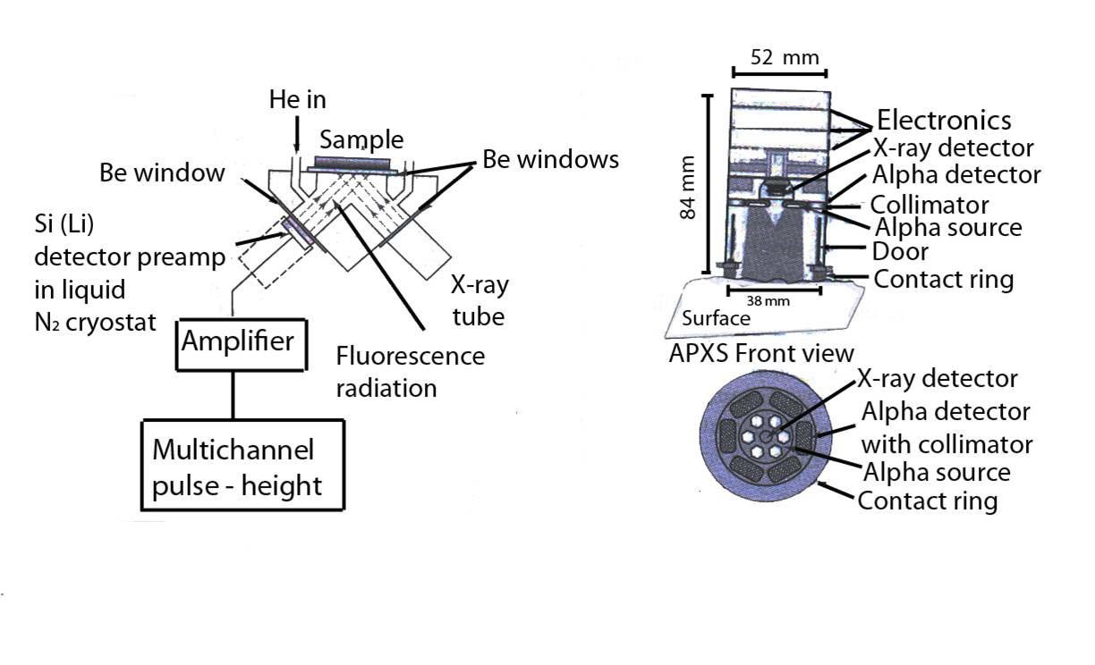
(a) Schematic design of EDXRF
(b) Mars Mission Rover head
S.S. IN CHEMISTRY & BIOCHEMISTRY

Slide 14
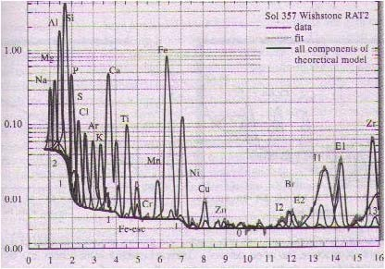
XRF Determination of Martian Rocks
Intensity counts per second
Energy, keV
S.S. IN CHEMISTRY & BIOCHEMISTRY

Slide 15
APPLICATIONS
When X-ray absorption and enhancement effects are minimal, the XRF line intensity and element concentration curves are linear. NIST standards provide such materials which can be used to calibrate the instruments. Typical application include :
Analysis of rock samples for 22 elements.
Alloy composition control during manufacture.
Lead and bromine, in aviation fuels, Ca, Ba, Zinc in lubricating oils, pigment in paint samples.
Determination of chlorine, sulphides an Sulphur dioxide on O-toluidine, silver nitrate and sodium hydroxide impregnated micropore filter papers.
Determination of Fe, Cu, Zn in rice samples.
S.S. IN CHEMISTRY & BIOCHEMISTRY

Slide 16
X-ray fluorescence (XRF) spectrometers are widely used for the determination of elements with atomic numbers from 4 (beryllium) to 92 (uranium) at concentrations from 0.1 μg g⁻¹ to high percentage levels.
S.S. IN CHEMISTRY & BIOCHEMISTRY

Slide 17
XRF (X-ray fluorescence) is a non-destructive analytical technique used to determine the elemental composition of materials. XRF analyzers determine the chemistry of a sample by measuring the fluorescent (or secondary) X-ray emitted from a sample when it is excited by a primary X-ray source.
The XRF analyzer reports that the sample contains 10.251% nickel (Ni) (column 2) with a precision of ±0.047% (column 3). Notice that the analyzer is precise to within less than 0.5% of the measured value (0.047 out of 10.251%).
S.S. IN CHEMISTRY & BIOCHEMISTRY

Slide 18
In summary, the difference between XRF and XRD is simple: XRF analyzes for Chemistry while XRD determines the mineralogy. ... XRF will produces and assay by giving information on the chemical composition of your sample without indicating what phases they are present in your sample.
S.S. IN CHEMISTRY & BIOCHEMISTRY

Slide 19
ADVANTAGES OF XRF
The spectra are relatively simple and not subject to much interference.
Non destructive technique. Hence useful for analysis of paintings, archeological specimens, jewellery, antique itmes etc.,
Speed and convenience of the procedure.
Precision and accuracy are comparable to established methods in classical techniques.
S.S. IN CHEMISTRY & BIOCHEMISTRY

Slide 20
DISADVANTAGES OF XRF
The concentration range aries from 0.01-100%.
Not useful for light elements .
High cost of the instruments.
S.S. IN CHEMISTRY & BIOCHEMISTRY

Slide 21
THANK YOU

