Slide 1
LECTURE CONTENT ON TOPIC:-Recruitment and Selection M.B.A IInd Semester BY Dr.Nayantara Damor Lecturer Pt.jawaharlal Nehru Institute of Business Management ,Vikram University,Ujjain (M.P)

Slide 7
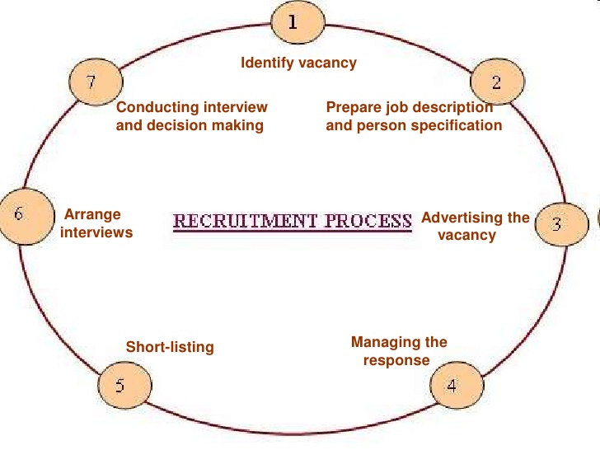

Slide 11
