Slide 1
INTERNATIONAL MARKETING ENVIRONMENT
Presented by
Dr. Anubha Gupta
Faculty , S.S. in Commerce Vikram University
Useful for BBA(H)/B.COM(H)/M.COM and allied subject

Slide 2
INTERNATIONAL MARKETING ENVIRONMENT
International marketing environment is a set of controllable (internal) and uncontrollable (external) forces or factors that affect international marketing.
These forces may be internal (such as resource ability and management attitudes), may be domestic (such as government policy toward international business and facilities), and global (such as overall international business environment of relevant part of the world). However, discussion of global forces is more relevant as they are major considerations in international marketing.

Slide 3
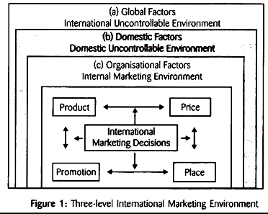
INTERNATIONAL MARKETING ENVIRONMENT

Slide 4
INTERNATIONAL MARKETING ENVIRONMENT
INTERNAL ENVIROMENT ... EXTERNAL ENVIRONMENT
(Controllable) (Uncontrollable)
(c) organizational factor (a) Global factor
(b)Domestic factor

Slide 5
EXTERNAL ENVIRONMENT
External Environment categorized in 2 part
Global Factor (Uncontrollable )
Domestic Factor (Uncontrollable)
(A) Global factors are related to the world economy. Broader picture of global phenomenon affects every decisions of international marketing.

Slide 6
EXTERNAL ENVIRONMENT
Main global factors include:
I. Customer-related factors
ii. Political and legal factors
iii. Social factors
iv. Cultural factors
v. Competition
vi. Global relations among nations and degree of the worldwide peace.
vii. Geographic/ecological/climate-related factors
viii. Functioning of international organisations like UNO, World Bank, WTO, etc.
ix. Availability of marketing facilities and functioning of international agencies, etc.

Slide 7
EXTERNAL ENVIRONMENT
(B)Domestic Factor are related to the economy of the nation. Overall economic, social and cultural, demographic, political and legal, and other domestic aspects constitute domestic environment for international marketing. This environment affects international marketing mix in several ways.

Slide 8
EXTERNAL ENVIRONMENT
Important domestic factors include:
i. Political climate/stability/philosophy
ii. Government approach and attitudes toward international trade
iii. Legal system and business ethics
iv. Availability and quality of infrastructural facilities
v. Availability and quality of raw-materials
vi. Functioning of institutions and availability of facilities
vii. Technological factors
viii. Ecological factors, etc.

Slide 9
INTERNAL ENVIROMENT
Internal Environment categorized :
( c) organizational factor
(C) Organisational Factors: These are internal and controllable factors. They are related to internal situation of the company dealing with international trade. International marketer needs to use, adjust, and organize these factors to satisfy needs and wants of the (international) target markets.

Slide 10
INTERNAL ENVIROMENT
These factors include:
i. Objectives of company
ii. Managerial philosophy of company
iii. Personal factors related to management
iv. Managerial attitudes toward other nations, customers, social welfare, etc.
v. Company’s policies and rules
vi. Resource ability of company and marketing mix
vii. Form of organisation and organisational structure.
ix. Internal relations with other departments
x. Company’s relations with other stakeholders and service providers.

Slide 11
Reference
https://www.yourarticlelibrary.com

Slide 12
.
Thank You

