Slide 1
PROMOTION MIX part-2
Presented by
Dr.Anubha Gupta
Faculty , S.S. in Commerce Vikram University
Useful for BBA(H)/B.COM(H)/M.COM and allied subject

Slide 2
TYPES OF PROMOTION
TYPES OF PROMOTION
PERSONAL SELLING
PUBLIC RELATIONS
SALES PROMOTION
ADVETISBNG

Slide 3
ADVERTISEMENT
Advertisement is printed, written, spoken or graphic salesmanship . This are designed to sell the products of the advertiser and to influence favorably the public mined individually and collectively with respect to the interest of the advertiser.

Slide 4
Personal selling
where businesses use people (the "sales force") to sell the product after meeting face-to-face with the customer. The sellers promote the product through their attitude, appearance and specialist product knowledge.

Slide 5
Public Relation
Public relations (PR) refer to the variety of activities conducted by a company to promote and protect the image of the company, its products and policies in the eyes of the public.

Slide 6
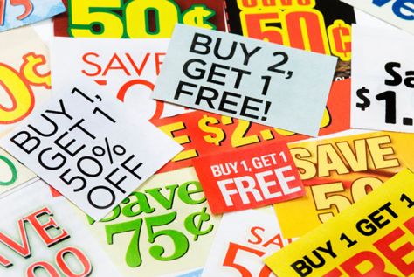
SALES PROMOTION
Those marketing activities other than personal selling advertising and publicity that stimulate consumer purchasing and dealer effectiveness such as displays shows and expositions demonstrations & various non recurrent selling efforts not in the ordinary.

Slide 7
Types of personal selling
Selling for retailers
Selling for wholesalers
Selling for manufactures

Slide 8
Types of sales promotion
Free sample
Coupons
Contests
Demonstration
Price reduction
Premiums
Fairs & exhibitions
Free training

Slide 9
Types of Advertising
A. Press Advertising:
News paper
Magazines
Journals
directory year book

Slide 10
Types of Advertising
B. Outdoor Advertising:
Publicity boards
Adv. On vehicles
Area mark
Electric sign
Adv. In sky
Advertising person

Slide 11
Types of Advertising
C. Direct advertising by Mail:
Handbills poster
Circular letters
Checklist
Direct mail
Window display
Exhibition
calendars

Slide 12
Types of Advertising
D.entertainment advertising
Films
Cinema slides
Radio
Television

Slide 13
Types of Advertising
E. Online advertising:
Google Adwords and Adsense
LinkedIn Advertising
Cell phone & mobile advertising

Slide 14
Types of public relations
Media Relations
Investor Relations
Government Relations
Community Relations
Internal Relations
Customer Relations
Marketing Communications

Slide 15
.
THANK YOU

