Slide 1
Subject- Thermal Engineering and Gas Dynamics Topic- Boilers and it’s types and High Pressure Boilers
Mrs. Anjali Upadhyay
Mechanical Engineering Dept.
SoET, VU, Ujjain

Slide 2
Contents-
Boilers and it’s classification
High Pressure Boilers
Velox Boiler
La-mont Boiler
Benson Boiler
Loeffler Boiler

Slide 3
Boilers
A boiler is an enclosed vessel in which a fluid such as water is heated to produce steam or the vaporized form of a liquid.
The steam or hot water is then circulated through a piping system, to transfer heat for various applications such as heating, power generation and other processes.
Boilers and associated systems can be dangerous if not properly maintained and operated.

Slide 4
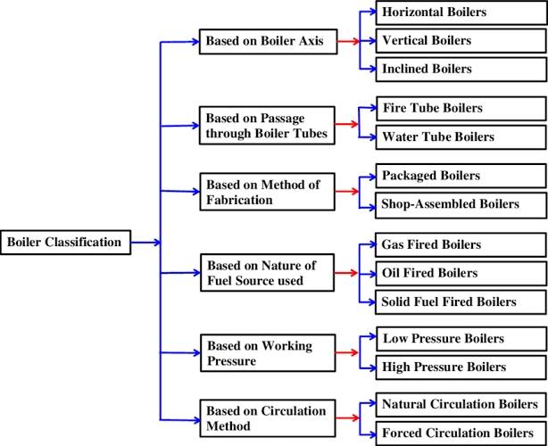
Classification of Boilers

Slide 5
Mountings and Accessories of Boilers
Boiler Mountings - Fittings which are mounted on the boiler for its proper functioning. Boiler can’t function safely without mountings.
Safety valve
Fusible Plug
Stop valve
Feed check valve
Blow off cock
Pressure Gauge
Water level indicator

Slide 6
Boiler Accessories- Boiler’s integral part but not mounted on it. Helps in improving efficiency and controlling proper running of boiler.
Economiser
Air preheated Super heater
Steam dryer / separater
Feed water pump
Injector Steam trap

Slide 7
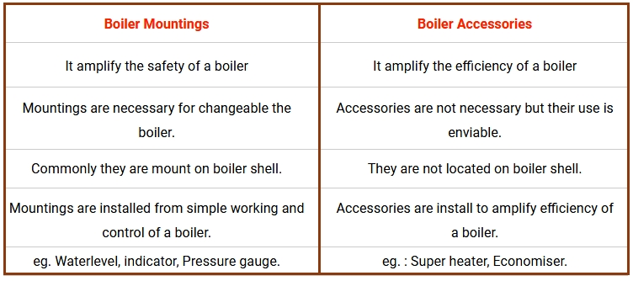
Difference in boiler mountings and boiler accessories

Slide 8
High Pressure Boilers
These high pressure boilers have pressures above 140 bar and the temperature may be up to 540 – 610°C.
These are used to increase the efficiency of the plant.
These are developed because of rising cost of fuel and restrictions on air pollution.
High pressure boilers use both natural and forced circulations.
Forced circulation is achieved with the help of centrifugal pumps.

Slide 9
Features of High Pressure Boilers
Improved mode of heating
Higher steam temperature and pressure
Improved mode of heat transfer
Large number of small diameter tubes
Compactness
Pressurized combustion
Forced circulation of water
High efficiency
Once through construction
Intensive heating

Slide 10
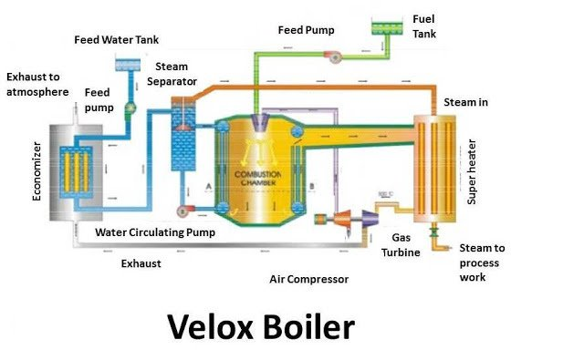
Velox Boiler

Slide 11
Velox Boiler
Principle:
When the velocity of the gas is greater than the speed of sound, its heat transfer rate is also increases. So more heat is transfer from gas to water as compare when the heat transfer at the subsonic speed. This is the basic principle of of it. This boiler can increase the heat transfer rate or can say steam generation rate without increasing boiler size. This is why; Velox boiler is most successful boiler in the gas turbine industries.
Construction:
Water tube forced circulation boiler.
Gas turbine driven air compressor, which compresses the air.
Compressed air enters into the vertical combustion chamber.
This is a force circulation boiler, so pump is used to circulate water inside the boiler.
Consist water and fire tube to maintain the flow of gas and water inside the boiler.
This boiler also consists other necessary mounting and accessories like economizer, super heater, blow off valve, safety valve etc.

Slide 12
Working:
The Velox boiler works as a basic heat exchanger. The working of this boiler is as follow.
The air is compressed by air compressor driven by gas a turbine driven. This compressed air passes from the combustion chamber, where more heat release by the fuel which increase the velocity of the flue gases up to sound velocity. From the bottom of combustion chamber, this flue gases pass from the fire tubes. These fire tubes surrounded by the evaporator water tubes.
The water from the economizer passes from the evaporator tube force by a circulating pump. This water passes 15 – 20 time from the evaporator tube at very high speed. Due to this high speed circulation, heat is transfer from the gases to the water at very high rate. The mixture of water and steam is formed which further passes from the water and steam separator.
Advantages:
1. This boiler has high heat transfer rate.
2. It has great flexibility.
3. it is compact in design.
4. It is easy to control. It is fully automatic.
5. It has great thermal efficiency of about 90 – 95%.

Slide 13
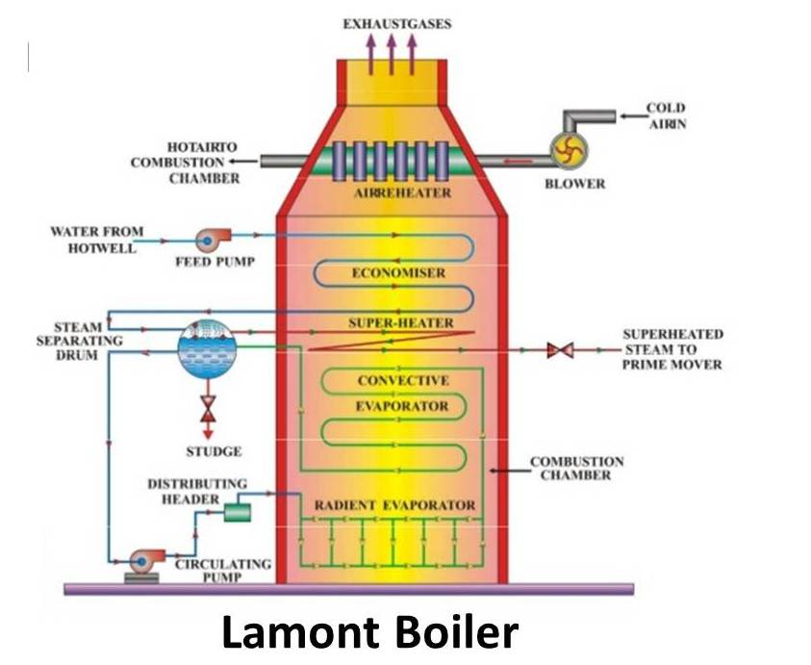
La-mont Boiler

Slide 14
Lamont Boiler
Lamont boiler is a high pressure, forced circulation, water tube boiler with internally fired furnace. An external pump is used to circulate the water within small diameter water tubes of the boiler. This boiler was invented by Walter Douglas La-Mont in the year 1925. At that time this boiler was invented to use in ships.
Working Principle
It works on the principle of forced circulation of water within the boiler with the help of centrifugal pump . Its working is totally depends upon the pump. The centrifugal pump circulates the mixture of steam and water through the small diameter tubes of the boiler.

Slide 15
Main Parts or Construction
The main parts of Lamont boiler are
1.Feed pump: It supply the feed water into the boiler form hot well.
2.Economizer: It increases the temperature of the feed water to some degree.
3.Steam separating drum: As its names indicates, the steam separating drum separates the steam form the water. The steam gets collected at the upper portion and water at the lower portion of the drum.
4.Circulating pump: It is a centrifugal pump driven by the turbine. It circulates the water from the steam separating drum to the small diameter tubes of the radiant superheater, convective superheater and back to the steam separating drum.
5.Radiant evaporator: It evaporates the water steam mixtures with the help of radiation.

Slide 16
Working
In Lamont boiler, feed pump circulates the water in the economiser of the boiler. The economiser heats the water to some degree. From economiser, water enters into steam separating drum.
From steam separating drum steam water mixture is forced circulated through the radiant evaporator by an external centrifugal pump.
Water circulation pressure hrough the tubes is more in forced circulation as compared with natural circulation.
Radiant evaporator heats the water and changes it into steam. Form radiant evaporator the water-steam mixture passes through the convective evaporator. Here the temperature of the fluid increase and most the water gets converted into saturated steam. And after that the saturated steam enters into the steam separator drum.
The steam separator drum as names indicates separates the steam from water. The steam gets collected at the upper portion of the drum. From steam separator drum, steam passes through the superheater. The super heater increases the temperature of the steam to the desired level. And finally the superheated steam is either transfer to the steam collecting drum or made to strike on the blades of the turbine.
Working pressure-170 bar,
Temperature-773K
Capacity of this boiler- 50 tonnes/h.

Slide 17
Advantages
High heat transfer rate
High steam generating capacity (about 50 tonnes per hour)
Easy start
This boiler can be reassembled with the natural circulation boilers.
Simple design
Disadvantages
There is a bubble formation at surfaces of the tubes in this boiler. This reduces the heat transfer rate to the steam.

Slide 18
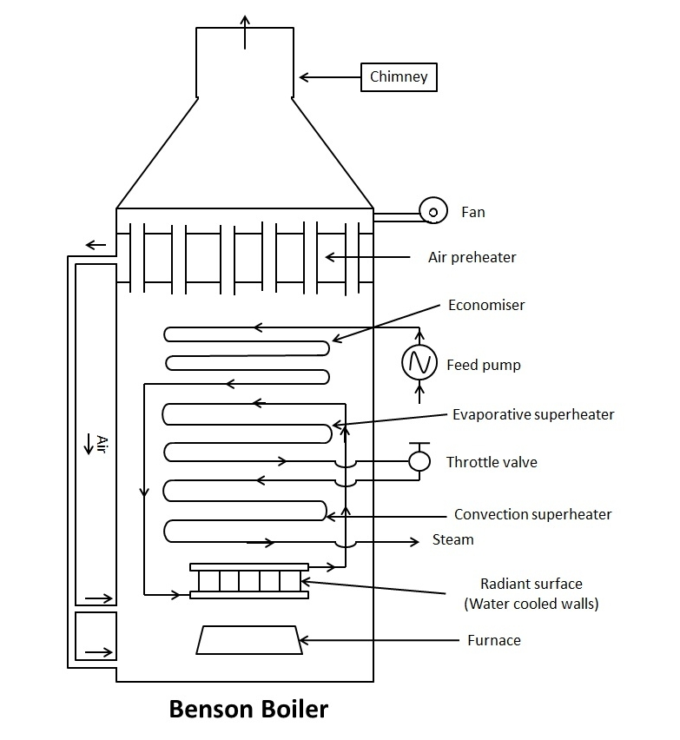
Benson Boiler

Slide 19
Benson Boiler
High pressure, drum less, supercritical, water tube steam boiler with forced circulation.
Invented in the year 1922 by Mark Benson.
Feed water is compressed to a supercritical pressure and this prevents the formation of bubbles in the water tube surface.
Supercritical pressure the density of water and steam becomes same so bubbles do not form.

Slide 20
Construction-
Main parts consists of-
1. Air Preheater-It preheats the air before entering into the furnace. The preheated air increases the burning efficiency of the fuel.
2. Economiser-It heats the water to a certain temperature
3. Radiant Superheater- It is super heater which heats the water with radiation produced by the burnt fuel. It raises the temperature to supercritical temperature.
4. Convection Evaporator- It evaporates the superheated water and converts them into steam. It does so by the convection mode of heat transfer to the water from the hot flue gases.
5. Convection Superheater- It superheats the steam to the desired temperature (nearly 650 degree Celsius).
6. Furnace - It is the place where the fuel is burnt.
7.Feed Pump- It is used to supply the water inside the boiler at supercritical pressure of 225 bars.

Slide 21
Working Principle
It works on the principle that the pressure of the water is increased to the supercritical pressure (i.e. above critical pressure of 225 bar). When the pressure of water is increased to the super critical level, the latent heat of water becomes Zero and due to this, it directly changes into steam without boiling. And this prevents the formation of bubbles at tube surface.
Working
In Benson Boiler, the feed pump increases the pressure of the water to the supercritical pressure and then it enters into the economiser.
From economiser, the water the water passes to the radiant heater. Here the water receives the heat through radiation and partly gets converted into steam.
The temperature raises almost to the supercritical temperature. After that mixture of steam and water enters into convective evaporator where it is completely converted into steam and may superheated to some degree.
Finally it is passed through the superheater to obtained the desired superheated steam. This superheated steam is then used by turbines or engine to produce the electricity.

Slide 22
Advantages
It is a drum less boiler and hence the weight of this type of boiler is 20 % less as compared with other boilers.
It is light in weight.
Occupy smaller floor area for its erection.
Explosion hazard is almost negligible because of use of smaller diameter tubes.
It can be started very easily within 15 minutes.
It avoids bubble formation due to the super critical pressure of water.
Transportation is easy.
This boiler may achieve thermal efficiency upto 90 %.
Application
This supercritical boiler is used in different industries to generate steam for the production of electricity or mechanical power. The average operating pressure, temperature and capacity of benson boiler is 650 degree Celsius, 250 bar and 135 tonnes/h.

Slide 23
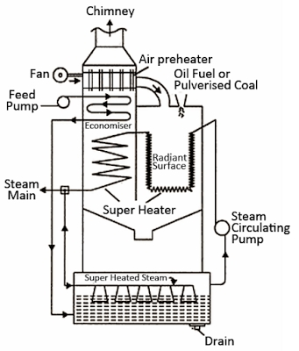
Loeffler Boiler

Slide 24
Loeffler Boiler
Loeffler boiler is forced circulation, high pressure, and water tube boiler with internally fired furnace.
A steam circulating pump is used to circulate the steam into the boiler.
Working Principle
Its main working principle is to evaporate the feed water by the use of superheated steam from the superheater.
2/3 of superheated steam is used to evaporate the water in the evaporating drum and remaining 1/3 of the steam from the superheater is used by the turbine.

Slide 25
Construction-
It consists of-
1. Economiser: It preheats the feed water before entering into the evaporating drum.
2. Evaporating drum: It is placed at lower portion of the boiler. It contains the mixing nozzle. Here the feed water is converted into saturated steam with the help of the superheated steam from the superheater.
3. Steam circulating pump: It is present in between the evaporating drum and radiant superheater. It circulates the steam into the boiler.
4. Radiant superheater: It superheats the steam with the help of radiations produced by the burnt fuel in the boiler.
5. Convective superheater: Convective superheater superheats the steam to the desired temperature of about 500 degree C.
6. Mixing nozzle: It is present inside the evaporating drum. It mixes the steam from the superheater with feed water and evaporates them.

Slide 26
Working
In loeffler boiler, the feed pump forces the water to enter into the economiser. The economiser preheats the feed water and then it is passed to the evaporator drum.
The evaporator drum has nozzles. The 2/3 of the superheated steam from the superheater enters into the nozzles of the evaporator drum and the nozzles mix this superheated steam with the feed water. This changes the feed water into saturated steam. This saturated steam is then drawn from the evaporating drum by a steam circulating pump and allows it to passes through the radiant superheater.
The radiant superheater superheats the saturated steam with help of radiation energy produce from the burning of the fuel. The radiant superheater tubes are placed in furnace. The heat transfer to the water takes place through the radiation produced. After the radiant superheater, the steam is passed to the convective superheater.
The convective superheater is placed in the path of hot flue gases. It superheats the steam coming from the radiant superheater to a temperature of about 500 degree C. This superheated steam is than flows to the turbine and evaporating drum. In this boiler, the 2/3 part of the superheated steam is used to evaporate the feed water into the evaporating drum and remaining 1/3 part flows to the turbine.
Loeffler boiler has the capacity to produce 100 tonnes/ h of steam at a temperature of 500 degree C and pressure of 140 bar.

Slide 27
Advantages-
It can use salt water for the steam generation.
The problem of deposition of sediments and scale in the boiler tubes are eliminated.
It is compact in size.

