Slide 1
Arc welding
The fusing of two or more pieces of metal together by using the heat produced from an electric arc welding machine.

Slide 2
How an arc is formed
The arc is like a flame of intense heat that is generated as the electrical current passes through a highly resistant air gap.

Slide 3
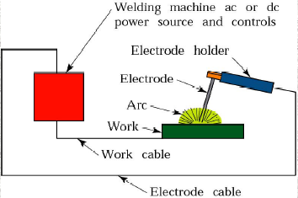
Arc welding process

Slide 4
Tungsten Inert Gas welding

Slide 5
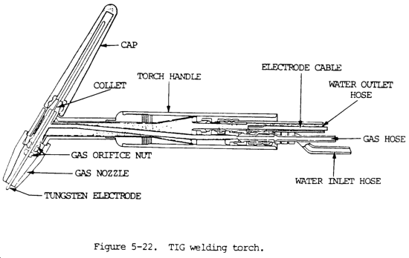
Welding torch

Slide 6
Applications
All types of metals & alloys
Recommended for thin metal sheet(.125mm)
Used in fabrication of missiles,air crafts,rockets& submarines

Slide 7
Disadvantages
Cost of inert gas
Proper cleaning required before welding
Relatively slow operation

Slide 8
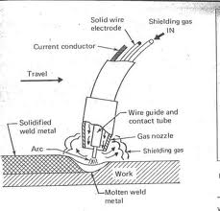
Metal Inert gas Welding

Slide 9
Advantages
All position capability
Higher deposition rates than SMAW
Less operator skill required
Long welds can be made without starts and stops
Minimal post weld cleaning is required
More rapid operation

Slide 10
Applications
Popular for non ferrous materials Al, Mg & Ti
Used for thickness > 4mm

Slide 11
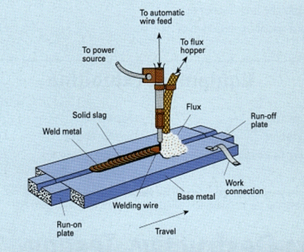
Submerged Arc Welding

Slide 12
Applications
Used for c steel, alloy steel
For non ferrous metals like Ni, Bronze etc.

Slide 13
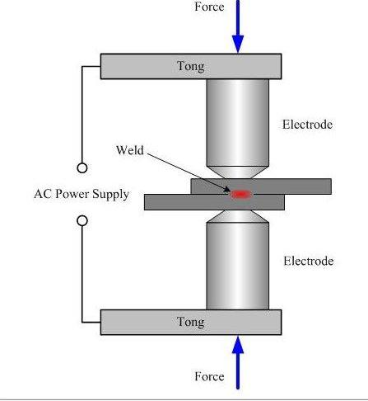
Electric Resistance Welding

Slide 14
Process Parameters
Current & power supply-
A.C. supply of 50Hz, with a voltage of 1-25V & a current of 100-200 A
Resistance
Time Interval-
should be very short
Pressure range-200-600 kg/square cm

Slide 15
Advantages
Very fast
Suitable for mass production
Less skills required
Economical
Can weld dissimilar metal

Slide 16
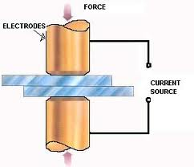
Spot Welding

Slide 17
Applications
For C- steel sheets up to 4mm thickness
Steel plates up to 12mm thickness
Manufacturing of metal containers & toys
Can b used for Cu , Steel, stainless steel.

Slide 18
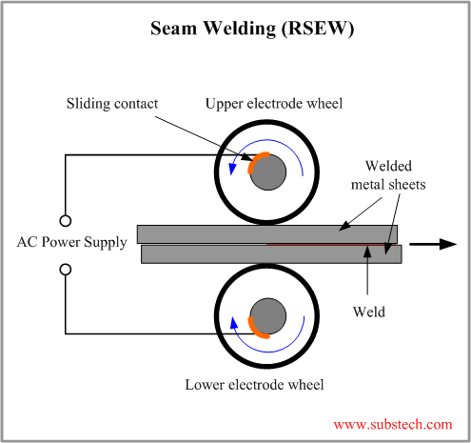
Seam welding

Slide 19
Process
Welding current-5000Amp
Force 6KN
Speed 12 feet/min

Slide 20
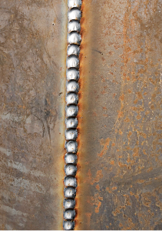
Stich welding

Slide 21
Applications & Advantages
Applications- pressure-tight joints in containers, boxes, tubes, cylinders etc.
Advantages- low cost, high production rate , suitable for automation
Disadvantages- thickness limited upto 4mm

Slide 22
BUTT Welding

Slide 23
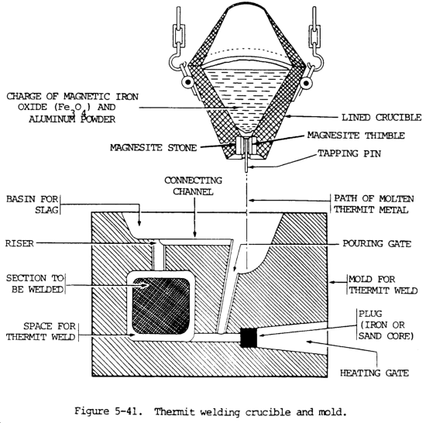
Thermit welding

Slide 24
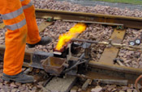
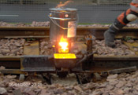

Slide 25
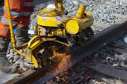
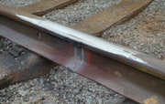

Slide 26
Applications
For very thick plate & heavy sections
For joining rail road , pipes thick steel sections
For heavy casting & gears

Slide 27
Advantages & Disadvantages
Simple , fast process for similar & dissimilar metal
cheap
Essentially used for ferrous metal parts of heavy sections
Uneconomical for cheap metals

Slide 28
Soldering
It is a low temperature joining process. It is performed at temperatures below 840ºF for joining.

Slide 29
Classification
Soldering iron
Torch
Dip & wave
Induction
Resistance
Furnace& hot plate method
Spray
Ultrasonic
Condensation

Slide 30
Types of solder
Soft solder-Pb, Tin mixture
Hard solder- brass, silver, Cu solder

Slide 31
Soldering Fluid
2 types-
1)which protect surface & also clean it
Killed spirit(zinc chloride),ammonium chloride , zinc ammonium chloride
2)tallow , resin, Vaseline, olive oil etc.

Slide 32
Advantages & Applications
Low cost, simplicity
Good & effective sealing
Radio , T.V. sets
Radiator brass tube

Slide 33
Brazing
Definition:
A process which a filler metal is placed at or between the faying surfaces, the temperature is raised high enough to melt the filler metal but not the base metal.
The molten metal fills the spaces by capillary attraction.
Non ferrous metal = spelter
M.P. of filler > 420
Torch Brazing
Oxy-fuel torch with a carburizing flame
First heat the joint then add the filler metal

Slide 34
Flux used
Borax,
boric acid
Borates
Fluorides
chlorides

Slide 35
Metals used for brazing
Cu , Cu alloys, brass, bronze
Ag alloys
Al alloys etc

Slide 36
Heating can be done by
Coal-gas & mouth blow pipe
Oxy-acetylene torch
Oxy-hydrogen torch
Electrical Resistance

Slide 37
Brazing Methods
Torch brazing
Furnace brazing
Resistance brazing
Dip
Salt-bath
Induction

Slide 38
Advantages & Limitations
Initially Cheap
No Metallurgical changes
Fast ,flexible & accurate
Suitable for mass production
For proper strength must be defined carefully

Slide 39
GAS CUTTING
Ferrous metal is heated in to red hot condition and a jet of pure oxygen is projected onto the surface, which rapidly oxidizes
Oxides having lower melting point than the metal, melt and are blown away by the force of the jet, to make a cut
Fast and efficient method of cutting steel to a high degree of accuracy
Torch is different from welding
Cutting torch has preheat orifice and one central orifice for oxygen jet
PIERCING and GOUGING are two important operations
Piercing, used to cut a hole at the centre of the plate or away from the edge of the plate
Gouging, to cut a groove into the steel surface

Slide 40
Weld Defects
Undercuts/Overlaps
Grain Growth
A wide ΔT will exist between base metal and HAZ. Preheating and cooling methods will affect the brittleness of the metal in this region
Blowholes
Are cavities caused by gas entrapment during the solidification of the weld puddle. Prevented by proper weld technique (even temperature and speed)

Slide 41
Inclusions
Impurities or foreign substances which are forced into the weld puddle during the welding process. Has the same effect as a crack. Prevented by proper technique/cleanliness.
Segregation
Condition where some regions of the metal are enriched with an alloy ingredient and others aren’t. Can be prevented by proper heat treatment and cooling.
Porosity
The formation of tiny pinholes generated by atmospheric contamination. Prevented by keeping a protective shield over the molten weld puddle.

Slide 42
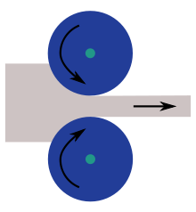
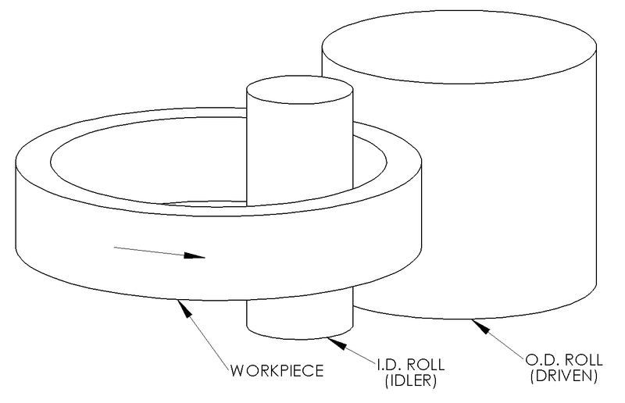
Rolling
Process of shaping metals into semi finished/ finshed forms by passing b/w rollers

Slide 43
Process of rolling
Primary->hot->cold->
Casted ingots-1.5m*1.5m
Blooms- 150-400mm
Slabs- b=500-1800mm;t=50-300mm
Billets- 30-150mm
Plates- t=6mm or >;b=1200-1400mm;l=6000mm
Sheets- 0.5-5.0 mm=t
strip- b<=750mm

Slide 44
Rolling process

Slide 45
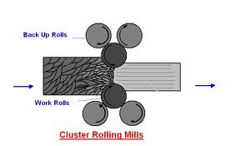
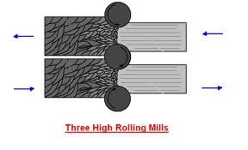
Types of mills
Two high roll mill
3 high roll mill
4 high roll mill
Cluster rolling mill
Multi high roll mill

Slide 46
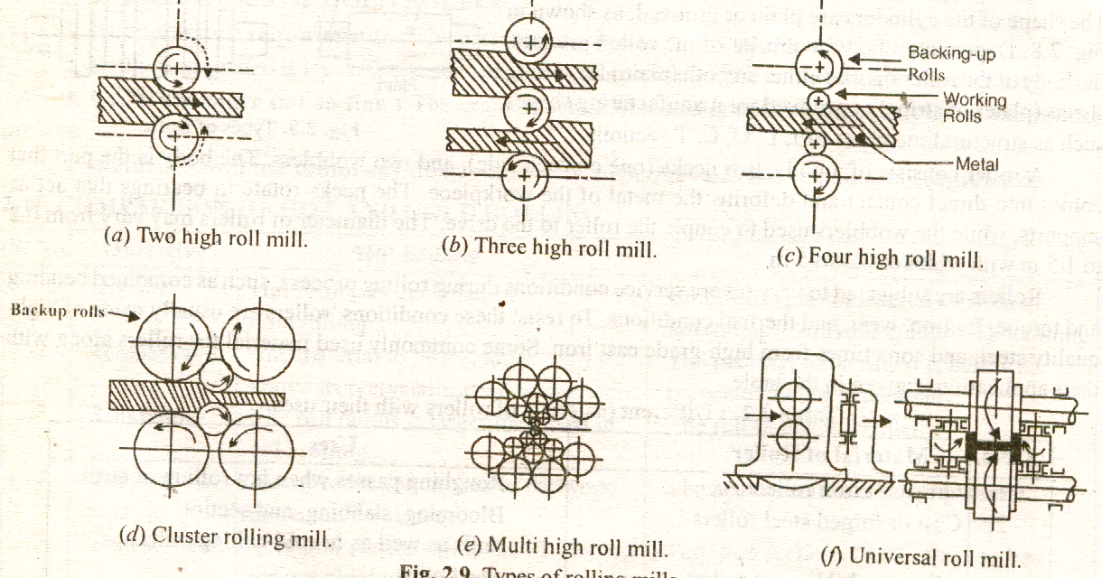
Types of mills

Slide 47
Terms related to rolling

Slide 48
Defects in rolling
Edge cracking
Folds
Alligatoring
Scale formation

Slide 49
METROLOGY

Slide 50
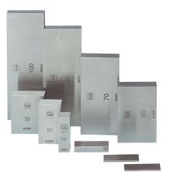
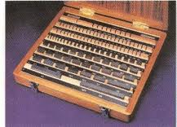
Slip Gauges
Can b used for tolerance of 0.001-0.0005mm
Different grades available-
Calibration grade Grade 00 Grade 0
Grade I Grade II

Slide 51
Comparators
An indirect type of instrument
Enables a comparison between an item & a length standard

Slide 52
Elements of A Comparators
A sensing device
A magnification system
A display system

Slide 53
Types of comparators
Mechanical
Electrical
Optical
Pneumatic
Fluid displacement
Mechanical optical

Slide 54
Mechanical comparators
Dial indicators
Lever comparator
Sigma comparator
Johanson Mikro kator
Read type comparator

Slide 55
Dial gauges

Slide 56
Application-
Trueness of milling m/c arbors
parallelism of shaper m/c
alignment of lathe m/c
Having graduations of 0.01mm or even 0.02mm

Slide 57
Lever comparators

Slide 58
Sigma comparators
Having a magnification of 1000:1
Worktable & contact tip are inter changeable
Can check a height up to 600mm

Slide 59
Electrical comparator
Magnification range-> 1100-18000
Can read up to 0.0001mm
Also available with magnification of 40000

Slide 60
Optical Comparators
Having magnification of 1000:1
Measuring range of 0.075mm

Slide 61
Pneumatic Comparator
Possible magnification is 30000:1, usually about 10000:1
Used to check I.D.,O.D., thickness, concentricity, depth of blind holes

Slide 62
Fluid Displacement Comparator

Slide 63
Angular Measuring Instrument
Protector
Sine Bar
Angle gauges
Clinometers

Slide 64
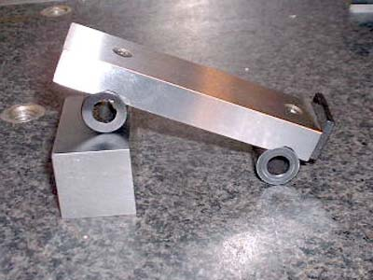
Sine Bars

Slide 65
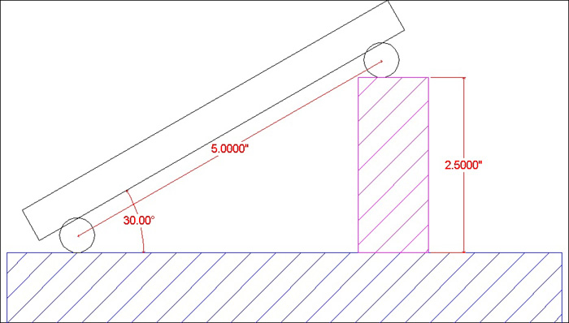
Working Principle

Slide 66
For heavy components

Slide 67
For small components

Slide 68
Angle gauges

Slide 69
Limit Gauges
Type->
Standard gauge
Limit gauge
Indicating gauge
Combination gauge
Workshop gauge
Inspection gauge
Master gauge

Slide 70
Standard Gauge

Slide 71
Limit gauge

Slide 72
Plug gauges
Check whether the whole dia. is within the limit or not

Slide 73
Pin Gauge
Holes to be check are larger than 75mm

Slide 74
Snap Gauge
Check the accuracy of shaft & male members
Check the tolerance of the shaft

Slide 75
Caliper Gauge
Used for both I.D. & O.D.

Slide 76
Thickness/ Filler Gauge
The width of strip is generally available to 12.5mm

Slide 77
Radius & Screw pitch Gauge

Slide 78
Limits , Fits & Tolerance

