Slide 1
Smart Antenna Systems
Yogesh Patidar

Slide 2
Overview
What Is a Smart Antenna System?
The Goals of a Smart Antenna System
Signal Propogation: Multipath and Cochannel Interference
The Architecture of Smart Antenna Systems

Slide 3
What Is a Smart Antenna System
smart antenna system combines an antenna array with a digital signal-processing capability to transmit and receive in an adaptive, spatially sensitive manner.
such a system can automatically change the directionality of its radiation patterns in response to its signal environment. This can dramatically increase the performance characteristics (such as capacity) of a wireless system.

Slide 4
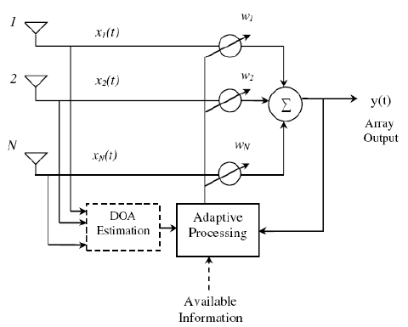
Block diagram of a smart antenna system

Slide 5
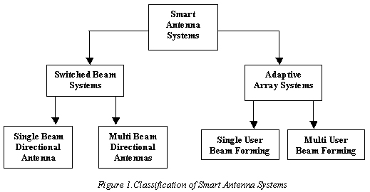
Classification of smart antenna systems

Slide 6
Types of Smart Antenna Systems
• switched beam - a finite number of fixed, predefined patterns or combining strategies (sectors)
adaptive array- an infinite number of patterns (scenario-based) that are adjusted in real time

Slide 7
Switched Beam Antennas
Switched beam antenna systems form multiple fixed beams with heightened sensitivity in particular directions. These antenna systems detect signal strength, choose from one of several predetermined, fixed beams, and switch from one beam to another as the mobile moves throughout the sector.

Slide 8
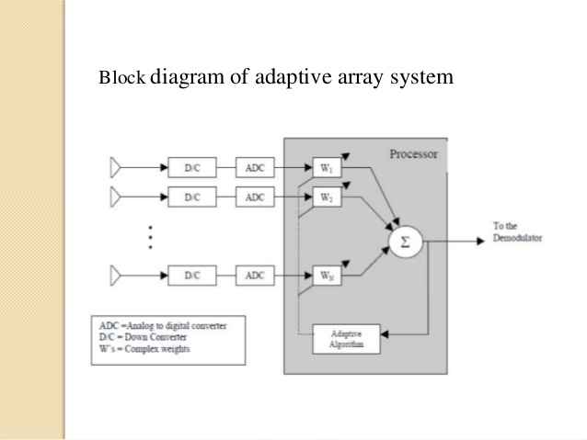
Adaptive Array Antennas
Adaptive antenna technology represents the most advanced smart antenna approach to date. Using a variety of new signal-processing algorithms, the adaptive system takes advantage of its ability to effectively locate and track various types of signals to dynamically minimize interference and maximize intended signal reception.

Slide 9
Goals of a Smart Antenna System
The dual purpose of a smart antenna system is to augment the signal quality of the radio-based system through more focused transmission of radio signals while enhancing capacity through increased frequency reuse.

Slide 10
features of smart antenna system
signal gain - Inputs from multiple antennas are combined to optimize available power required to establish given level of coverage.
interference rejection - Antenna pattern can be generated toward cochannel interference sources, improving the signalto-interference ratio of the received signals.
spatial diversity - Composite information from the array is used to minimize fading and other undesirable effects of multipath propagation.
power efficiency - combines the inputs to multiple elements to optimize available processing gain in the downlink (toward the user)

Slide 11
Signal Propagation: Multipath And Co-channel Interference
Multipath is a condition where the transmitted radio signal is reflected by physical features/structures, creating multiple signal paths between the base station and the user terminal

Slide 12
Conditions caused by multipath that are of primary concern are as follows:
Fading - When the waves of multipath signals are out of phase, reduction in signal strength can occur. One such type of reduction is called a fade; the phenomenon is known as "Rayleigh fading" or "fast fading."
phase cancellation - When waves of two multipath signals are rotated to exactly 180° out of phase, the signals will cancel each other. While this sounds severe, it is rarely sustained on any given call (and most air interface standards are quite resilient to phase cancellation). In other words, a call can be maintained for a certain period of time while there is no signal, although with very poor quality.

Slide 13
Counti…
delay spread - The effect of multipath on signal quality for a digital air interface (e.g., TDMA) can be slightly different. Here, the main concern is that multiple reflections of the same signal may arrive at the receiver at different times. This can result in intersymbol interference (or bits crashing into one another) that the receiver cannot sort out.

Slide 14
Counti..
Co-channel interference- One of the primary forms of man-made signal degradation associated with digital radio, co-channel interference occurs when the same carrier frequency reaches the same receiver from two separate transmitters.

Slide 15
Architecture of Smart Antenna Systems
switched beam and adaptive array systems enable a base station to customize the beams they generate for each remote user effectively by means of internal feedback control. Generally speaking, each approach forms a main lobe toward individual users and attempts to reject interference or noise from outside of the main lobe.

Slide 16
Listening to the Cell (Uplink Processing)
It is assumed here that a smart antenna is only employed at the base station and not at the handset or subscriber unit. Such remote radio terminals transmit using omnidirectional antennas, leaving it to the base station to separate the desired signals from interference selectively.

Slide 17
Speaking to the Users (Downlink Processing)
The task of transmitting in a spatially selective manner is the major basis for differentiating between switched beam and adaptive array systems. As described below, switched beam systems communicate with users by changing between preset directional patterns, largely on the basis of signal strength. In comparison, adaptive arrays attempt to understand the RF environment more comprehensively and transmit more selectively.

Slide 18
Switched Beam Systems
In terms of radiation patterns, switched beam is an extension of the current microcellular or cellular sectorization method of splitting a typical cell. The switched beam approach further subdivides macrosectors into several microsectors as a means of improving range and capacity. Each microsector contains a predetermined fixed beam pattern with the greatest sensitivity located in the center of the beam and less sensitivity elsewhere. The design of such systems involves high-gain, narrow azimuthal beamwidth antenna elements.

Slide 19
Adaptive Antenna Approach
Adaptive arrays utilize sophisticated signal-processing algorithms to continuously distinguish between desired signals, multipath, and interfering signals as well as calculate their directions of arrival. This approach continuously updates its transmit strategy based on changes in both the desired and interfering signal locations

Slide 20
Smart Antenna Technology uses
PCS,
Cellular Comm
wireless local loop (WLL)

