Slide 1
Analog Communication SSB-SC Modulators
Yogesh Patidar
School of engineering and technology Dept. of Electronics Engineering vikram university ujjain

Slide 2
SSB-SC Modulation
Sidebands along with the carrier and transmitting a single sideband is called as Single Sideband Suppressed Carrier system or simply SSBSC.
Advantages
Bandwidth or spectrum space occupied is lesser than AM and DSBSC waves.
Transmission of more number of signals is allowed.
Power is saved.
High power signal can be transmitted.
Less amount of noise is present.
Signal fading is less likely to occur.
Disadvantages
The generation and detection of SSBSC wave is a complex process.
The quality of the signal gets affected unless the SSB transmitter and receiver have an excellent frequency stability.

Slide 3
SSB-SC MODULATOR
We can generate SSBSC wave using the following two methods.
Frequency discrimination method
Phase discrimination method

Slide 4
Frequency discrimination method
In this method, first we will generate DSBSC wave with the help of the product modulator. Then, apply this DSBSC wave as an input of band pass filter. This band pass filter produces an output, which is SSBSC wave.

Slide 5
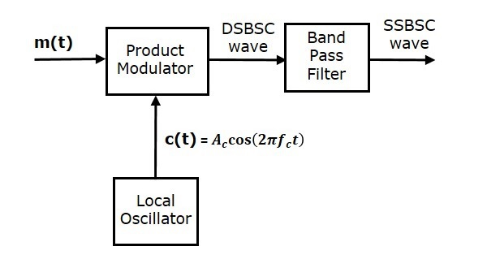
Block diagram of Frequency discrimination method

Slide 6
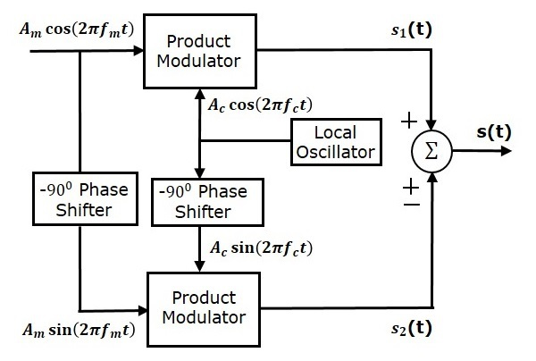
Phase Discrimination Method for SSB-SC
The following figure shows the block diagram of SSBSC modulator using phase discrimination method.

Slide 7
Phase Discrimination Method
The modulating signal Am cos(2πfmt) and the carrier signal Ac cos⁡(2πfct) are directly applied as inputs to the upper product modulator. So, the upper product modulator produces an output, which is the product of these two inputs.
s2(t)=AmAcCos⁡(2πfmt−90)cos⁡(2πfct−90)
s2(t)=AmAcSin⁡(2πfmt)sin⁡(2πfct)
s2(t)=AmAc2{Cos⁡[2π(fc−fm)t]−Cos⁡[2π(fc+fm)t]}
Add s1(t) and s2(t) in order to get the SSBSC modulated wave s(t) having a lower sideband.
s(t)=AmAc2{Cos⁡[2π(fc+fm)t]+Cos⁡[2π(fc−fm)t]}+ AmAc2{Cos⁡[2π(fc−fm)t]−cos⁡[2π(fc+fm)t]}
s(t)=AmAc{Cos⁡[2π(fc−fm)t]}

Slide 8
Phase Discrimination Method cont…
Subtract s2(t) from s1(t) in order to get the SSBSC modulated wave s(t) having a upper sideband.
s(t)=AmAc2{cos⁡[2π(fc+fm)t]+cos⁡[2π(fc−fm)t]}−AmAc2{cos⁡[2π(fc−fm)t]−cos⁡[2π(fc+fm)t]} ‘
s(t)=AmAccos⁡[2π(fc+fm)t]
Hence, by properly choosing the polarities of inputs at summer block, we will get SSBSC wave having a upper sideband or a lower sideband.

Slide 9
THANK YOU

