Slide 1
SCHOOL OF STUDIES IN COMMERCE
VIKRAM UNIVERSITY, UJJAIN (M.P.)

Slide 2

TAX AUDIT
LECTURE BY:
DR. KAYNAT TAWAR

Slide 3
RELEVANT TOPICS ON TAX AUDIT FOR
B.COM (HONS.)
B.B.A. (HONS.)
M.COM.

Slide 4
TOPICS
INTRODUCTION OF INCOME TAX AUDIT
AUDIT PROCESS
PRE- AUDIT
DURING AUDIT
POST- AUDIT
TAX AUDIT UNDER SECTION:
*SECTION 44AB
*SECTION 44 AD
*SECTION 44AE
REPORTING IN FORM 3CB-3CD
SCOPE OF INCOME TAX AUDIT
LIMITATIONS OF TAX AUDIT
ROLE OF ICAI IN TAX AUDIT
CHALLENGES FACED BY TAX AUDITOR

Slide 5
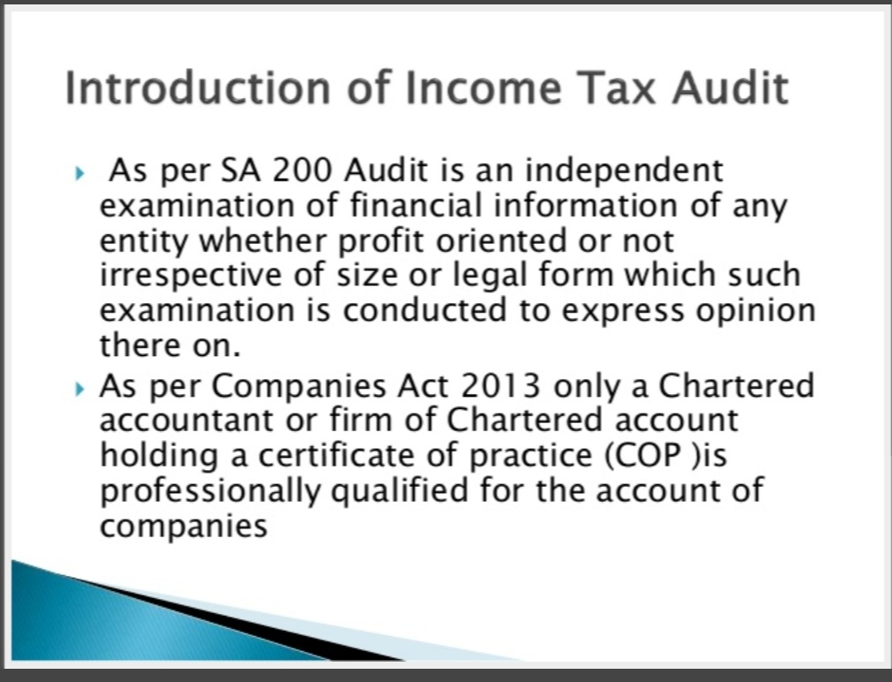

Slide 6
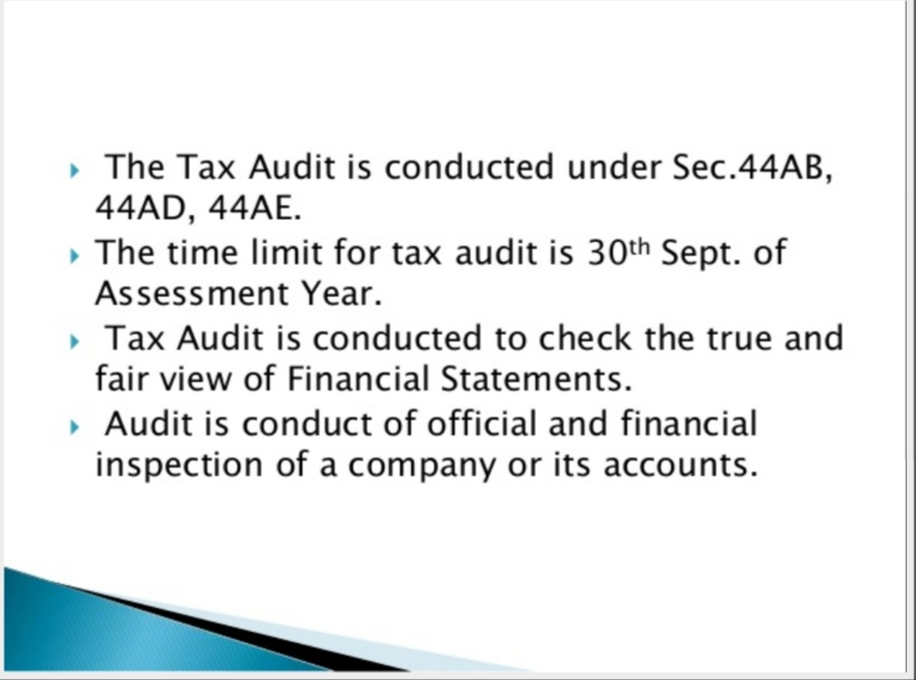

Slide 7
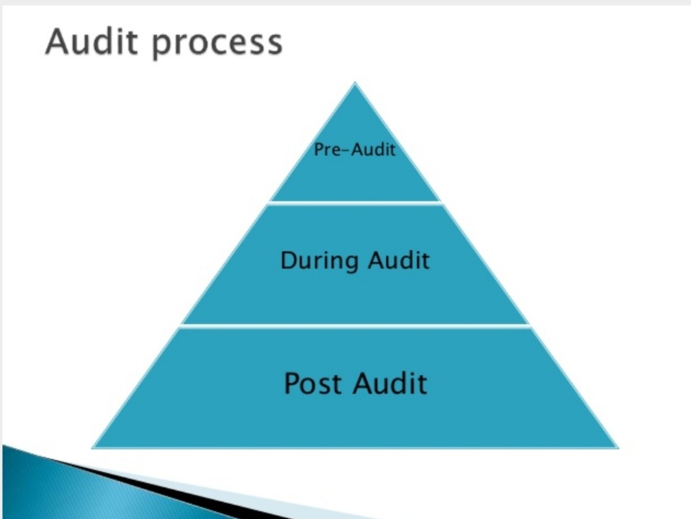

Slide 8
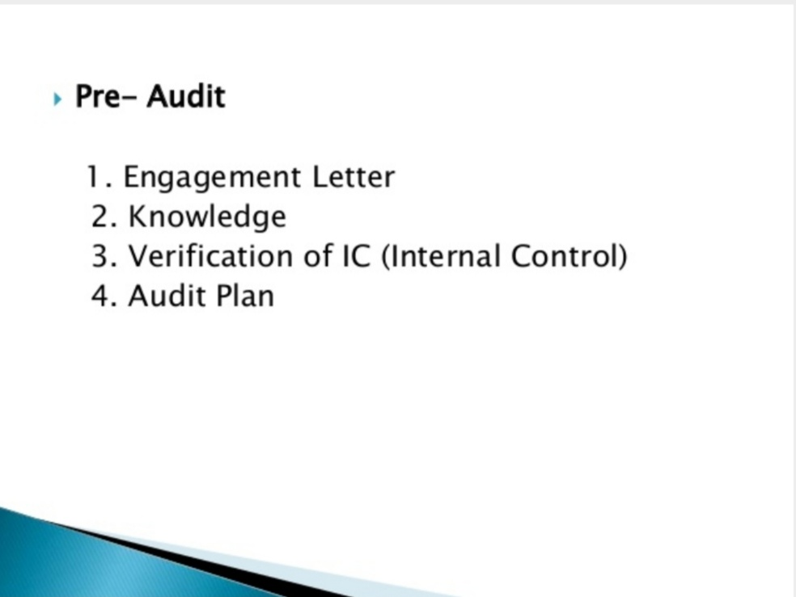

Slide 9
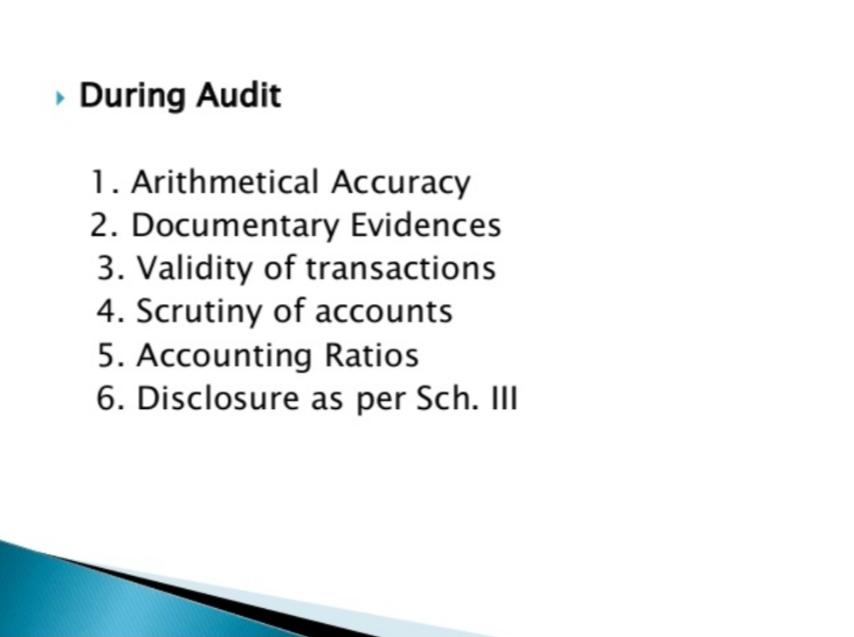

Slide 10
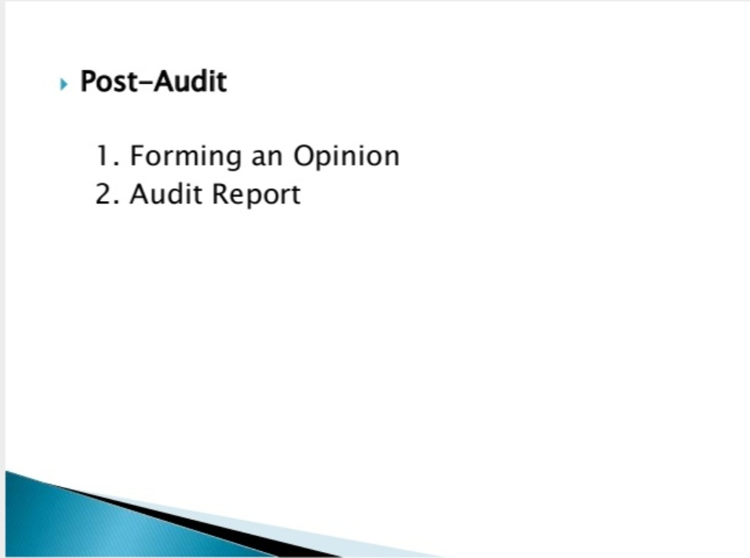

Slide 11
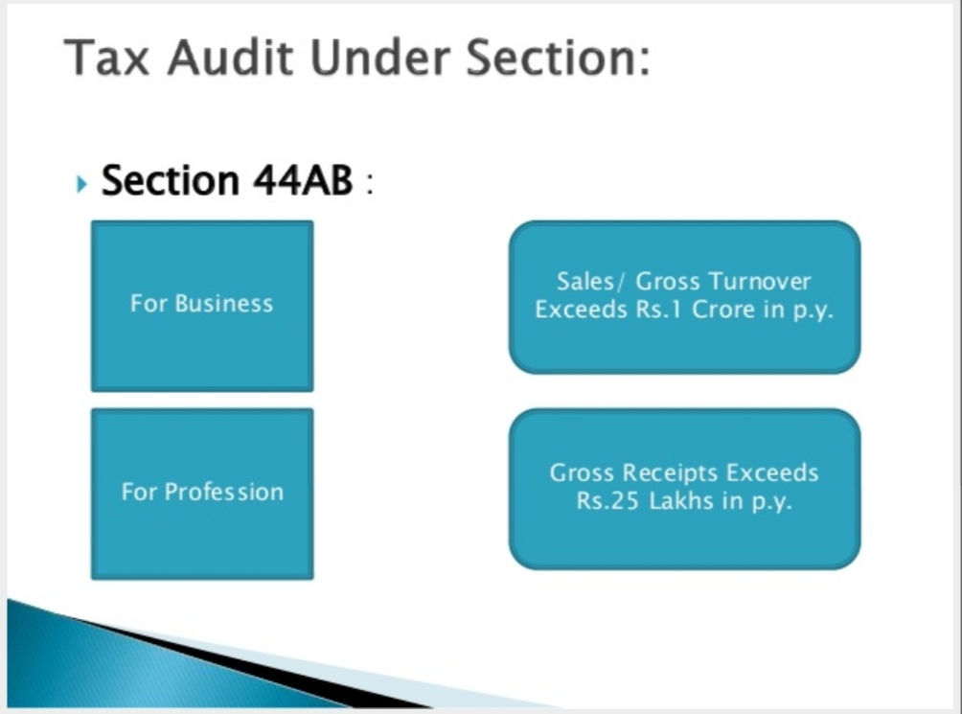

Slide 12
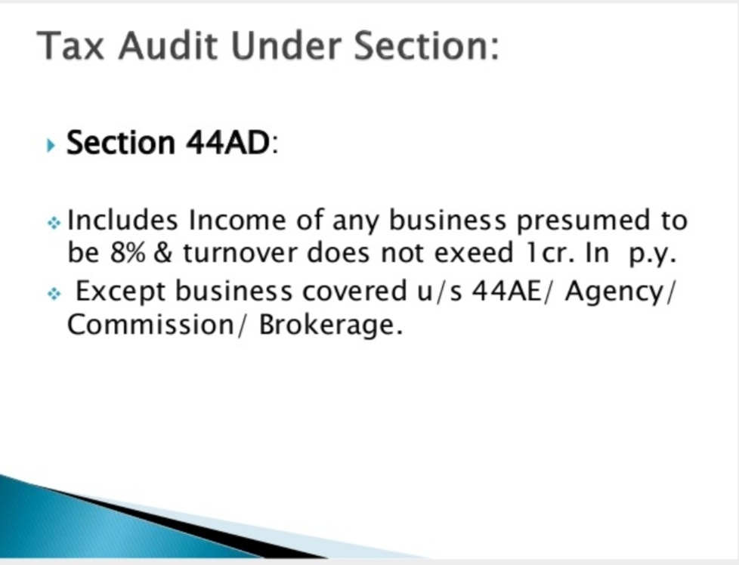

Slide 13
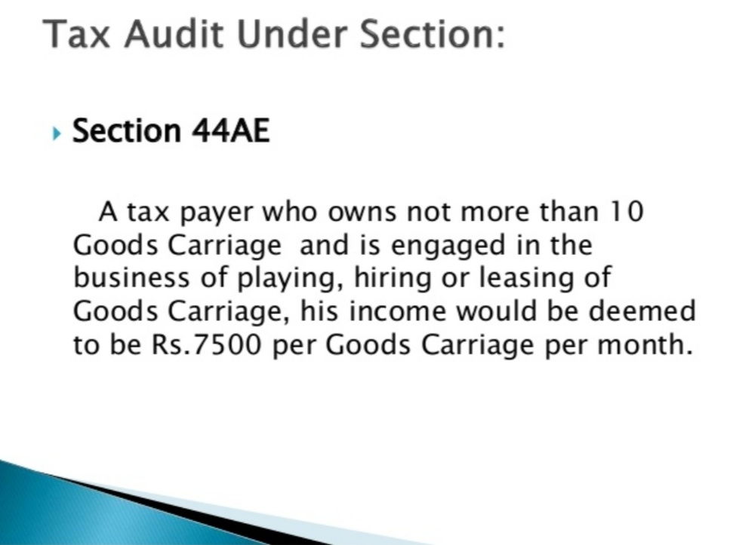

Slide 14
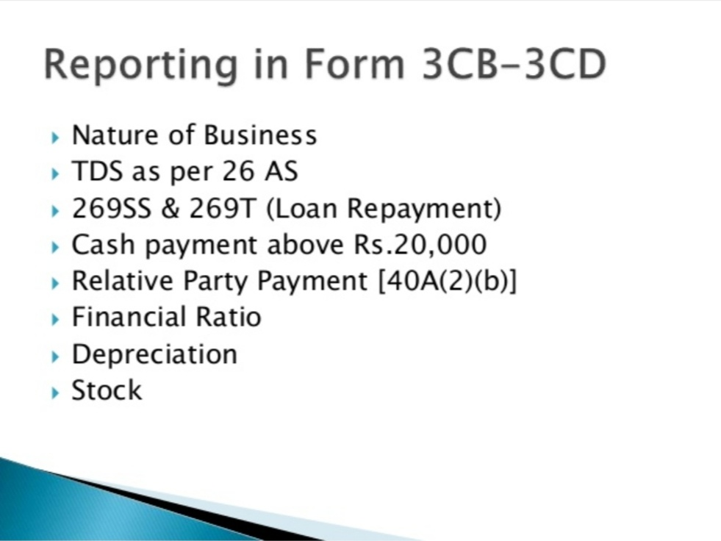

Slide 15
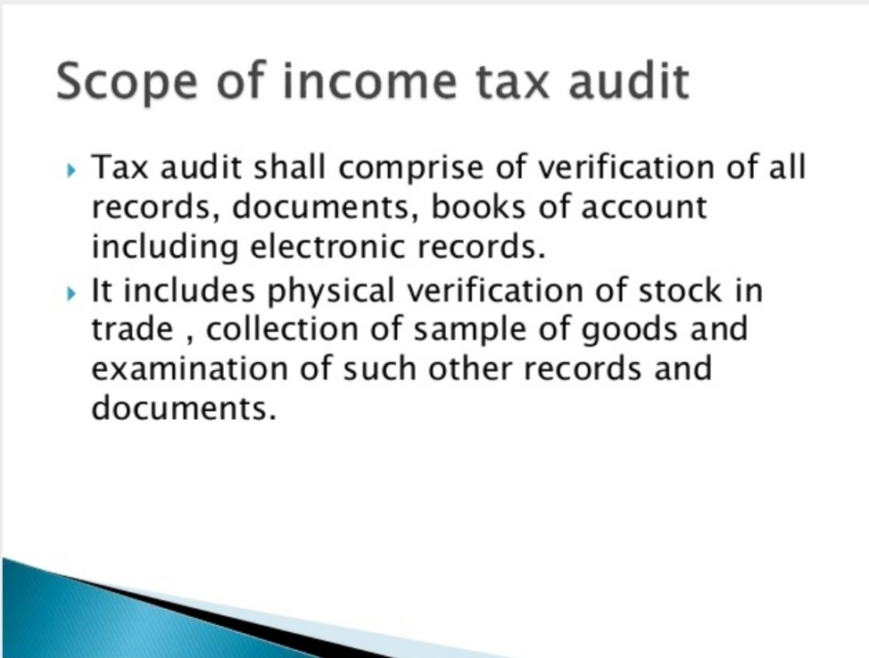

Slide 16
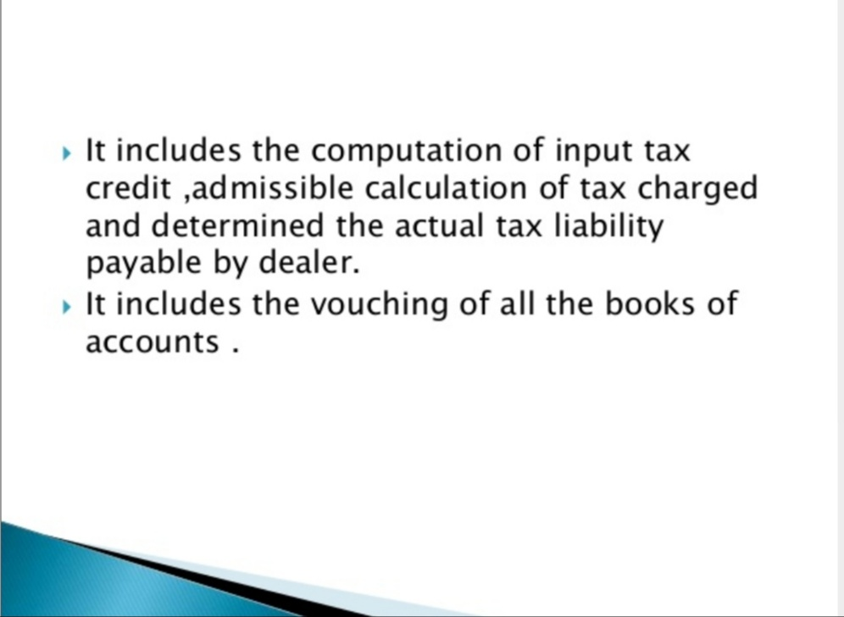

Slide 17
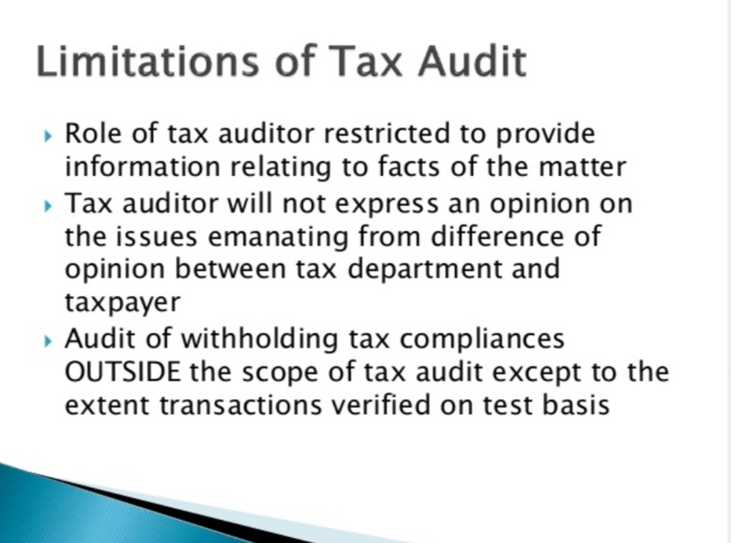

Slide 18
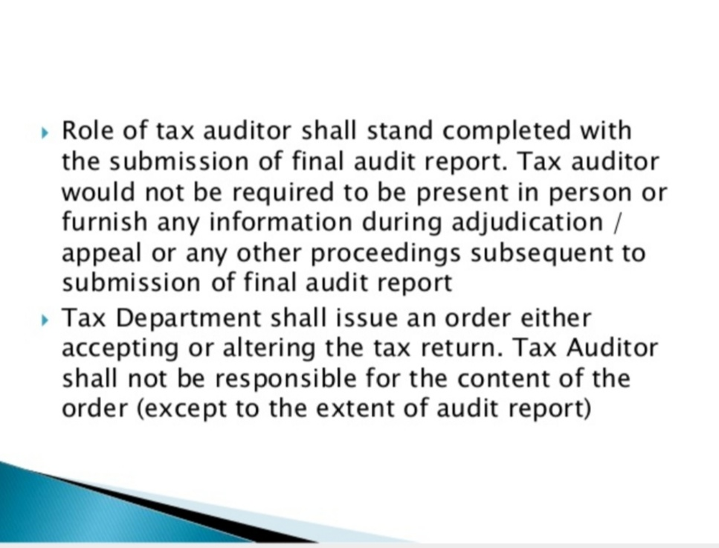

Slide 19
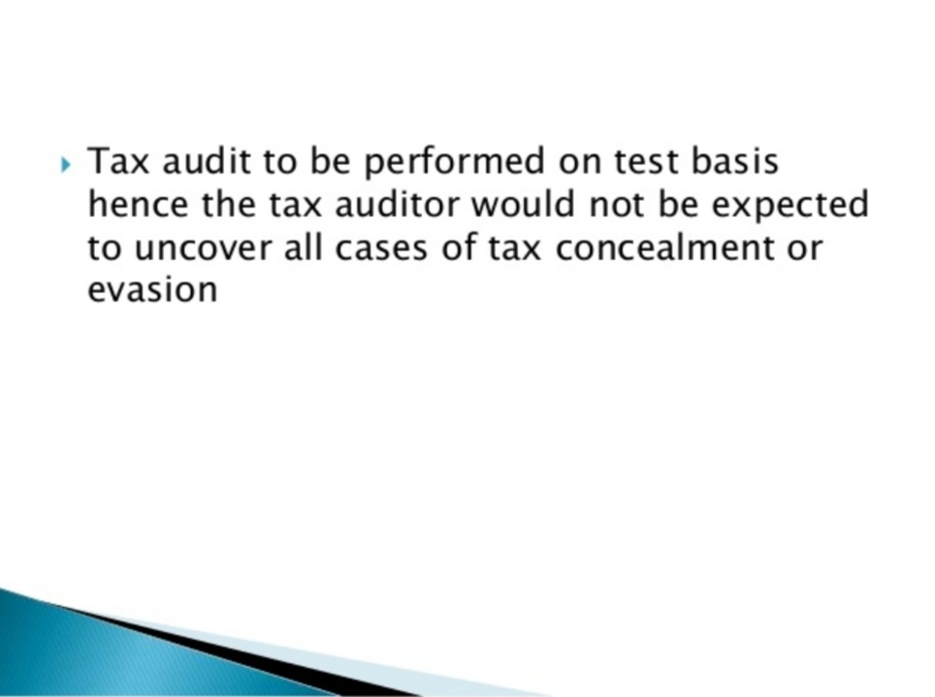

Slide 20
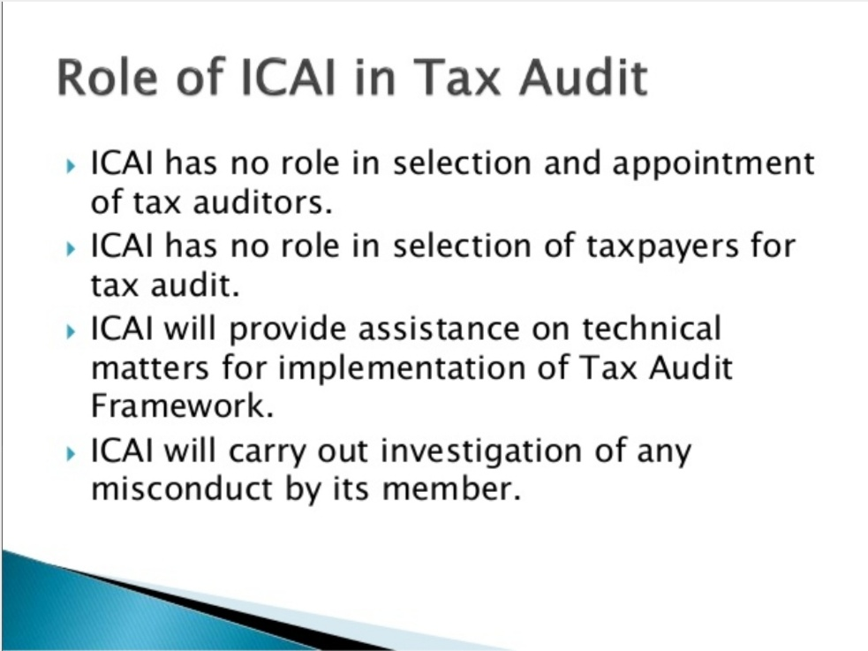

Slide 21
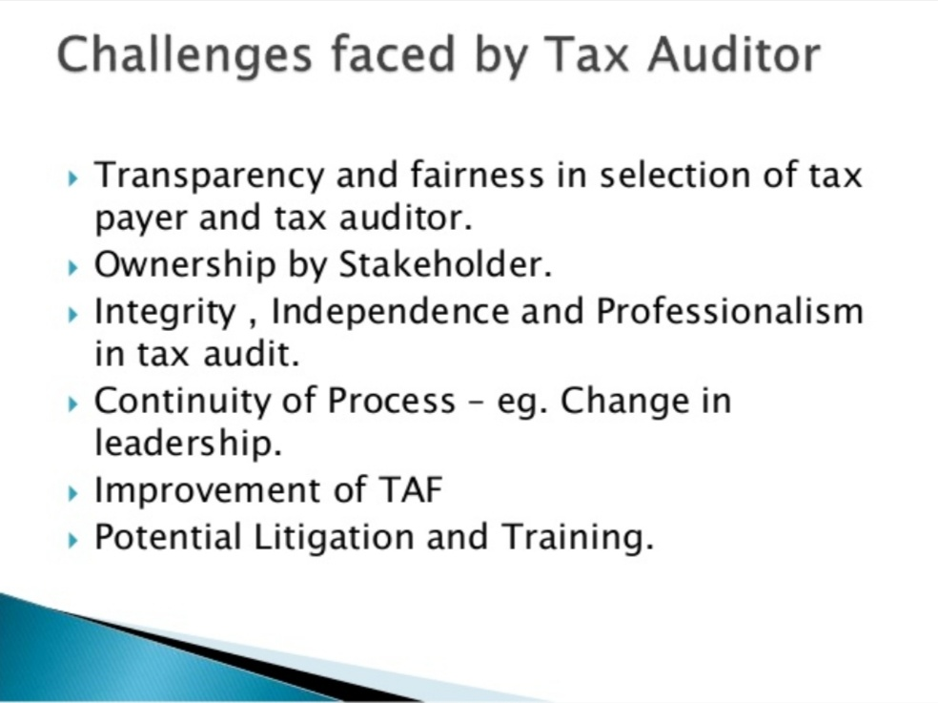

Slide 22
REFERENCE
www.google.com.
www. wikipedia.com.
www.studymafia.org

Slide 23
CONTACT DETAILS
EMAIL : dr.kaynattawar@gmail.com

Slide 24
THANK YOU

