Slide 1
SCHOOL OF STUDIES IN COMMERCE
VIKRAM UNIVERSITY, UJJAIN (M.P.)

Slide 2
AUDIT PROCEDURE / AUDIT PROCESS
LECTURE BY : DR. KAYNAT TAWAR

Slide 3
RELEVANT TOPICS ON AUDIT PROCEDURE / AUDIT PROCESS FOR
B.COM (HONS.)
B.B.A. (HONS.)
M.COM.

Slide 4
TOPICS
AUDIT PROCESS
AUDIT PLANNING
PLANNING
AUDIT PROGRAM
AUDIT REPORT
DISCUSSION DRAFT
EXIT CONFERENCE
AUDIT FINDING
EXIT CONFERENCE CHECKLIST
EXIT CONFERENCE
AUDIT EXIT CONFERENCE WP
FORMAL DRAFT
AUDIT REPORT
REPORT ISSUANCE CONTROL SHEET

Slide 5
FINAL REPORT
INDEPENDENT AUDITOR’S REPORT
CLIENT RESPONSE
CLIENT RESPONSE EXAMPLE
CLIENT COMMENTS
CLIENT COMMENT EXAMPLE
AUDIT FOLLOW UP
AUDIT
FOLLOWED UP REVIEW
FOLLOWED UP REPORT
AUDIT ANNUAL REPORT

Slide 6
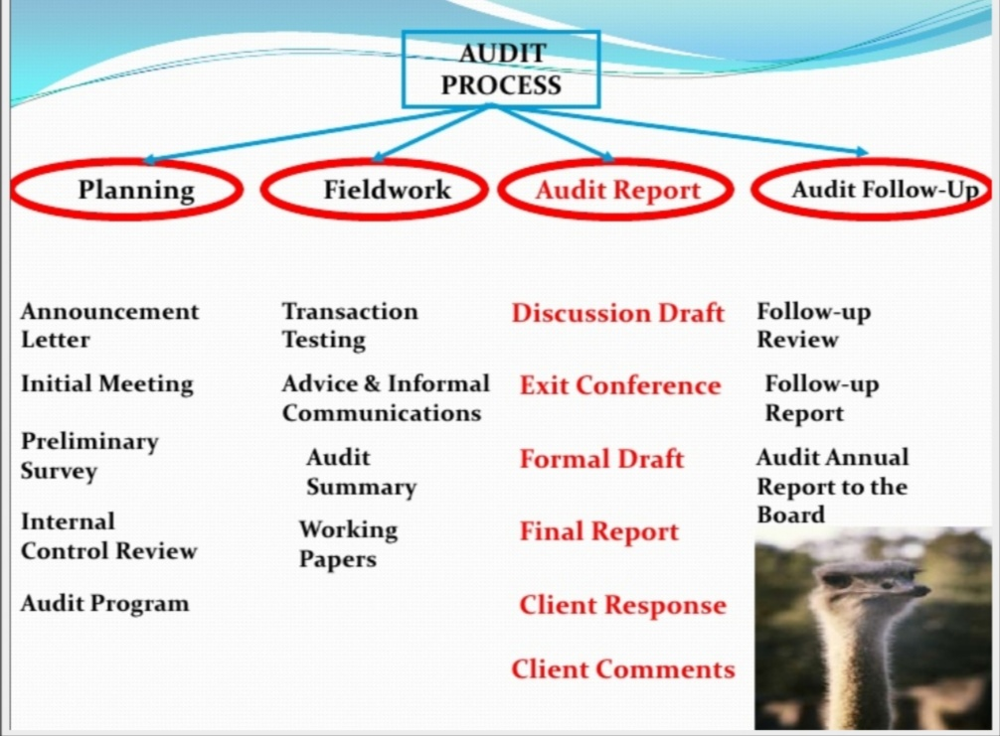

Slide 7
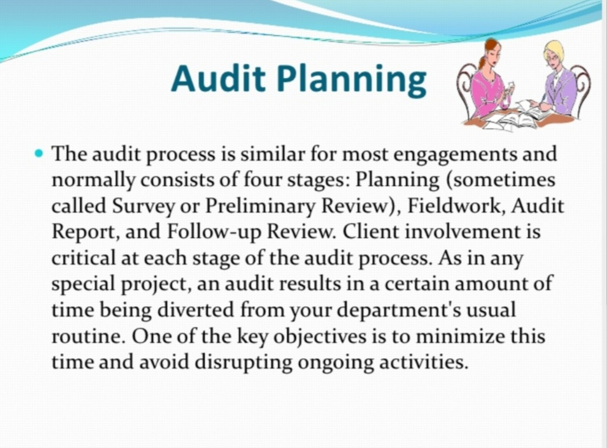

Slide 8
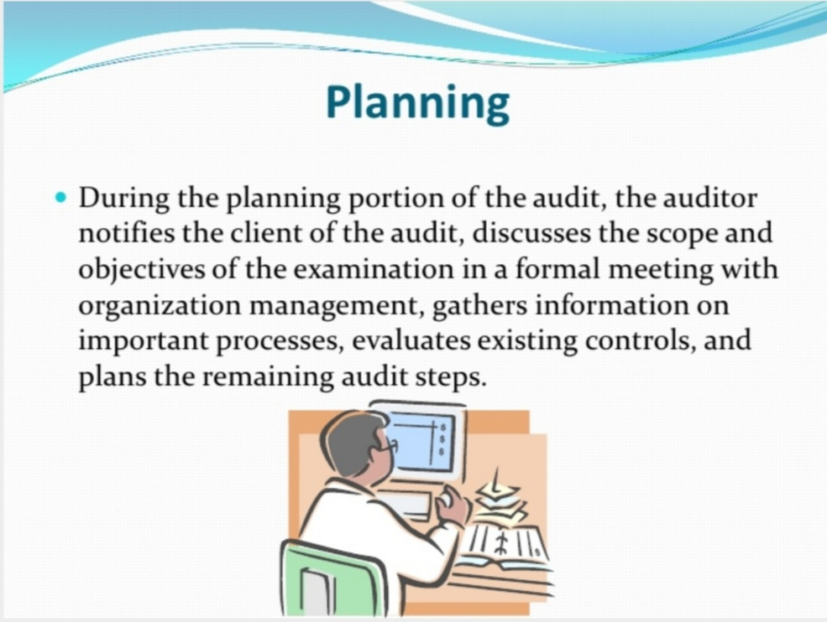

Slide 9
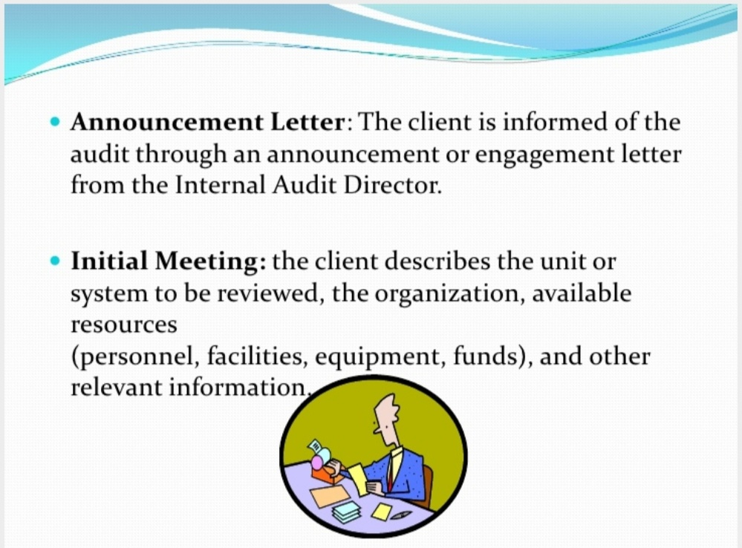

Slide 10
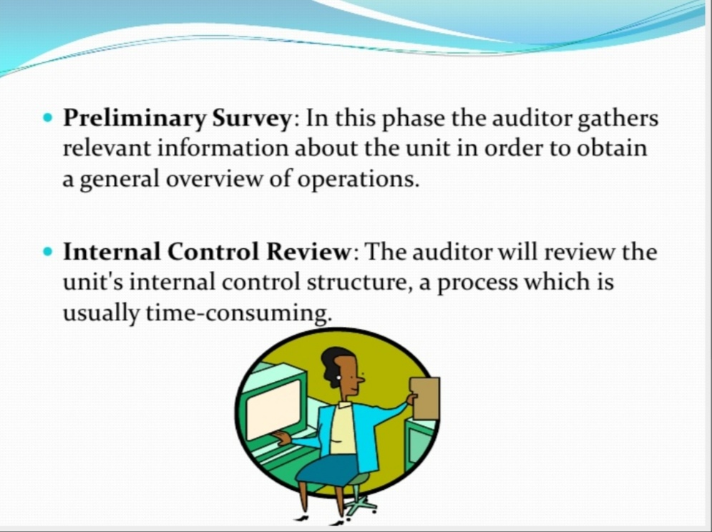

Slide 11
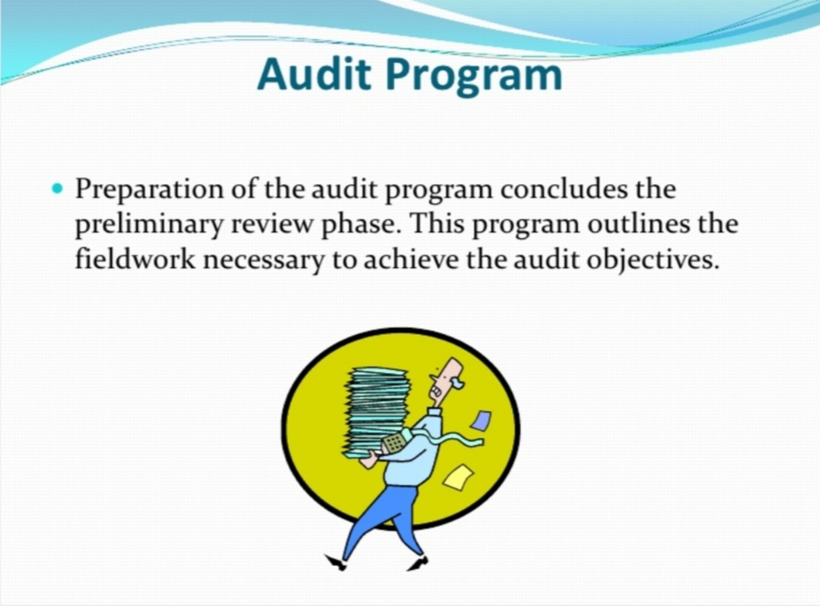

Slide 12
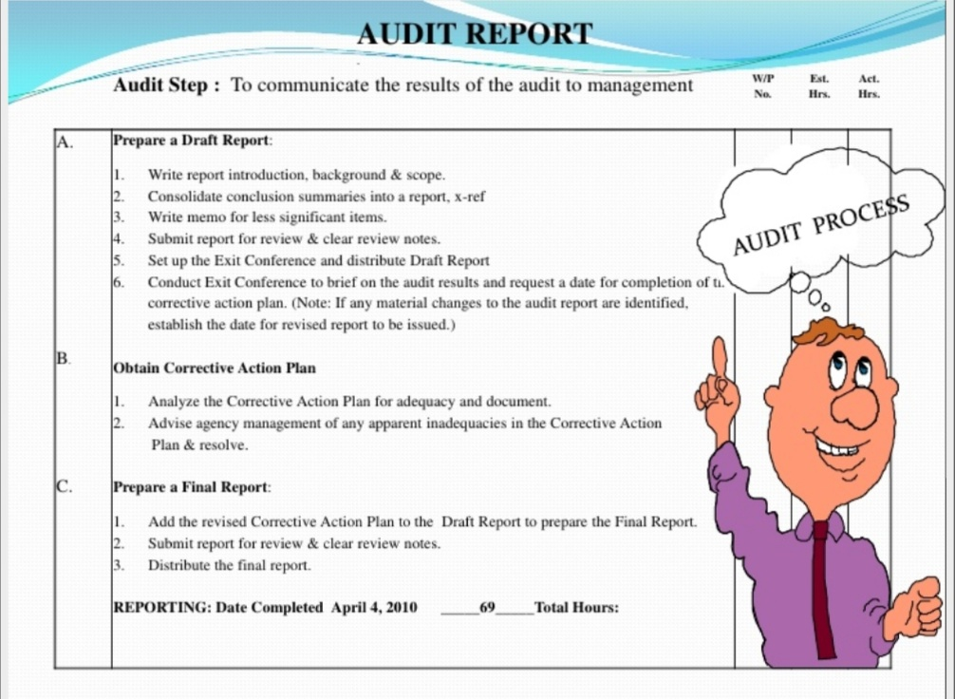

Slide 13
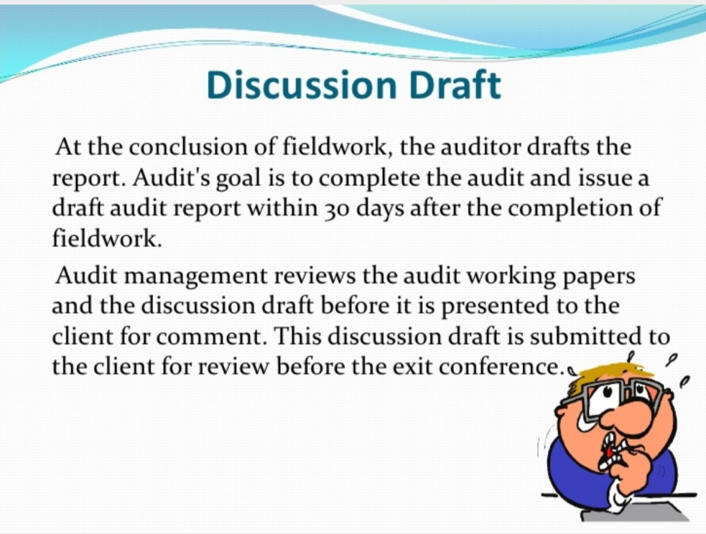

Slide 14
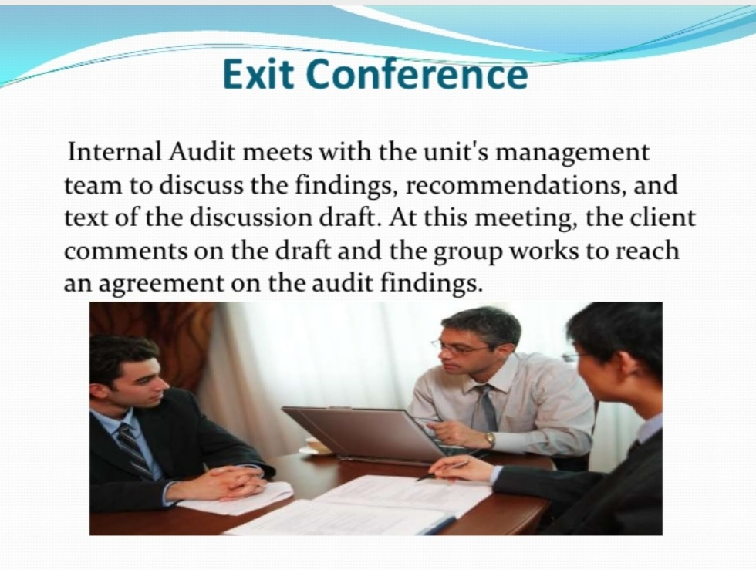

Slide 15
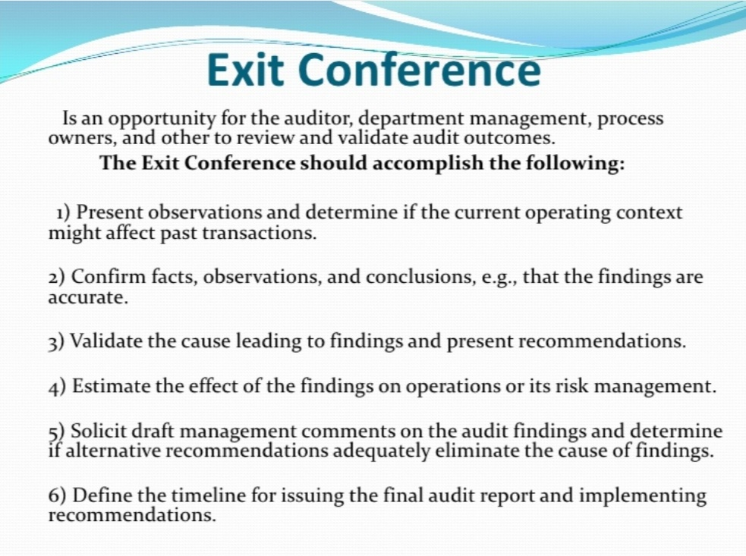

Slide 16
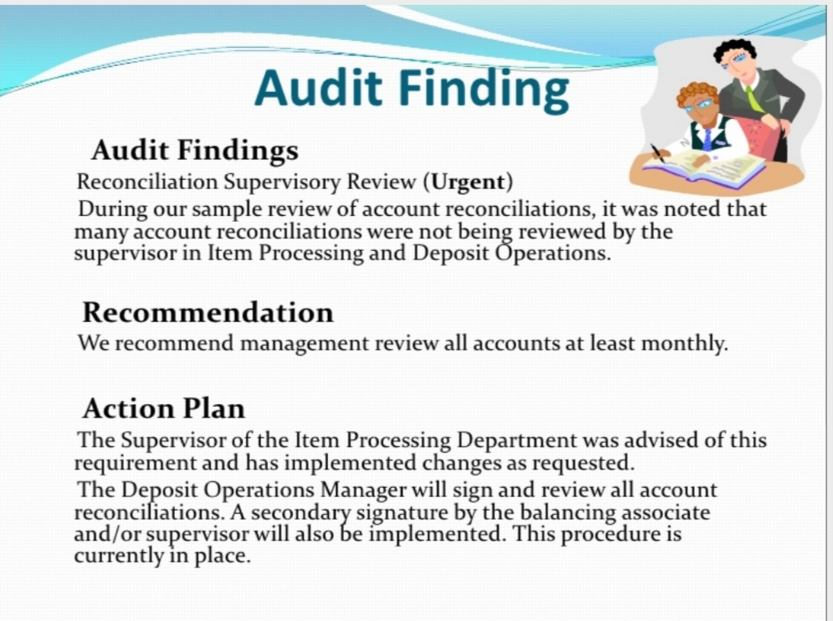

Slide 17
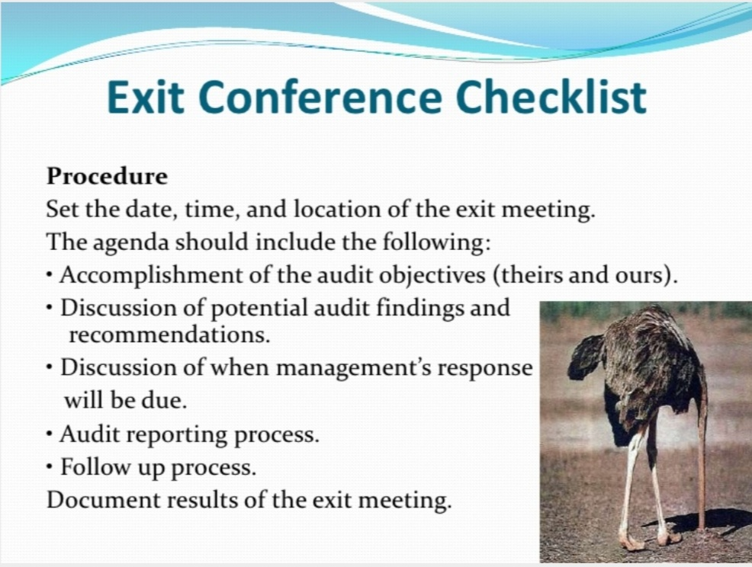

Slide 18
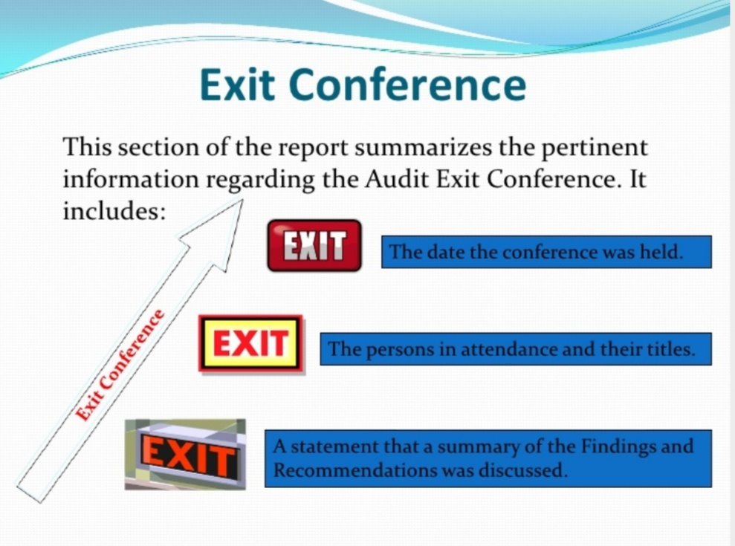

Slide 19
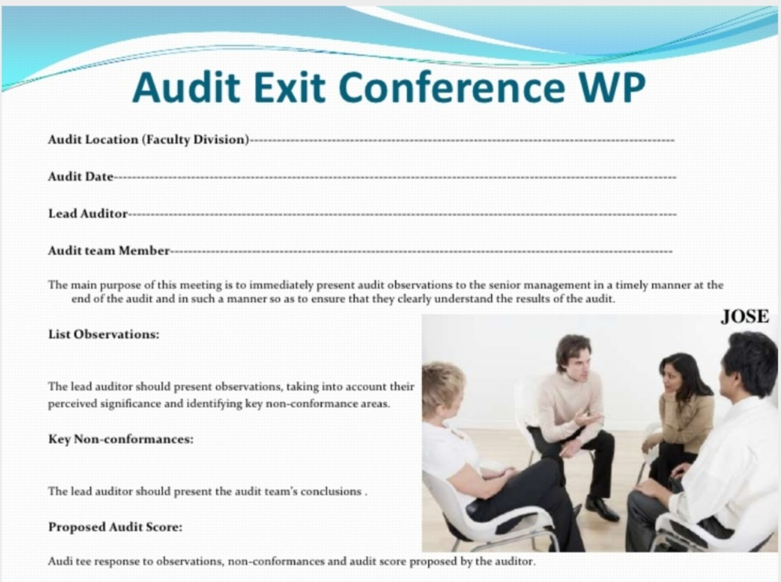

Slide 20
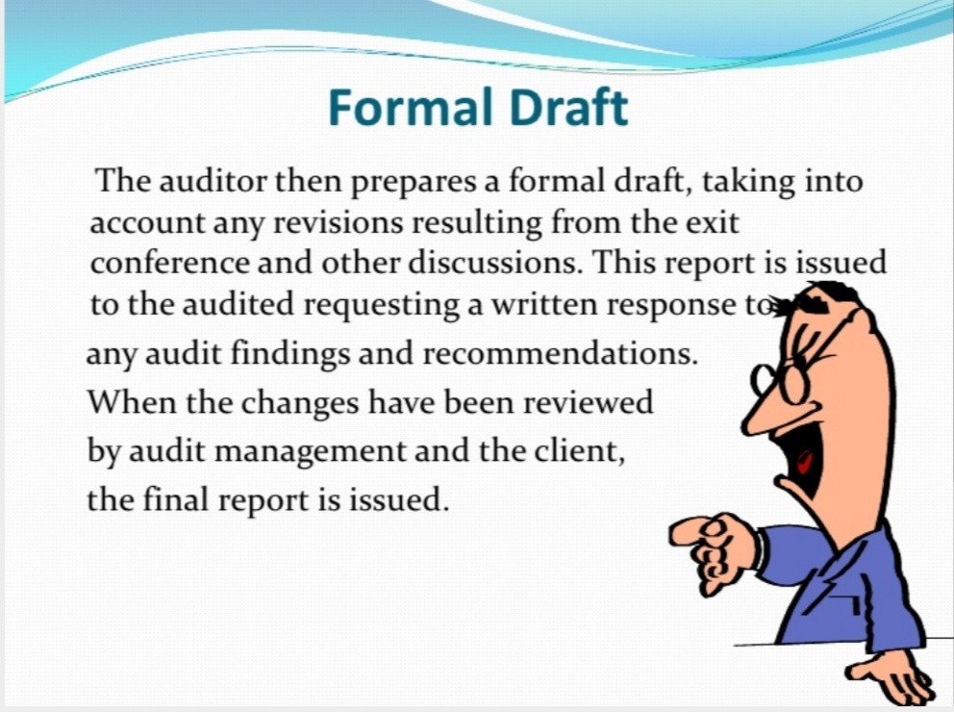

Slide 21
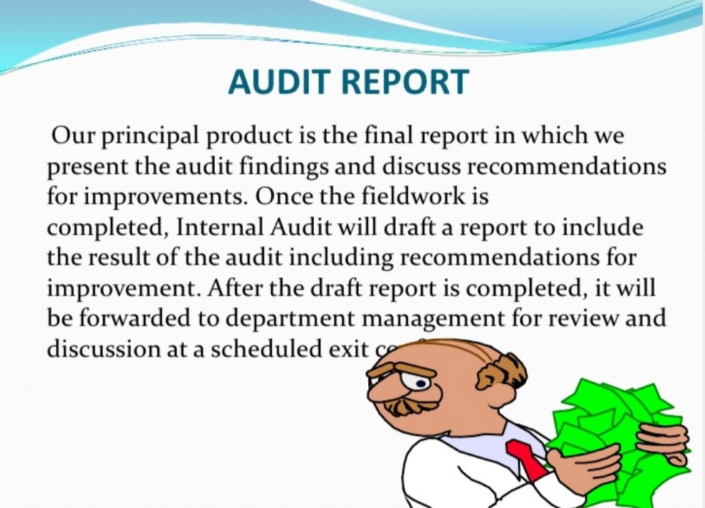

Slide 22
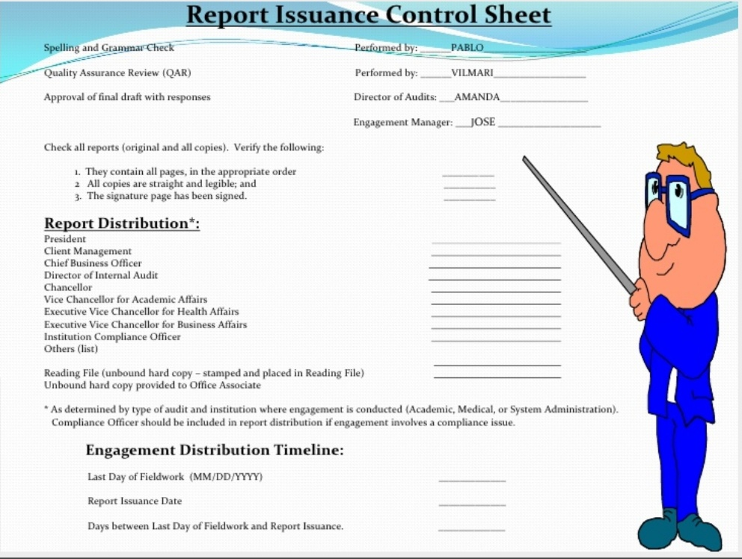

Slide 23
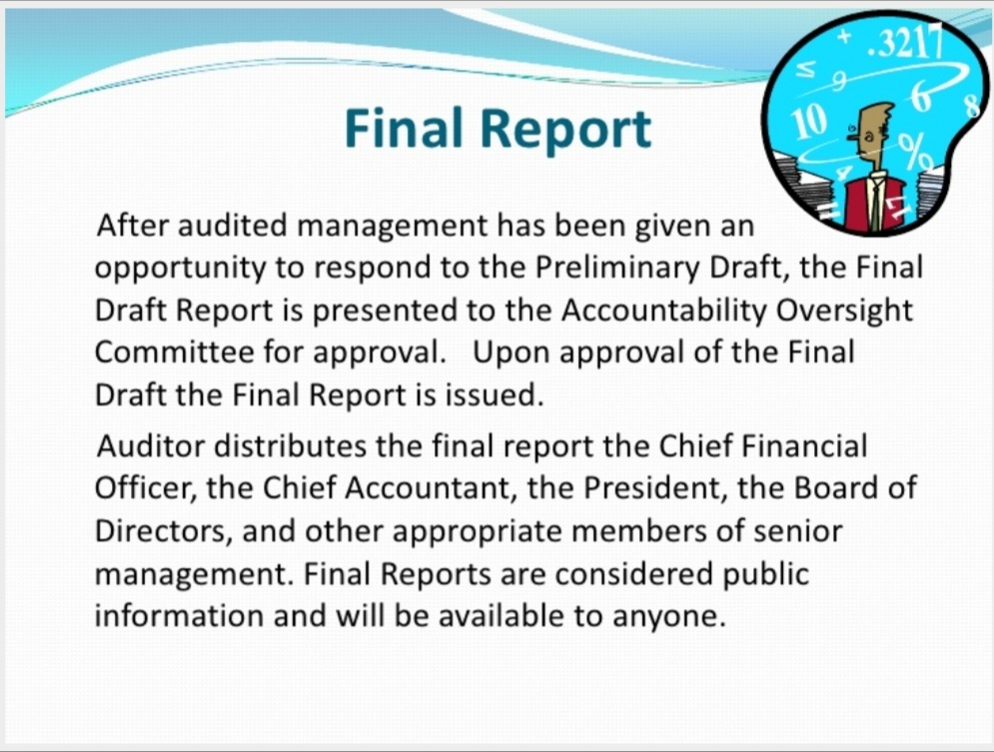

Slide 24
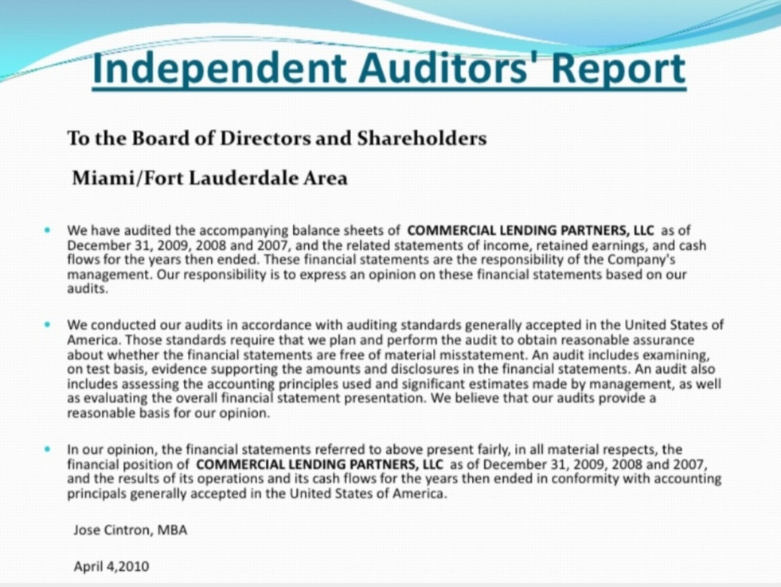

Slide 25
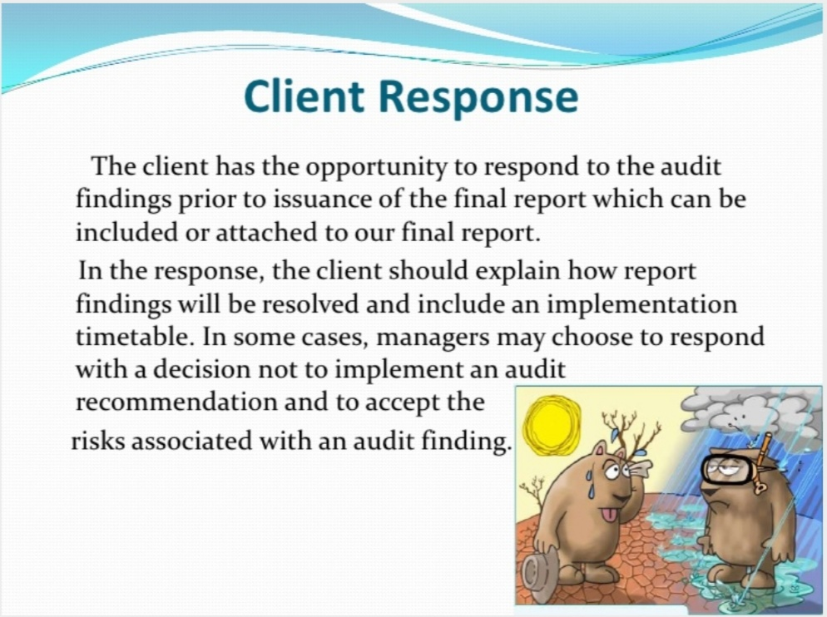

Slide 26
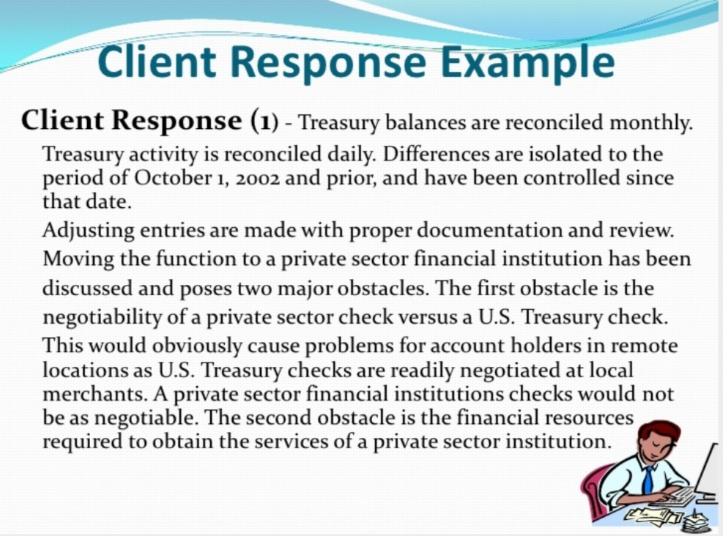

Slide 27
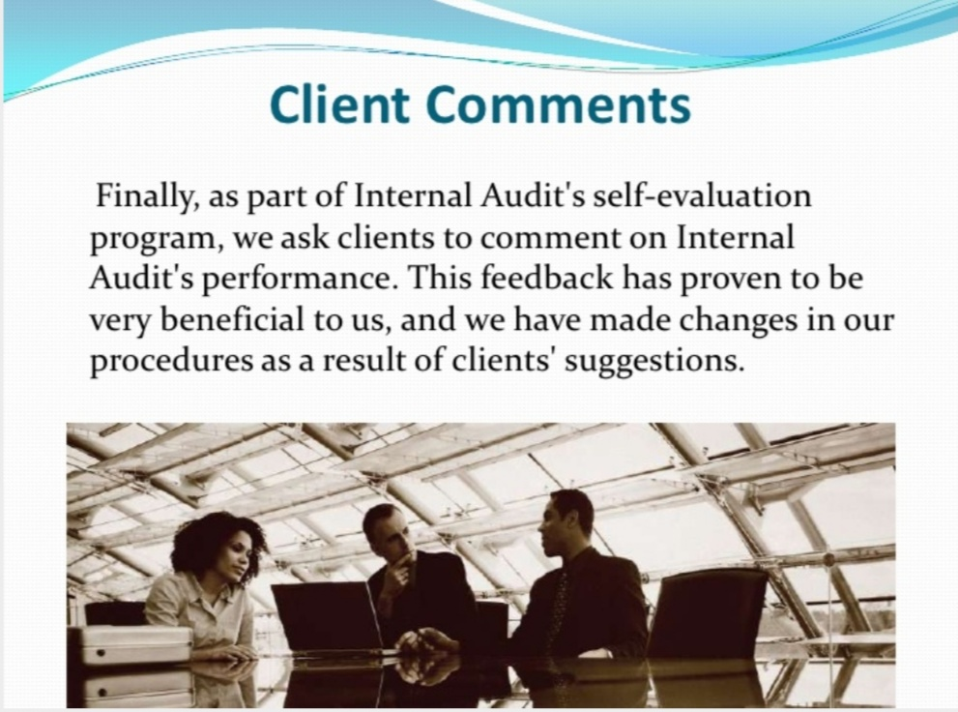

Slide 28
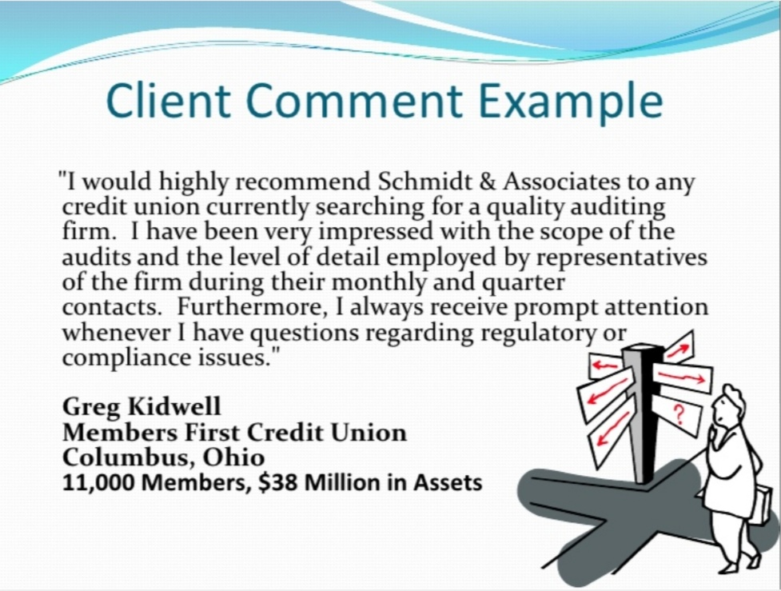

Slide 29
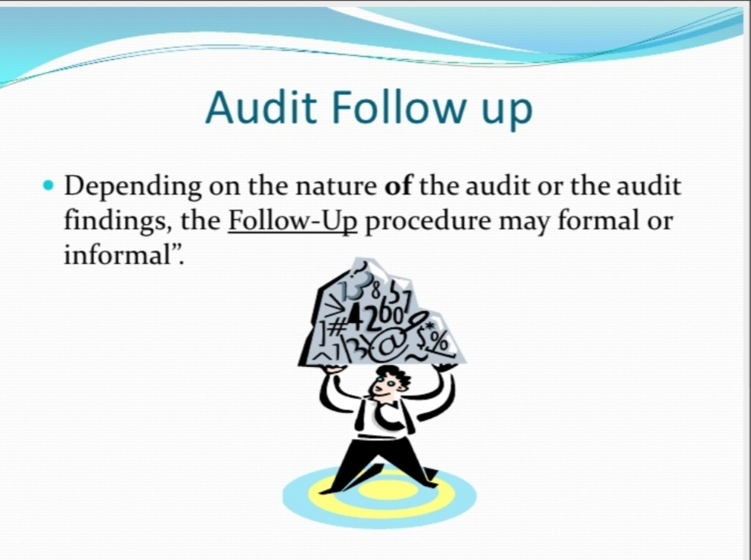

Slide 30
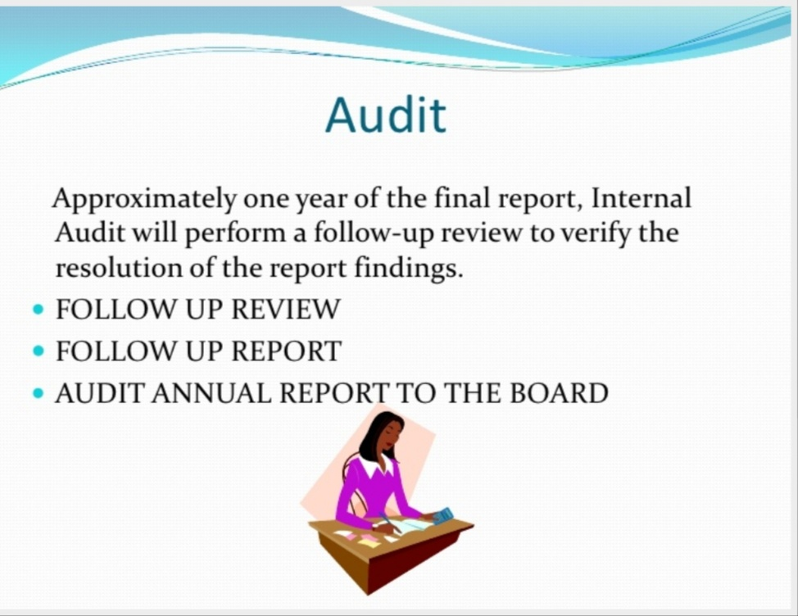

Slide 31
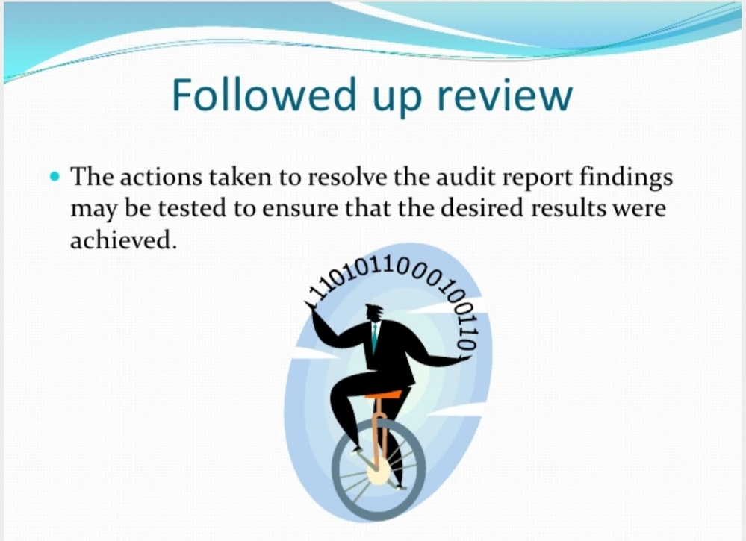

Slide 32
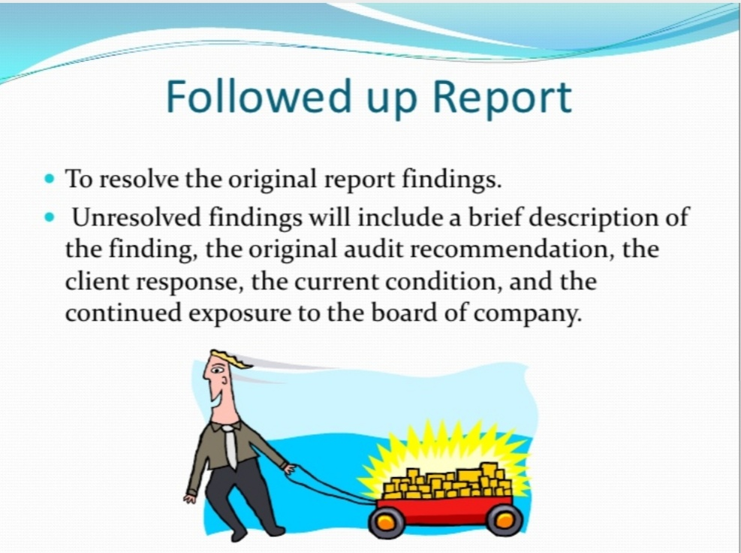

Slide 33
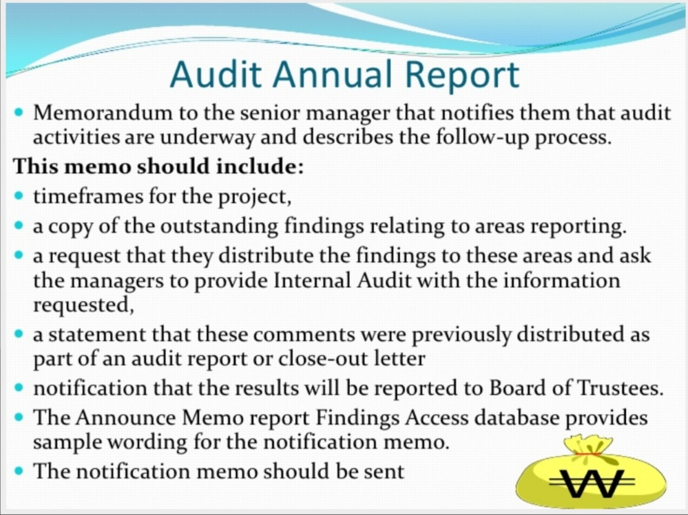

Slide 34
REFERENCE
www.google.com.
www. wikipedia.com.

Slide 35
CONTACT DETAILS
EMAIL : dr.kaynattawar@gmail.com

Slide 36
THANK YOU

