Slide 1
SCHOOL OF STUDIES IN COMMERCE
VIKRAM UNIVERSITY, UJJAIN (M.P.)

Slide 2
AUDITOR’S REPORT
LECTURE BY : DR. KAYNAT TAWAR

Slide 3
RELEVANT TOPICS ON AUDITOR’S REPORT FOR
B.COM (HONS.)
B.B.A. (HONS.)
M.COM.

Slide 4
TOPICS
* INTRODUCTION
* AUDIT REPORT
* MEANING AND DEFINITION
* IMPORTANCE
* BASIC ELEMENTS OF THE AUDIT REPORT
* CONTENTS OF AUDIT REPORT
* POINTS TO BE CONSIDERED WHILE PREPARING THE AUDIT REPORT
* TRUE AND FAIR CONCEPT
* TYPES OF AUDIT REPORT
* DISTINGUISH BETWEEN CLEAN REPORT AND QUALIFIED REPORT
AUDIT CERTIFICATE
* SIGNIFICANCE OF AUDIT CERTIFICATES
* DISTINGUISH BETWEEN AN AUDIT REPORT AND AUDIT CERTIFICATE

Slide 5
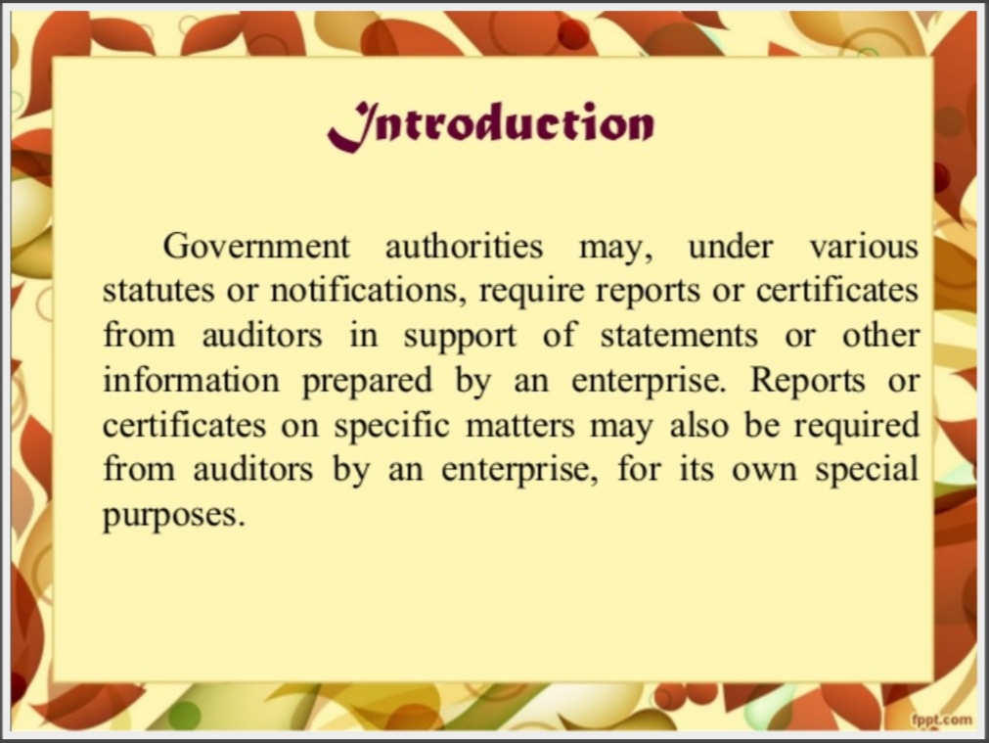

Slide 6
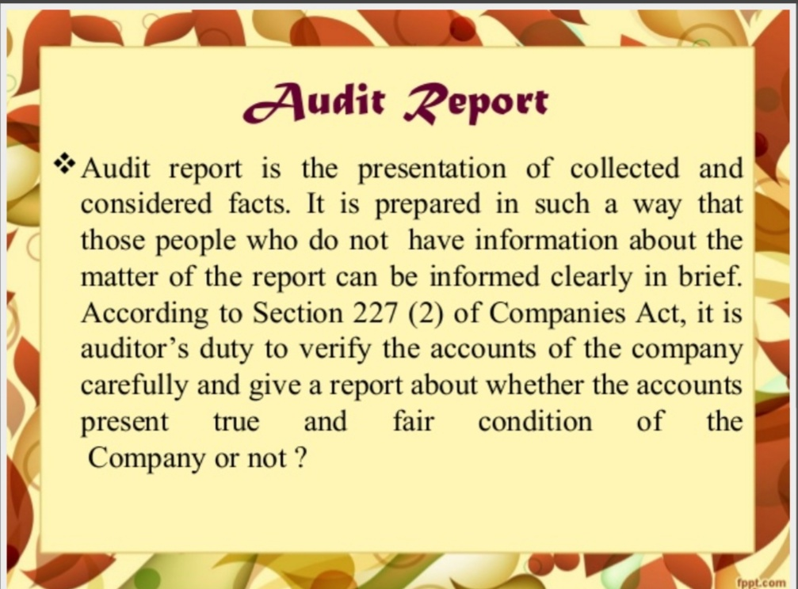

Slide 7
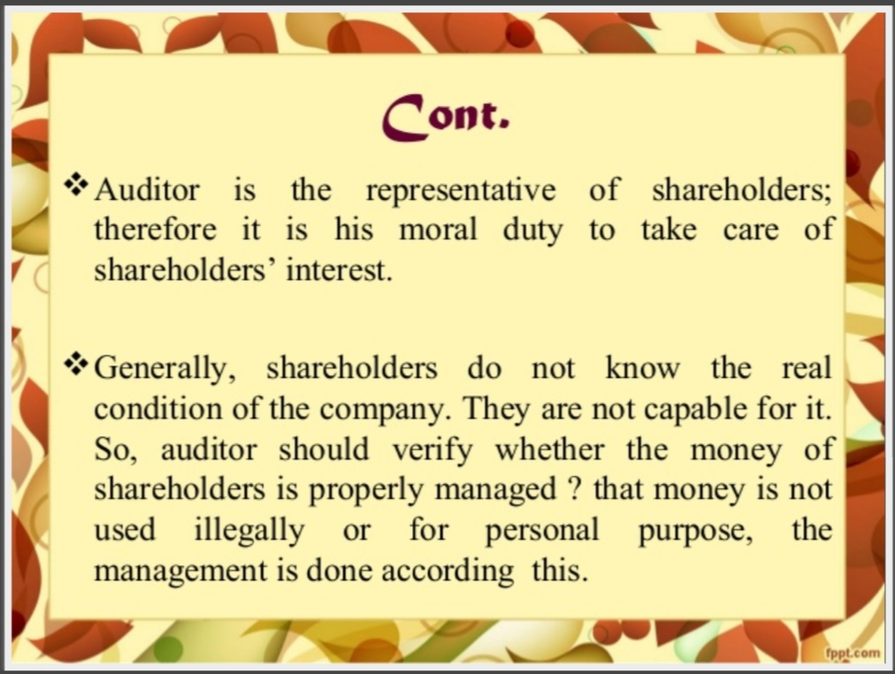

Slide 8
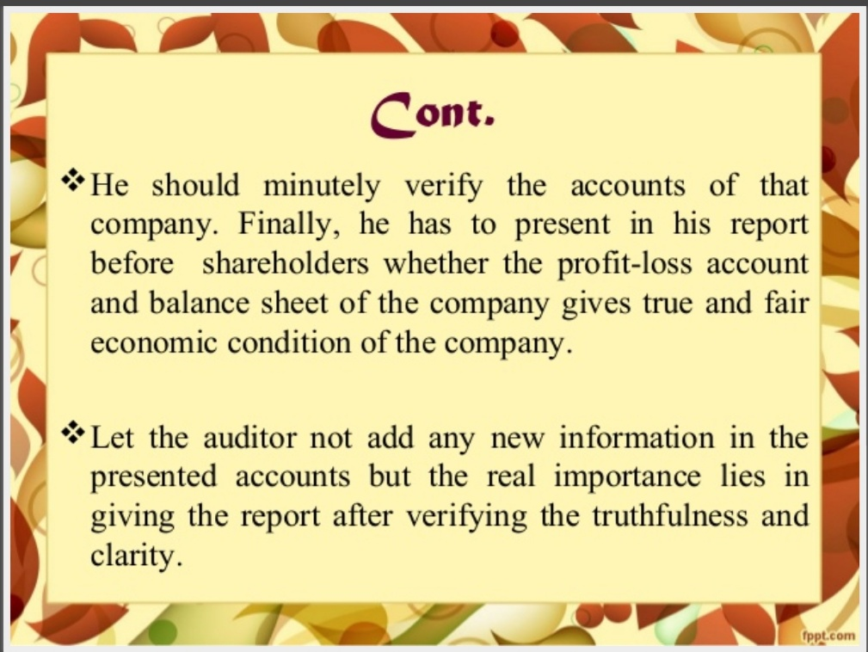

Slide 9
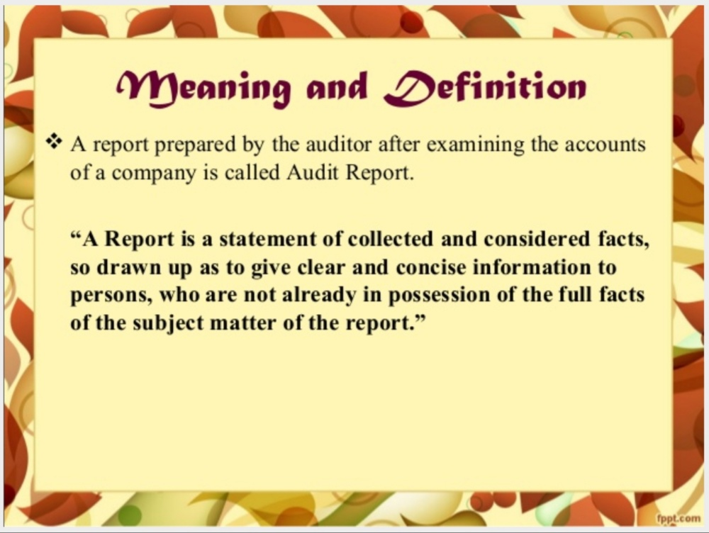

Slide 10
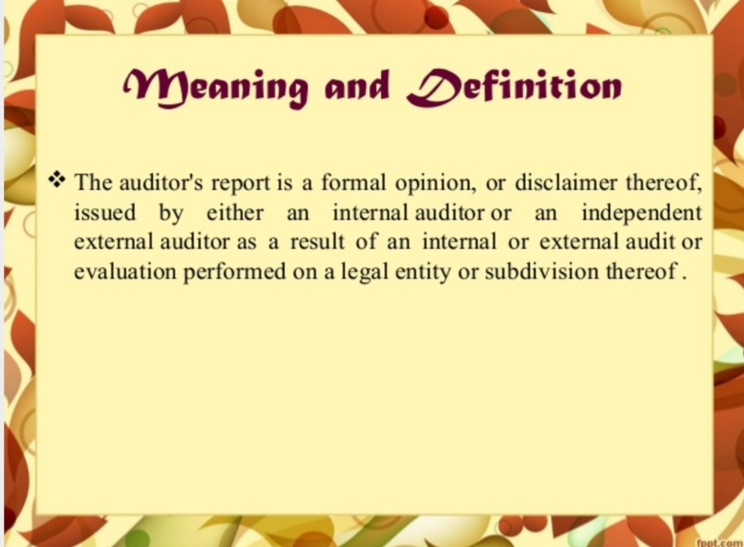

Slide 11
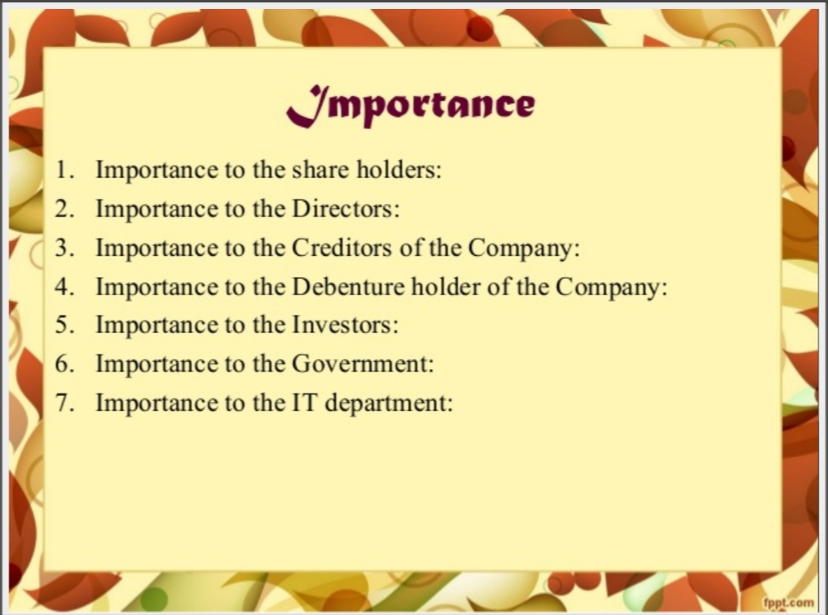

Slide 12
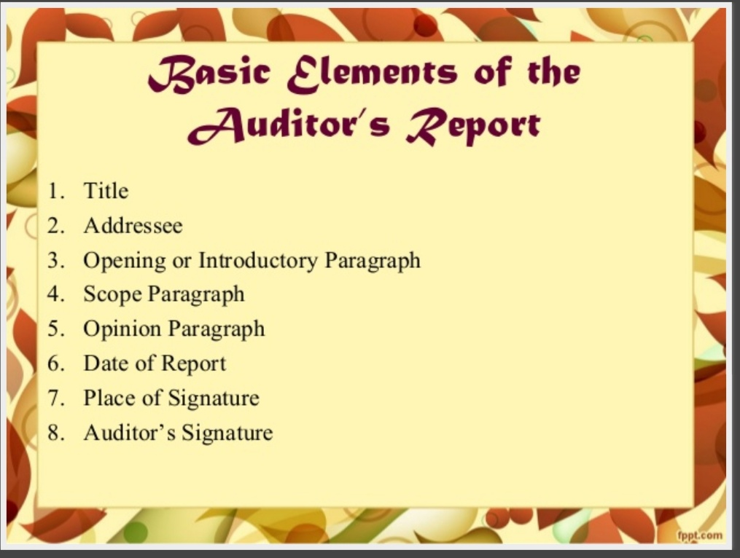

Slide 13
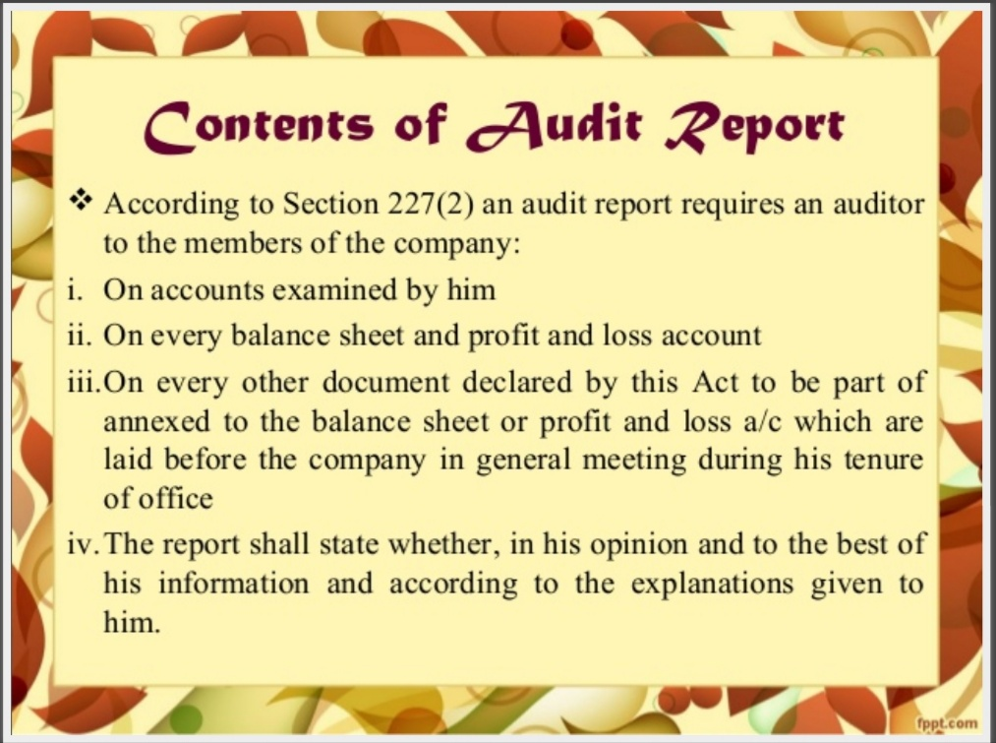

Slide 14
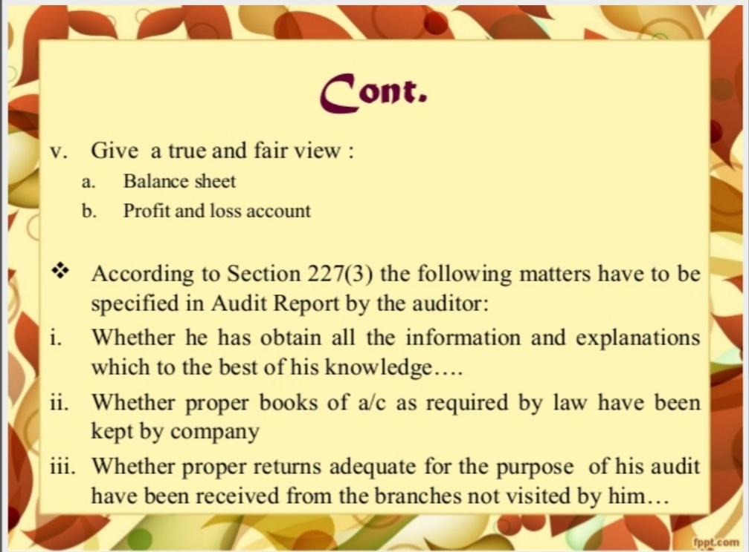

Slide 15
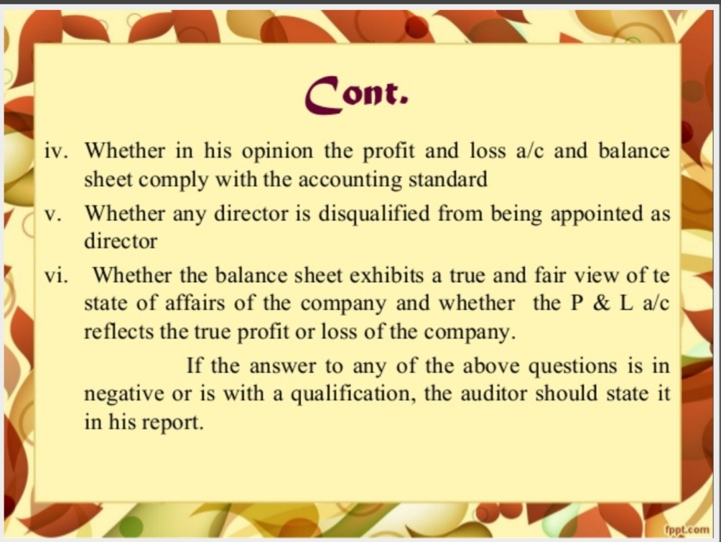

Slide 16
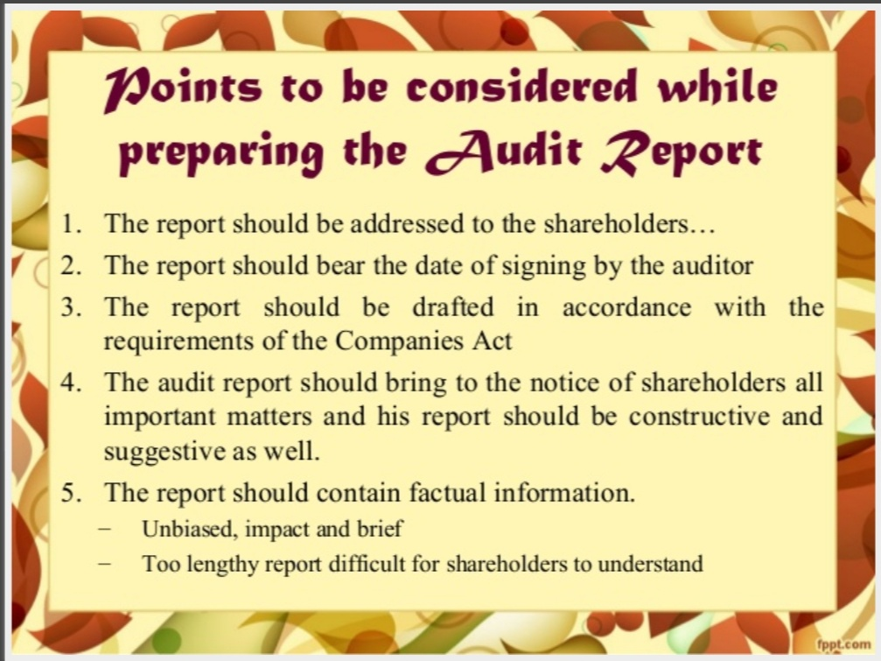

Slide 17
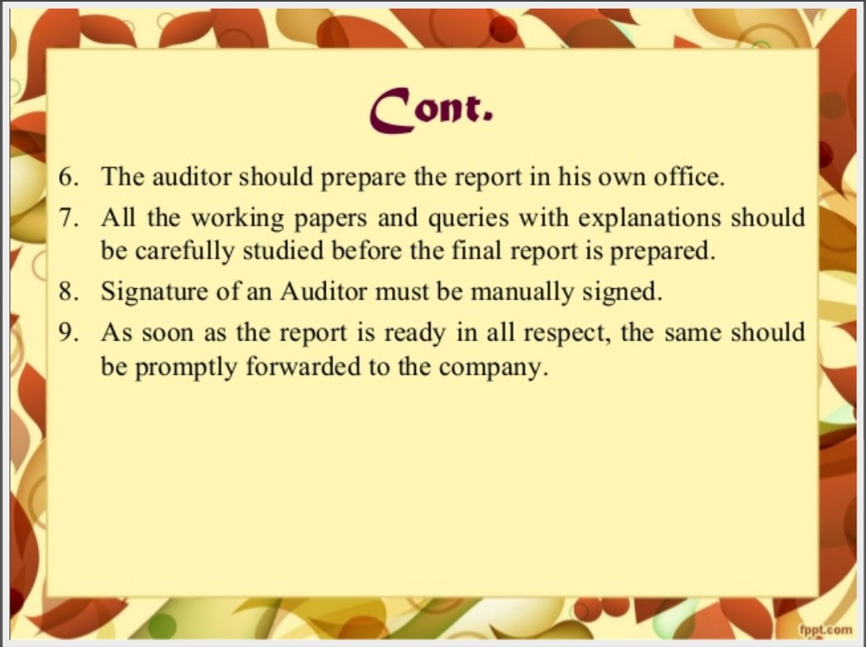

Slide 18
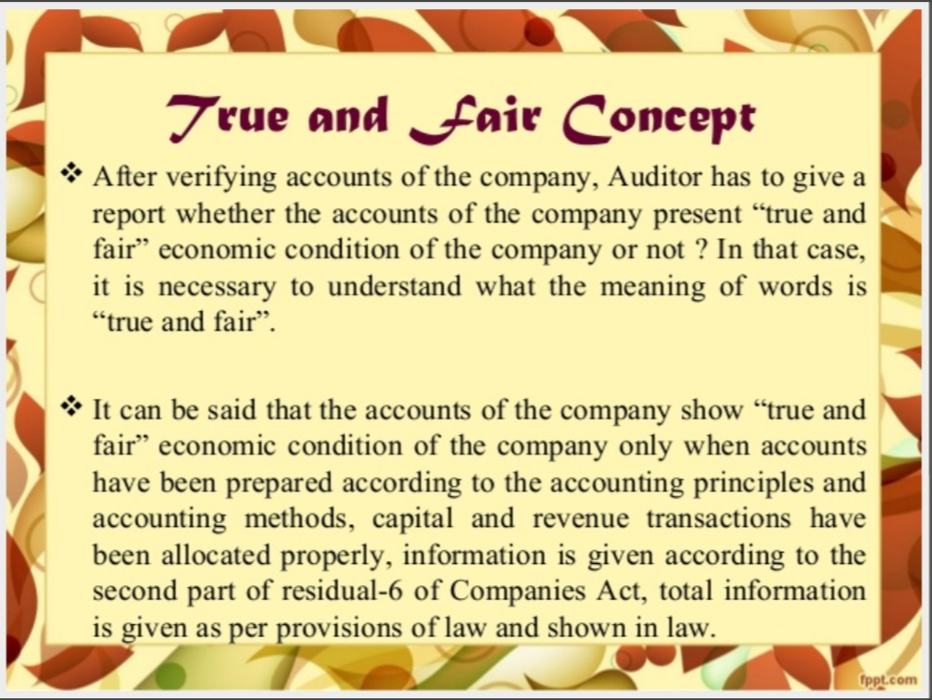

Slide 19
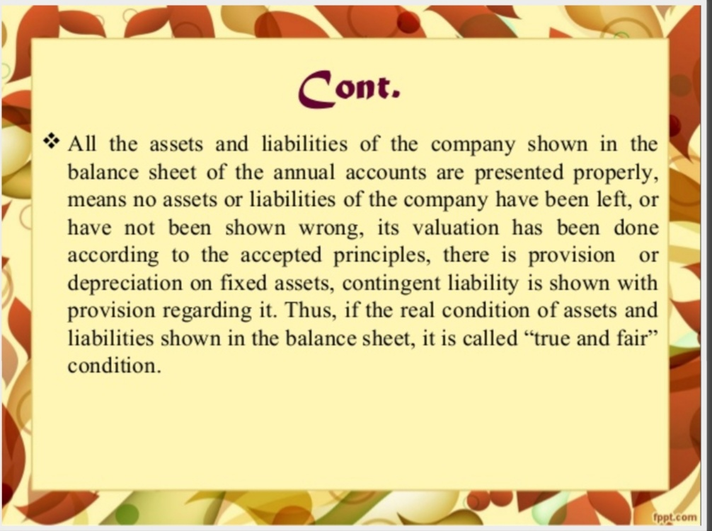

Slide 20
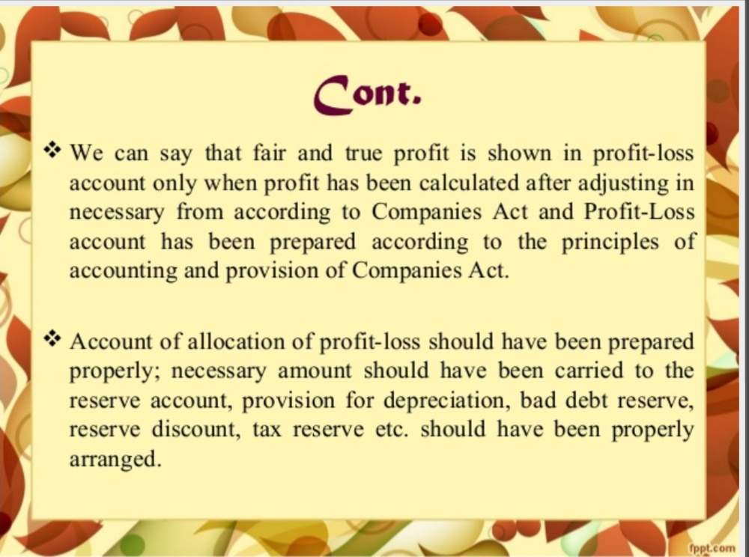

Slide 21
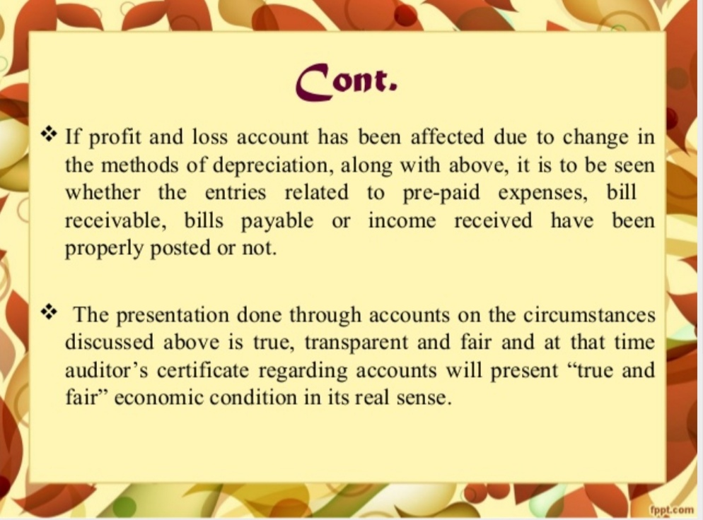

Slide 22
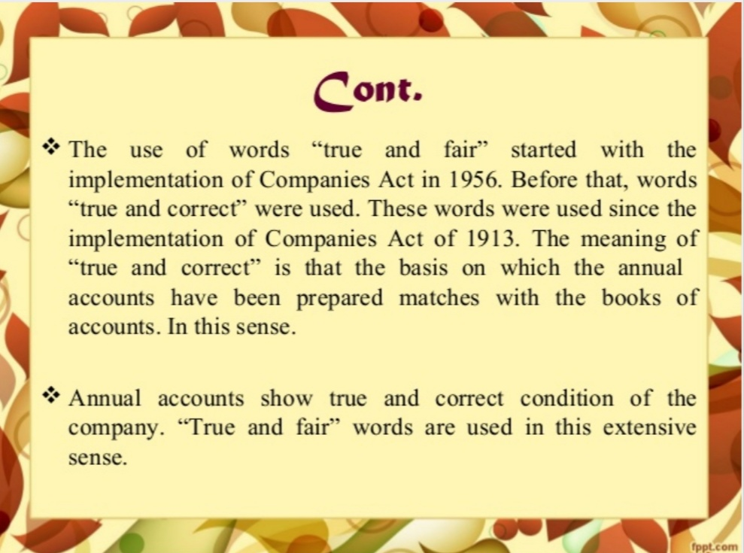

Slide 23
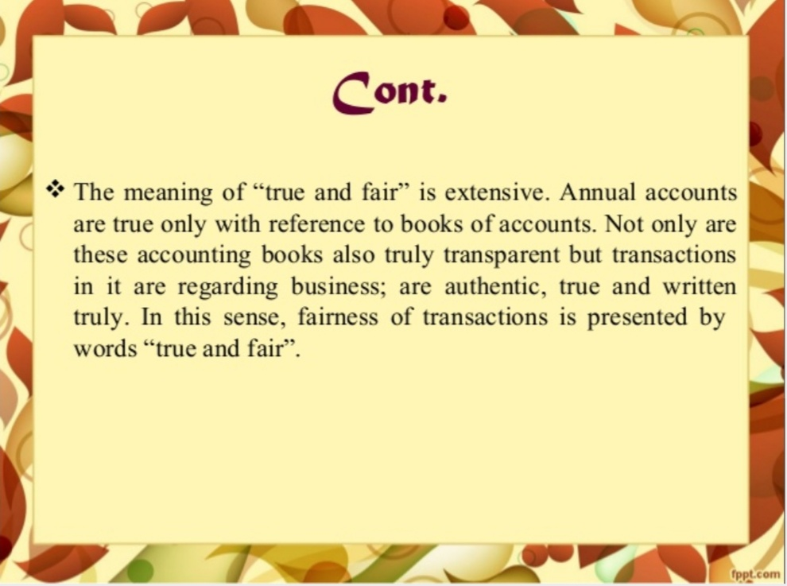

Slide 24
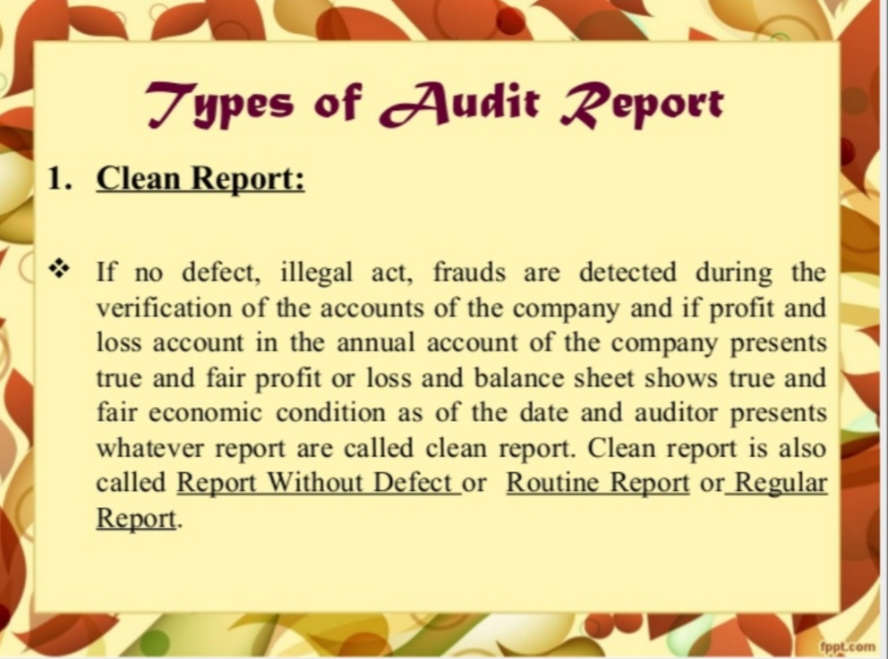

Slide 25
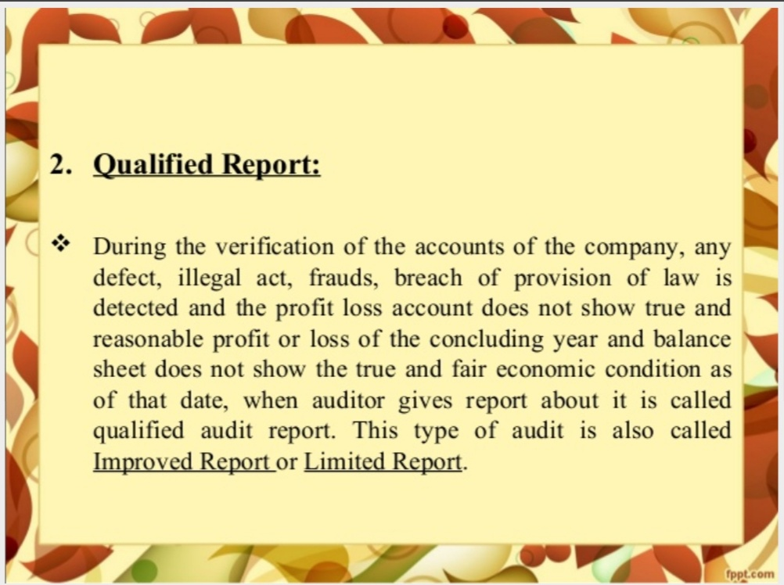

Slide 26
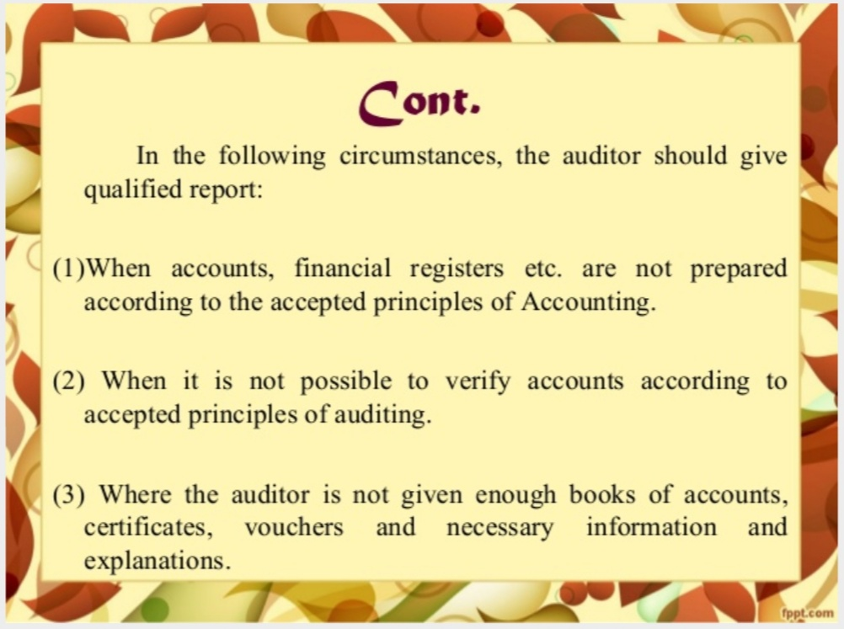

Slide 27
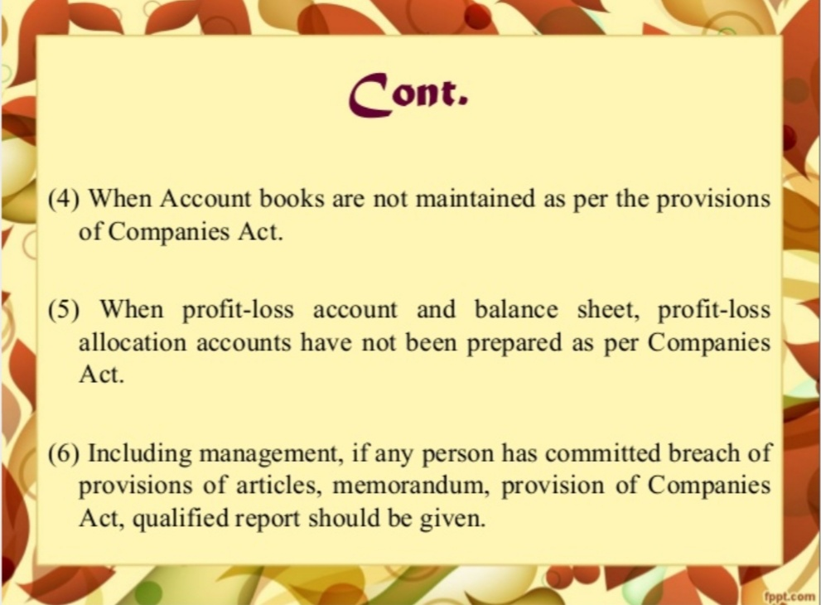

Slide 28
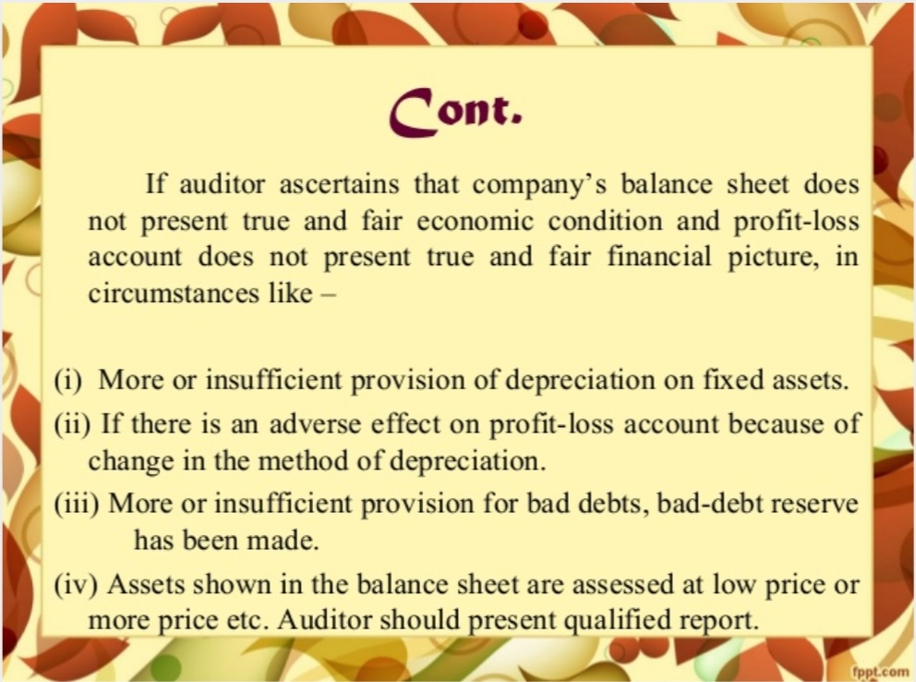

Slide 29
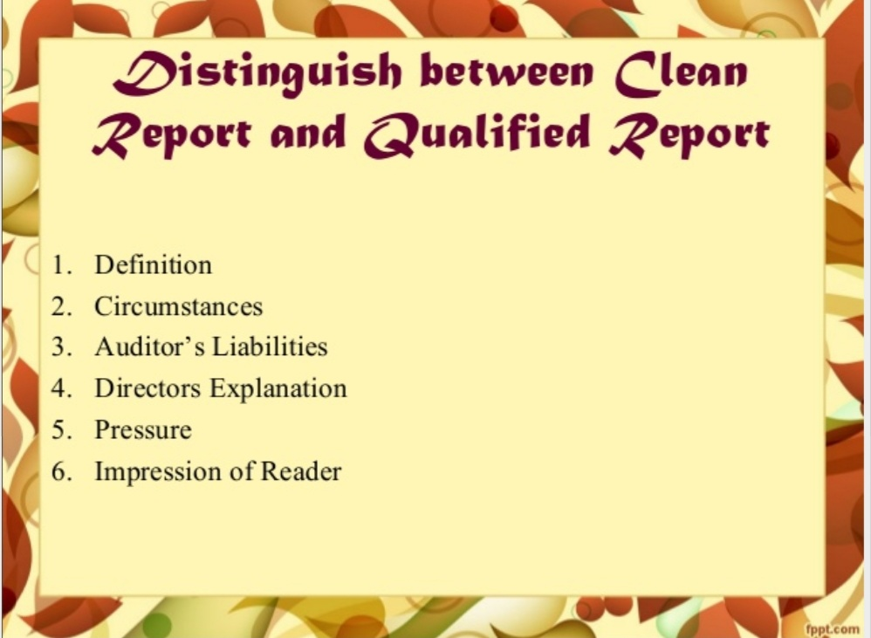

Slide 30
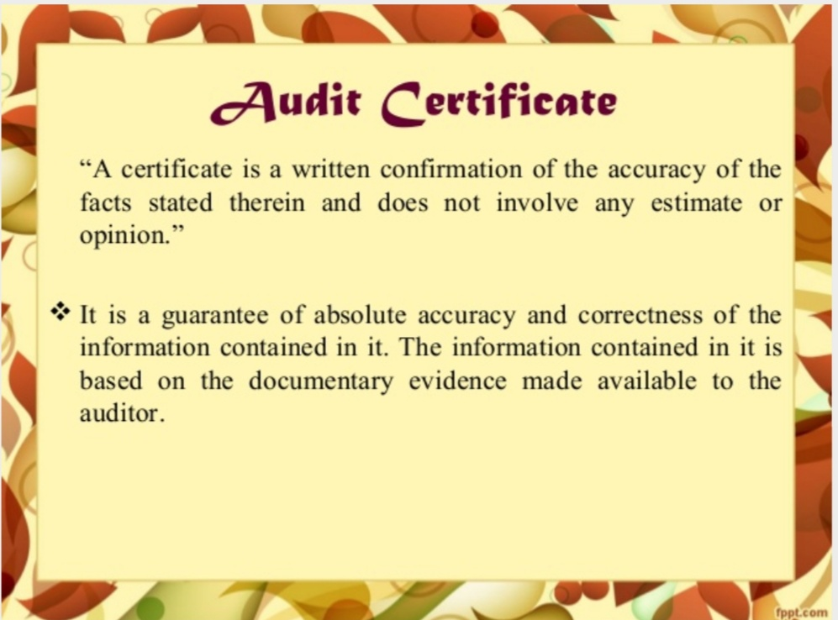

Slide 31
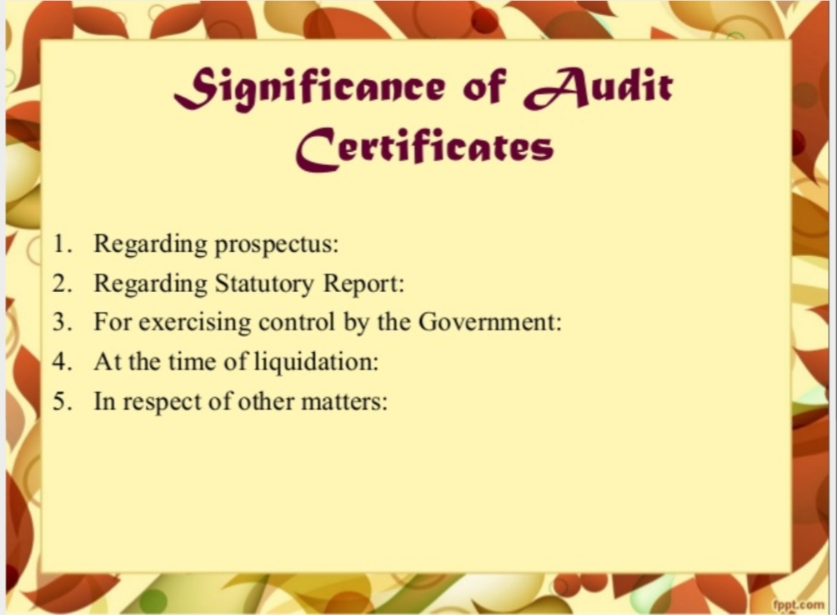

Slide 32
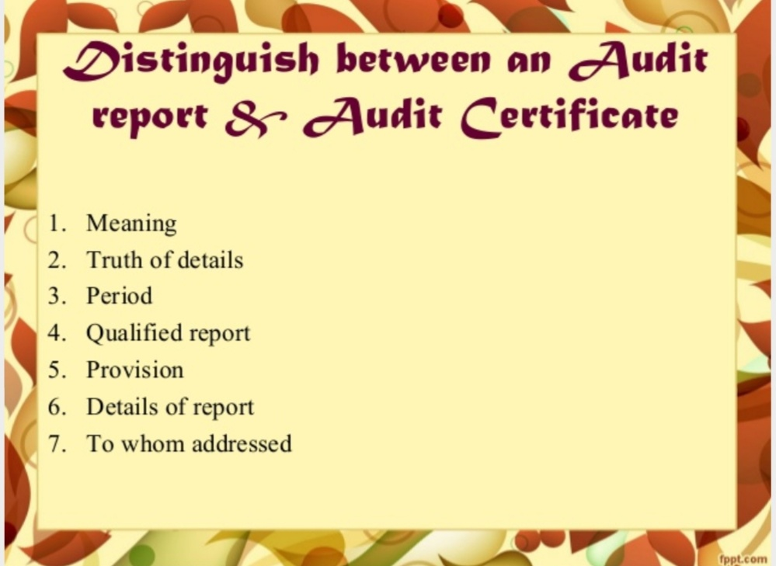

Slide 33
REFERENCE
www.google.com.
www. wikipedia.com.

Slide 34
CONTACT DETAILS
EMAIL : dr.kaynattawar@gmail.com

Slide 35
THANK YOU

