Slide 1
SCHOOL OF STUDIES IN COMMERCE
VIKRAM UNIVERSITY, UJJAIN (M.P.)

Slide 2
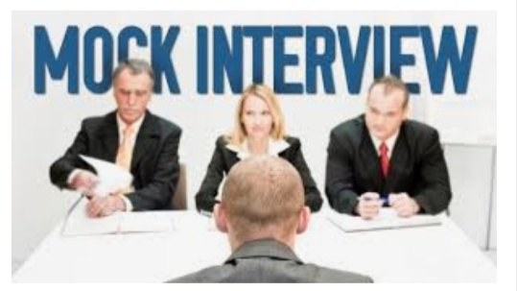
MOCK INTERVIEW
LECTURE BY :
DR. KAYNAT TAWAR

Slide 3
RELEVANT TOPICS ON MOCK INTERVIEW
FOR
B.COM (HONS.)
B.B.A. (HONS.)
M.COM.

Slide 4
TOPICS
What is a Mock Interview?
Purpose
Scheduling / Preparing
No-Show Policy
Optional Recording of Mock Interview
What to Expect: From Start to Finish
Preparing for your Mock Interview
First Impressions
Dress for Success
Image Tips for Men
Image Tips for Women
Image Tips for All

Slide 5
Body Image
Voice Image
INTERVIEWING ATTIRE
Be Prepared
Interview Checklist
Central Themes of Questions
How will the questions be asked?
Questions
How Do You Formulate Your Answers?
Interview Types
Handling negatives or objections
Discussing a weakness

Slide 6
Illegal Questions
Asking Questions
The Close
How You Will Be Evaluated

Slide 7

What is a Mock Interview?
A simulation interview conducted by Career Advisors.
The role of a mock interviewer is to advise about interviewing and appropriate questions to ask as well as to guide you to resources about interviewing.

Slide 8

Purpose
Through practice, increase comfort and confidence during the interview process and enhance interviewing skills.
Provide feedback to aid in assessing current strengths and weaknesses with your interviewing skills.

Slide 9

Scheduling / Preparing
Call the front desk at 540-231-6241 to schedule your mock interview.
After scheduling, you will receive a confirmation e-mail with information to help you prepare, including information about interview attire.
At least 24 business hours before your interview reply to your confirmation e-mail with your updated resume, personal statement, job description, or other helpful documents for your mock interviewer to review.
Review the interviewing section in the career planning guide as well as tips provided throughout this document.
Business/ professional dress is required for your mock interview.
Arrive 10-15 minutes early for your mock interview and check in at the front desk.

Slide 10

No-Show Policy
Missed mock interviews take time away from other students seeking mock interviews or appointments. Cancellations must be made 24 business hours before the interview appointment. If you fail to cancel at least one day before the interview or simply do not show up, you must wait at least one week to schedule another mock interview.

Slide 11
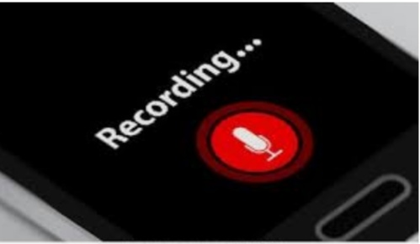
Optional Recording of Mock Interview
If you choose to have your interview recorded, it will be shared with you via Google drive. Watching back your interview can help you better present your skills, abilities, and professionalism in the future.

Slide 12
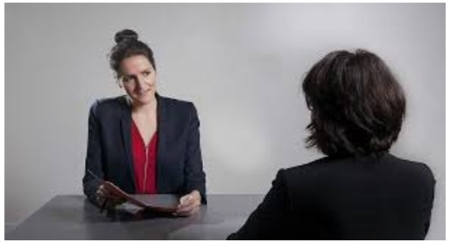
What to Expect: From Start to Finish
Your mock interview experience begins the moment that your interviewer greets you in the waiting area.
Start with a firm handshake and professional greeting.
The mock interview will last about 30 minutes, and the interview will be critiqued for 15-30 minutes.
At the end of your interview you will have the opportunity to discuss any particular questions or concerns about interviewing with your interviewer.

Slide 13

Preparing for your Mock Interview
Preparation and practice are key ingredients to a successful interview. Use this packet and the career planning guide to prepare for both your mock interview as well as future interviews.
As you prepare:
* Understand and be able to express your attributes/ personality in relation to the position/ graduate or professional school program.
*Research the company/ organization/ school, your field, the position, the graduate program.
* Know your goals (professional, education) and be able to express them to the interviewer.
* Think of stories and examples you would like to highlight during the interview.
* Practice telling your stories to smooth out the details.

Slide 14
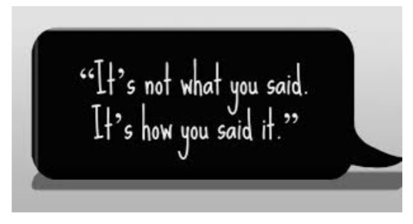
First Impressions
The first words you speak count
It is a pleasure meeting with you
Thank you for scheduling this time to meet.
Walk with vigor and show confidence
People who walk 10% faster than they normally do are perceived as getting more done

Slide 15

Dress for Success
*From head to toe should reflect impeccable grooming. Your hair, collar, tie/scarf and other accessories should be a reflection of the quality person you are.
*It is a fact of life that we do “judge books by their covers.” To be marketable in business today, your image is as important as what you know. You must “fit in.”

Slide 16
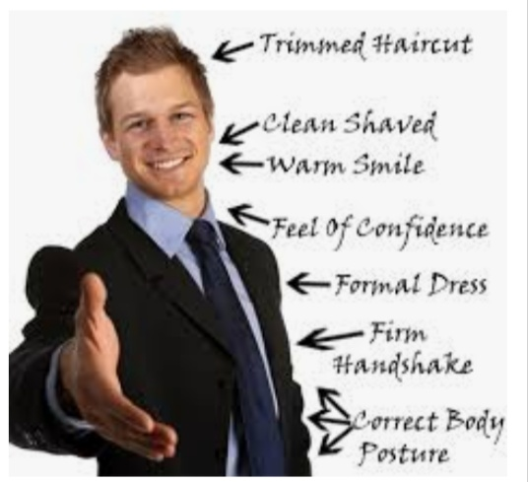
Image Tips for Men
Suits :
Invest in a conservative color (navy or gray).
Jacket and trousers should coordinate.
Check for proper fit.
Best investment; worsted wool or wool gabardine
Do the wrinkle test

Slide 17

Shirts :
Long sleeve white shirt is the best option
A light blue is an alternative
Shirts in 100% cotton are a good investment
Have it professionally ironed for the interview

Slide 18
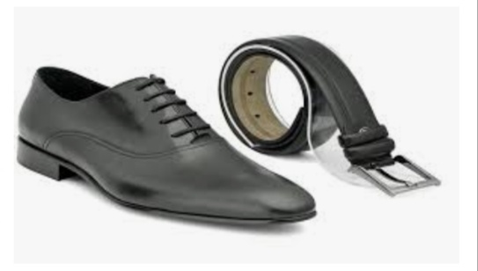
Belts and Shoes :
Leather belts in black and burgundy to match your shoes are good investments
Wing-tips portray a more conservative image than tassel loafers
Wear socks that cover you calf and match your trouser

Slide 19
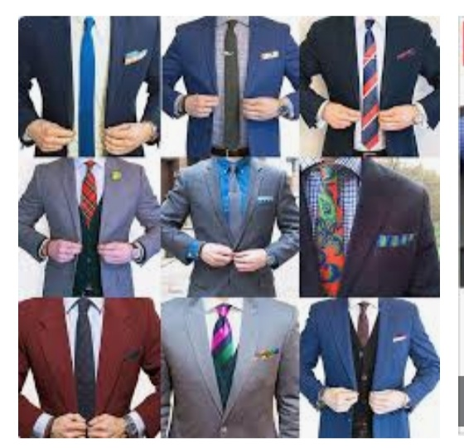
Ties :
The smaller the pattern, the more authority you will project.
Use a power color (yellow or red) in the pattern
The tip of the tie should barely touch the top of your belt buckle
The knot should be small

Slide 20
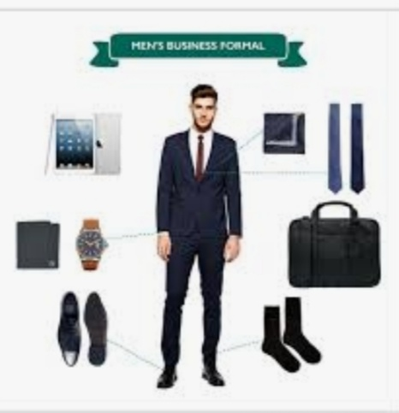

Slide 21
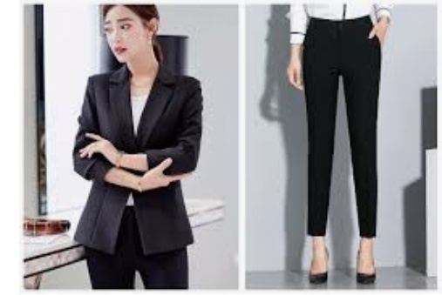
Image Tips for Women
Suits :
Navy, gray, taupe and black are all good suit colors to invest in when building a wardrobe
Skirts should be no shorter than 2 inches above the knee
Worsted wool is the best

Slide 22

Dresses :
Suits show more authority but a dress is a second option
Conservative colors are best
No shorter than 2 inches above the knee
Wrinkle free fabric is best
Keep with classic styles

Slide 23
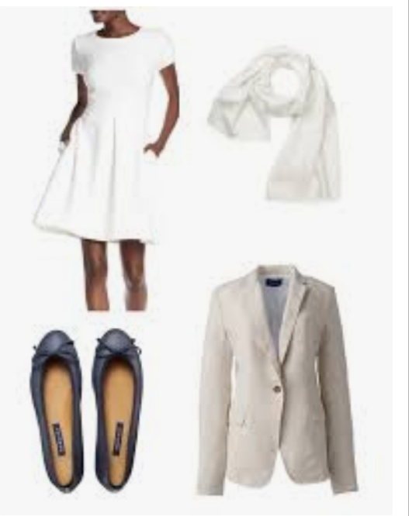
Accessories:
*Shoes should be darker than the suit and be at least a one inch heel
*Hosiery should be skin tone
*Keep accessories to a minimum
*Hair should be away from your face
*Make-up should look natural
*Choose one; handbag or briefcase not both

Slide 24

Image Tips for All
*Keep it conservative
*Do not wear cologne or perfume
*It feels like a uniform because it is a uniform
*Be aware of all details (the shine on your shoes, nail polish chips, etc)

Slide 25

Body Image
*Use good posture
*Give a firm handshake (regardless of sex)
*Lean forward while listening and answering questions
*Hands above board
*Make eye contact

Slide 26

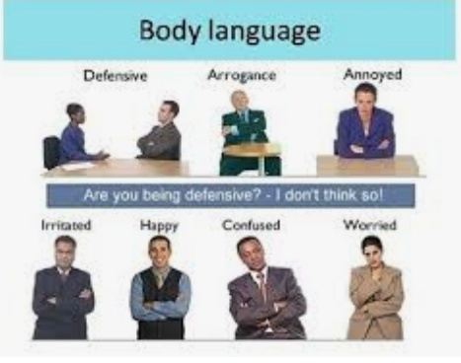

Slide 27

Voice Image
*Speak with confidence
*Speak clearly and concisely
*Project your voice so that you are heard

Slide 28
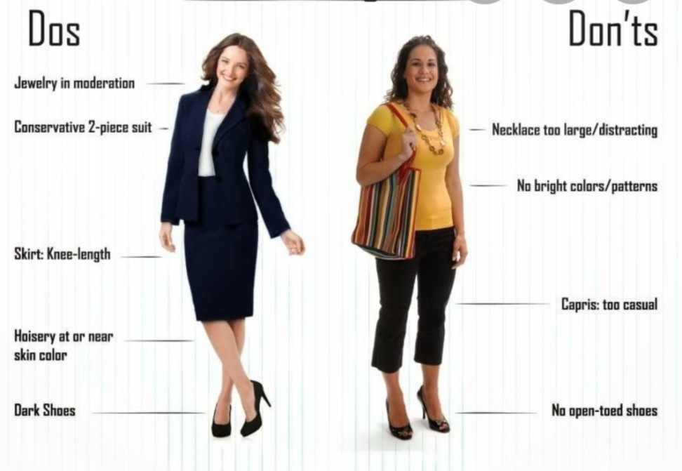
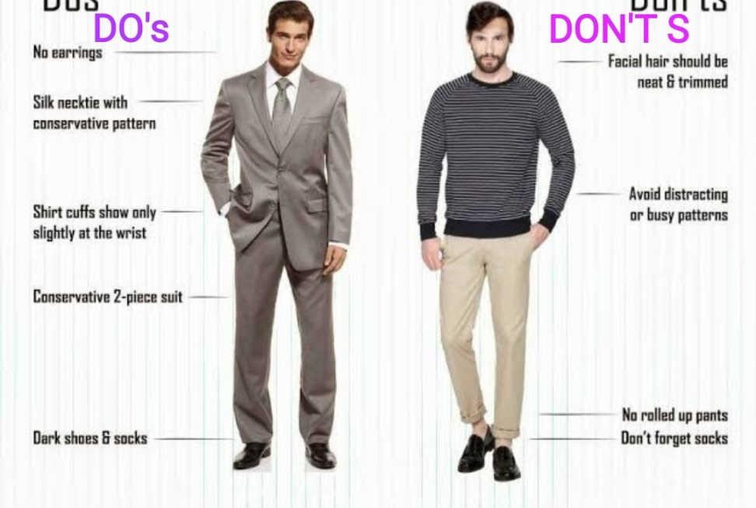
INTERVIEWING ATTIRE

Slide 29

Be Prepared
You should have a briefcase or portfolio containing the following:
*A note pad
  Two erasable pens
  Extra resumes and reference sheets
  Letters of recommendation (if applicable)
  Educational transcripts
  Work samples (if applicable)
*Special note for women-extra hosiery

Slide 30
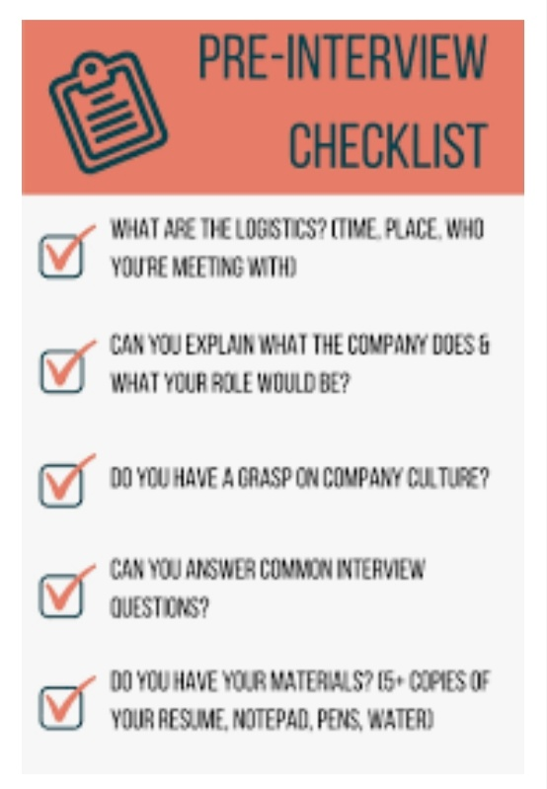
Interview Checklist
*Arrive 15 minutes early
*Dress should be appropriate
*Know the interviewer’s name and pronunciation
*Extend a warm greeting and handshake
*Wait to be asked to have a seat
*Good eye contact
*Enthusiasm
*Knowledge of the company, industry, and position
*Ready to answer and ask questions

Slide 31

Central Themes of Questions
*Suitability
*Credibility
*Capability
*Compatibility
*Affordability

Slide 32

How will the questions be asked?
*STRAIGHT FORWARD
*PROBLEM SOLVING
- Don’t find the “right answer” -show them you know the right way to come up with the answer
    •Listen to what is being asked
    •Ask clarifying questions
    •Respond by first explaining how you’d gather the data needed to make an informed decision
    •Discuss how you’d use that data to generate options
•Finally, based on the data, the available options, and your understanding of the open position explain your recommendation

Slide 33

Questions
Behavior based questions
Behavior is the best predictor of future performances
  *Don’t tell a story that will hurt you
  *If you don’t understand a question, clarify
  *Explain what you hoped to show from your story
*Ask for feedback
*Don’t be intimidated
Unrelated questions
Make your best to make it related
  *Who would you want with you if you were stranded on a deserted island?
–A boat builder thus showing your resourcefulness.

Slide 34

How Do You Formulate Your Answers?
* S: Situation
*T: Task
*A: Action
*R: Result

Slide 35

Interview Types
*Screening interviews
*Sequential interviews
*Group interviews
*Stress interviews (take control)
*Performance interviews (show case your skills)
*Testing
*Computer assisted interviews
*Mealtime interviews
*Out-of-town interviews

Slide 36

Handling negatives or objections
*Be positive -never complain
*Recognize stereotypes and biases
*Stress your strengths
*Use examples that show your reasons and motivations -avoid yes or no answers
*The underlying questions is always “why should I hire you” -give them reason

Slide 37

Discussing a weakness
*Discuss a negative which is not related to the job
*Discuss a negative an employer already knows, but make up for it in another way
*Discuss a negative you have improved on
*Discuss a negative that can become a positive

Slide 38
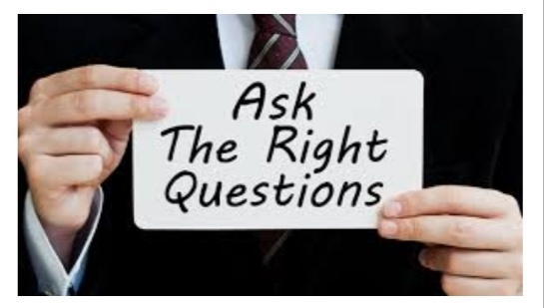
Illegal Questions
*Most employers are familiar with the laws regarding what questions they can ask and what they can not ask.
*If you feel a question is inappropriate, don’t get upset and refuse to answer. Ask the question “Can you tell me how that pertains to the job” in a polite and respective way

Slide 39

Asking Questions
*You should have questions prepared. It is your chance to interview the interviewer.
*Don’t ask questions that can be readily found on company brochures.
*Ask questions that will directly affect you or shows your interest in the companies success

Slide 40

The Close
*Thank them for their time
*Restate your interests and strengths
*Ask what type of follow-up you should expect
*Send thank-you notes to each interviewer

Slide 41
How You Will Be Evaluated
Appearance | * Attire should be interview/ business professional dress * Dress neatly and appropriately (conservative, not trendy)
Greeting/ Introduction | * Stand to greet interviewer with a firm handshake/ professional greeting * Maintain good eye contact with the interviewer and smile * Be ready to easily pick up your belongings and go to your interview

Slide 42
Body Language | * Maintain good eye contact and good posture; avoid fidgeting *Use subtle but effective gestures when speaking *Pay attention to your non-verbals (voice projection, nervous habits)
Attitude About Work/ Working with Others | * Demonstrate enthusiasm and sincerity in your answers *Be genuine; don’t say what you think the interviewer wants to hear *Stay positive; when talking about challenges don’t blame/ judge

Slide 43
Responses to Interview Questions | * Demonstrate research conducted before the interview * Speak with confidence
Oral Communication | *Speak clearly and concisely; be polite and tactful *Include enough detail to give a clear picture of your experiences, but not too much that your answer is unfocused *Try to think through your response before answering a question

Slide 44
Preparation | *Prepare questions for your interviewer based on research *Practice answering interview questions ahead of time

Slide 45
REFERENCE
www.google.com.
www. wikipedia.com.

Slide 46
CONTACT DETAILS
EMAIL : dr.kaynattawar@gmail.com

Slide 47
THANK YOU

