Slide 1
SCHOOL OF STUDIES IN COMMERCE VIKRAM UNIVERSITY, UJJAIN (M.P.)

Slide 2
E-MAIL
LECTURE BY:
DR. KAYNAT TAWAR

Slide 3
RELEVANT TOPICS ON E-MAIL FOR
B.COM (HONS.)
B.B.A. (HONS.)
M.COM.

Slide 4
TOPICS
WHAT IS E-MAIL?
EVOLUTION OF E-MAIL.
USES OF E-MAIL.
ADVANTAGES OF E-MAIL.
DISADVANTAGES OF E-MAIL.
BUILDING RAPPORT.
RAPPORT.
4 A’s FORMULA.
CUSTOMER’S NEEDS.
IMPACT OF E-MAIL ON BUSINESS.
WRITING A BUSINESS E-MAIL.
WHEN E-MAIL IS APPROPRIATE ?

Slide 5
WHEN E-MAIL IS NOT APPROPRIATE ?
POINT TO BE CONSIDERED WHILE WRITING E-MAIL.
WHO SHOULD BE COPIED ?
FILES, FONTS AND FORMATS.
SUBJECT LINES.
SIGNATURE.

Slide 6
WHAT IS E-MAIL?
E-mail (electronic mail) is the exchange of computer- stored massages by telecommunication.
E- mail messages are usually encoded in ASSCII (American standard code for information interchange) text.
You can also send non-text files, such as graphic images and sound files, as attachments.

Slide 7
E-mail was one of the first uses of the internet and is still the most popular use.
According to a CNN article, in 2001, the international data corporation (DIC) predicted the number of emails sent each day would exceed 39 billion by 2016. but in 2014, the IDC reported that 36 billion emails were already being sent daily, and they expected the number to double by 2019.

Slide 8
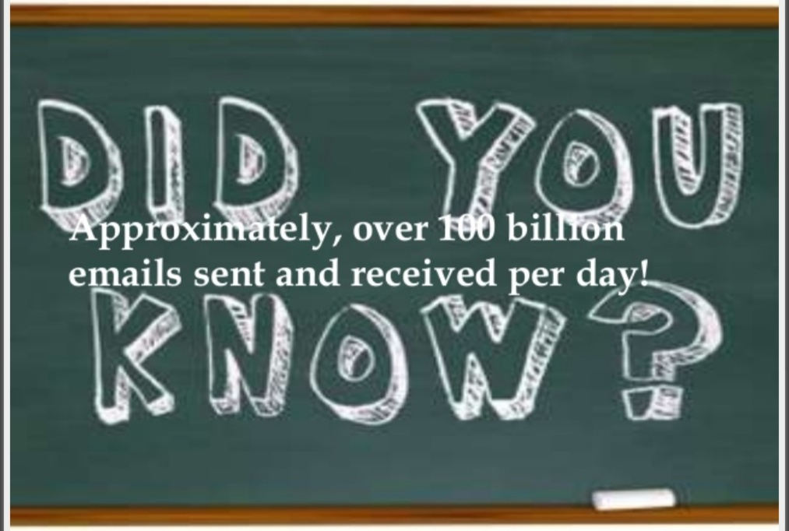

Slide 9
EVOLUTION OF E-MAIL
Its been 47 years since Ray Tomlinson sent the first ever E-mail.
1971, the first network mail was sent on ARPANET and this was the first step for electronic mail, fondly called “E-mail”.
1988, first commercial E-mail client, Microsoft mail is released for Mac.
Till 1990, pure text E-mails were used.

Slide 10
Later 1990s introduction us to HTML emails taking over plain text E-mails.
1993-1997 Yahoo! Mail, AOL, Hotmail and Gmail get recognized as E-mail clients.
2014 integration of CSS along with HTML brought in the era of interactive E-mails.
2015 CSS animation within E-mail gains momentum.

Slide 11
USES OF E-MAIL
Exchange of information
Group work
Problem solving
Attaching files
Forwarding
Staying in touch
Collaborate projects

Slide 12
ADVANTAGES OF E-MAIL
Emails are delivered extremely fast when compared to traditional post.
Emails can be sent 24 hours a day, 365 days a year.
Webmail means emails can be sent and received from any computer, anywhere in the world, that has an internet connection.
Cheap – when using broadband, each mail sent is effectively free. Dial – up users are charged at local call rates but it only takes a few seconds (for conventional email, e.g. text only) to send an email.
Email can be sent to one person or several people.

Slide 13
DISADVANTAGES OF E-MAIL
The recipient needs access to the internet to receive E-mail.
Viruses are easily spread via email attachments (most email providers scan E-mails for viruses on your behalf)
Phishing – sending an E-mail to a user falsely claiming to be a legitimate company to scam the user into providing information, such as personal information and bank account numbers on a bogus website. The details will then be used for identity theft.
No guarantee the mail will be read until the user logs on and check their E-mail.
Spam – unsolicited E-mail, e.g. junk mail.

Slide 14
BUILDING RAPPORT
WHAT IS RAPPORT ?
* Dictionary (Oxford American) defines rapport has a harmonious and understanding relationship between people.
* In other words rapport is getting on well with another person, or group of people, by having things in common ; this makes the communication process easier and usually more effective.

Slide 15
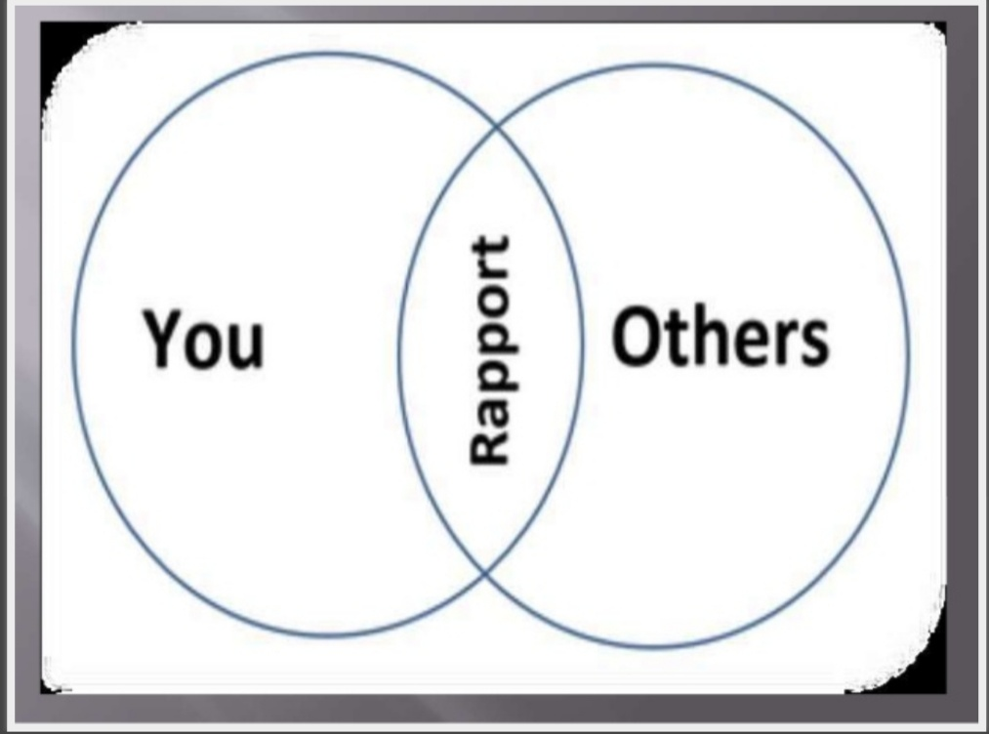

Slide 16
RAPPORT
Developing a relationship built on trust.

Slide 17
RAPPORT
The art of customer service is making people feel special.
Making people feel special is one of the essential elements in forming good customer relationships.
You can show that you think a customer is worth your time and attention in many ways. It is this ability to show that you feel this and not just say it – that makes good customer relationship.

Slide 18
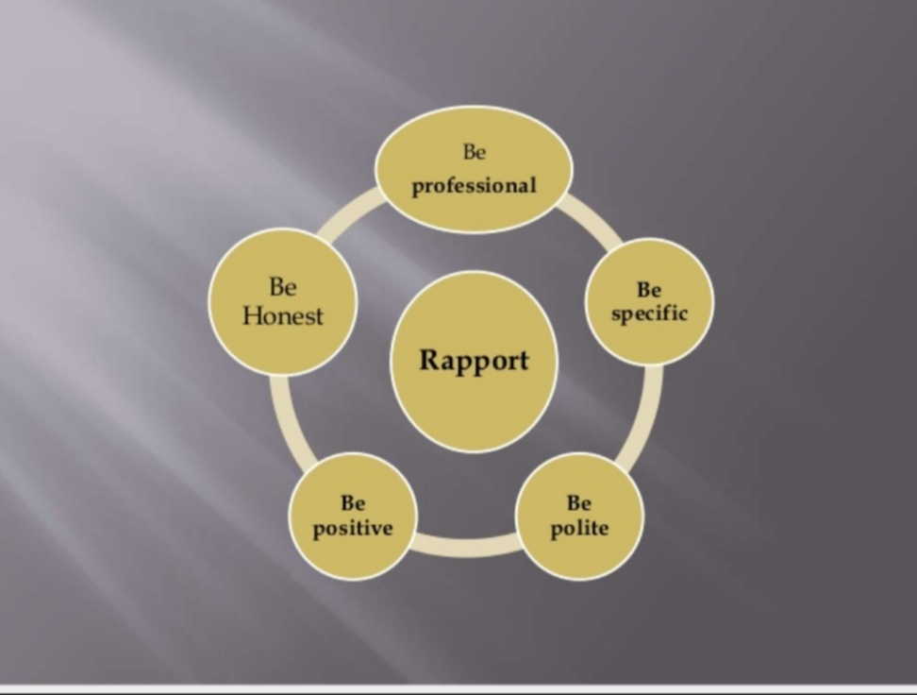

Slide 19
4 A’s FORMULA
By using the 4 A’s formula.
ASSURE
ACKNOWLEDGE
AFFIRM
APPRECIATE

Slide 20
ASSURE : I assure you we can solve this.
Everyone likes to know you can help them.
ACKNOWLEDGE : I can help you….
** Note :
Always acknowledge the customer’s opening statement.

Slide 21
AFFIRM : That is a great choice !
Such as “ I like your sense of humor.”
APPRECIATE : Thank you for your patience…. Or I appreciate your patience, thank you !

Slide 22
CUSTOMER’S NEEDS
They need to feel welcome.
They need to feel comfortable.
They need to be understood.
They need assistance.
They need to feel important.
They need to be recognized.
They need to be treated with respect.
they need to be listened to.

Slide 23
It’s all about communicating effectively in your life to strengthen your connection with people and ensure you are understood.

Slide 24
IMPACT OF E-MAIL ON BUSINESS
E-mail is widely used as a form of business communication and overall it is highly effective communication tool.
E-mail is inexpensive, only requiring an internet connection that is generally already present in the business.
From the CEO to the Janitorial staff and even temporary employees of the business can send and receive email communications.

Slide 25
More than 34% of the people worldwide use email. That’s about 2.5 billion people. It’s predicted to increase 2.8 billion email users in next 2 years.
E-mail marketing is also a very personal way of reaching your target customers.
Social media is a great channel for interacting with your audience and strengthening your personal relationships with them.

Slide 26
E-mail marketing allows business owners to reach a large number of consumers at a rate of nearly nothing per message.
A message from top level management to lower level management can convey in short time.
E-mail convey product’s characteristics in low cost and short time. Its save time.
More secure.

Slide 27
WRITING A BUSINESS E-MAIL
From a business perspective, many of us have little or no experience as authors or writers.
As a result, E-mails are often sent that exhibit poor use of grammar or punctuation; incorrect spelling; and incomplete, outdated or conflicting information.
E-mails are legal documents.
E-mail is admissible in court.
Never write anything in an email that you do not want to be released to the public.
Always assume that your entire professional and personal network could read your E-mail.

Slide 28
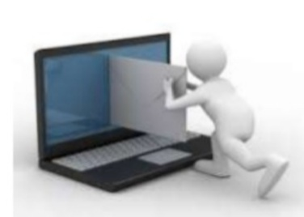
WHEN E-MAIL IS APPROPRIATE ?
You need to get in touch with someone who is hard to reach.
You need to send someone a file.
The information is not time sensitive.
You need a written record of the communication.

Slide 29
WHEN E-MAIL IS NOT APPROPRIATE ?
The information is highly confidential.
Your message is emotionally charged.
Your message is long and complicated, or requires additional in – depth discussion.

Slide 30
POINT TO BE CONSIDERED WHILE WRITING E-MAIL.
Be S.M.A.R.T.
Specific.
Measurable.
Attainable.
Realistic.
Time – bound.
Just like goals, business emails should state the purpose, the required action and the timeline for the action.

Slide 31
ATTRACTION : Gain the attraction of the reader with an interesting introductory sentence.
INTEREST : Empathize with the problem, or state the benefit to the reader.
DESIRE : Make an offer to make your prospect desire your product.
ACTION : Give a call to action to get your prospect to make the decision you want.

Slide 32
*WRITE A POSITIVE TONE : Communication via. E-mail is not supported by gesture, voice inflection or other cues and can easily be misread.
Emoticons are sometimes used to convey the nuances of verbal communication. Emoticons are not acceptable in business and should not be used.

Slide 33
THINK BEFORE YOU TYPE !
* Who is the audience ?
* What is the purpose ?
* Organize your thoughts in a logical sequence.
BE BRIEF AND TO THE POINT : Deliver the news up front and include the action you require.

Slide 34
GREETINGS, CLOSINGS AND SIGNATURES :
* Always use a professional greeting.
* “Hello Mr. Carman.”
* Regards, Sincerely, Respectfully, Thank you.

Slide 35
PROOFREAD ALL EMAIL :
* Spell check and grammar check all messages.
* Re-read messages before sending, out loud if needed.
* Never write E-mails in capital letters, use sentences case when emailing.
* Double check all names that may be used in the body of the E-mail, to ensure they are spelled correctly.

Slide 36
WHO SHOULD BE COPIED ?
Cc: vs. Bcc:
* Only copy those who are directly involved.
* Any recipients in the To : Cc: fields will be able to see the addresses of everyone else who received it.
* Bcc is useful for sending to a large distribution list, so recipients will not see a huge list of names.

Slide 37
FILES, FONTS AND FORMATS
Use an appropriate font and point size.
Use space to separate paragraphs into separate blocks of text.
Bullet important details.
Use bold type or capital letters to highlight critical information, such as due dates.
Do not send large attachments, instead, send a link to a shared network resource.

Slide 38
SUBJECT LINES
SUBJECT LINES :
* Write the subject lines first so you don’t forget it.
* An email with a blank subject will likely go unread or get lost.
* Be clear and specific about the topic of the E-mail.
* Keep it short !

Slide 39
* Avoid words in ALL CAPS or special characters like exclamation points !
* E-mails like this can end up in the spam filter.
* Indicate if a response is needed at the end of subject.
* i.e. “ proposed changes to documents – please respond by Friday.”

Slide 42
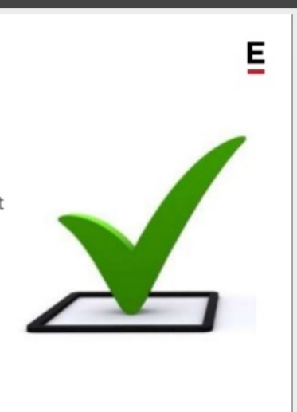
CLOSINGS – Dos :
“Best”
* Experts agree – “best “ is safe, in offensive and almost universally appropriate.
* Variations include “all the best” and “best wishes.”
“Regards”
* Another simple and common sign-off.
* Variations include “best regards” , “kind regards”, and “warm regards”.

Slide 43
CLOSING – DON’TS
* “Thanks”
While it can be a good sign-off when it is sincere, many times variations of “thanks” are used as a command disguised as premature gratitude.
* “sincerely”, “yours truly”, “yours faithfully”
Can appear as overly formal and stuffy - use with caution.

Slide 44
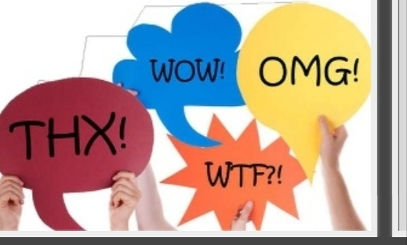
CLOSING – DON’TS
* “XOXO”, “THX”
In business E-mails, abbreviations and emoticons are not appropriate.
* “cheers” or “ciao”
If you wouldn’t say it in real life, don’t use it in an E-mail.

Slide 45
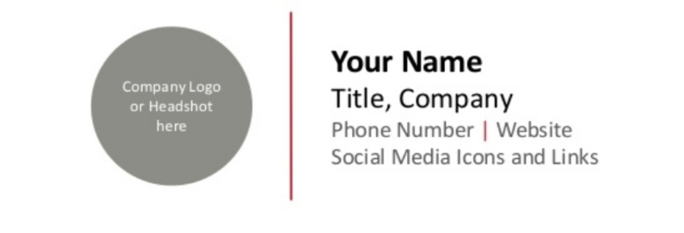
SIGNATURE
If you don’t have a signature already, make one now.
They promote your business, get you more customers, make it easier to contact you, and look more professional.

Slide 46
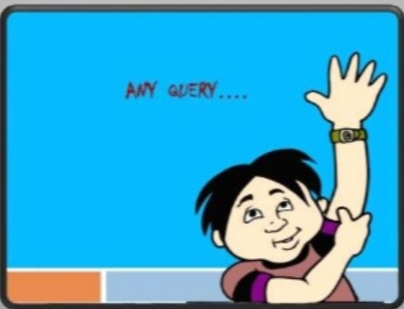

Slide 47
REFERENCE
www.google.com.
www. wikipedia.com.
www.studymafia.org

Slide 48
CONTACT DETAILS
EMAIL : dr.kaynattawar@gmail.com

Slide 49
THANK YOU

