Slide 1
SCHOOL OF STUDIES IN COMMERCE
VIKRAM UNIVERSITY, UJJAIN (M.P.)

Slide 2
ADVERTISEMENT
LECTURE BY : DR . KAYNAT TAWAR

Slide 3
RELEVANT TOPICS ON ADVERTISEMENT FOR
B.COM (HONS.)
B.B.A. (HONS.)
M.COM.

Slide 4
TOPICS
MEANING
TYPES OF ADVERTISING
ADVERTISINGS IN DIFFERENT MEDIUMS
BENEFITS OF ADVERTISEMENTS
IMPORTANCE OF ADVERTISEMENT
IMPORTANT FOR THE CUSTOMERS
IMPORTANT FOR THE MARKETING
IMPORTANT FOR THE SOCIETY
IMPORTANT FOR EDUCATION
SUPPORT TO PRESS

Slide 5
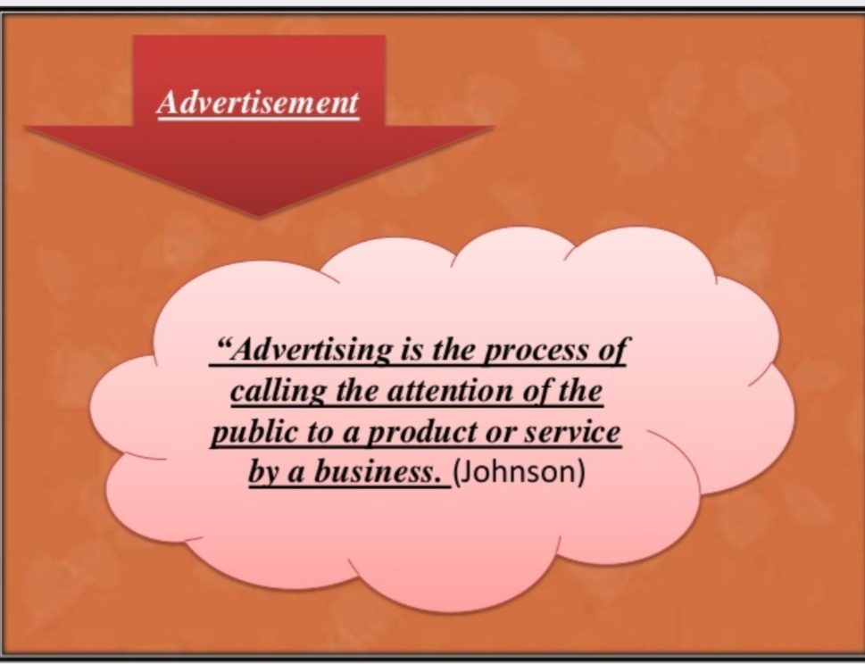

Slide 6
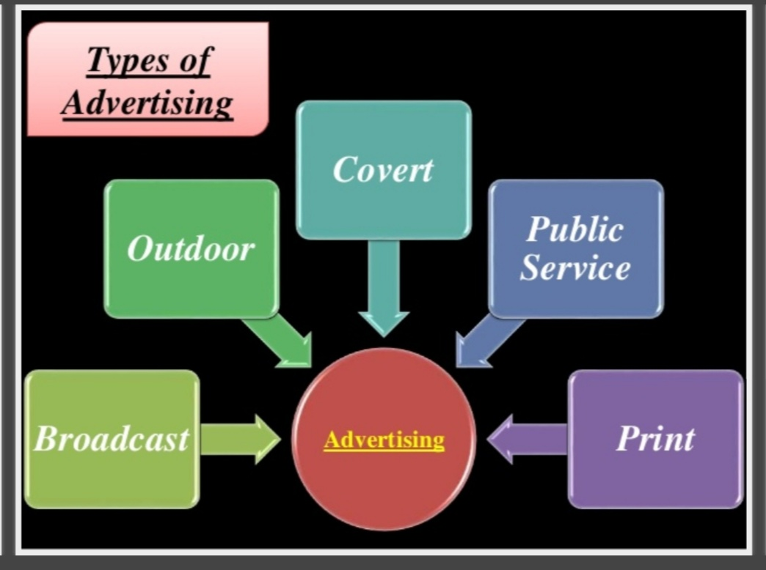

Slide 7
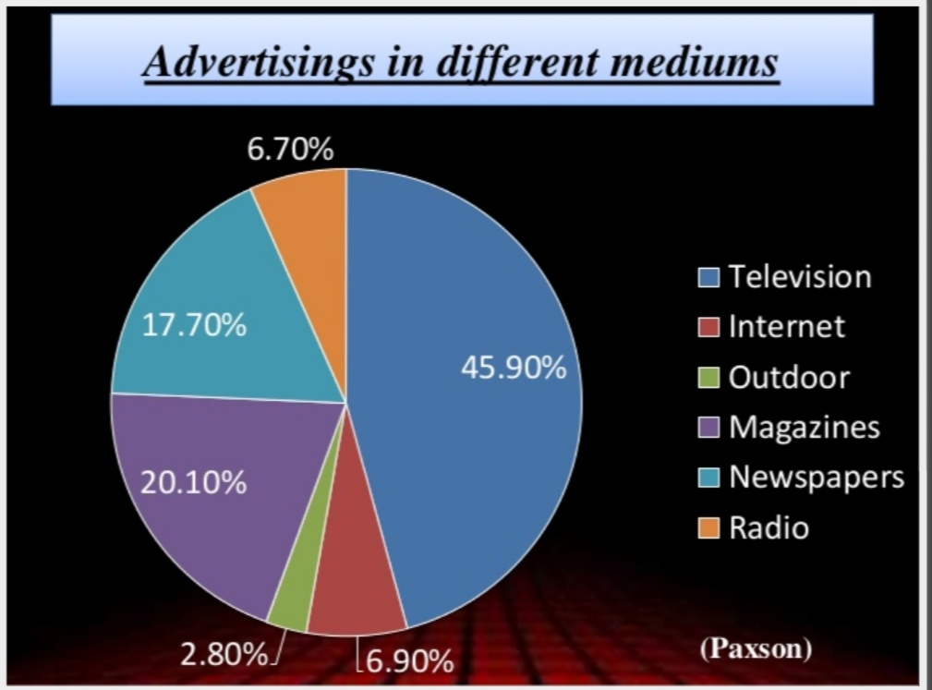

Slide 8
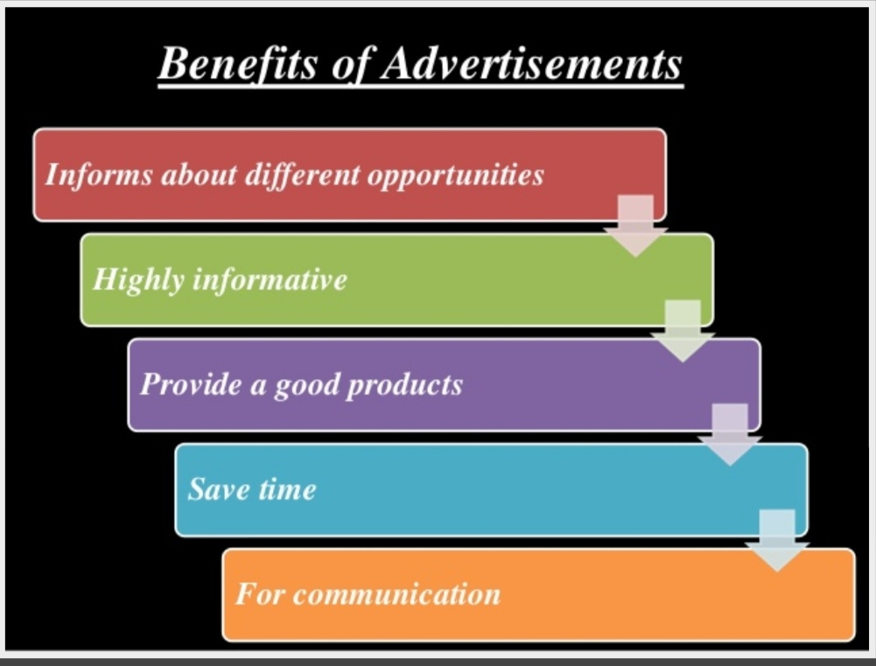

Slide 9
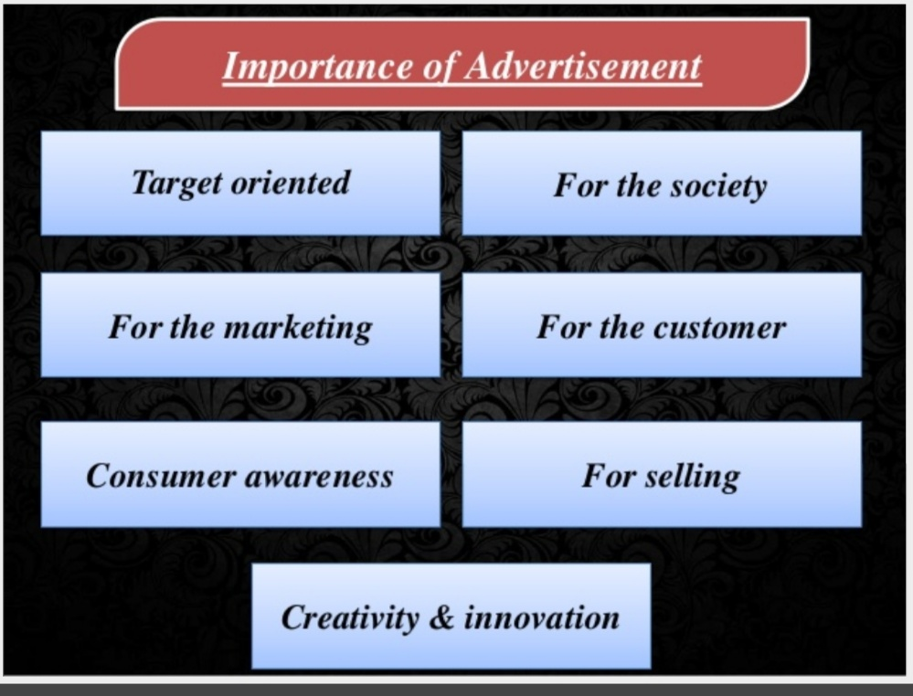

Slide 10
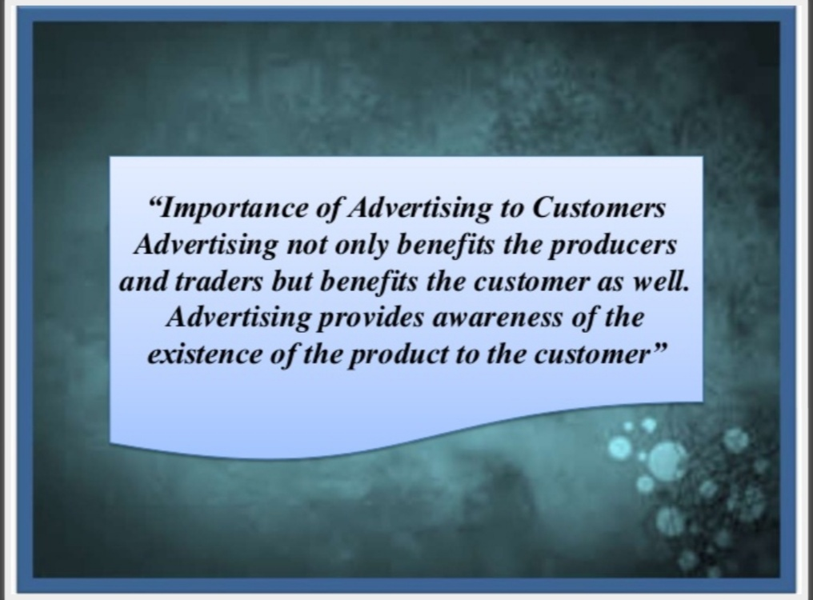

Slide 11
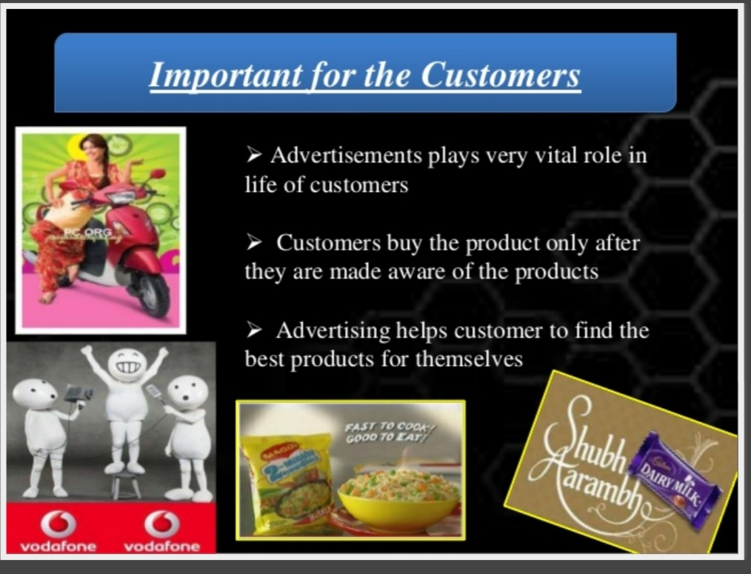

Slide 12


Slide 13
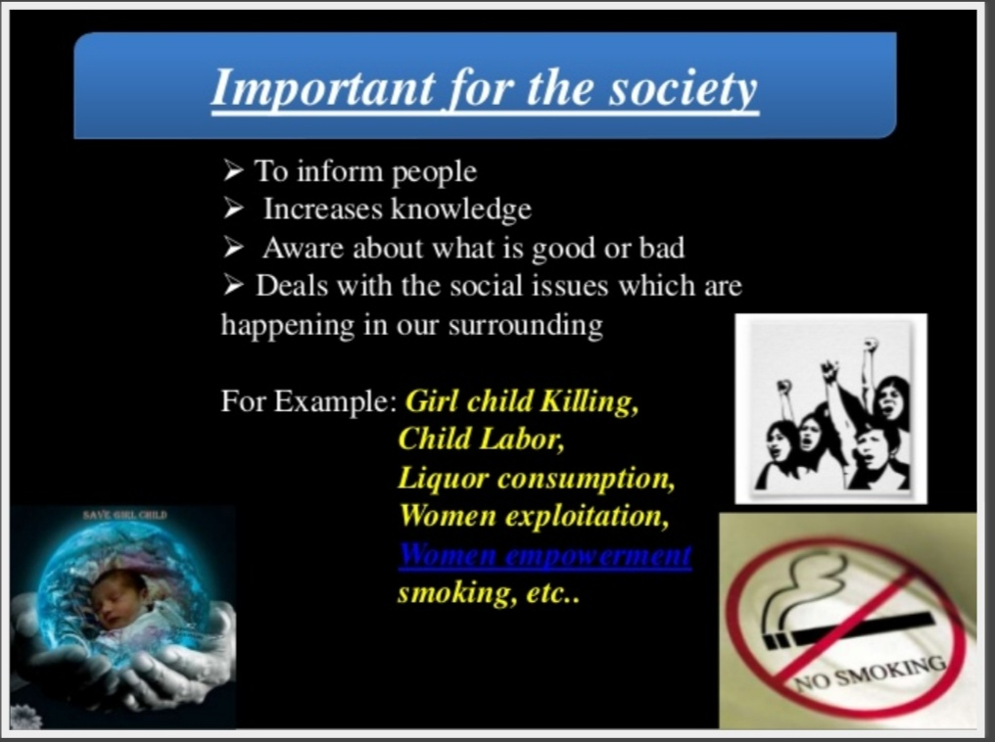

Slide 14


Slide 15


Slide 16
REFERENCE
www.google.com.
www. wikipedia.com.

Slide 17
CONTACT DETAILS
EMAIL : dr.kaynattawar@gmail.com

Slide 18
THANK YOU

