Slide 1
SCHOOL OF STUDIES IN COMMERCE VIKRAM UNIVERSITY, UJJAIN (M.P.)

Slide 2
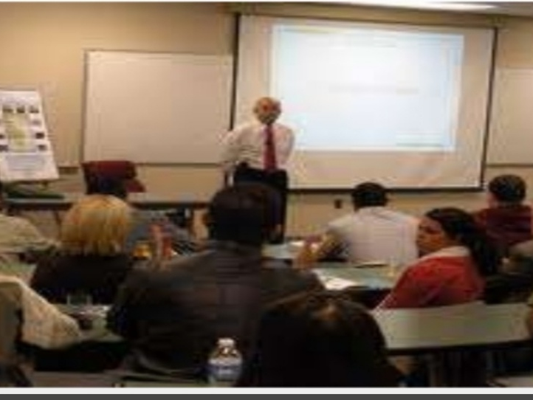
SEMINAR PARTICIPATION
LECTURE BY : DR KAYNAT TAWAR

Slide 3
RELEVANT TOPICS ON SEMINAR PARTICIPATION FOR
B.COM (HONS.)
B.B.A. (HONS.)
M.COM.

Slide 4
TOPICS
MEANING
DEFINITION
THE SEMINAR IS A METHOD OF TEACHING
OBJECTIVES OF SEMINAR METHOD
*COGNITIVE OBJECTIVES
*AFFECTIVE OBJECTIVES
CLASSIFICATION OF SEMINAR
ROLE OF DIFFERENT PERSONNEL
*ROLE OF ORGANISERS
*ROLE OF CHAIRPERSON
*ROLE OF SPEAKERS
*ROLE OF PARTICIPANTS

Slide 5
SEMINAR TECHNIQUE
REQUIREMENTS OF SEMINAR
ADVANTAGES OF SEMINAR
DISADVANTAGES OF SEMINAR
CONDUCTING OF A SEMINAR
THE RULES FOR CONDUCTING A SEMINAR
FUNCTION OF THE ORGANISER / CONVENER IN SEMINAR

Slide 6
MEANING
A seminar as an instructional technique involves generating situation for a group to have guided interaction among themselves on different aspects or components of a topic, which is generally presented by one or more members.

Slide 7
DEFINITION
Seminar is an instructional technique of higher learning which involves paper reading on a theme and followed by the group discussion to clarify the complex aspects of theme.

Slide 8
THE SEMINAR IS A METHOD OF TEACHING

Slide 9
OBJECTIVES OF SEMINAR METHOD
COGNITIVE OBJECTIVES
AFFECTIVE OBJECTIVES

Slide 10
COGNITIVE OBJECTIVES
To develop higher cognitive abilities.
To develop the ability of responding.
To develop the ability of keen observation of experience, feelings and to present them effectively.
To develop the ability to seek clarification and defend the ideas of others effectively.

Slide 11
AFFECTIVE OBJECTIVES
To develop the feeling of tolerance.
To develop the feelings co-operation.
To develop the emotional ability among the participants of the seminar.
To acquire the goods manners of putting questions and answering the questions of others effectively.

Slide 12
CLASSIFICATION OF SEMINAR
MINI SEMINAR
MAIN SEMINAR
NATIONAL SEMINAR
INTERNATIONAL SEMINAR

Slide 13
ROLE OF DIFFERENT PERSONNEL

Slide 14
ROLE OF ORGANISERS
It is the organizers who decides the topic of seminar.
Topic are related to the current trends or recent developments in the clinical or nursing education.
Once the topic is decided and objectives are formulated, organizers start searching for a suitable chairperson and select an eminent person who is well versed in the concerned topic as the chairperson. In consultation with the chairperson, organizers modifies the objectives if needed, finalize the various aspects of the topic and select speakers.
Date and time is fixed according to the convenience of the chairperson and speakers.
In case of national or international seminars, large scale preparation is needed and organizers have to form various committees like invitation committee, finance committee academic committee, etc. and co-ordinate effectively for the successful conduction of the seminar.

Slide 15
ROLE OF CHAIRPERSON
Chairperson should possess in depth knowledge regarding the topic and it is duty to guide the seminar in a fruitful manner.
Seminar begins with an introductory speech by the chairperson.
In the introductory talk, he justifies the topic selection by stating its relevance and importance in the current context and introduces the speakers by highlighting their achievements.
After the introductory speech chairperson invites speakers according to the order.

Slide 16
When one speaker completes his speech, he gives a brief summary of it and invites next speaker to present his viewpoints.
Once all the speakers complete their presentations, chairperson opens the discussion session by inviting participants to come out with their doubts, clarifications and contribution.
Some chairperson prefer discussion after each speaker completes the presentation.

Slide 17
ROLE OF SPEAKERS
Success of a seminar depends on how well the discussion session is utilized by the participants.
The quality and quantity of the information presented by the speakers have a direct role in preparing the participants for the discussion session.
Success of the seminar is largely determined by the performance of the speakers.

Slide 18
Speakers have to prepare and hand over the study materials to the organizers in advance so that organizers can combine all study materials in a user friendly way.
Study material is given to the participants one or two hours before the seminar. Speakers are expected to present the relevant information in an interesting and comprehensible manner with the help of suitable audio – visual aids.

Slide 19
ROLE OF PARTICIPANTS
Objectives of seminars are framed in accordance with the learning needs of the participants.
Always participants make the seminar very live and interesting.
They have to prepare themselves well in advance and the study material issued by the organizers before the seminar will also provide the required information in a condensed form.
They have to utilize the discussion session by asking questions, seeking clarifications and expressing their viewpoints. Participants should use discussion to enrich their knowledge rather than testing the knowledge of the speakers or the chairperson.

Slide 20
SEMINAR TECHNIQUE
Organizers make necessary arrangement for the seminar and distribute study material to the participants one or two hours before the seminar.
Seminar begins with an introductory speech by the chairperson.
Chairperson then invites the speakers to present the latest information about different aspects of the seminar topic.
After each speech chairperson has to summarise it before inviting the next speaker.
After all speakers presented the information on various aspects of the topic, chairperson opens the discussion session by inviting questions, clarifications and contributions.

Slide 21
Questions and clarifications should be addressed to the chairperson instead of addressing directly to the speakers.
Chairperson then invite the concerned speaker, chairperson himself can clear the doubt.
Seminar will come to an end after the discussion session with concluding note by the chairperson.
In the concluding note, chairperson summarizes the whole information exchanged in the seminar and congratulate organizers, speakers and participant.

Slide 22
REQUIREMENTS OF SEMINAR
Teacher is a leader.
10-15 members are participants.
The topic is presented by the students taking 15-20 minutes time.
Duration is 1-2 hours.
Leader should keep the discussion within the limits of problem discussed.
Students present their data in an informal way under the leadership of the teacher.

Slide 23
Care should be taken to avoid stereotype.
All the members take part in discussion in an informal way but orderly in manner.
The chairperson should be skilled in encouraging the timid participants.
A student secretary should record the problems which arise and the solution given.

Slide 24
ADVANTAGES OF SEMINAR
Role of the student is active; it presupposes that student has background knowledge.
If properly conduct, the seminar teaches the method of scientific analysis and techniques of research.
The group as a whole and the individual students try to solve problems.
Exchange of facts and attempts to crystalize the group opinion which is sound and workable.

Slide 25
By participation, in the solution of problems the student becomes more articulate and develops a more critical point of view and organized, scientific approach towards issue.
Seminar gives training in self – learning and promotes independent thinking.
Ability to see and solve our own problems is increased because personal difficulties can be compared with those of the group.
Skillfully directed, seminar promotes group spirit and cooperativeness.

Slide 26
DISADVANTAGES OF SEMINAR
Time consuming.
Cannot be applied to new students.
Timid students cannot improved.
If subject knowledge is poor, unnecessary discussion arises.
The approach to problems extends to their professional and personal activities.

Slide 27
CONDUCTING OF A SEMINAR
The establishing of an environment that contributes to the purposes of the seminar is of importance and requires a skilled teacher.
A motivating learning situation that is not too highly organized or too relaxed is essential.
The discussion needs to be kept active, while at the same time the orderly development of the subject content should be maintained.
The teacher usually guides the seminar, however student carry out this function under the guidance of teacher.

Slide 28
THE RULES FOR CONDUCTING A SEMINAR
Define the purpose of the discussion.
Relate the topic of discussion to the main concept or the objectives to be attained.
Direct and focus the discussion on the topic.
Helps students express their ideas.
Keep the discussion at a high level of interest so that students will listen attentively to those who are contributing ideas.
Plan comments and questions the relate to the subject and will also help to guide the discussion.

Slide 29
Set time limitations for each person to contribute.
Guard against monopoly of the discussion by any members of the seminar.
Plan for a summary at intervals during discussion and also at the end and relate the ideas expressed to the purpose of discussion.
Have the discussion recorded either by a student as a recording secretary or have it tape recording.
Plan for teacher and student self–evaluation of the progress made towards the immediate objectives.

Slide 30
FUNCTION OF THE ORGANISER / CONVENER IN SEMINAR
Selecting the topic.
Remaining in the background at the seminar, but sitting where she / he can see the whole group.
Being prepare to help out in the initial stages of using the method, where there are long silences.
See that no essential points are overlooked and that gross inaccuracies are corrected.
See that all have a share in the discussion and that irrelevant discussion is avoided.

Slide 31
REFERENCE
www.google.com.
www. wikipedia.com.

Slide 32
CONTACT DETAILS
EMAIL : dr.kaynattawar@gmail.com

Slide 33
THANK YOU

