Slide 1
SCHOOL OF STUDIES OF COMMERCE
VIKRAM UNIVERSITY,UJJAIN (M.P.)

Slide 2

BUSINESS LETTER
LECTURE BY:
DR. KAYNAT TAWAR

Slide 3
RELEVANT TOPICS ON BUSINESS LETTER FOR
B.COM (HONS.)
B.B.A. (HONS.)
M.COM.

Slide 4
TOPICS
INTRODUCTION
PURPOSES
BASIC PRINCIPLES
CORRECTNESS AND COMPLETENESS
TO ACHIEVE CORRECTNESS AND COMPLETENESS
POSITIVE APPROACH
COURTESY AND CONSIDERATION
CERTAIN PHRASES WHICH EXPRESS COURTESY AND CONSIDERATION
AVOID ARTIFICAL AND ANGRY EXPRESSIONS
COHERENCE
ACHIEVING THE “YOU ATTITUDE” : FOUR GUIDELINES
SIGNIFICANCE

Slide 5
LETTER STRUCTURE
HEADING
DATE
INSIDE ADDRESS
SALUTATION
SUBJECT LINE
BODY OR SUBSTANCE OF THE LETTER
SUBSCRIPTION OR COMPLIMENTARY CLOSING
SIGNATURE BLOCK
ADDITIONAL ELEMENTS
ADDRESSEE NOTATION
ATTENTION LINE

Slide 6
ENCLOSURES
COPY NOTATION
MAILING NOTATION
POST SCRIPT
SPECIMEN OF BUSINESS LETTER
DO’s AND DON’T’s
ADVANTAGES OF BUSINESS LETTER
DISADVANTAGES OF BUSINESS LETTER
TIPS FOR BUSINESS LETTER
PROOF READING YOUR LETTER
FEATURES OF AN EFFECTIVE BUSINESS LETTERS
BREVITY
CLARITY

Slide 7
ACCURACY
POLITENESS
CONSIDERATION OF THE ADDRESSEE
USE OF JARGONS
LAYOUTS OF LETTERS
DEMI-OFFICIAL FORM
MODIFIED BLOCKED FORM
FULL BLOCK FORM
SEMI BLOCKED FORM
HEADING PARAGRAPH
NORMA-SIMLIFIED OR MEMORANDUM
THE USE OF LETTERHEAD STATIONERY
TYPES OF BUSINESS LETTER

Slide 8
SALES LETTER
GUIDELINES FOR SALES LETTER
SPECIMEN OF SALES LETTER
COMPLAINT / CLAIM LETTER
GUIDELINES FOR CLAIM/ COMPLAINT LETTER
SPECIMEN OF CLAIM/ COMPLAINT LETTER
ADJUSTMENT LETTER
GUIDELINES FOR ADJUSTMENT LETTER
SPECIMEN OF ADJUSTMENT LETTER
FOLLOW UP LETTER
GUIDELINES FOR FOLLOW UP LETTER
SPECIMEN OF FOLLOW UP LETTER

Slide 9
COLLECTION LETTER
GUIDELINES FOR COLLECTION LETTER
SPECIMEN OF COLLECTION LETTER
ENQUIRY LETTER
GUIDELINES FOR ENQUIRY LETTER
SPECIMEN OF ENQUIRY LETTER
QUOTATION LETTER
GUIDELINES FOR QUOTATION LETTER
SPECIMEN OF QUOTATION LETTER
JOB APPLICATION LETTER
GUIDELINES FOR JOB APPLICATION LETTER
SPECIMEN OF JOB APPLICATION LETTER

Slide 10
LETTER OF TRANSMITTAL
GUIDELINES FOR LETTER OF TRANSMITTAL
SPECIMEN OF LETTER OF TRANSMITTAL
GOOD NEWS LETTER
GUIDELINES FOR GOOD NEWS LETTER
SPECIMEN OF GOOD NEWS LETTER
BAD NEWS LETTER
GUIDELINES FOR BAD NEWS LETTER
SPECIMEN OF BAD NEWS LETTER
ORDER LETTER
GUIDELINES FOR ORDER LETTER
SPECIMEN OF ORDER LETTER

Slide 11
RECOMMENDATION LETTER
GUIDELINES FOR RECOMMENDATION LETTER
SPECIMEN OF RECOMMENDATION LETTER

Slide 12
INTRODUCTION
A business letter is usually a letter from one company to another, or between such organizations and their customers, client and other external parties. The overall style of letter depends on the relationship between the parties concerned.
A letter, whether long or short has to be planned before it is written.
When writing a business letter, the writer produces one-side conversation with the reader in the sense that he/she has to anticipate the reader’s questions and provide answers to those questions.
A carelessly written letter may fail to secure an order or loan.
Business letter assist you in sustaining your business relationships with other business and customers.

Slide 13
It is essential to write a business letter to maintain contacts with the external world including other businessmen, customers and government departments.
It serve as a record for future reference.
It is used to build goodwill.
In other words, A business letter is a letter written in formal language, usually used when writing from one business organization to another or for correspondence between organizations and their customers, clients and other external parties.

Slide 14
PURPOSES
To inform.
To congratulate.
To enquire.
To order.
To request.
To collect dues.
To complain.
To make an adjustment.
To sale a product, service or scheme.

Slide 15
BASIC PRINCIPLES
Planning of the letter.
Sincerity.
Simplicity.
Clarity.
Brevity.
Courtesy.
Layout.
“You” attitude.
Concise.
Correct.
Complete.
Emphasize positive side.
Considerate.

Slide 16
CORRECTNESS AND COMPLETENESS
Correctness refers to concreteness or precision.
Completeness refers to thoroughness or giving all the required details.
To be correct and complete you need to understand the purpose of the letter and think clearly.

Slide 17
TO ACHIEVE CORRECTNESS AND COMPLETENESS
Use evaluative and factual words/phrases rather than abstract and general expressions.
Use unambiguous words.
Proof read your message for accuracy of spelling and grammar before sending.
Check whether you have answered all the queries and provided all the details.
For Example : we need a large office.
we need at least 10,000 square a feet.

Slide 18
POSITIVE APPROACH
Avoid words with negative connotations.
Frame your message with words which will not hurt or offend your readers.
Replace unpleasant words with mild terms or expressions.
Emphasize the positive side of your message.
Stress what is or what will be rather than what is not what will not be.
Tell what you done or what you can do instead of what you have not done or what you cannot do.

Slide 19
Negative :
We never change damaged goods.
Positive :
You may exchange the purchased goods provided they are in good condition.

Slide 20
COURTESY AND CONSIDERATION
Being polite means, earning respect and sustaining your relationship with your readers.
A rude and short letter should not be retaliated with an equivalently and vehemently rude reply.
While writing a business letter we should be in a cool, favorable and reasonable frame of mind.

Slide 21
Original :
Your indifferent attitude has caused a great loss.
Revised :
Had you been a bit more careful, we could have avoided this 20% loss.

Slide 22
CERTAIN PHRASES WHICH EXPRESS COURTESY AND CONSIDERATION
Many thanks for your letter dated…..
Kindly respond to our request for……
Please refer to our order dated…..
You will be pleased to know that….
We appreciate your prompt response to our…..
We are sorry that we may not be able to grant you……

Slide 23
AVOID ARTIFICAL AND ANGRY EXPRESSIONS
Please permit to say that….
We beg to state that….
Never has there been, nor there will be, a customer as good as you.
I simply cannot understand your negligence.
We have no intention of allowing this state of affairs to continue.

Slide 24
COHERENCE
The topic sentence should be placed in the beginning of a paragraph so that it can give the gist of the whole paragraph immediately.

Slide 25
ACHIEVING THE “YOU ATTITUDE” : FOUR GUIDELINES
Never forget that your reader is a real person.
Avoid writing cold, impersonal letter.
Keep the reader in the forefront of your letter.
Be courteous and tactful.
Be neither boastful nor meek.
Focus on the recipient’s needs, purposes or interest instead of your own.
Recipient oriented style is called you attitude.

Slide 26
Use more of you and yours instead of I ,me, mine, us, our, ours etc…
For Example : we are glad we can now send our tape recorders.
You would be glad to know that your tape recorders are ready for sale.
You attitude is a matter of genuine empathy.

Slide 27
You attitude may not help at times.
For Example : if someone makes mistake, minimize ill feeling by referring to the mistake impersonally rather than pointing out directly.
For e.g. : we have a problem instead of “you caused a problem”.

Slide 28
You attitude:
You should never use this type of paper for photocopiers.
You have not connected the wires properly.
Impersonal attitude:
This type of paper does not work well in photocopiers.
The wires have not been connected properly.

Slide 29
SIGNIFICANCE
Assist in sustaining business relationship.
To convey complex information.
Serve as permanent record.
To reach a large and geographically diverse audience.

Slide 30
LETTER STRUCTURE
Heading.
Date.
Inside address.
Salutation.
Message.
Complementary close.
Signature block.

Slide 31
HEADING
It is also known as letter head, it includes organization’s name, full address and telephone numbers.
If the letter head is not used, the heading includes sender’s address.

Slide 32
DATE
Date should include the month, date and year.
Date can be written in 3 forms : March 6,2019 (American style).
6th March, 2019 (English style).
6th March , 2019 (Oxford university style).
Date is placed on the left hand side.

Slide 33
INSIDE ADDRESS
Inside address include the addressee's / receiver’s name, the company’s name, street, state and zip code.
The same address appears on the envelope.
If you are writing internationally , the addressee’s country should follow in capital letters.
For example :
The general manager,
Corporate communications inc.,
32465 grant,
Chicago Il 60758,
USA.

Slide 34
SALUTATION
Salutation should be placed two space below the inside address.
In the simplified letter format, salutation (Dear Sir, Dear Madam) is replaced by the subject line.

Slide 35
SUBJECT LINE
Certain business firms prefer to write subject between inside address and the salutation.
In the simplified block format only subject is written which indicates the topic or purpose of the letter.
It also indicates where to file the letter for future reference.
It usually appears below the salutation.
Sometimes it is placed above the salutation and below the attention line.

Slide 36
For example:
*Dear Mr. Kumar,
Subject : information regarding last week’s inspection.
*Attention :personal manager
Subject : information regarding last week’s inspection.
Dear Mr. Kumar,

Slide 37
BODY OR SUBSTANCE OF THE LETTER
The message that a letter conveys must be divided into short paragraphs.
Unnecessary repetition should be avoided.
It should begin two lines below the salutation / subject line.
Letter should contain short sentences and straight forward style.

Slide 38
SUBSCRIPTION OR COMPLIMENTARY CLOSING
It marks the end of the letter.
It contains certain courteous words.
Use of these courteous words depends upon the tone or nature of the letter whether it is a formal or informal letter.
Yours sincerely, yours truly, yours faithfully.

Slide 39
SIGNATURE BLOCK
The complimentary closing line is followed by the signature block, which includes your signature, name and title.
Every letter must end with a signature to give authenticity to the information.
An unsigned letter is of no consequence.
Place the signature block 4 lines below the complimentary close.
If your name leaves the reader in doubt, include the courtesy title indicating gender with or within parentheses in the signature block.

Slide 40
For Example :
Sincerely
(ms.) Santosh Singh,
Senior executive.

Slide 41
If you are writing on a plain paper place the company’s name in capital letter, double space below the complimentary close.
Include the sender’s name and title four lines below the company’s name.

Slide 42
For Example :
Sincerely ,
Wentworth industries,
Mr. Atul chauhan
President.

Slide 43
ADDITIONAL ELEMENTS
Addressee notation.
Attention line.
Subject line.
Enclosures.
Copy notation.
Mailing notation.
Post

Slide 44
ADDRESSEE NOTATION
Notation generally appears a double space above the inside address, in all capital letters.
Personal, confidential or please forward are examples of such notations.
For Example :
Mr. Samuel David,
Penn state university, north halls,
104 Warnock commons,
State college, PA 16802.

Slide 45
ATTENTION LINE
It is used to draw the attention of a particular person or a particular department to ensure a quick and prompt action on your letter.
You may place the attention line on the first line and use the company name as the second line of the inside address.
For Example :
Attention scheduling coordinator
Peachtree lecture bureau
2930 S . Bennett Parkway
Albany, GA 31768-1324.

Slide 46
ENCLOSURES
It indicates other relevant matter in support of the message of a letter.
All additional papers, documents, tables, charts etc. enclosed to the letter are listed.
This appears at the bottom of the letters.
It may be written as “enclosures” or “encl”.
For example :
Enclosures : Resume
Photograph
Draft
Enclosures : Report (10 pages)
list of participants

Slide 47
COPY NOTATION
It indicates the same message, copies sent to various persons.
It is mentioned against “C.C” stands for courtesy copy.
Recipients are listed in the order of rank if they hold different ranks or in alphabetical order if they hold equal ranks.
For example :
Chairman
Chief Executive Chairperson
Vice- Chancellor
Pro- Vice Chancellor
Director IIMS
Director IIEM

Slide 48
MAILING NOTATION
It is placed at the top letter above the inside address on the left hand side.
By registered post, by courier, by speed post etc generally appears in the capital letters to catch the attention.
The same notation also appears on the envelope.

Slide 49
POST SCRIPT
Messages or matters included in a letter at the end which is after thought.
Additional information typed or written after the letter is fully completed is called post script.
It is written in the case of unplanned and unprepared with hurry and carelessness.
Avoid post scripts as they convey an impression of poor planning.
You can use them in sales letters as punch line.

Slide 50
Resident welfare association nehru colony, jawahar nagar, goa.
Date 0ct 12, 2019
Mailing Notation Speed post
Addressee Notation Personal
Inside Address Water Works Department
Murthy Complex
Ashish Nagar
Goa.
Attention Line Attention: Mr. Rohan Kumar
i ncharge, Water Supply
Salutation Dear Mr. Rohan Kumar
Subject Line No Water Supply on 14 oct, 2019
Body Matter
Regards
Complimentary close yours sincerely
Signature block mayank, president
Enclosure line enclosure (1)
Copy line copy : chairman, water board
Post script PS: please instruct your office to give prior intimation in case of not supplying water on
a particular day.

Slide 51
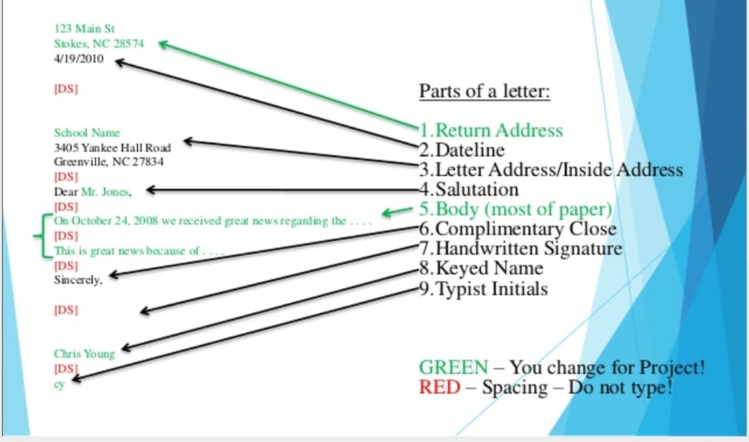
SPECIMEN OF BUSINESS LETTER

Slide 52
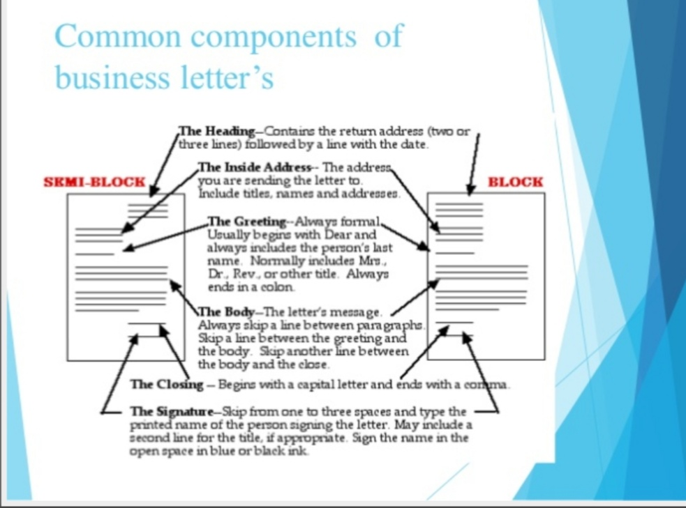

Slide 53

DO’s AND DONT’s

Slide 54
ADVANTAGES OF BUSINESS LETTER
VALUE CREATION : through sales and appeal letter an image or value of the firm can be created.
ACCESS : letter is widely accepted tools for communication. It has easy access to any form of business.
ANNOUNCEMENT : a letter can act as an announcer. Qualities of a product, introduction of a new product, any offer for the customer can be announced by a letter.
GUIDE : another advantage of letter is it can guide the guide the action of the reader. Sometimes company authorities try to guide the activities of the workers through open letter.

Slide 55
DISADVANTAGES OF BUSINESS LETTER
COSTLY : In comparison to other form of communication letter is costly.
NO IMMEDIATE RESPONSE : In case of letter there is no immediate feedback.
TIME CONSUMING : In this modern area of communication letter is considered as slow moving tool of communication. It takes more time than any other form of communication.
FORMALITY : Letter are written by following specific format and tone. Thus there is lot of formalities required in case of a letter.

Slide 56
TIPS FOR BUSINESS LETTER
Think of them as mainly persuasive documents.
Write a reader orientated document not a writer oriented document.
Be respectful.

Slide 57
PROOF READING YOUR LETTER
Proofread everything that has your name on it.
Take time to proofread your letter for:
* Errors of facts
* Miscalculations
* Accuracy of prices, dates and serial numbers

Slide 58
Full – block format : all text flush left, spaces between paragraphs.
Notations of enclosures.

Slide 59
FEATURES OF AN EFFECTIVE BUSINESS LETTERS
Brevity.
Clarity.
Accuracy.
Politeness.
Consideration of the addressee.
Use of jargons.

Slide 60
BREVITY
Present the subject matter in brief.
Too many words often mar the beauty of business correspondence and lead to confusion.

Slide 61
CLARITY
Avoid vagueness or ambiguity.
Business letter should be direct.
In order to sound natural, the writer should use plain conversational English.
Howsoever serious matter is presented in a letter, the writer should use a relaxed, clear tone.
Too familiar style should also be avoided.
Bombastic language can spoil even well written letter.
Avoid ambiguous, difficult and obsolete words.

Slide 62
ACCURACY
Genuine information strengthens the business relations between two business firms or two individuals.
Hence facts mentioned must be true and genuine.

Slide 63
POLITENESS
Politeness is a keywords in a business letter. Therefore it should be courteously written.
It should include the expressions such as thanks, I regret, please, my pleasure.
Letter of request or complaint should avoid unpleasant and rude expressions.

Slide 64
CONSIDERATION OF THE ADDRESSEE
Keep in view the type of the addressee or the receiver.
Take into consideration the nature, the post an d also the mental level of the receiver so that the reader can it with ease.

Slide 65
USE OF JARGONS
The writer should use only those technical terms which the reader of the letter is sure to understand.

Slide 66
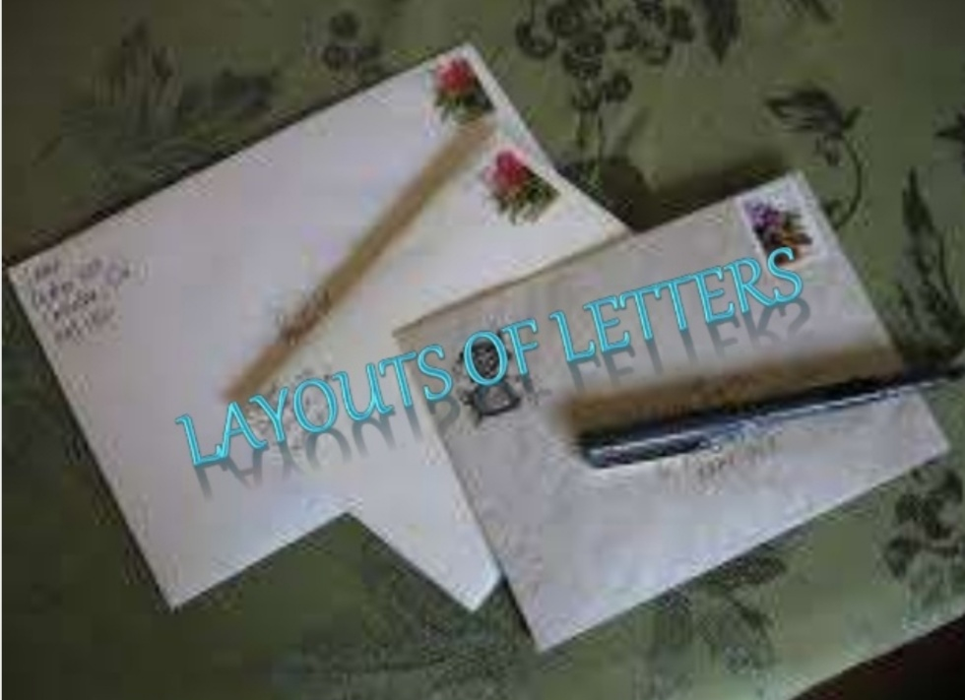
LAYOUTS OF LETTERS

Slide 67
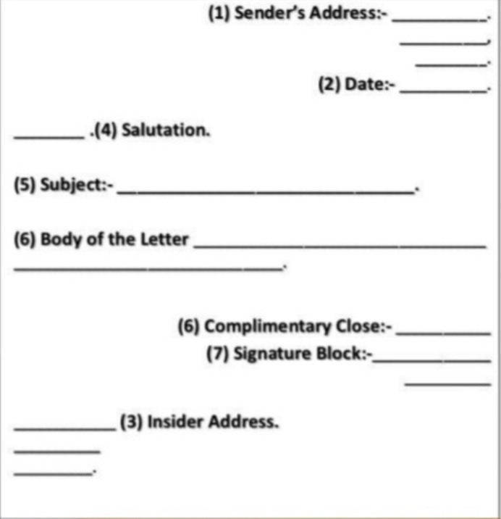
DEMI-OFFICIAL FORM

Slide 68
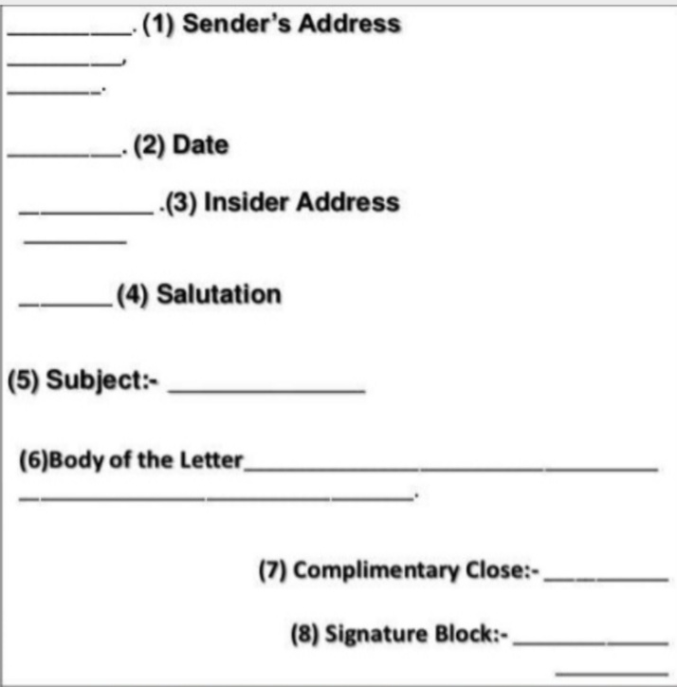
MODIFIED BLOCKED FORM

Slide 69
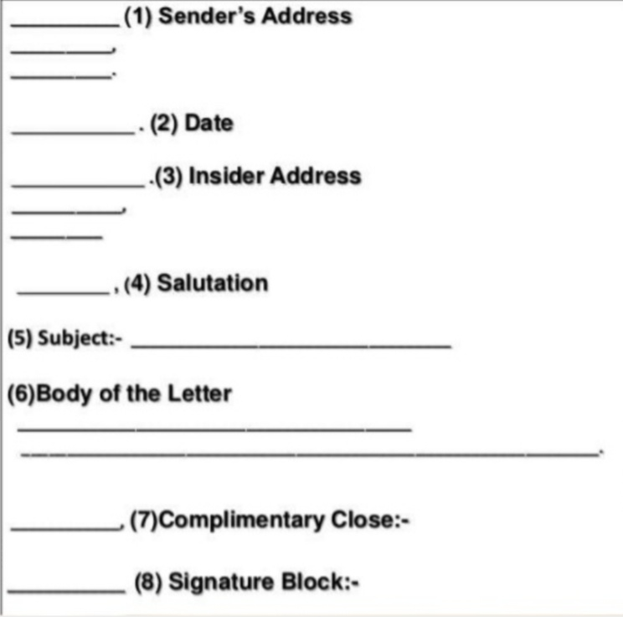
FULL BLOCK FORM

Slide 70
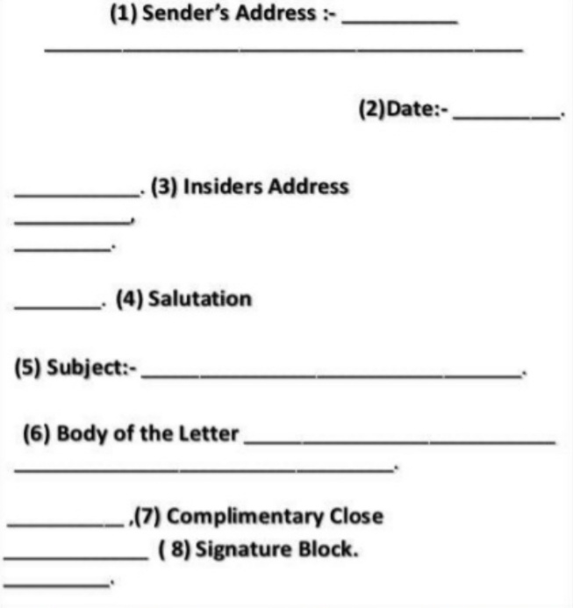
SEMI BLOCKED FORM

Slide 71
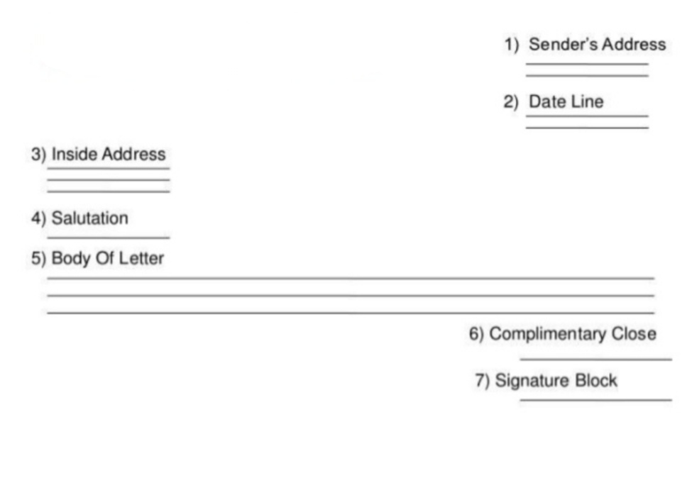
HEADING PARAGRAPH

Slide 72
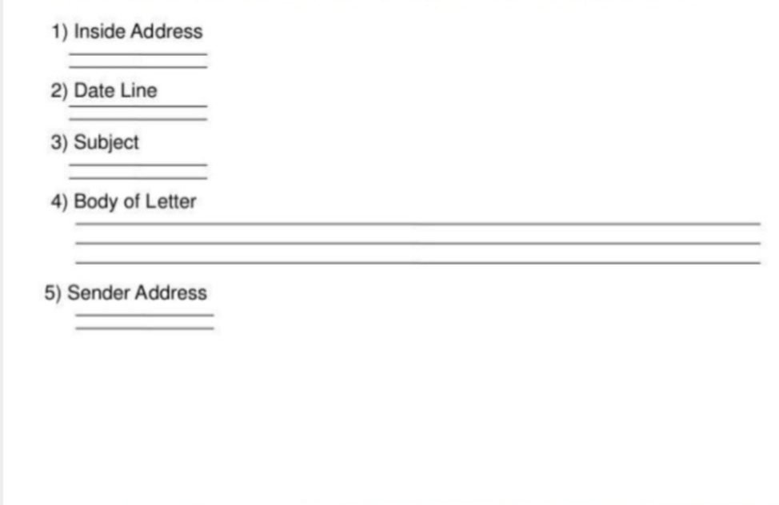
NORMA-SIMLIFIED OR MEMORANDUM

Slide 73
THE USE OF LETTERHEAD STATIONERY
When a writer is representing a company or organization, he/she should use the organization’s letterhead stationery for correspondences with people outside the organization.
If a letter requires more than one page, the additional pages are called continuation pages are typed on plain paper, not letterhead.

Slide 74
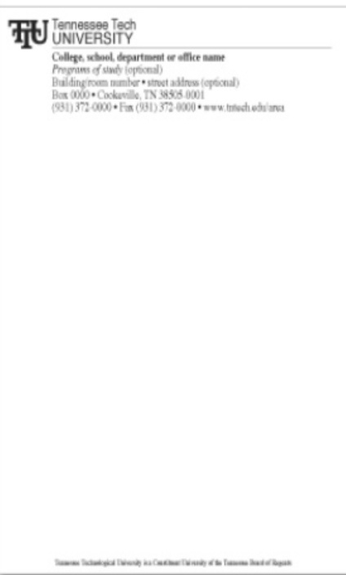

Slide 75
TYPES OF BUSINESS LETTER
SALES LETTER
COMPLAINT / CLAIM LETTER
ADJUSTMENT LETTER
FOLLOW UP LETTER
COLLECTION LETTER
ENQUIRY LETTER
QUOTATION LETTER
JOB APPLICATION LETTER
LETTER OF TRANSMITTAL
GOOD NEWS LETTER
BAD NEWS LETTER
ORDER LETTER
RECOMMENDATION LETTER

Slide 76
SALES LETTER
Sales letter is used to convince the customers for an existing product or a new particular product
A sales letter should be persuasive and contain the main features of the product.

Slide 77
GUIDELINES FOR SALES LETTER
Get attention from attractive opening.
Arouse interest in the product.
Present reader benefit information.
Close with a clincher sentence.
Mention about enclosures if added.

Slide 78
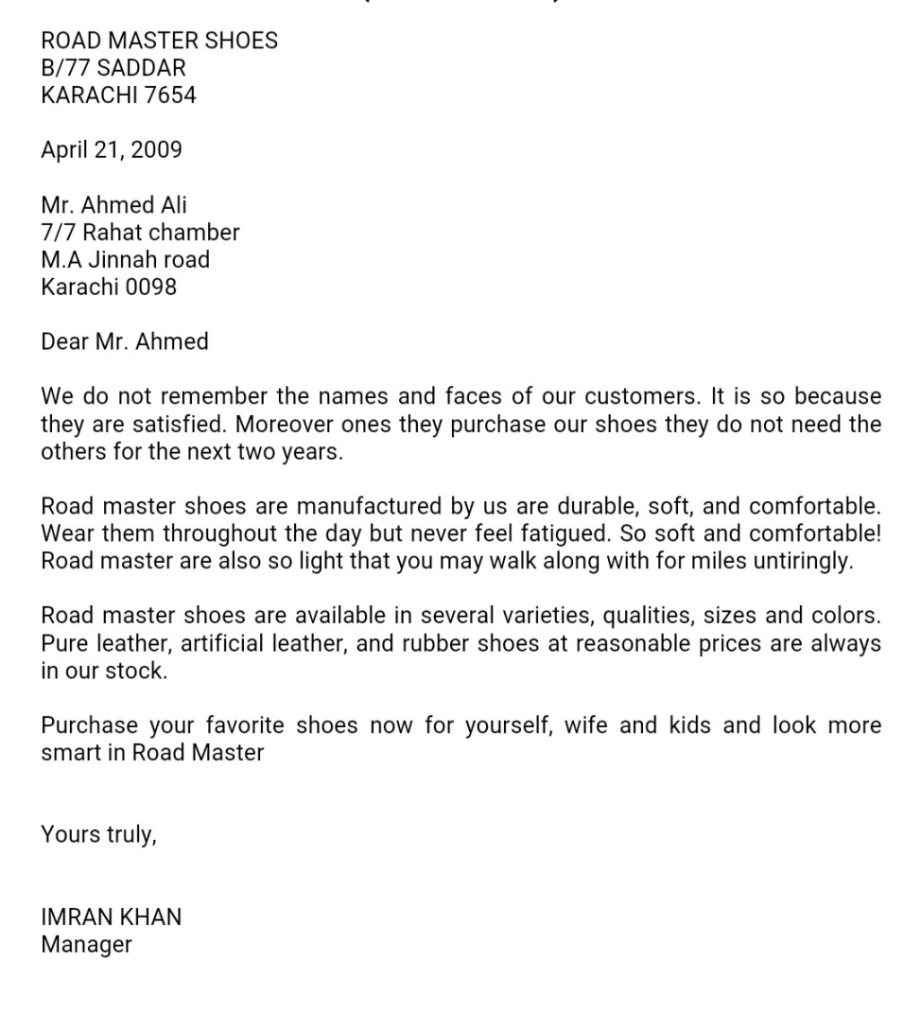
SPECIMEN OF SALES LETTER

Slide 79
COMPLAINT / CLAIM LETTER
A claim letter is also called as complaint letter.
It is written to rectify the mistakes made or wrongs done.
The words and tone you choose to use in a letter complaining to a business may be the deciding factor on whether your complaint is satisfied. Be direct but tactful and always use a professional tone if you want the company to listen to you.

Slide 80
GUIDELINES FOR CLAIM/ COMPLAINT LETTER
Explain clearly what has gone wrong.
Give sufficient data if necessary.
Motivate prompt action.
Specify clearly what adjustment you would consider fair.
Address the letter to a senior officer of the organization.

Slide 81
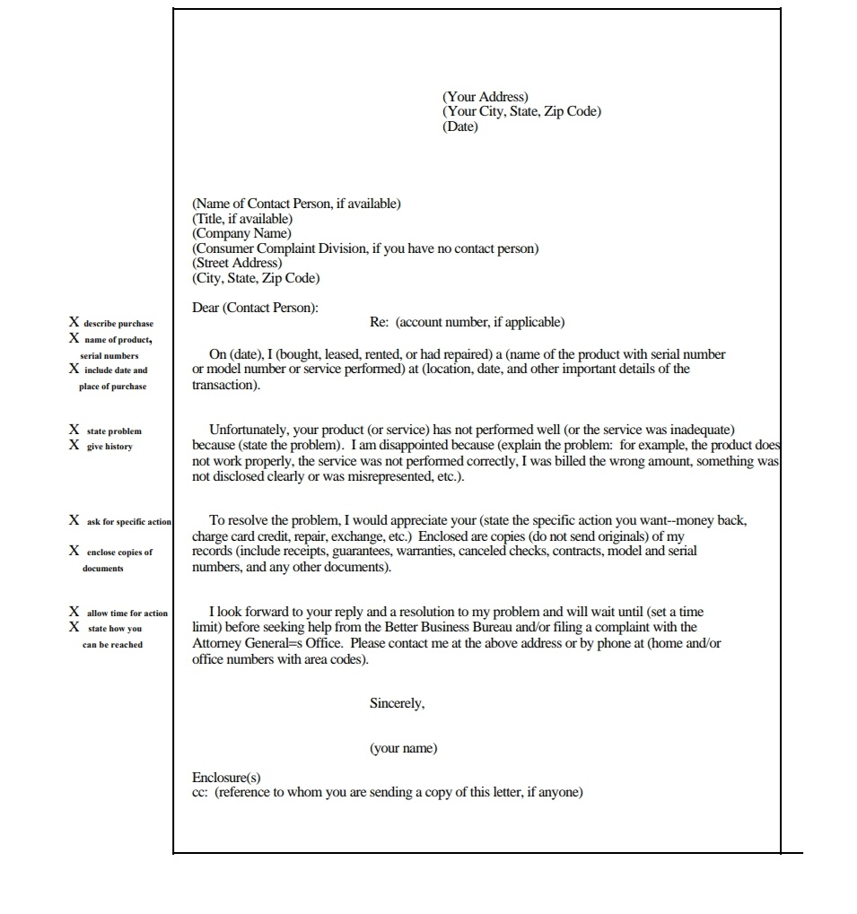
SPECIMEN OF CLAIM/ COMPLAINT LETTER

Slide 82
ADJUSTMENT LETTER
Adjustment letter is a reply to a claim letter. It should not be sent in a moment of excitement or anger, take sometime to restore to one’s usual self before writing such letter.
Adjustment letter is normally sent is response to a claim or complaint. If the adjustment is the customer’s favor, begin the letter with that news. If not, keep your tone factual and let the customer know that you understand the complaint.

Slide 83
GUIDELINES FOR ADJUSTMENT LETTER
Convey good news first.
Explain why things went wrong.
Give additional information for the same product.
Send new sales material about product in which the customer might be interested.
Close the letter, emphasizing the action to be taken by customer.
Address the letter to the claimant by name.

Slide 84
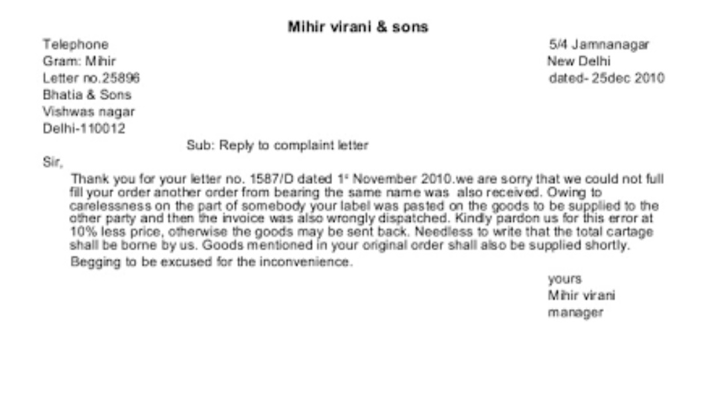
SPECIMEN OF ADJUSTMENT LETTER

Slide 85
FOLLOW UP LETTER
Follow up letters are usually sent after some type of initial communication. This could be a sales department thanking a customer for an order, a businessman reviewing the outcome of a meeting or a job seeker enquiring about the status of his application. In many cases, these letters are a combination than you note and sales letter.

Slide 86
GUIDELINES FOR FOLLOW UP LETTER
Use a follow up letter to reiterate your attributes, and the positive dimensions of a new relationship for each party. If you are representing your business, you can make a short sales pitch. If you are applying for a job, remind the potential employer of your key skills.
Don’t cover old ground: offer new insights to add to your appeal.
Make sure your follow up letter is sent within 2 days of the meeting or interview; this will help keep things fresh, and promote continuity between your performance at the interview and your letter.
In your follow up letter, indicate how you want to proceed from this point.
Do not convey any negative sentiments in your follow up letter.

Slide 87
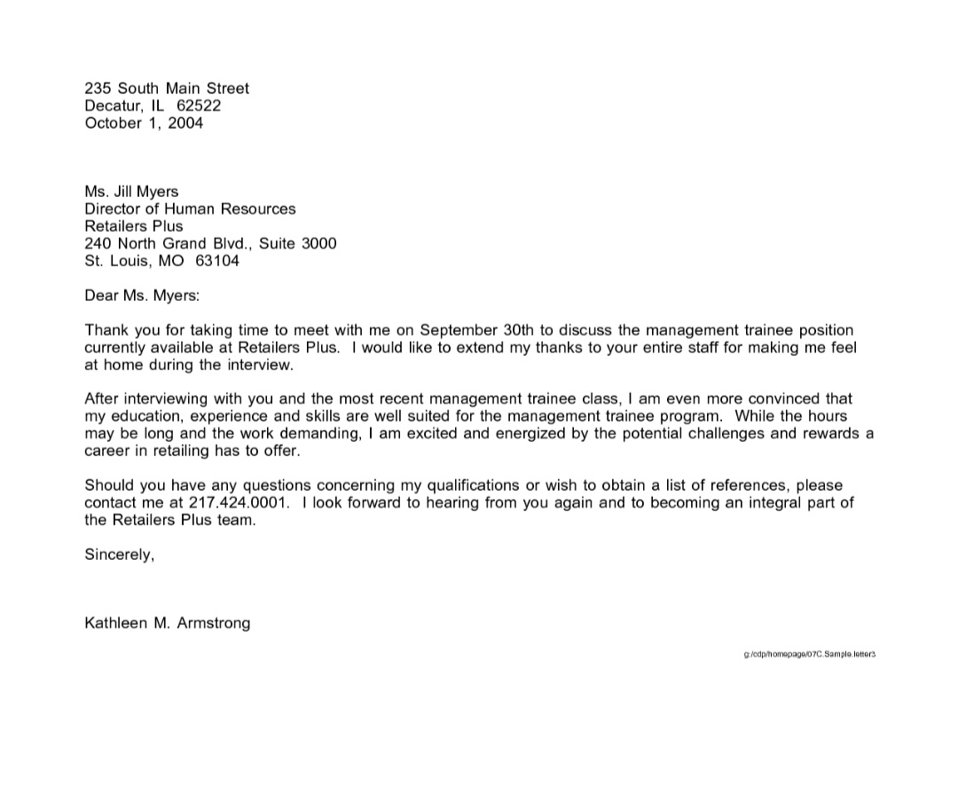
SPECIMEN OF FOLLOW UP LETTER

Slide 88
COLLECTION LETTER
A collection letter is written to persuade the customers to make them the delayed payment. Utmost tact should be used in reminding them which should not affect the business link.

Slide 89
GUIDELINES FOR COLLECTION LETTER
Tone should be persuasive.
Purpose is to get the money and maintain the business link.
Do not use straightforward language to ask for the payment.

Slide 90
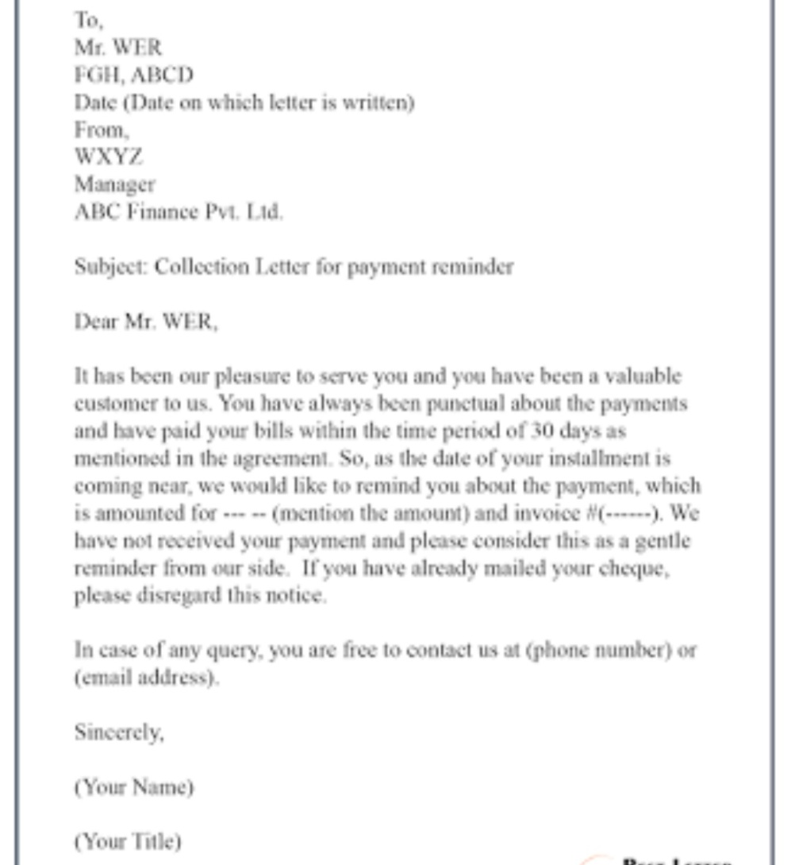
SPECIMEN OF COLLECTION LETTER

Slide 91
ENQUIRY LETTER
An enquiry letter is written to seek information form other organizations. It may deal with a simple matter or a matter of wider dimensions.

Slide 92
GUIDELINES FOR ENQUIRY LETTER
Indicate the nature of enquiry at the beginning.
State reasons for the enquiry.
Clearly state what information you are seeking.
Close with a statement which would elicit quick response.

Slide 93
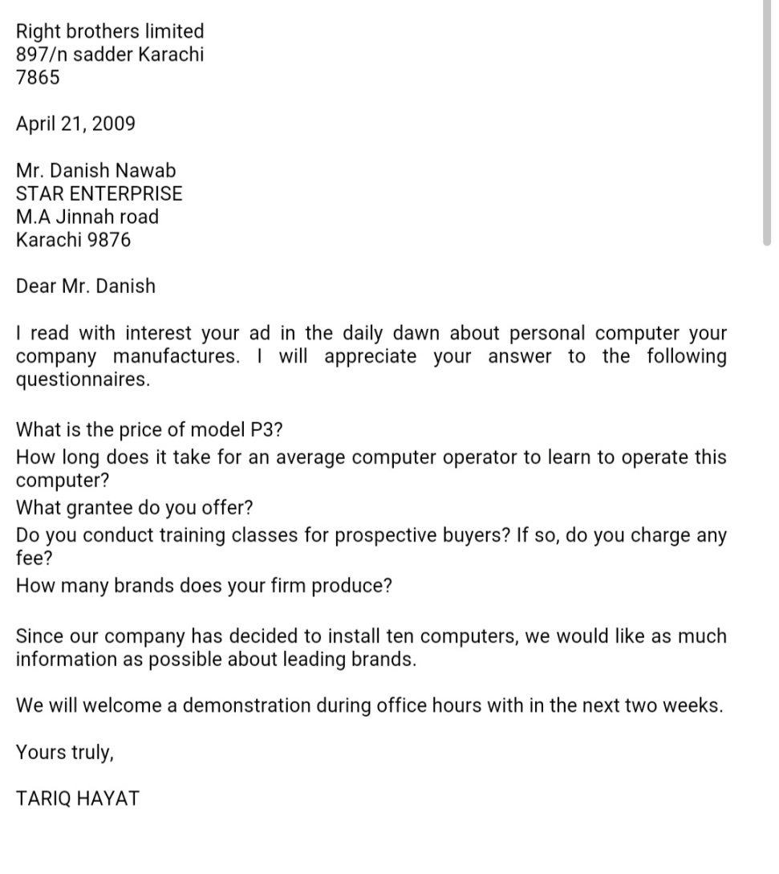
SPECIMEN OF ENQUIRY LETTER

Slide 94
QUOTATION LETTER
A quotation letter is sent in reply to an enquiry letter. It should contain point by point detailed information.

Slide 95
GUIDELINES FOR QUOTATION LETTER
Mention the letter number and date of enquiry letter to which reply is made.
Give detailed information in points.
Mention the terms and conditioned involved.
Keep in mind that the letter will be explained from several point of view : quality, price, promptness in reply etc….

Slide 96
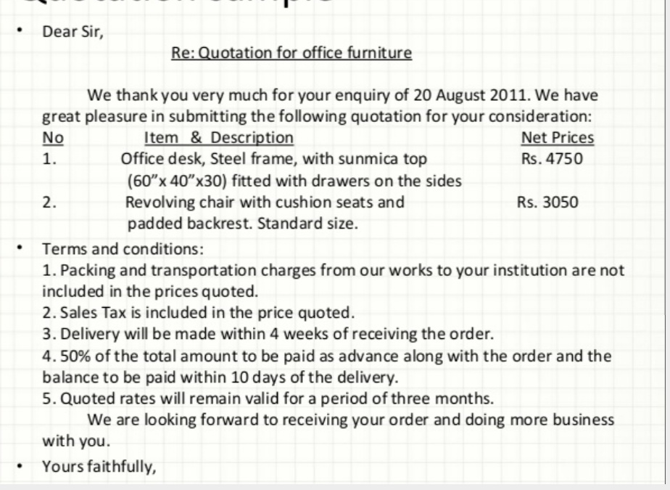
SPECIMEN OF QUOTATION LETTER

Slide 97
JOB APPLICATION LETTER
A job application letter is like a sales letter; it is written to sell one’s services. A job application should be drafted carefully as it is related with one’s career.
It carries sequence of information regarding the qualification and experience.

Slide 98
GUIDELINES FOR JOB APPLICATION LETTER
The sequence of information in job application letter usually follows the following pattern.
* Personal details.
* Educational details.
* Training its nature and duration.
* Experience organization in which you worked, nature of duties and duration.
* Other accomplishments – prizes and awards won, research paper and books published.
* References

Slide 99
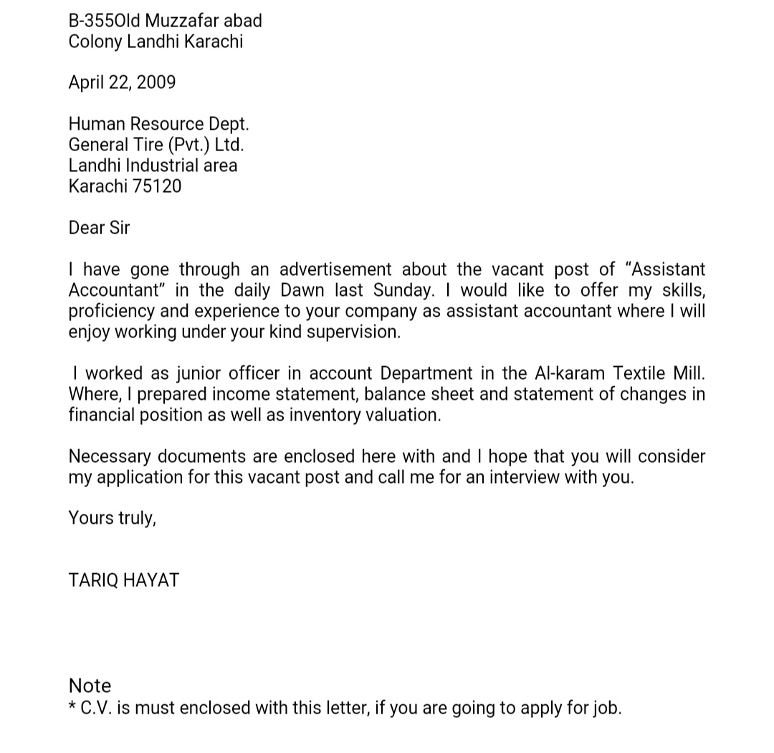
SPECIMEN OF JOB APPLICATION LETTER

Slide 100
LETTER OF TRANSMITTAL
In finance, a letter of transmittal is a type of cover letter that accompanies a document, such as a financial report or security certificate. Within financial markets it is used by a security holder to accompany certificates surrendered in an exchange or corporate action.

Slide 101
GUIDELINES FOR LETTER OF TRANSMITTAL
Most examples of this type will contain three short paragraphs.
The first paragraph will state what is being transmitted and why it is being transmitted.
The middle paragraph will describe in moderate detail the item being transmitted; for example, if a report is being transmitted, the description would include the major sections of the report and its major conclusion (s).
The final paragraph will express hope for satisfaction with whatever is being transmitted.
Modified block with indentions is the usual format for this type of letter. Always include an enclosure notation.

Slide 102
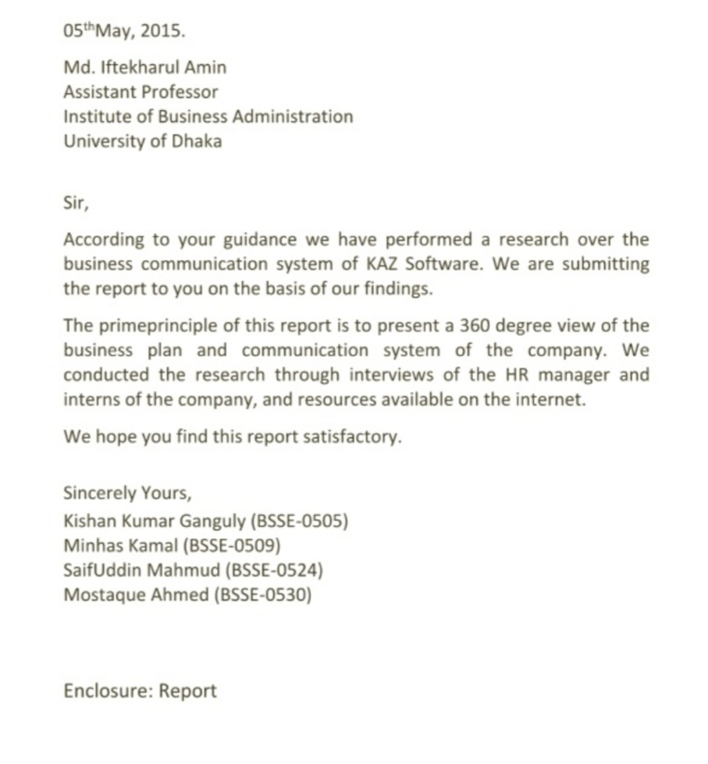
SPECIMEN OF LETTER OF TRANSMITTAL

Slide 103
GOOD NEWS LETTER
Letter that contain good news or a good message or favorable information are good news letter.
A letter sanctioning a loan to a customer or an over-draft facility to a concern, a letter of appointment or promotion or a letter acceding to the request of a client are good news letter.

Slide 104
GUIDELINES FOR GOOD NEWS LETTER
Most examples of this letter type contain three short paragraphs.
The first paragraph makes the “great” that is, the solution to the problem / complaint that the complainer has requested.
The next longish paragraph explains in detail how the problem arose in order, if possible, to show that is was not a result of bad faith or business practice on the part of the company.
The last paragraph hopes for satisfaction on the part of the complainer regarding the solution that has been offered.
Usually modified block or modified block with indentions format is used with this letter type.

Slide 105
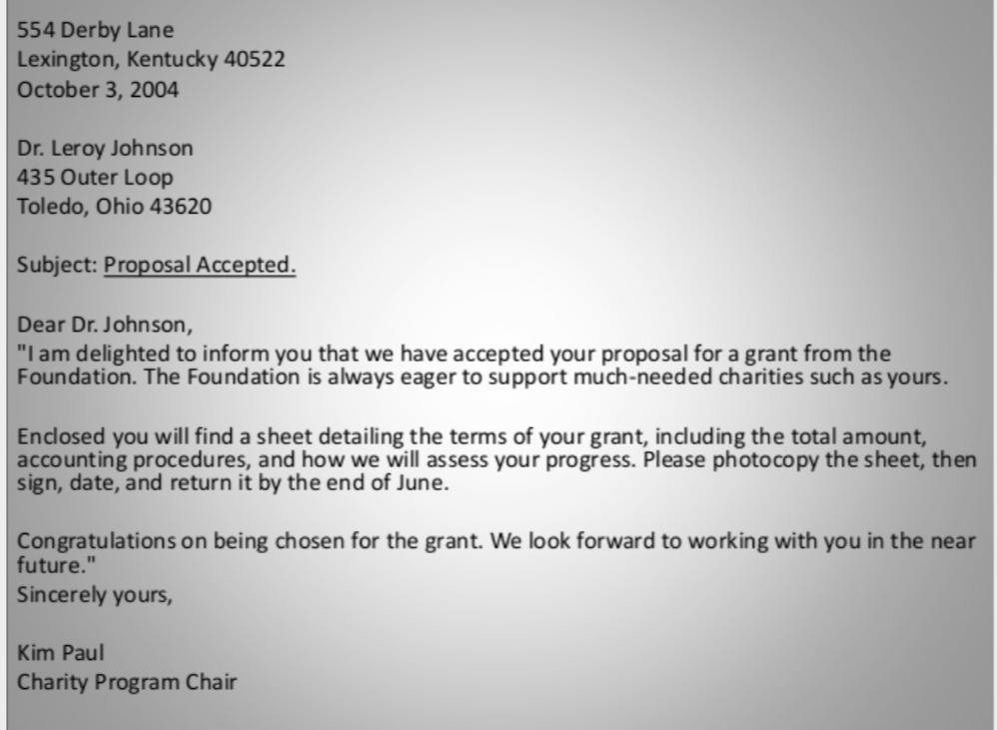
SPECIMEN OF GOOD NEWS LETTER

Slide 106
BAD NEWS LETTER
In business writing, a bad news message is a letter, memo, or email that conveys negative or unpleasant information- information that is likely to disappoint, upset , or even anger a reader. It is also called an indirect message or a negative message.

Slide 107
GUIDELINES FOR BAD NEWS LETTER
Letter of this type may contain three or more than three paragraphs, depending on the degree of detail that is presented.
The opening paragraph is usually short and neutral with regard to the issue (i.e.... We received your letter of august 29,2019, in which you…..).
The middle paragraph(s) explains in detail the upcoming bad news, but does not actually state the bad news (i.e. we cannot comply with your request to solve the problem) until near, but not at, the end of the paragraph: i.e., “bury” the bad news.
The last paragraph returns to a neutral topic.
Full block format is usually used with this letter type.

Slide 108
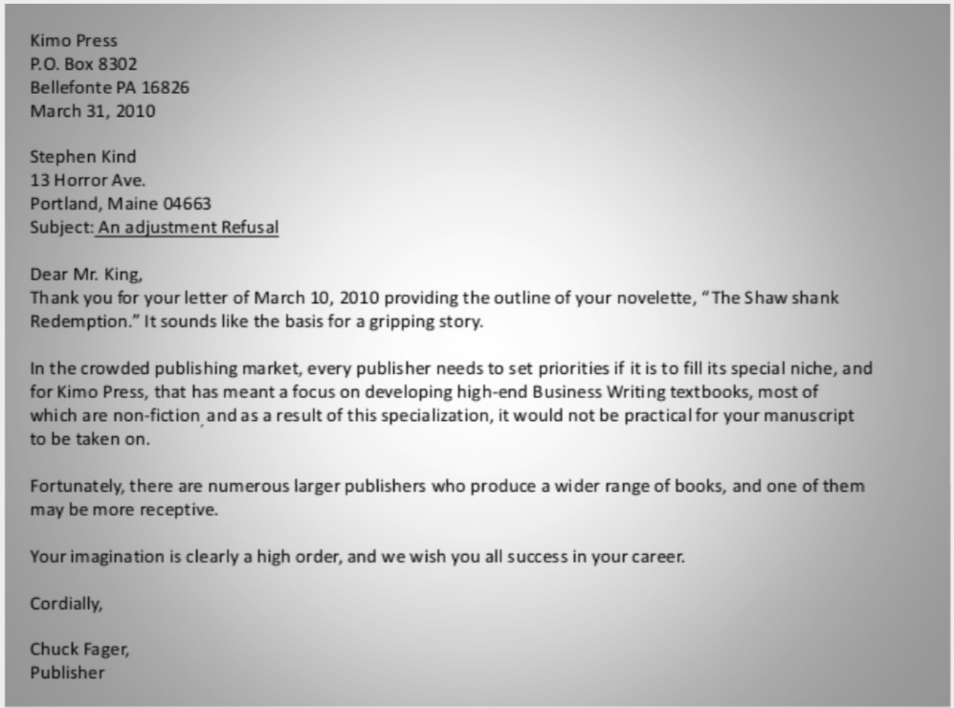
SPECIMEN OF BAD NEWS LETTER

Slide 109
ORDER LETTER
Order letter are sent by consumers or businesses to a manufacturer, retailer or order goods or services. These letter must contain specific information such as model number, name of the product, the quantity desired and expected price. Payment is sometimes included with the letter.

Slide 110
GUIDELINES FOR ORDER LETTER
The letter should be very precise, there is no pep talk or casual talking required here.
The language should be easy while also being formal.
Do not make any mistake in the specifications and quantities.
Avoid spelling and grammatical errors.
Stick to the topic.
Be polite.

Slide 111
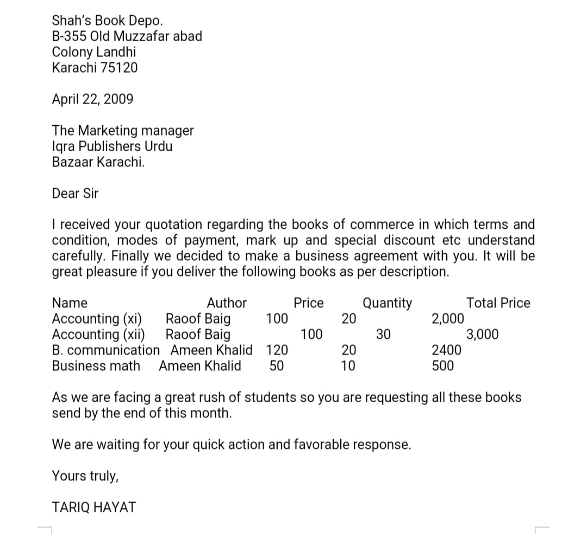
SPECIMEN OF ORDER LETTER

Slide 112
RECOMMENDATION LETTER
Prospective employers often ask job applicants for letter of recommendation before they hire them. This type of letter is usually from a previous employer or professor, and it describes the sender’s relationship with and opinion of the job seeker.

Slide 113
GUIDELINES FOR RECOMMENDATION LETTER
Explain your relationship to the applicant.
Evaluate the applicant’s skill and qualification.
Include specific examples that illustrate the applicant’s strengths.
Summarize why you would recommend the applicant.

Slide 114
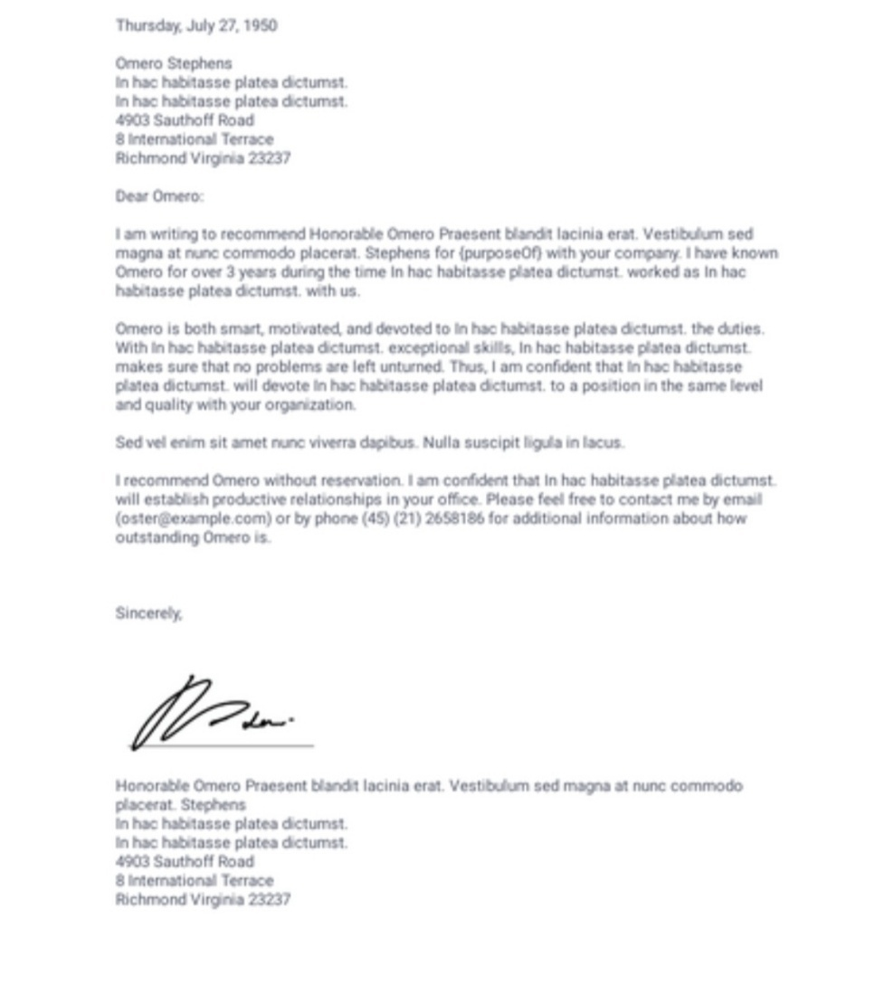
SPECIMEN OF RECOMMENDATION LETTER

Slide 115
RESIGNATION LETTER
When an employee plan to leave his job, a letter of resignation is usually sent to his immediate manager giving him notice and letting know when the last day of employment will be. In many cases, the employee also will detail his reason for leaving the company.

Slide 116
GUIDELINES FOR RESIGNATION LETTER
A statement that clearly says you’re going to resign.
The date of your last day of work (based on the notice you’re giving).
A short explanation of why you are leaving.
A short , polite thank you at the end of the letter.

Slide 117
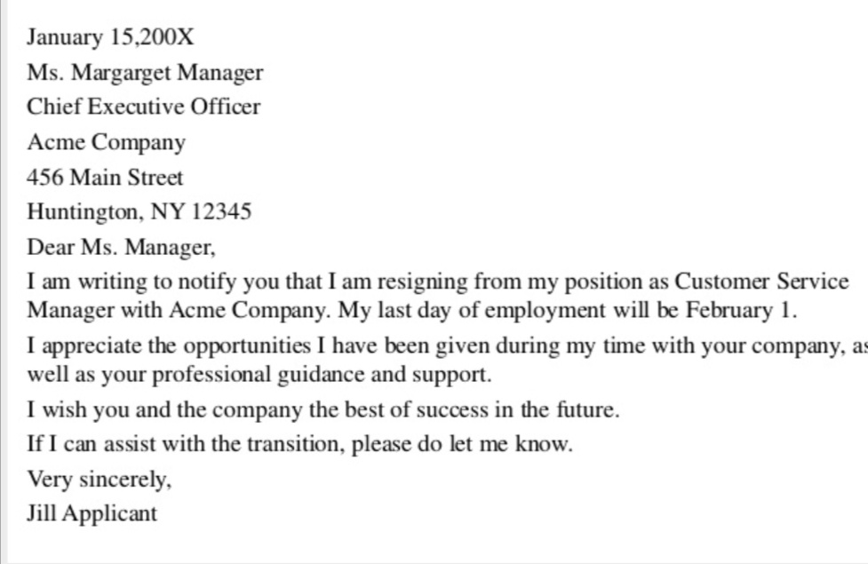
SPECIMEN OF RESIGNATION LETTER

Slide 118
ACKNOWLEDGMENT LETTERS
Acknowledgement letters acts as simple receipts. Businesses send them to let other know that they have received a prior communication, but action may or may not have taken place.

Slide 119
GUIDELINES FOR ACKNOWLEDGMENT LETTERS
When you are beginning the letter of acknowledgement, start with a brief sentence stating that this is , indeed, a letter of acknowledgement some phrases you can included:
I hereby acknowledgement the receipt of the following documents….
I am acknowledging receipt of….
We will make sure that the person responsible receives these materials immediately upon returning to the office.

Slide 120
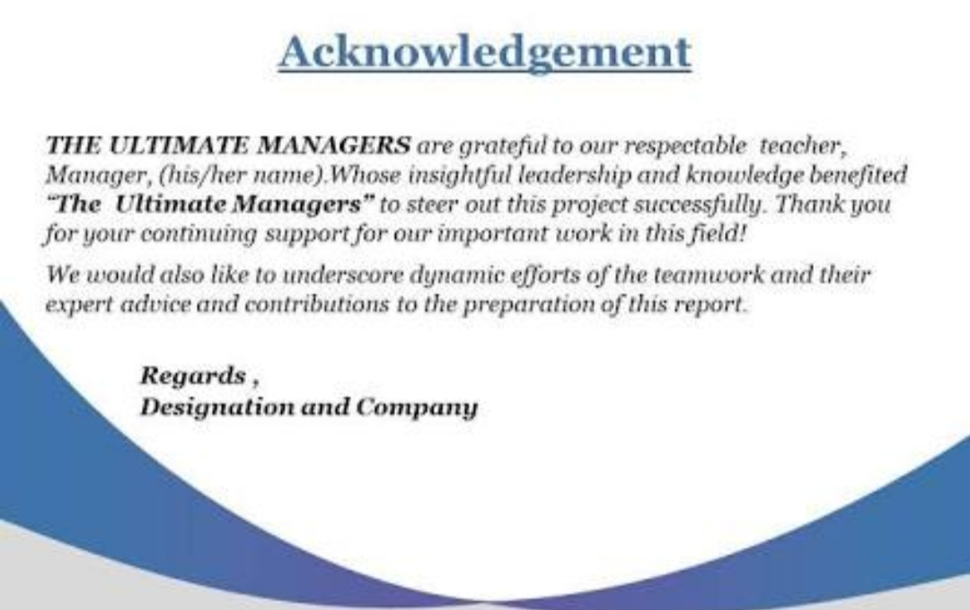
SPECIMEN OF ACKNOWLEDGMENT LETTERS

Slide 121
COVER LETTERS
Cover letters usually accompany a package, report or other merchandise. They are used to describe what is enclosed, why it is being sent and what the recipient should do with it, if there is any action that needs to be taken. These types of letters are generally very short and succinct.

Slide 122
GUIDELINES FOR COVER LETTERS
Introduce yourself.
Mention the job (or kind of job) you’re applying for (or looking for).
Show that your skills and experience match the skills and experience needed to do the job.
Encourage the reader to read your resume.
Finished with a call to action (for example, asking for an interview or a meeting).

Slide 123
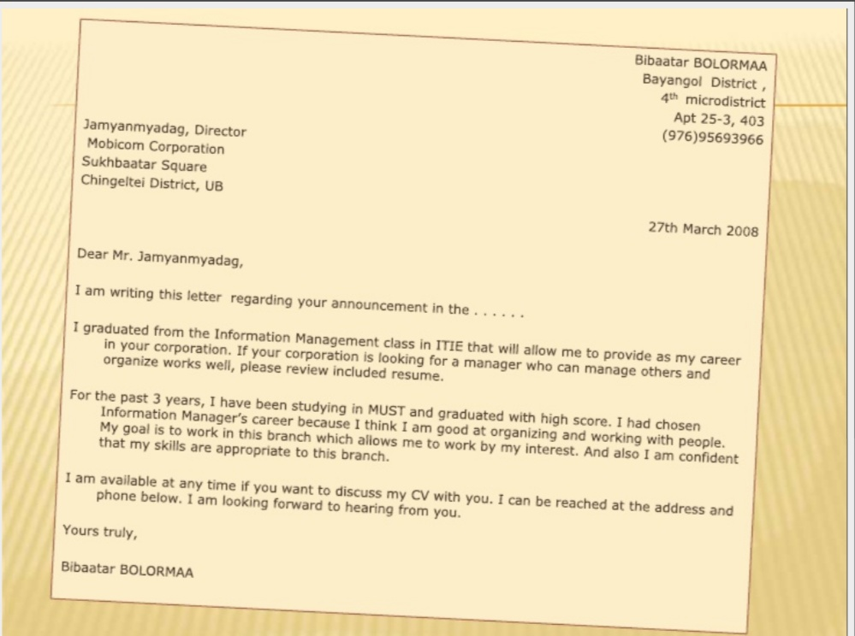
SPECIMEN OF COVER LETTERS

Slide 124
REFERENCE
www.google.com.
www. wikipedia.com.
www.studymafia.org

Slide 125
CONTACT DETAILS
EMAIL : dr.kaynattawar@gmail.com

Slide 126


