Slide 1
Dr.Vishwajeet Singh Parmar
Ancient Indian History Culture & Archaeology
Vikram University,Ujjain (M.P.)
BA IV SEMESTER
THE RUSSIAN REVOLUTION
Part-3

Slide 2
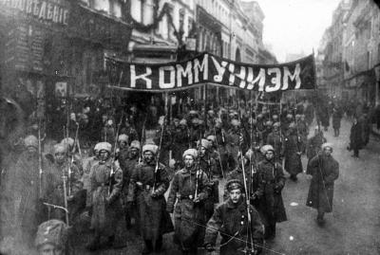
Bolshevik Revolution :
On November 6 and 7, 1917 (or October 24 and 25 on the Julian Calendar, which is why the event is often referred to as the October Revolution), leftist revolutionaries led by Bolshevik Party leader Vladimir Lenin launched a nearly bloodless coup d’ etat against the Duma’s provisional government.

Slide 3
The provisional government had been assembled by a group of leaders from Russia’s bourgeois capitalist class. Lenin instead called for a Soviet government that would be ruled directly by councils of soldiers, peasants and workers.
The Bolsheviks and their allies occupied government buildings and other strategic locations in Petrograd and soon formed a new government with Lenin as its head. Lenin became the dictator of the World’s first communist state.

Slide 4
Russian Civil War :
Civil War broke out in Russia in late 1917 after the Bolshevik Revolution. The warring factions included the Red and White Armies.
The Red Army fought for the Lenin’s Bolshevik government. The White Army represented a large group of loosely allied forces, including monarchists, capitalists and supporters of democratic socialism.

Slide 5
On July 16, 1918, the Romanovs were executed by the Bolsheviks.
The Russian Civil War ended in 1923 with Lenin’s Red Army claiming victory and establishing the Soviet Union.

Slide 6
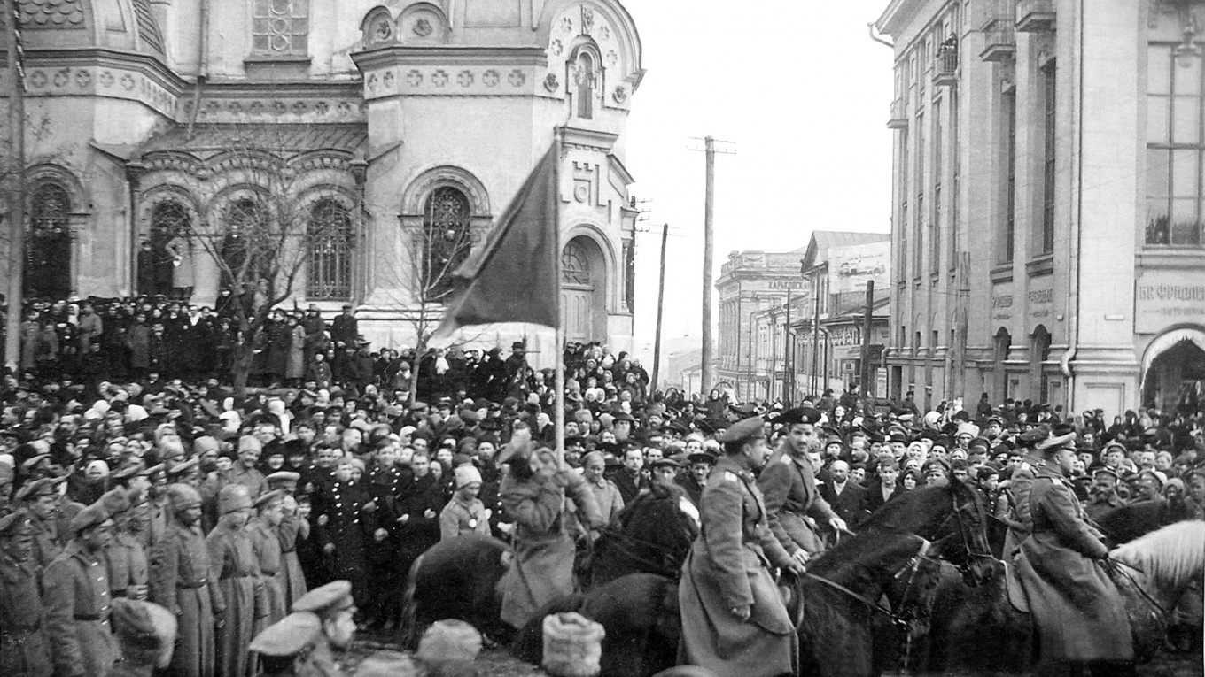

Slide 7
Impact of the Russian Revolution :
The Russian Revolution paved the way for the rise of communism as an influential political belief system around the World. It set the stage for the rise of the Soviet Union as a world power that would go head-to-head with the United States during the Cold War.

Slide 8
Sources :
The Russian Revolutions of 1917.
Anna M. Cienciala, University of Kansas.
The Russian Revolution of 1917.
Daniel J. Meissner, Marquette University.
Russian Revolution of 1917.
McGill University.

