Slide 1
Dr.Vishwajeet Singh Parmar Ancient Indian History Culture & Archaeology Vikram University, Ujjain (M.P.)
BA IV SEMESTER
League of Nations
Part-2

Slide 2
Disputes Solved by the League of Nations :
Poland was in frequent distress, fearing for its independence against threats from neighboring Russia, which in 1920 occupied the city of Vilna and handed it over to Lithuanian allies. Following a demand that Poland recognize Lithuanian independence, the League became involved.
Vilna was returned to Poland but hostilities with Lithuania continued. The League was also brought in as Poland grappled with Germany about Upper Silesia and with Czechoslovakia over the town of Cieszyn.

Slide 3
Other areas of dispute that the League got involved in included the squabble between Finland and Sweden over the Aaland Islands, disputes between Hungary and Rumania, Finland’s separate quarrels with Russia, Yugoslavia and Austria, a border argument between Albania and Greece and the tussle between France and England over Morocco.
In 1923, following the murder of Italian General Enrico Tellini and his staff within the borders of Greece, Benito Mussolini retaliated by bombing and invading the Greek island Corfu. Greece requested the League’s help but Mussolini refused to work with it.

Slide 4
The League was left on the sidelines watching as the dispute was solved instead by the Conference of Ambassadors, an Allied group that was later made part of the League.
The incident at Petrich followed two years later. It’s unclear precisely how the debacle in the border town of Petrich in Bulgaria started, but it resulted in the deaths of a Greek captain and retaliation from Greece in the form of invasion.
Bulgaria apologized and begged the League for help. The League decreed a settlement that was accepted by both countries.

Slide 5
Larger efforts by the League of Nations :
Other League efforts include the Geneva Protocol, devised in the 1920s to limit what is now understood as chemical and biological weaponry and the World Disarmament Conference in the 1930s, which was meant to make disarmament a reality but failed after Adolf Hitler broke away from the conference and the League in 1933.
In 1920 the League created its Mandates Commission, charged with protecting minorities. Its suggestions about Africa were treated seriously by France and Belgium but ignored by South Africa. In 1929, the Mandates Commission helped Iraq join the League.

Slide 6
The Mandates Commission also got involved in tensions in Palestine between the incoming Jewish population and Palestinian Arabs, though any hopes of sustaining peace there was further complicated by Nazi persecution of the Jews, which lead to a rise in immigration to Palestine.
The League was also involved in the Kellogg-Briand Pact of 1928, which sought to outlaw War. It was successfully adapted by over 60 countries. Put to the test when Japan invaded Mongolia in 1931, the League proved incapable of enforcing the Pact.

Slide 7
Why did the League of Nations fail :
When World War II broke out, most members of the League were not involved and claimed neutrality, but members France and Germany were.
In 1940, League members Denmark, Norway, Luxembourg, Belgium, the Netherlands and France all fell to Hitler. Switzerland became nervous about hosting an organization perceived as an Allied one and the League began to dismantle its offices.

Slide 8
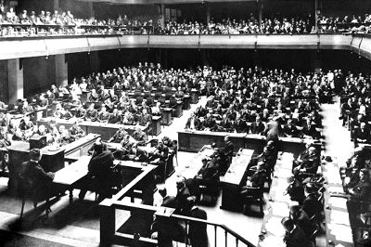
Soon the Allies endorsed the idea of the United Nations, which held its first planning conference in San Francisco in 1944, effectively ending any need for the League of Nations to make a post-war return.

Slide 9
Sources :
The Guardians Susan Pederson.
The League of Nations : From 1919 to 1929 Gary B.Ostrower.
The League of Nations, 1920 U.S. Department of State, Office of the Historian.
The League of Nations and the United Nations BBC.

