Slide 1
BILATERAL AND MULTILATERAL TRADE AGREEMENT
Dr.Anubha Gupta
Faculty , S.S. in Commerce Vikram University
Useful for BBA(H)/B.COM(H)/M.COM and allied subject

Slide 2
BILATERAL TRADE AGREEMENT
Bilateral trade is the exchange of goods & services between two nations promoting trade and investment. The two countries will reduce or eliminate tariffs, import quotas, export restraints, and other trade barriers to encourage trade and investment. The agreements may be limited to certain goods and services or certain types of market entry barriers. Different types of agreements define the level of the international integration from free trade to customs and economic unions.

Slide 3
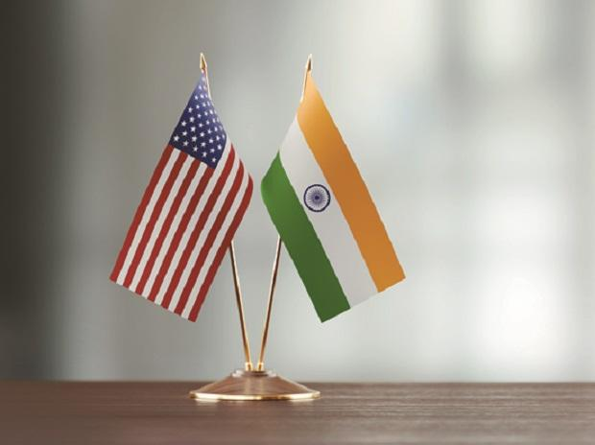
BILATERAL TRADE AGREEMENT

Slide 4
BILATERAL TRADE AGREEMENT
They set rules of trade between two countries. For example, there are India-US, Canada-Peru, EU-South Africa, US-Australia and other free trade agreements.

Slide 5
MULTILATERAL TRADE AGREEMENT
A multilateral trade involving three or more parties. The agreements reduce tariff and make it easier for international businesses . Since they are among many countries, they are difficult to negotiate.

Slide 6
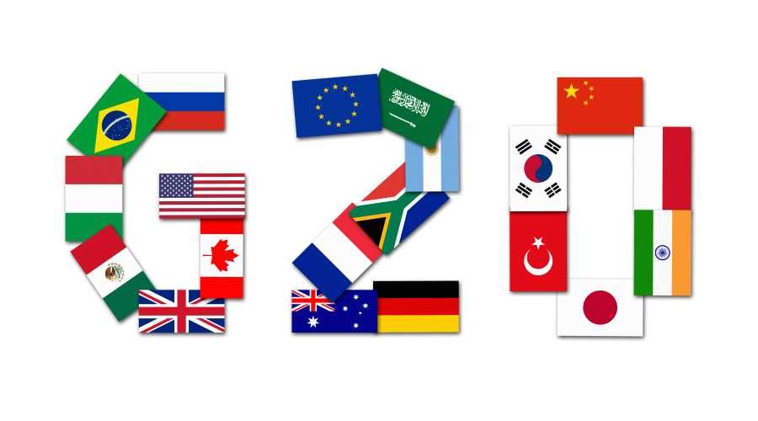
MULTILATERAL TRADE AGREEMENT

Slide 7
MULTILATERAL TRADE
Multilateral trade agreements create international trade unions, such as WTO, EU, NAFTA, etc. For example, WTO is regulated by General Agreement on Trade and Tariffs. European Union is regulated by several treaties, such as Treaty of Rome, Treaty of Maastricht, etc.

Slide 8
OBJECTIVES
The objectives of the bilateral trade are the same as a multilateral trade, except it is between two countries that negotiated the trade agreement.
Increases trade and economic growth between countries.
Through tariff and taxes elimination between countries have price advantages.
product available at cheapest cost.
All member countries treat each other equally.
it standardizes business regulations for all the trade partners.

Slide 9
IMPORTANCE
Open a new markets for companies.
more job opportunities because of new market.
It refers consumers to buy goods at lower price.
These agreements standardize business operations and commerce regulations; establish fair labour standards and environmental protection.
Increases competition in developing nations.
Increases investment opportunity.

Slide 10
.
Thank You

